Slide 1




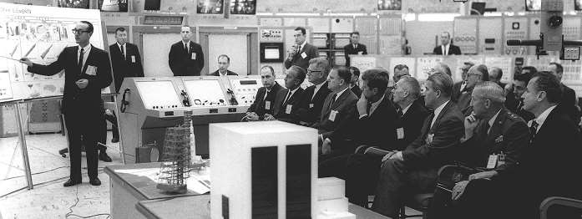















1 Project Management – Why and What
Time
Resource
“Project Management is an art of managing and ensuring the RESOURCES is utilize efficiently, within the TIME allocated, to deliver highest QUALITY of deliverables”
– Ir Mohd Haizad Hussin, MD of Matrix Power Network
Quality

Slide 2

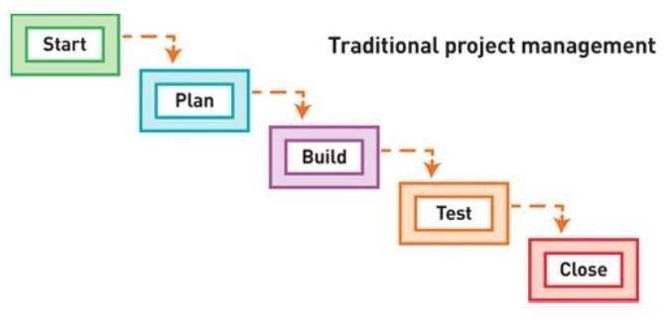
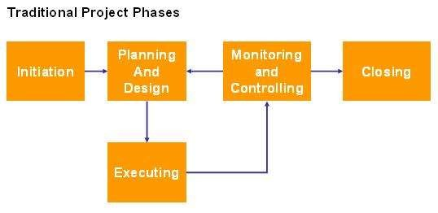
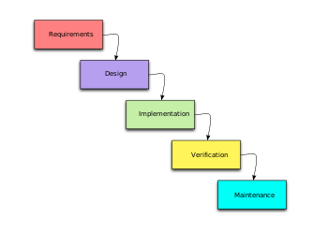
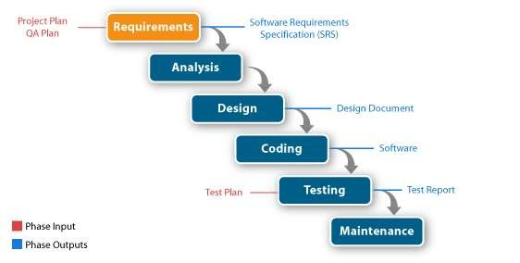
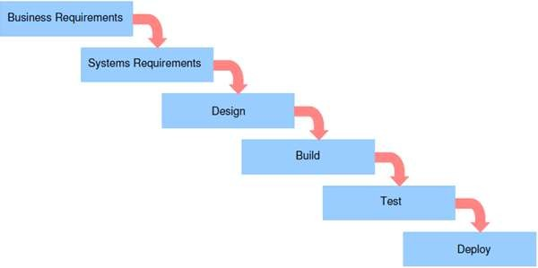
1 Project Management – The Traditional Method

Slide 3

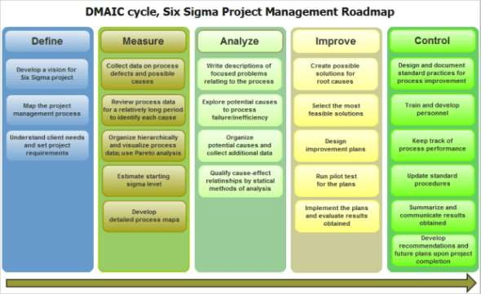
1 Project Management – The Not So Traditional Method
Source: Jack Grabovski (MyMG) – Lean Thinking Project Management in Six Sigma and Agile Models (http://www.mymanagementguide.com/lean-thinking-project-management-six-sigma-agile-models/)

Slide 4





1 Project Management – The Traditional Method
Longer time to
know the result
The issues faced (some of it):
To many planning
– obsolete on time of
implementation
Missing / incorrect user requirements
Lack of visibility of the deliverables

Slide 5


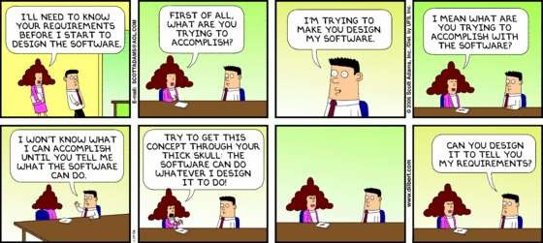













2 AGILE – What is?
It is a project management with high quality control management.
Implies leadership philosophy but at the same time support team work, self control,
organization and accountability.
A set of engineering best practices that allow for rapid delivery of high-quality product/project.
A business framework that align development with business/customer/company envision.
Images courtesy Dilbert(R) by Scott Adams

Slide 6
2 AGILE – What is?
Agile versus Traditional Project Management
Metrics | Traditional | Agile
Planning Scale | Long-term (> 6 months) | Short (3 – 6 months)
Interaction between customer and project team | Rare | Frequent
Time between specifications and implementation | Long | Short
Time to discover issues | Long | Short
Project schedule risk | High | Low
Ability to respond quickly to change | Low | High

Slide 7


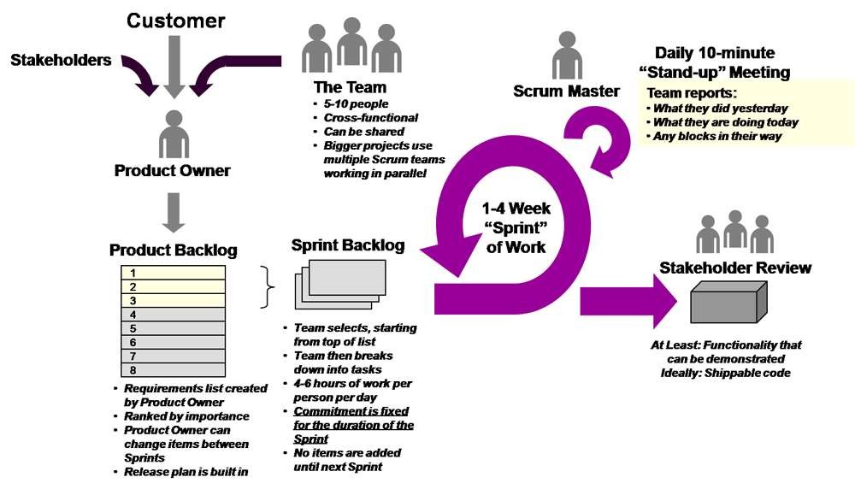
3 AGILE Project Management Process Flow – Adapting the process flow
Source: Zen Ex Machina – The Blog (https://zenexmachina.wordpress.com/category/agile/page/2/)

Slide 8
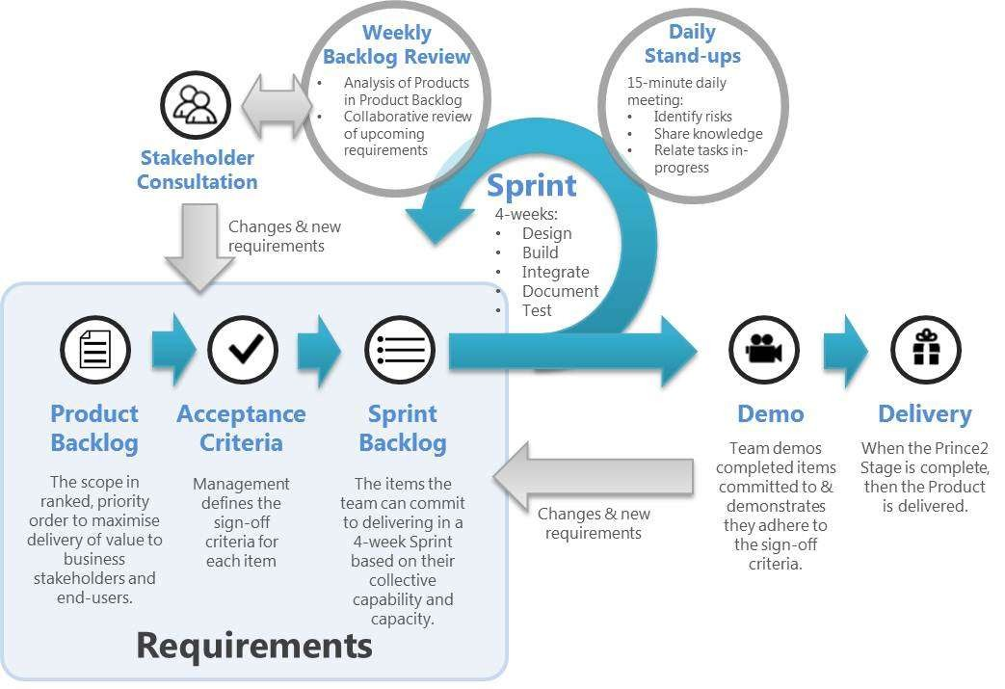
3 AGILE Project Management Process Flow – Adapting the process flow
Source: Ian Mitchel - Scrum Alliance (https://www.scrumalliance.org/community/articles/2013/june/the-kanban-sandwich-a-bite-size-recipe-for-agile-w)

Slide 9



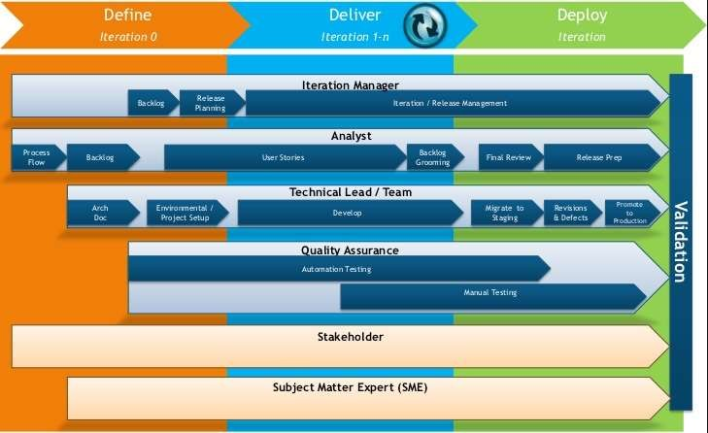
3 AGILE Project Management Process Flow – Actor and role
* This is basic role as recommended by Agile practitioner

Slide 10


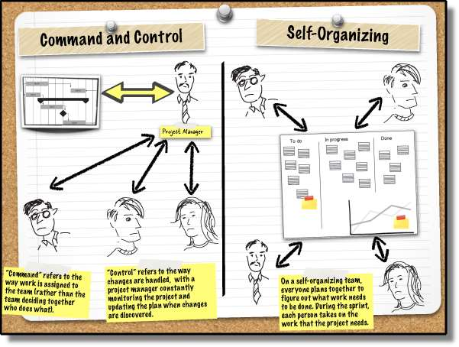

4 Transition from Traditional to Agile
Source: Andrew Stellman (Building Better Software) – A Learning Agile Question from a business analyst (http://www.stellman-greene.com/2015/11/19/a-question-from-a-business-analyst/)

Slide 11
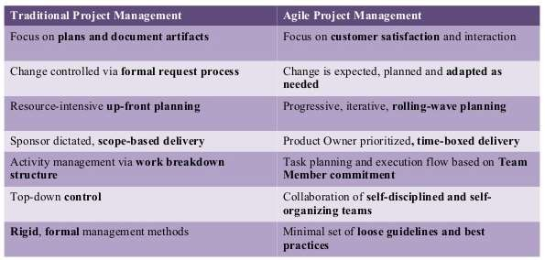
4 Transition from Traditional to Agile

Slide 12
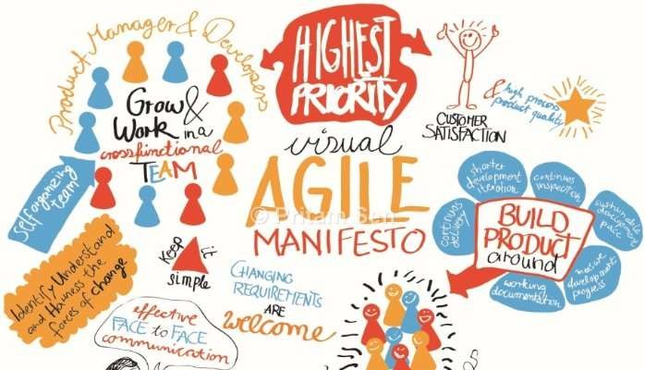
4 Transition from Traditional to Agile
5 Steps to successfully apply agile
Get the complete story
Empower your team member
Prioritize the deliverables
Estimate the load and resources carefully
Always update/do check-point
S.M.A.R.T.
Image from: Shanaka Nagasinghe via LinkedIn (https://www.linkedin.com/pulse/impact-agile-project-management-practices-enhancing-nagasinghe-pmp-)

Slide 13

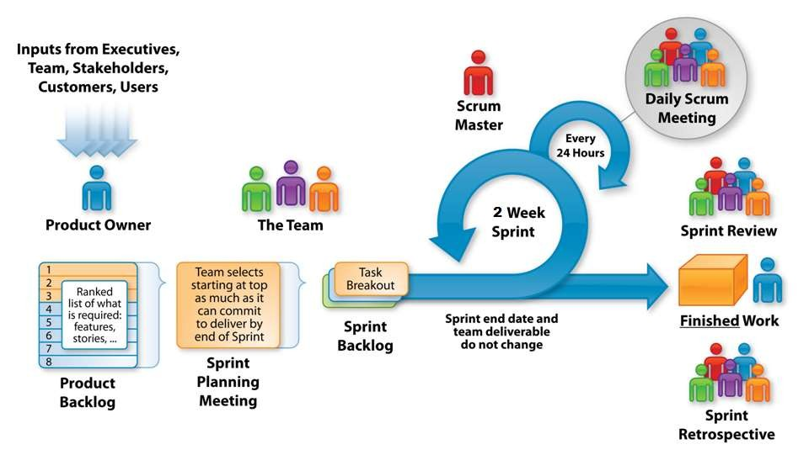
5 Applying Agile
Image from: Ravi Kumar – What is the Scrum Process Flow (http://www.etechpulse.com/2015/02/agile-scrum-process-sdlc.html)

Slide 14
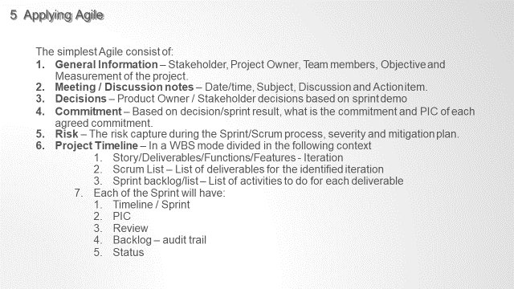

Slide 15
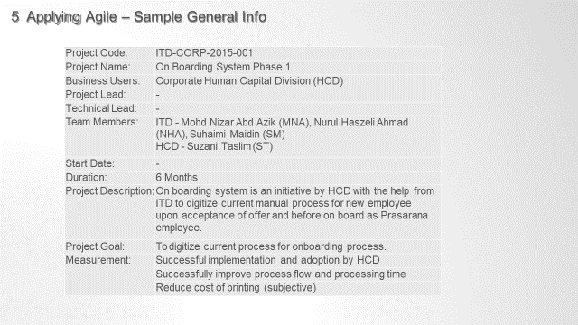

Slide 16


5 Applying Agile – Sample Meeting Notes
Product Owner Meeting Notes
Date | Subject | Discusion | Action
14-Aug-2015 | Iteration 1 demonstration | HCD request to access it for pre-demonstration with HOD | MNA to release the system at staging/test server for HCD trial
 |  | Change of form listing and sequence | MNA to update the system with changes
 |  | Iteration 2 is expected to complete and demonstrated to HCD and GD of HCD by middle of September | MNA to set reasonable date with ST by middle of September
08-Sep-2015 | Iteration 1 Sprint 2 demonstrated | Pn Ruswati request few changes on the field and the content | MNA to update the system with changes
 |  | Pn Rohana will share latest STD | NHA to follow up with Pn Rohana
 |  | Releasing Phase 1 for used | MNA will release the system (Phase 1) for used by October 15th.
30-Sep-2015 | CMC Presentation | MHA - update the slide with additional info | NHA - to update the slide on architecture, process flow and RACI
 |  | Pn Ruswati - To share the info with CHRO after 7-Oct-2015 | NHA - to check with Pn Suzani / Pn Rohana on CHRO availability after 7-Oct- 2015

Slide 17

5 Applying Agile – Sample Decision Log
Product Owner Decisions
# | Raised | Action | Owner
1 | 14-Aug-2015 | Change of form listing | MNA
2 | 14-Aug-2015 | Dashboard showcase to GD HCD before mid september | MNA/ST
3 | 08-Sep-2015 | To present to GD by October | MNA/ST
4 | 08-Sep-2015 | To release to production by October 15 | MNA/NHA/SM
5 | 30-Sep-2015 | To present to CHRO after 7-Oct-2015 | MNA/NHA/SM
6
7
8
9

Slide 18

5 Applying Agile – Sample Commitment Log
Product Owner Commitments
# | Raised | Action | Owner | Ready by | Complete | Remark
1 | 14/08/2015 | Iteration 1 Demonstration | MNA, NHA, ST |  | Done
2 | 14/08/2015 | Release to Staging/Test Environment | MNA |  | Done | Released on 28/08/2015. Delay 1 week
3 | 28/08/2015 | Iteration 1 - Bug Fix and Update changes based on comment during demo | MNA |  | Done | Completed on time.
4 | 28/08/2015 | Iteration 1 - Demonstration to HCD HOS | MNA, NHA, ST |  | Done | Demo to Pn Ruswati and Pn Rohana on 08/09/2015
5 | 08/09/2015 | Iteration 1 - Demonstration to HCD GD | MNA, NHA, ST |  | WIP | Plan to execute on 03/10/2015 To check with Pn Suzani on 7- Oct-2015 as CHRO not available until the date (Hajj)
6 | 08/09/2015 | Release Server to production | MNA |  | WIP | Plan to complete by 15-Oct- 2015 30-Sep-2015: Presented In CMC - Plan to release on 13- Oct-2015
7
8

Slide 19

5 Applying Agile – Sample Risk Log
Risk Log
# | Raised | Description | Impact | Severity | Action | Owner | Complete
1 | 04-Sep- 2015 | Production Environment not ready | Delay of go-live date | Low | Work with Infra Team | MNA, NHA | WIP
2 | 21-Sep- 2015 | SSL not ready | Delay of go-live date for external | Low | Work with Infra Team | MNA, NHA | WIP
3

Slide 20

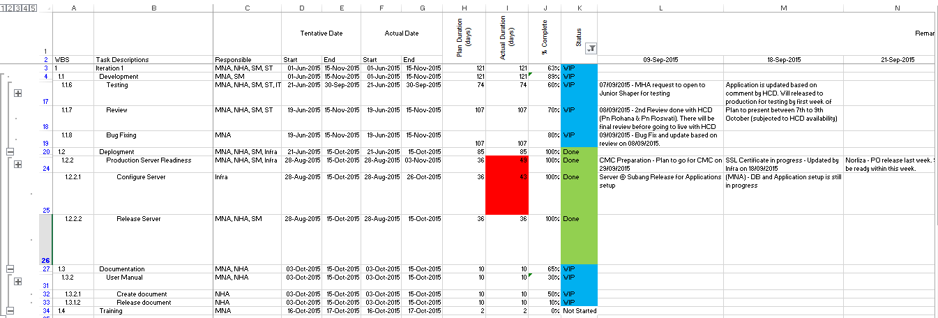
5 Applying Agile – Sample Project Timeline

Slide 21
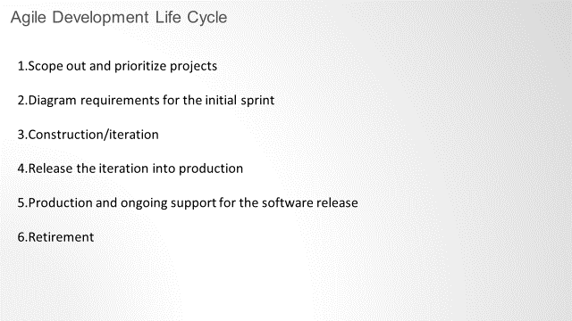

Slide 22
