Slide 1
AUP Philosophies
Your staff knows what they’re doing
Simplicity
Agility
Focus on high value activities
Tool independence
You’ll want to tailor the AUP to meet your own needs

Slide 2
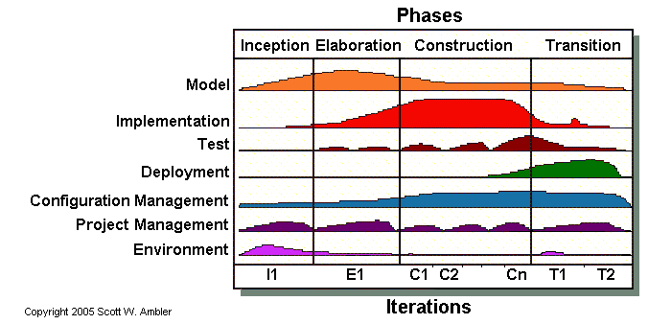
Agile unified process

Slide 3
Agile Unified Process
Phases
Disciplines
Philosophies
Releases

Slide 4
Phases
Inception
  Initial scope, potential architecture, stakeholder acceptance
Elaboration
  Prove the systems architecture
Construction
  Build working software, incremental basis, highest priority first
Transition
  Validate and deploy

Slide 5
Disciplines
Model
  Understand business & problem domain
  Identify a viable solution
Implementation
  Transform model(s) into executable code
Test
  Ensure quality
  Verify that requirements are met

Slide 6
Disciplines
Deployment
  Make system available to end users
Configuration Management
  Manage access to project artifacts
  Control and manage changes
Project management
  Managing risks, directing and coordinating people
Environment
  Ensuring a proper process, guidance and tools

Slide 7
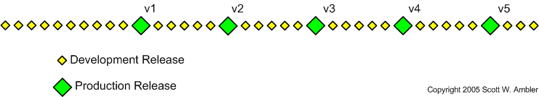
Releases
Development release iteration
  Deployment to QA or demo area
Production release iteration
  Deployment to production area

