Slide 1








33
When we need Project Management
www.qmsiso.com
1

Slide 2

Project Initiation Stage
Project Lifecycle Model
Project Management Roles
Documenting Project Objective
Final Result Description
Determining Project Milestones
Determining Preliminary Resources
www.qmsiso.com
2

Slide 3


Most of the Projects are initiated based on the following reasons (for Industrial Sector):
New Installation
New Product Designing (Prototype)
New Process Designing and Installation
Enhancement of existing Process or Product
Development of New Site
Up gradation : Equipment & Machinery
www.qmsiso.com
3

Slide 4
Most probable reasons behind such initiations are to meet Customer’s (Stakeholders) new requirements OR to compete with market competitors OR to enhance productivity
But an initiation is only considered “Project Initiation” when the idea has been documented and presented to approving
Cou_{a}rse_{u}Cod_{t}e_{h}: P_{o}M-0_{r}2_{ities}
www.qmsiso.com
4

Slide 5
An Initiating Officer documents the Project Requirement
The document gives the following details:
Project Requirement
Advantages
Its effects on Existing Processes
Final Objective (Expected Result)
Projected Timeline
www.qmsiso.com

Slide 6






Initiating Officer
Initiation
Documentation
Project Objective
Example:
K-8 Project
www.qmsiso.com

Slide 7
On the basis of Project Initiation Document, approving authorities appoint a Project Manager (may call Proj. Dir. at times)
Project Manager’s role is to ensure:
Requirement Analysis
Project Scoping
Project Phases and Milestones (Draft Model)
Resource requirement
And this is just the beginning …
www.qmsiso.com

Slide 8


Project Manager designs a model that represents Project’s Lifecycle
The lifecycle can be in form of a document, process flow or even a table chart
It should express general phases overview with deliverables to get to final objective of Project
It is also preferred to express timeline as well
www.qmsiso.com

Slide 9
















 | Planning Phase (6 weeks)
Resource Allocation | Project Scope & Plan | Roles & Tasking
 | Assessment Phase (8 weeks)
Cost Analysis & Budgeting | Comparisons | Risk Assessment
Implementation and Correction Phase (24 weeks)
Prototype Design | Development and QA | Change Management
 | Closure (4 weeks)
Final Prototype Delivery | Final Approval | Closing Documentation
www.qmsiso.com

Slide 10


Based on the Project Lifecycle, Project Manager can chalk down Project Milestones
These short targets will ensure proper project progress
Based on their achievement, Project Progress can be monitored and reviewed
It is recommended to put Milestones in the end of each phase, so that their delivery can also express phase closing and a stepping stone for next phase
www.qmsiso.com

Slide 11
A Milestone or Deliverable must express these characteristics:
It should be a useful component of the Project
It should contribute in achievement of Project Objective
It should be supported with a document / report
Weak and unrelated deliverables will never give true picture of the Project Lifecycle
And they always disturb Project Scoping!
www.qmsiso.com

Slide 12
Project Manager shall document these and on its basis shall identify scope of project
Project Scoping document is separate from this for ease of document management associated with Project Management
After approval of Project Initiation Document, Project Manager starts Project Scoping, a short but very important part of Project Management …
Mod 3
www.qmsiso.com

Slide 13


Slide 14
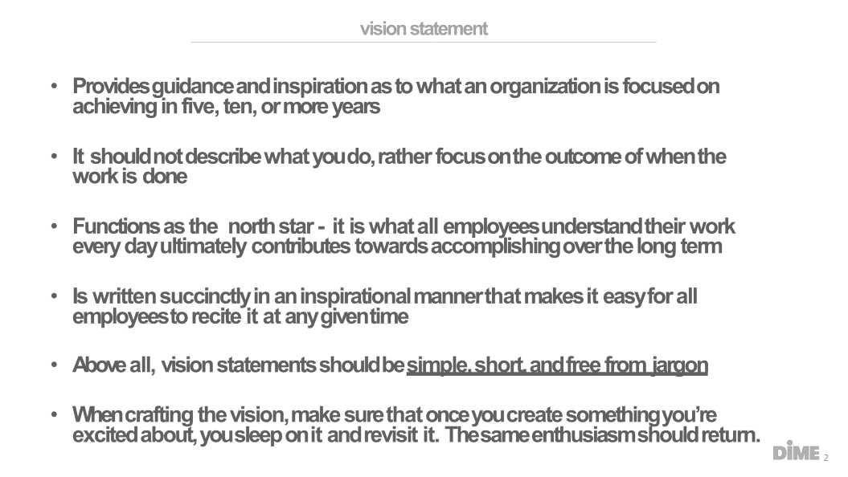

Slide 15


Slide 16
