Slide 1
TDD, ATDD, AND BDD
2 levels of Test First Development
TDD (Test Driven Development)
ATDD (Acceptance Test Driven Development)

Slide 2
TDD, ATDD, AND BDD
ATDD TDD
Create User Story
Create failing
Unit Test
Unit / Component
Make the test
pass
Capture Acceptance
Criteria
Refactor
Convert to Scenarios
Create failing Acceptance Test
Make the test
pass
For each Scenario
Verifiable Working Software

Slide 3
TDD, ATDD, AND BDD
TDD
Developer focused – Unit / Component Level
Validates “building the code right”
“Encourages simple designs and inspires software” - Kent Beck
Usually tests code in isolation (Dependency Injection and Mocking frameworks)
Advantages
Enables you to take small steps when writing software
Prevents gold plated software

Slide 4
TDD, ATDD, AND BDD
TDD
General Steps
Red -> Green -> Refactor
Write a failing Test
Write the code to make the test pass
Refactor code and know you didn’t break any functionality

Slide 5
TDD, ATDD, AND BDD
ATDD
Acceptance level or functional level
Validates “building the right code”
Executable Specifications
Expressing requirements such that they are also executable tests
Word can’t prove software works
Meaningful to business, testers, and developers
General Steps
Acceptance Criteria
Convert to Executable Requirement / Test Case
In Parallel
Dev - Write Code to make tests pass
Testing - Manually Test and Pass

Slide 6
TDD, ATDD, AND BDD
Scenarios
Executable acceptance criteria
Gherkin
Format to capture conversations with business
GIVEN – some context…
WHEN – some action is performed…
THEN – some result can be verified…

Slide 7
TDD, ATDD, AND BDD
BDD
Behavior Driven Development
Specific implementation of ATDD / TDD using Gherkin language
Creates the executable scenario with automated tests
Dependent on a tool such as Cucumber for Java/Perl (others) or SpecFlow for .NET
Functional level (xBehave) or developer level (xSpec)

Slide 8
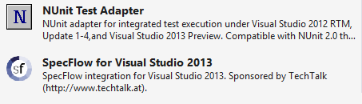
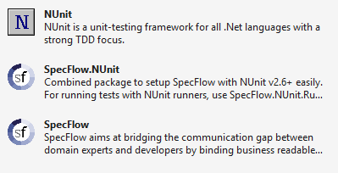
TDD, ATDD, AND BDD
BDD Tools
Functional written by team – SpecFlow or NBehave
Developer level – Nspec
SpecFlow
Integration with Visual Studio
Visual Studio Extensions Project NuGet Packages

Slide 9
WHY ATDD?
Test maintainability
Refactor code with minimal impact on the tests
Avoid misunderstood requirements
Common language so that business, testers, and developers can better understand the requirements
Automated regression testing is delivered as part of the project
Automated Executable Specifications
Reporting of ATDD progress
Provides great insight of progress during Sprints
Testing the functionality that has been requested
Preventing the gold plated code

