Slide 1

Burn Down Charts
Project tracking used in agile software development methodologies (e.g.: SCRUM)
Used for management documentation
Displays remaining effort for a given period of time
Work remaining is the Y axis and time is the X axis.
The work remaining should jig up and down and eventually trend downward
Notes:
A burn down chart is a graphical representation of work left to do versus time. The outstanding work (or backlog) is often on the vertical axis, with time along the horizontal. That is, it is a run chart of outstanding work. It is useful for predicting when all of the work will be completed. It is often used in agile software development methodologies such as Scrum. However, burn down charts can be applied to any project containing measurable progress over time.

Slide 2
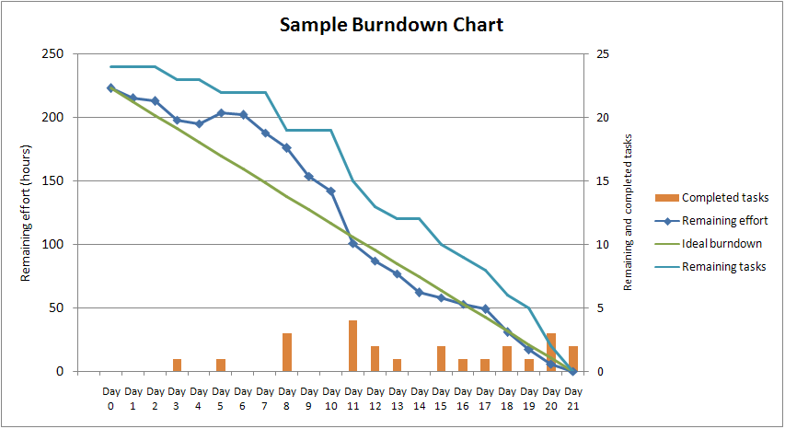
Overview
Notes:
X-Axis: The project/iteration timeline
Y-Axis: The work that needs to be completed for the project. The time estimates for the work remaining will be represented by this axis.
Project Start Point: This is the farthest point to the left of the chart and occurs at day 0 of the project/iteration.
Project End Point: This is the point that is farthest to the right of the chart and occurs on the predicted last day of the project/iteration
Ideal Work Remaining Line: This is a straight line that connects the start point to the end point. At the start point, the ideal line shows the sum of the estimates for all the tasks (work) that needs to be completed. At the end point, the ideal line intercepts the x-axis showing that there is no work left to be completed. The goal of a burn down chart is to display the progress toward completion and give an estimate on the likelihood of timely completion.
Actual Work Remaining Line: This shows the actual work remaining. At the start point, the actual work remaining is the same as the ideal work remaining but as time progresses, the actual work line fluctuates above and below the ideal line depending on how effective the team is. In general, a new point is added to this line each day of the project. Each day, the sum of the time estimates for work that was recently completed is subtracted from the last point in the line to determine the next point.

Slide 3
Chart types
Product Burn Down Chart
In Scrum, the product burn down chart is a "big picture" view of a project's progress. It shows how much work was left to do at the beginning of each sprint. The scope of this chart spans releases; however, a release burn down chart is limited to a single release.
http://www.sw-engineering-candies.com/blog-1/howtouseproduct-burndown-chartsandsprint-burndown-chartsnotonlyinscrumprojects
Notes:
A Product-Burndown-Chart depicts story points of all user stories in the so called product backlog, where the product backlog is a simple ranked list of all functional and non-functional requirements described as user stories. The chart displays story points for each completed sprint, so it depicts the completion of requirements over time. Backlog and Product-Burndown-Chart is usually updated at the end of each sprint. New user stories can be added and/or removed before each sprint planning meeting.

Slide 4
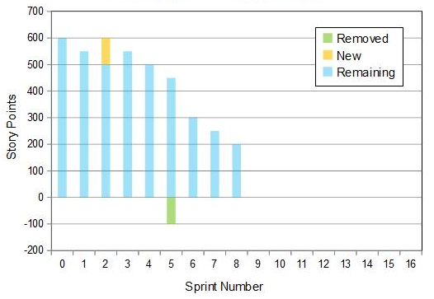
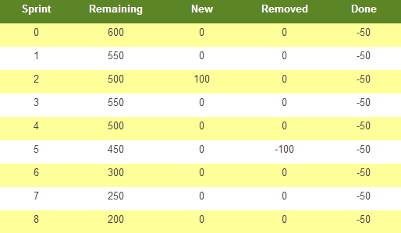
Product Burn Down Chart
Chart
Corresponding Data
Notes:
A simplified Product-Burndown-Chart is shown in Figure 1. Here the team had a constant velocity of 50 story points per sprint. In the second sprint some user stories (with 100 story points) had been added and in the fifth sprint some user stories (100 story points) have been removed. The sprint with the number zero is just used to show the initial backlog value before the first sprint (Table 1 contains the raw data of the graph).

Slide 5
Chart types
Release Burn Down Chart
The release burn down chart is a "big picture" view of a release's progress. It shows how much work was left to do at the beginning of each sprint comprising a single release. The scope of this chart is a single release; however, a product burn down chart spans all releases
http://www.mountaingoatsoftware.com/scrum/release-burndown/

Slide 6
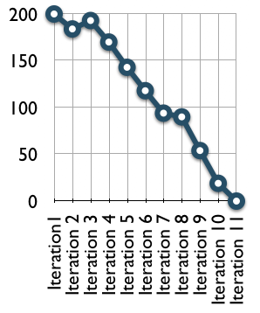

Release Burn Down Chart
Notes:
On this burndown chart, the team started a project that was planned to be eleven two-week sprints. They began with 200 story points of work. The first sprint went well and from the chart you can infer that they had around 180 story points of work remaining after the first sprint. During the second sprint, however, the estimated work remaining actually burned up. This could have been because work was added to the project or because the team changed some estimates of the remaining work. From there the project continued well. Progress slowed during sprint 7 but then quickly resumed. All this information is clearly visible on the release burndown and the team can easily keep track of everything that is going on.

Slide 7
Sprint Burn Down Chart
A Sprint-Burndown-Chart shows all remaining work of the so called the sprint backlog. This sprint backlog contains all work for the current sprint as committed by the team. Usually it is displayed as remaining work in ideal hours for each work day. The Sprint-Burndown-Chart is updated on a daily basis by the team - often before the stand-up meeting of the next work day
http://msdn.microsoft.com/en-us/library/ff731588.aspx
Notes:
A sprint burndown chart (or "sprint burndown graph") depicts the total task hours remaining per day. This shows you where your team stands regarding completing the tasks that comprise the product backlog items that achieve the goals of the sprint. The X-axis represents days in the sprint, while the Y-axis is effort remaining (usually in ideal engineering hours).
To motivate the team, the sprint burndown chart should be displayed prominently. It also acts as an effective information radiator . A manual alternative to this is a physical task board .
Ideally the chart burns down to zero by the end of the sprint. If the team members are reporting their remaining task hours realistically, the line should bump up and down chaotically. The profile shown below is typical, and demonstrates why the "percentage done" concept of traditional project management breaks down. Assuming we started measuring on July 26, what "percentage done" were we on July 28?

Slide 8
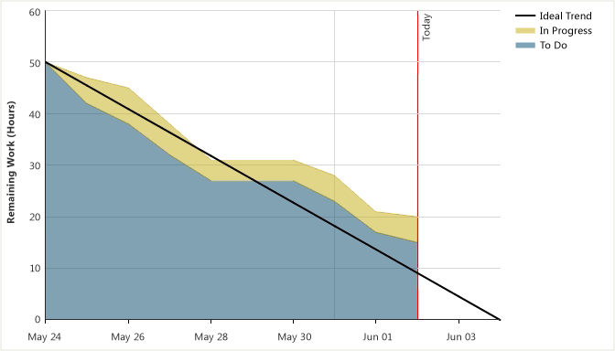
Sprint Burn Down Chart
Notes:
A sprint burndown report shows how much work remained at the end of specified intervals during a sprint. The source of the raw data is the sprint backlog. The horizontal axis shows days in a sprint, and the vertical axis measures the amount of work that remains to complete the tasks in the sprint. The work that remains is shown in hours.
A sprint burndown graph displays the following pieces of data:
The Ideal Trend line indicates an ideal situation in which the team burns down all of the effort that remains at a constant rate by the end of the sprint.
The In Progress series shows how many hours remain for tasks that are marked as In Progress in a sprint.
The To Do series shows how many hours remain for tasks that are marked as To Do in a sprint.
Both the In Progress and the To Do series are drawn based on the actual progress of your team as it completes tasks.
The following illustration shows an example of a sprint burndown graph.

Slide 9
Benefits
Track the development process
Assess the productivity of team
Estimation of number of hours to be worked

