Slide 1

FDD is an agile software development process
FDD uses a short-iteration model
FDD combines key advantages of other popular agile approaches along with other industry-recognized best practices
FDD was created to easily scale to much larger projects and teams

Slide 2

Definition: small function expressed in client-valued terms
FDD’s form of a customer requirement

Slide 3
Features are to be “small” in the sense they will take no more than two weeks to complete
Features that appear to take longer are to be broken up into a set of smaller features
Note: Two weeks is the maximum, most features take far less time (1 - 5 days)

Slide 4

Project Manager
Chief Architect
Development Manager
Domain Experts
Class Owners
Chief Programmers

Slide 5

Class assigned to specific developer
Class owner responsible for all changes in implementing new features
Collective Ownership
  Any developer can modify any artifact at any time
  addresses problem of deadlock
Class Ownership does not imply exclusivity but only responsibility

Slide 6
Advantages
  Someone responsible for integrity of each class
  Each class will have an expert available
  Class owners can make changes much quicker
  Easily lends to notion of code ownership
  Assists in FDD scaling to larger teams

Slide 7
Project Manager
Chief Architect
Development Manager
Domain Experts
Class Owners
Chief Programmers

Slide 8

Domain Manager
Release Manager
Language Guru
Build Engineer
Toolsmith
System Administrator
Tester
Deployer
Technical Writer

Slide 9
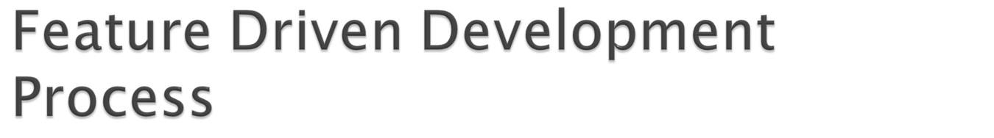
Process #1: Develop an Overall Model
Process #2: Build a Features List
Process #3: Plan By Feature
Process #4: Design By Feature
Process #5: Build By Feature

Slide 10
Project wide upfront design activities:
  Process #1: Develop an Overall Model
  Process #2: Build a Features List
  Process #3: Plan By Feature
  Goal: not to design the system in its entirety but instead is to do just enough initial design that you are able to build on

Slide 11
Deliver the system feature by feature:
  Process #4: Design By Feature
  Process #5: Build By Feature
  Goal: Deliver real, completed, client-valued function as often as possible

Slide 12
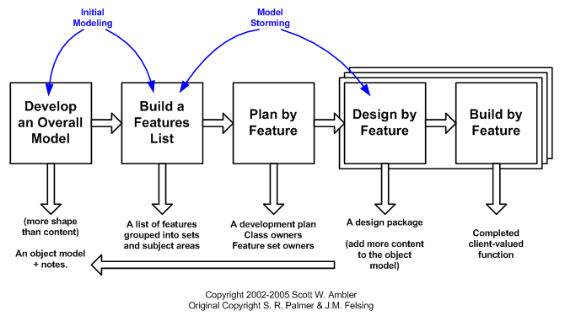

Slide 13
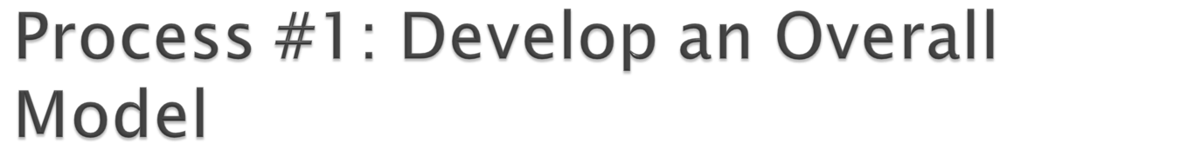
Form a modeling team
Domain walk-through
Build High-level object model
Record Notes
Goal - for team members to gain a good, shared understanding of the problem domain and build a foundation

Slide 14

All Features are organized in a three level hierarchy :
  Domain Subject Area
    Business Activity
      Features

Slide 15

Construct initial schedule
  Formed on level of individual features
    Prioritize by business value
    Also consider dependencies, difficulty, and risks
Assign responsibilities to team members
  Determine Class Owners
  Assign feature sets to chief programmers

Slide 16
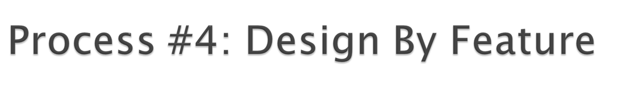
Form Feature Teams
Team members collaborate on the full low level analysis and design
Certain features may require teams to bring in domain experts
Teams need to update the model artifact to support their changes

Slide 17

Chief Programmers pick teams based on the current feature in development
Chief Programmers lead picked team
Usually 3 to 5 people
Upon completion of the current feature the team disbands
Each team will concurrently work on their own independent iteration
Possible to be on multiple teams at once

Slide 18
Form Feature Teams
Team members collaborate on the full low level analysis and design
Certain features may require teams to bring in domain experts
Teams need to update the model artifact to support their changes

Slide 19
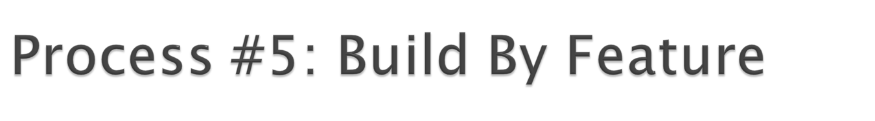
Implement designed feature
Test feature
  Unit-level
  Feature-level
Mandated Code Inspections
Integrate with regular build

Slide 20

Two Main Reasons
  Research has shown that when done properly, inspections find more bugs as well as different types of bugs than any other form of testing
  Great learning experience

Slide 21


FDD emphasizes the ability to provide accurate, meaningful, and timely progress information to all stakeholders within and outside the project
Feature Milestones

Slide 22

FDD combines many of the best practices of other agile models
FDD was initially created for and is more geared towards large project teams
FDD puts less focus on initial design and quickly gets to the point where the team can deliver new functionality to the project feature by feature

