Slide 1
What is Agile Testing?
A software testing practice that follow the principle of agile software development is called agile testing.
Agile is an iterative development methodology where requirement evolve through collaboration between the customer and self-organizing teams and agile aligns development with customer need.

Slide 2
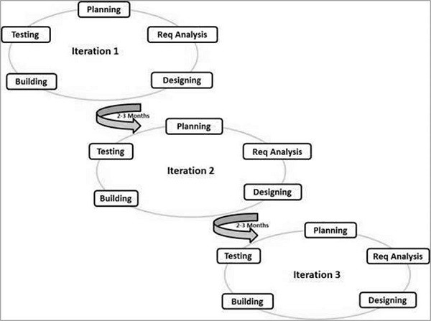
Agile Testing Graphical Representation

Slide 3
Principles of Agile Testing
Testing is NOT a Phase: Agile team tests continuously and continuous testing is the only way to ensure continuous progress.
Testing Moves the project Forward:
When following conventional method, testing is considered as quality gate but agile testing provide feedback on an ongoing basis and the product meets the business demand.
Everyone Tests: In conventional SDLC only test team test while in agile including developer and BA's test the application.

Slide 4
Principles of Agile Testing
Shortening Feedback Response Time: In conventional SDLC only during the acceptance testing the Business team will get to know the product development while in agile for each and every iteration they are involved and continuous feedback shorten the feedback response time and cost involved in fixing is also less.

Slide 5
Advantages of Agile Testing
Agile Testing Saves Time and Money
Less Documentation
Regular feedback from the end user
Daily meetings can help to determine the issues well in advance

