Slide 1
Session Management
Dr. Sunil Kumar Singh
Assistant Professor
SCOPE
VIT-AP University
Amaravati
Email-sunil.singh@vitap.ac.in

Slide 2
Functions of Session Management
Management of dialog control.
It allows machines to make sessions between them seamlessly.
Token management and Synchronization, such services also provided by the session layer.
Provide quality and intensified services to the user.

Slide 3
Web Browser and Network
Network
Browser
request
Web site
reply
OS
Hardware
Browser sends requests
Web site sends response pages, which may include code
Interaction susceptible to network attacks

Slide 4
HTTP: HyperText Transfer Protocol
Browser sends HTTP requests to the server
  Methods: GET, POST, HEAD, …
  GET: to retrieve a resource (html, image, script, css,…)
  POST: to submit a form (login, register, …)
  HEAD
Server replies with a HTTP response
Stateless request/response protocol
  Each request is independent of previous requests
  Statelessness has a significant impact on design and implementation of applications

Slide 5
Use Cookies to Store State Info
Cookies
  A cookie is a name/value pair created by a website to store information on your computer
Enters form data
Server
Browser
Response + cookies
Request + cookies
Server
Browser
Returns data
Http is stateless protocol; cookies add state

Slide 6
Cookies Fields
An example cookie from my browser
  Name session-token
  Content "s7yZiOvFm4YymG….”
  Domain .amazon.com
  Path /
  Send For Any type of connection
  Expires Monday, September 08, 2031 7:19:41 PM

Slide 7
Cookies
Stored by the browser
Used by the web applications
  used for authenticating, tracking, and maintaining specific information about users
    e.g., site preferences, contents of shopping carts
  data may be sensitive
  may be used to gather information about specific users
Cookie ownership
  Once a cookie is saved on your computer, only the website that created the cookie can read it

Slide 8
Web Authentication via Cookies
HTTP is stateless
  How does the server recognize a user who has signed in?
Servers can use cookies to store state on client
  After client successfully authenticates, server computes an authenticator and gives it to browser in a cookie
    Client cannot forge authenticator on his own (session id)
  With each request, browser presents the cookie
  Server verifies the authenticator

Slide 9



A Typical Session with Cookies
client
server
POST /login.cgi
Verify that this
client is authorized
Set-Cookie:authenticator
GET /restricted.html
Cookie:authenticator
Check validity of
authenticator
Restricted content
  Authenticators must be unforgeable and tamper-proof
  (malicious clients shouldn’t be able to modify an existing authenticator)
  How to design it?
Notes:
What should the authenticator depends upon?
User name, current time

Slide 10
Data compression techniques

Slide 11
Data Compression
Data Compression is a technique in which the size of data is reduced without loss of information. Lossy compression and Lossless compression are the categories of data compression method.
Because networks are sensitive to congestion, and network availability is often expensive. The key reason is because compressed data can be transmitted and received much faster than non-compressed data.

Slide 12
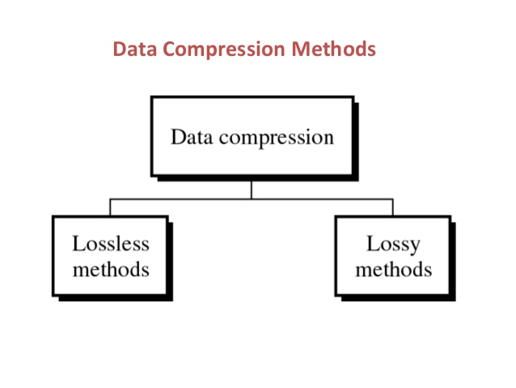

Slide 13
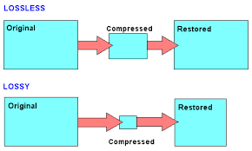
Notes:
Do not want one site to manipulate another site’s web page.

Slide 14
