Slide 1

Notes:
1st slide (Mandatory)

Slide 2

Inet address class
This class represents an IP address. It represents both the 32 bit IPv4 address and 128 bit IPv6 address.
It is the superclass of Inet6Address and Inet4Address classes.
Types of address:
Unicost
Multicost
Notes:
Description:
An IP address is represented by 32-bit or 128-bit unsigned number.
An instance of InetAddress represents the IP address with its corresponding host name.
Moreover, InetAddress has a cache mechanism to store successful and unsuccessful host name resolutions.

Slide 3
Commonly used methods of InetAddress class:
public static InetAddress getByName(String host) throws UnknownHostException
public static InetAddress getLocalHost() throws UnknownHostException
public String getHostName()
public String getHostAddress()
Notes:
Description:
public static InetAddress getByName(String host) throws UnknownHostExceptionit :returns the instance of InetAddress containing LocalHost IP and name.
public static InetAddress getLocalHost() throws UnknownHostException:it returns the instance of InetAdddress containing local host name and address.
public String getHostName():it returns the host name of the IP address.
public String getHostAddress():it returns the IP address in string format.

Slide 4
Other methods of InetAddress class:
1. getAddress() 8. isMCNodeLocal()
2. getHostAddress() 9. isMCOrgLocal()
3. isAnyLocalAddress() 10. isMCSiteLocal()
4. isLinkLocalAddress() 11. isMulticastAddress()
5. isLoopbackAddress() 12. isSiteLocalAddress()
6. isMCGlobal() 13. hashCode()
7. isMCLinkLocal() 14. equals()
Notes:
Description:
1)getAddress() : returns raw IP address of this InetAddress object as an array. The order in which bytes appear in array are same as in IP address i.e. getAddress[0] will contain highest order byte . Syntax : public byte[] getAddress()
2)getHostAddress() : returns IP address in textual form .Syntax :public String getHostAddress()
3)isAnyLocalAddress() : returns true if this address represents a local address .Syntax :public boolean isAnyLocalAddress()
4)isLinkLocalAddress() : returns true if this address is a link local address .Syntax :public boolean isLinkLocalAddress()
5)isLoopbackAddress() : returns true if this address is a loopback address .Syntax :public boolean isLoopbackAddress()
6)isMCGlobal() : returns true if this multicast address has global scope .Syntax :public boolean isMCGloabal()
7)isMCLinkLocal() : returns true if this multicast address has link scope.Syntax :public boolean isMCLinkLocal()
8)isMCNodeLocal() : returns true if this multicast address has node scope.Syntax :public boolean isMCNodeLocal()
9)isMCOrgLocal() : returns true if this multicast address has organisation scope.Syntax :public boolean isMCOrgLoacal()
10)isMCSiteLocal() : returns true if this multicast address has site scope.Syntax :public boolean isMCSiteLocal()
11)isMulticastAddress() : returns true if this address is an IP multicast address. Multicast addresses have 1110 as their first 4 bits .Syntax :public boolean isMulticastAddress()
12)isSiteLocalAddress(): returns true if this address is a site local address .Syntax :public boolean isSiteLocalAddress()()
13)hashCode() : returns the hashcode associated with this address object .Syntax : public int hashCode()
14)equals() : returns true if this ip address is same as that of the object specified. Equals() method don’t consider host names while comparing and only consider IP address associated . Syntax : public boolean equals(Object obj) Parameters : obj : object to compare with

Slide 5
IP address scope:
Link-local addresses are designed to be used for addressing on a single link for purposes such as auto-address configuration, neighbor discovery, or when no routers are present.
Notes:
Description:
Site-local addresses are designed to be used for addressing inside of a site without the need for a global prefix.
Global addresses are unique across the internet.

Slide 6
Textual representation of IP addresses:
The textual representation of an IP address is address family specific.
Notes:
Description:
For IPv4 address format, please refer to Inet4Address#format; For IPv6 address format, please refer to Inet6Address#format.
There is a couple of System Properties affecting how IPv4 and IPv6 addresses are used.

Slide 7
Host Name Resolution:
Host name-to-IP address resolution is accomplished through the use of a combination of local machine configuration information and network naming services such as the Domain Name System (DNS) and Network Information Service(NIS).
Notes:
Description:
The particular naming services(s) being used is by default the local machine configured one.
For any host name, its corresponding IP address is returned.
Reverse name resolution means that for any IP address, the host associated with the IP address is returned.
The InetAddress class provides methods to resolve host names to their IP addresses and vice versa.

Slide 8
InetAddress Caching:
The InetAddress class has a cache to store successful as well as unsuccessful host name resolutions.
Notes:
Description:
By default, when a security manager is installed, in order to protect against DNS spoofing attacks, the result of positive host name resolutions are cached forever. When a security manager is not installed, the default behavior is to cache entries for a finite (implementation dependent) period of time. The result of unsuccessful host name resolution is cached for a very short period of time (10 seconds) to improve performance.
If the default behavior is not desired, then a Java security property can be set to a different Time-to-live (TTL) value for positive caching. Likewise, a system admin can configure a different negative caching TTL value when needed.
Two Java security properties control the TTL values used for positive and negative host name resolution caching:

Slide 9

//Predict the Output
import java.io.*;
import java.net.*;
public class InetDemo
{
public static void main(String[] args)
{
try{
InetAddress ip=InetAddress.getByName("www.facenow.in");
System.out.println("Host Name: "+ip.getHostName());
System.out.println("IP Address: "+ip.getHostAddress());
}
catch(Exception e){
System.out.println(e);
}
}
}
1
2
3
4
5
6
7
8
9
10
11
12
13
14
15
16
17
18
19
20
21
22

Slide 10
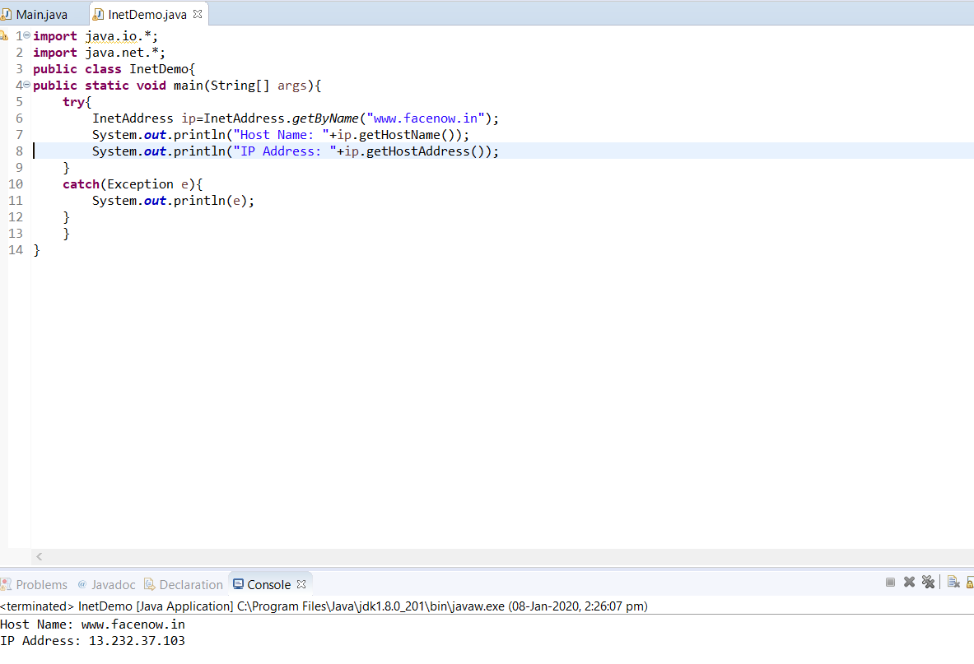
Notes:
Output for previous program.

Slide 11
//Predict the Output
import java.net.Inet4Address;
import java.net.InetAddress;
import java.net.UnknownHostException;
import java.util.Arrays;
public class inetadd
{
public static void main(String[] args) throws UnknownHostException
{
String url = "www.faceprep.in";
byte addr[]={127, 0, 0, 1};
InetAddress ip1 = Inet4Address.getByName(url);
InetAddress ip2 = InetAddress.getByAddress(addr);
System.out.println("Address : " + Arrays.toString(ip1.getAddress()));
System.out.println("Host Address : " + ip1.getHostAddress());
System.out.println("isAnyLocalAddress : " + ip1.isAnyLocalAddress());
System.out.println("isLinkLocalAddress : " + ip1.isLinkLocalAddress());
System.out.println("isLoopbackAddress : " + ip1.isLoopbackAddress());
1
2
3
4
5
6
7
8
9
10
11
12
13
14
15
16
17
18
19
20
21
22

Slide 12
System.out.println("isMCGlobal : " + ip1.isMCGlobal());
System.out.println("isMCLinkLocal : " + ip1.isMCLinkLocal());
System.out.println("isMCNodeLocal : " + ip1.isMCNodeLocal());
System.out.println("isMCOrgLocal : " + ip1.isMCOrgLocal());
System.out.println("isMCSiteLocal : " + ip1.isMCSiteLocal());
System.out.println("isMulticastAddress : " + ip1.isMulticastAddress());
System.out.println("isSiteLocalAddress : " + ip1.isSiteLocalAddress());
System.out.println("hashCode : " + ip1.hashCode());
System.out.println("ip1==ip2 : " + ip1.equals(ip2));
}
}
1
2
3
4
5
6
7
8
9
10
11
12
13
14
15
16
17
18
19
20
21
22

Slide 13
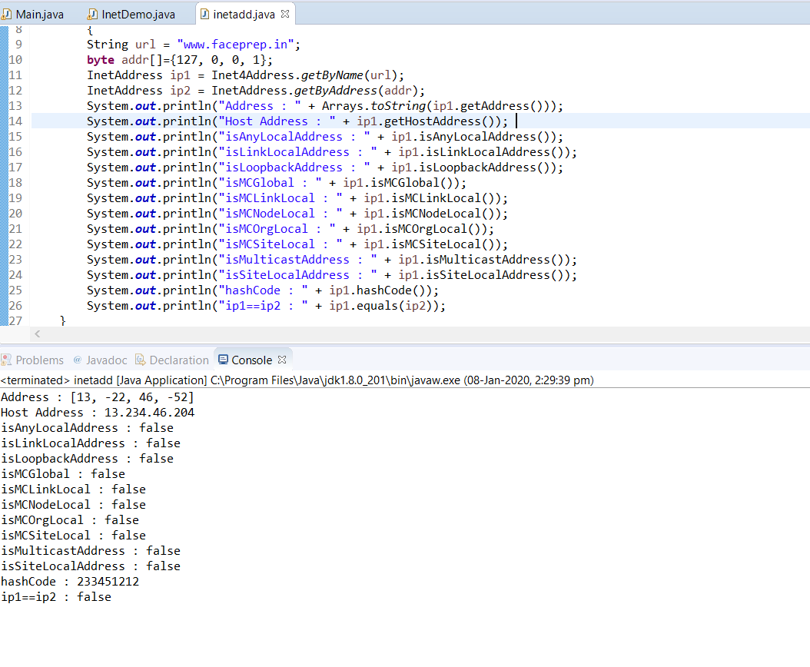
Notes:
Output for previous program.

Slide 14

MCQ

Slide 15


Question 01
Which of these interface abstractes the output of messages from httpd?
A)
LogMessage
B)
LogResponse
C)
Httpdserver
D)
httpdResponse

Slide 16
Question 02
Which of these method of httpd class is used to get report on each hit to HTTP server?
A)
log()
B)
logEntry()
C)
logHttpd()
D)
logResponse()

Slide 17
Question 03
Which of these variables stores the number of hits that are successfully served out of cache?
A)
hits
B)
hitstocache
C)
hits_to_cache
D)
hits.to.cache

Slide 18
Question 04
Which of these method is used to start a server thread?
A)
run()
B)
start()
C)
runThread()
D)
startThread()

Slide 19
Question 05
Which of these method is called when http daemon is acting like a normal web server?
A)
Handle()
B)
HandleGet()
C)
handleGet()
D)
Handleget()

Slide 20

THANK YOU
Notes:
Thank you slide

