Slide 1


Slide 2


Queue
First in First out (FIFO)
Last Element
1 | 2 | 3 | 4 | 5
Insert values
First Element
Notes:
Description:
Queue is a collection of ordered elements (or objects). We can use Queue to store elements before processing those elements. Queue works based on FIFO manner. Queue is used to insert elements at the end of Queue and removes the element from the front of queue. The element arrived first, is the first element to go out.

Slide 3
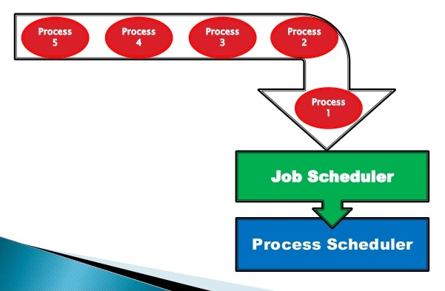
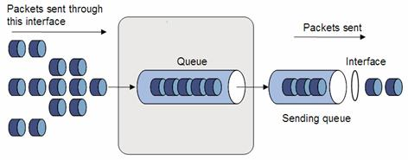
Real time application
Notes:
Description:
Queue is used by operating systems for job scheduling. Job scheduling means the process of allocating system resources to many different tasks by an operating system (OS). Different schemes are used in scheduling to determine which specific job to run. OS allocates different task based on priority. Queue of packets in data communication is also a best example for queue interface.
In real world, to get movie ticket, we should stand in a queue. The person who arrived first will get the ticket first. Other examples: One way road, the car which enters first in the one way will leave first.

Slide 4
Queue
Iterator
extends
Collection
implements
Queue
Priority Queue
Deque
Array Deque
Notes:
Description:
Collection extends to iterator and queue interface extends from the collection interface. Iterators are used in collection framework in Java to retrieve elements one by one . Queue interface in java collections has two implementation classes LinkedList and Priority Queue. These two classes implements queue interface. As queue is an interface, we cannot instantiate it. We create instance of LinkedList or Priority queue and assign it to the queue. Priority queue is used to sort a collection of elements. A teacher and students stand in a queue. For whom the priority is given first? Absolutely Yes, the priority is given to the teacher. Here, while processing, priority is given to represent the group of individual objects. But, it is not necessary to give priority in order. If the elements stored in Queue as 10,9,8,…,1, the priority queue arranged the elements by natural ordering as 1,2,3,…,10. Another example is there is a queue of patients in hospital. It servers normal and emergency case. If some emergency patient come, he will be given a priority and will be treated first.

Slide 5

//Predict the output
import java.util.Queue;
public class Queueinterface
{
public static void main(String [] args)
{
Queue<Integer> queue=new Queue<Integer>();
System.out.println(queue);
}
}
1
2
3
4
5
6
7
8
9
10
11
12
13
14
15
16
17
18
19
20
21
22
Notes:
Output:
Compilation Error
/Queueinterface.java:7: error: Queue is abstract; cannot be instantiated
Queue<Integer> queue=new Queue<Integer>();
^1 error
Description:
Without Priority Queue can't excute the Queue.

Slide 6
//Predict the output
import java.util.PriorityQueue;
import java.util.Queue;
public class Queueinterface
{
public static void main(String [] args)
{
Queue<Integer>queue=new PriorityQueue<Integer>();
System.out.println(queue);
}
}
1
2
3
4
5
6
7
8
9
10
11
12
13
14
15
16
17
18
19
20
21
22
Notes:
Output:
[]
No elements in Queue and so the output displays only the square brackets. Using various methods, we can add or remove elements from the queue.

Slide 7
//Predict the output
import java.util.PriorityQueue;
public class Queueinterface
{
public static void main(String [] args)
{
PriorityQueue<Integer>queue=new PriorityQueue<Integer>();
queue.add(1);
queue.add(2);
queue.add(3);
queue.add(4);
queue.add(5);
System.out.println(queue);
}
}
1
2
3
4
5
6
7
8
9
10
11
12
13
14
15
16
17
18
19
20
21
22
Notes:
Output:
[1, 2, 3, 4, 5]
The elements inserted in queue using add() method.

Slide 8
//Predict the output
import java.util.Queue;
import java.util.PriorityQueue;
public class Queueinterface
{
public static void main(String [] args)
{
Queue<Integer>queue=new PriorityQueue<Integer>();
queue.add(5);
queue.add(4);
queue.add(3);
queue.add(2);
queue.add(1);
System.out.println(queue);
}
}
1
2
3
4
5
6
7
8
9
10
11
12
13
14
15
16
17
18
19
20
21
22
Notes:
Output:
[1, 2, 5, 4, 3]
The elements inserted in queue using add() method. In this example, the queue assigns the value as [5, 4, 3, 2, 1]. But the Priority queue assigns the output as [1, 2, 5, 4, 3].The Priority is given to the elements as per the natural ordering.

Slide 9
//Predict the output
import java.util.PriorityQueue;
import java.util.Queue;
public class Queueinterface
{
public static void main(String [] args)
{
int i;
Queue<Integer>queue=new PriorityQueue<Integer>();
for(i=5;i>0;i--)
{
queue.add(i);
}
System.out.println(queue);
}
}
1
2
3
4
5
6
7
8
9
10
11
12
13
14
15
16
17
18
19
20
21
22
Notes:
Output:
[1, 2, 3, 4, 5]
In this program, consider the for loop. Integer i is assigned as 5. The decrement of i is performed by checking the condition i>0. The elements arranged in queue as [5, 4, 3, 2, 1]. Due to priority queue, the output print as [1, 2, 3, 4, 5]. In priority queue, all he elements are ordered as per their natural ordering.

Slide 10
//Predict the output
import java.util.Queue;
import java.util.PriorityQueue;
public class Queueinterface
{
public static void main(String [] args)
{
Queue<Integer>queue=new PriorityQueue<Integer>();
queue.offer(14);
queue.offer(18);
queue.add(42);
queue.add(46);
queue.add(30);
System.out.println(queue);
System.out.println("The head is:" +queue.peek());
}
}
1
2
3
4
5
6
7
8
9
10
11
12
13
14
15
16
17
18
19
20
21
22
Notes:
Description:
These are some important methods used in queue interface.
add() or offer(): To insert an element
remove() or poll(): To remove the head element or the first element
element() or peek(): To examine the head element
The difference between remove() and poll(): If there is no element to remove in the queue, remove() gives output as exception. poll() returns null or false. Similarly, if there is no element , element() throws exception and peek() returns null value.
Output:
[14, 18, 42, 46, 30]
The head is:14
Instead of peek(), element() can also be used to print the head of the element.

Slide 11
//Predict the output
import java.util.Queue;
import java.util.LinkedList;
public class Main
{
public static void main(String[] args)
{
Queue<String> queue = new LinkedList<>();
queue.offer("Technical");
queue.offer("Technology");
System.out.println(queue);
System.out.println(queue.poll());
System.out.println(queue.poll());
System.out.println(queue.poll());
}
}
1
2
3
4
5
6
7
8
9
10
11
12
13
14
15
16
17
18
19
20
21
22
Notes:
Output:
[technical, technology]
technical
technology
null

Slide 12
//Predict the output
import java.util.Queue;
import java.util.PriorityQueue;
public class Main
{
public static void main(String [] args)
{
Queue<Integer>queue=new PriorityQueue<Integer>();
queue.offer(24);
queue.offer(48);
queue.offer(12);
queue.add(16);
queue.add(20);
System.out.println(queue);
System.out.println("The removed element is:" +queue.poll());
System.out.println(queue);
System.out.println("The head is:" +queue.peek());
}
}
1
2
3
4
5
6
7
8
9
10
11
12
13
14
15
16
17
18
19
20
21
22
Notes:
Output:
[12, 16, 24, 48, 20]
The removed element is:12
[16, 20, 24, 48]
The head is:16
In this program, the head element 4 is removed using poll(). So, the second element be the head of the queue.

Slide 13
//Predict the output
import java.util.PriorityQueue;
public class Main
{
public static void main(String [] args)
{
PriorityQueue<Integer>queue=new PriorityQueue<Integer>();
System.out.println("The remove element is:" +queue.remove());
System.out.println("The head element is: " +queue.element());
}
}
1
2
3
4
5
6
7
8
9
10
11
12
13
14
15
16
17
18
19
20
21
22
Notes:
Output:
No output
Error: Exception in thread "main" java.util. No Such Element Exception at java.util.AbstractQueue.remove(AbstractQueue.java:117) at Queueinterface.main(Queueinterface.java:7)

Slide 14
//Predict the output
import java.util.Queue;
import java.util.PriorityQueue;
public class Main
{
public static void main(String [] args)
{
Queue<Integer>queue=new PriorityQueue<Integer>();
System.out.println("The removed element is:" +queue.poll());
System.out.println("The head element is: " +queue.peek());
}
}
1
2
3
4
5
6
7
8
9
10
11
12
13
14
15
16
17
18
19
20
21
22
Notes:
Output:
The removed element is: null
The head is: null

Slide 15
//Predict the output
import java.util.PriorityQueue;
public class Queueinterface
{
public static void main(String [] args)
{
PriorityQueue<String>queue=new PriorityQueue<String>();
queue.add("A");
queue.add("B");
queue.add("C");
queue.offer("D");
queue.offer("E");
System.out.println(queue);
System.out.println(queue.element()+ " " + queue.poll());
System.out.println(queue.peek()+ " " + queue.remove()+ " " + queue.element());
System.out.println(queue);
}
}
1
2
3
4
5
6
7
8
9
10
11
12
13
14
15
16
17
18
19
20
21
22
Notes:
Output:
[A, B, C, D, E]
A A
B B C
[C, D, E]
In this example program, the elements arranged in queue as [A, B, C, D, E]. The head of the element is A and then to remove the head of the element, poll() is used. Again, print the head element + remove the head element + head element. Now, the head of the element becomes B.

Slide 16
//Predict the output
import java.util.Queue;
import java.util.PriorityQueue
public class Queueinterface
{
public static void main(String [] args)
{
int i;
Queue<Integer>queue=new PriorityQueue<Integer>();
for(i=0;i<=5;i++)
{
queue.add(i);
}
System.out.println(queue);
Integer head=queue.peek();
System.out.println(queue.size());
System.out.println(head);
Iterator<Integer> itr = queue.iterator();
1
2
3
4
5
6
7
8
9
10
11
12
13
14
15
16
17
18
19
20
21
22

Slide 17
System.out.println("Iterating over PriorityQueue");
while(itr.hasNext())
{
System.out.println(itr.next());
}
}
}
1
2
3
4
5
6
7
8
9
10
11
12
13
14
15
16
17
18
19
20
21
22
Notes:
Output:
[0,1,2,3,4,5]
6
0
Iterating over priorityqueue
0
1
2
3
4
5
You can iterate all elements, instead of just processing the elements one at a time.

Slide 18
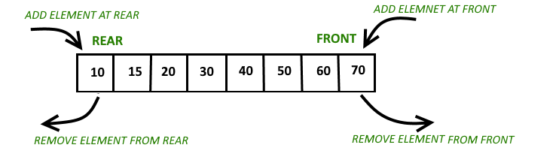
Deque
Double ended queue
Notes:
Description:
Deque (pronounced as deck), supports elements insertion and deletion at both ends. Deque interface extends the queue interface. The implementation classes such as LinkedList and Array Deque implements the Deque interface. The array deque class stores its elements internally in an array. If the number of elements exceeds the space in the array, a new array is allocated. All the elements moved over the newly created array.

Slide 19
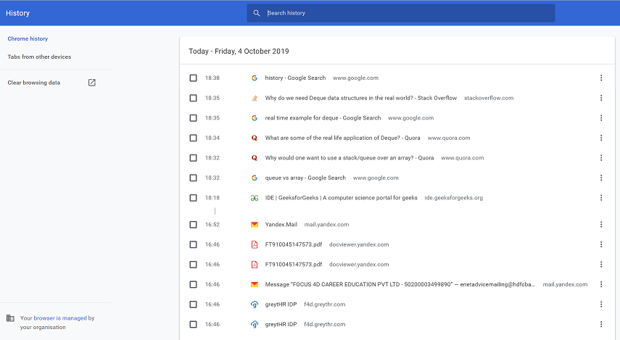
Real time example
Notes:
Description:
One best example of deque is storing a web browser's history. Recently visited URLs are added to the front of the deque, and the URL at the back of the deque is removed after some specified number of insertions at the front.

Slide 20
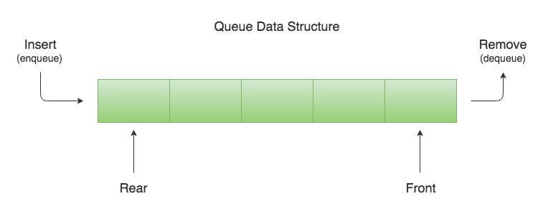
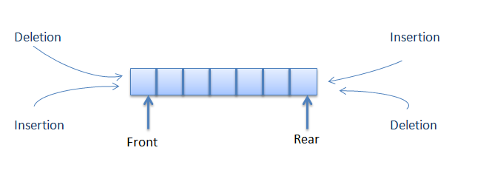
Queue vs Deque
Notes:
Description:
A queue is designed to have elements inserted at the end of the queue, and elements removed from the beginning of the queue. Where as Dequeue represents a queue where you can insert and remove elements from both ends of the queue.

Slide 21
//Predict the output
import java.util.ArrayDeque;
public class Dequeinterface
{
public static void main(String [] args)
{
ArrayDeque<Integer>deque=new ArrayDeque<Integer>();
deque.add(20);
deque.addFirst(40);
deque.addLast(60);
deque.addFirst(80);
deque.add(100);
deque.addFirst(120);
System.out.println(deque);
}
}
1
2
3
4
5
6
7
8
9
10
11
12
13
14
15
16
17
18
19
20
21
22
Notes:
Description:
Some of the methods are explained here.
add() and addLast(): To insert an element at last
addFirst(): To insert the element at First
remove() and removeFirst(): Removes the first element or head of the queue.
removeLast(): Removes the last element.
peek() and peekFirst(): To obtain the reference of first element
peekLast(): To peek the last element
Output:
[120, 80, 40, 20, 60, 100]
Explanation:
20
40 20
40 20 60
80 40 20 60
80 40 20 60 100
120 80 40 20 60 100

Slide 22
//Predict the output
import java.util.ArrayDeque;
public class Dequeinterface
{
public static void main(String [] args)
{
ArrayDeque<String>deque=new ArrayDeque<String>();
deque.add("day");
deque.addFirst("each");
deque.addLast("your");
deque.addFirst("make");
deque.add("masterpiece");
System.out.println(deque);
deque.removeFirst();
deque.removeLast();
System.out.println(deque);
System.out.println(deque.peek());
}
}
1
2
3
4
5
6
7
8
9
10
11
12
13
14
15
16
17
18
19
20
21
22
Notes:
Output:
[Make, each, day, your, masterpiece]
[each, day, your]
each

Slide 23
//Predict the output
import java.util.*;
public class Queueinterface
{
public static void main(String [] args)
{
int i;
Queue<Integer>queue=new ArrayDeque<Integer>();
for(i=10;i<15;i++)
{
queue.add(i);
}
System.out.println(queue);
queue.addLast(20);
System.out.println("deque:" +queue);
boolean isAdded = deque.offerLast(30);
System.out.println("isAdded:“ +isAdded);
Iterator<Integer> itr = queue.iterator();
System.out.println("Iterating elements");
1
2
3
4
5
6
7
8
9
10
11
12
13
14
15
16
17
18
19
20
21
22

Slide 24
while(itr.hasNext())
{
System.out.println(itr.next());
}
}
}
1
2
3
4
5
6
7
8
9
10
11
12
13
14
15
16
17
18
19
20
21
22
Notes:
Output:
[10, 11, 12, 13, 14]
Deque: [10, 11, 12, 13, 14, 20]
isAdded: true
Iterating elements
10
11
12
13
14
20
30
If any of the element added is true, then print true.

Slide 25

Programming
Notes:
Section End/Start
Use this at section’s start or end. For example: “Questions” or “Time for Practice”. To be used for Impacts (get the student’s attention).

Slide 26

Question 1
Write a java program to delete an element from the back end of the queue and display the traversing elements using iterator

Slide 27
import java.util.Queue;
import java.util.ArrayDeque;
import java.util.Iterator;
import java.util.Scanner;
public class Main
{
public static void main(String [] args)
{
Scanner s1 = new Scanner(System.in); ArrayDeque<Integer>dq=new ArrayDeque<Integer>();
int a,b,c,d,e;
a = s1.nextInt();
b = s1.nextInt();
c = s1.nextInt();
d = s1.nextInt();
e = s1.nextInt();
dq.add(a);
dq.add(b);
dq.add(c);
1
2
3
4
5
6
7
8
9
10
11
12
13
14
15
16
17
18
19
20
21
22

Slide 28
dq.add(d);
dq.add(e);
dq.removeLast();
Iterator<Integer> itr = dq.iterator();
System.out.println(“ ");
while(itr.hasNext())
{
System.out.println(itr.next());
}
}
}
1
2
3
4
5
6
7
8
9
10
11
12
13
14
15
16
17
18
19
20
21
22
Notes:
Output:
15
30
45
60
75
[15, 30, 45, 60, 75]
15
30
45
60

Slide 29
Question 2
Write a java program using queue interface to display the sample output
Sample Input:
Sample Output:
Elements = [a, b, c, d]
a a b b c c d d
null

Slide 30
import java.util.PriorityQueue;
import java.util.Iterator;
import java.util.Scanner;
public class Main
{
public static void main(String [] args)
{
Scanner b1 = new Scanner(System.in); Queue<Character>s1=new PriorityQueue<Character>();
char x = b1.next().charAt(0);
char y = b1.next().charAt(0);
char z = b1.next().charAt(0);
char w = b1.next().charAt(0);
s1.offer(x);
s1.offer(y);
s1.offer(z);
s1.offer(w);
1
2
3
4
5
6
7
8
9
10
11
12
13
14
15
16
17
18
19
20
21
22

Slide 31
System.out.println(s1.peek() +" " +s1.poll() +" " +s1.peek() +" " +s1.poll() +" " +s1.peek() +" " +s1.poll() +" " +s1.peek() +" " +s1.poll()); System.out.println(s1.peek());
}
}
1
2
3
4
5
6
7
8
9
10
11
12
13
14
15
16
17
18
19
20
21
22
Notes:
Output:
a
b
c
d
a a b b c c d d
null

Slide 32
Question 3
Write a java program to convert the elements from queue to array
Notes:
Question+ Input + Output (Programming)

Slide 33
import java.util.PriorityQueue;
import java.util.Scanner;
public class Main
{
public static void main(String args[])
{
Scanner s1 = new Scanner(System.in);
PriorityQueue<Integer> queue = new PriorityQueue<Integer>(); int a,b,c,d,e;
a = s1.nextInt();
b = s1.nextInt();
c = s1.nextInt();
d = s1.nextInt();
e = s1.nextInt();
queue.add(a);
queue.add(b);
queue.add(c);
queue.add(d);
queue.add(e);
1
2
3
4
5
6
7
8
9
10
11
12
13
14
15
16
17
18
19
20
21
22

Slide 34
System.out.println(queue);
Object[] arr = queue.toArray(); System.out.println("The array is:");
for (int j = 0; j < arr.length; j++)
{
System.out.println(arr[j]);
}
}
}
1
2
3
4
5
6
7
8
9
10
11
12
13
14
15
16
17
18
19
20
21
22
Notes:
Output:
[30, 32, 34, 36, 38]
The array is:
30
32
34
36
38

Slide 35
Question 4
Write a java program to print the even numbers from 1 to 10 using queue interface
Notes:
Question+ Input + Output (Programming)

Slide 36
import java.util.PriorityQueue;
import java.util.Scanner;
public class Main
{
public static void main(String[] args)
{
Scanner s1 = new Scanner(System.in); PriorityQueue<Integer>queue= new PriorityQueue<Integer>();
int x;
x = s1.nextInt();
for (int i=1;i<=x;i++)
{
queue.add(i);
}
System.out.println(queue);
System.out.println("Even numbers:");
Integer[] a = new Integer[5];
Integer[] b = queue.toArray(a);
1
2
3
4
5
6
7
8
9
10
11
12
13
14
15
16
17
18
19
20
21
22

Slide 37
for (int i = 0; i <b.length; i++)
{
if (b[i] %2==0)
System.out.println(b[i]+" ");
}
}
}
1
2
3
4
5
6
7
8
9
10
11
12
13
14
15
16
17
18
19
20
21
22
Notes:
Output:
10
[1, 2, 3, 4, 5, 6, 7, 8, 9, 10]
Even numbers:
2
4
6
8
10

Slide 38
Question 5
Write a java program to print the integers in an ascending order using poll() method in Queue

Slide 39
import java.util.PriorityQueue;
import java.util.Scanner;
class Main
{
public static void main(String [] args)
{
Scanner s1 = new Scanner(System.in);
PriorityQueue<Integer> pq= new PriorityQueue<Integer>();
int a,b,c,d,e;
a = s1.nextInt();
b = s1.nextInt();
c = s1.nextInt();
d = s1.nextInt();
e = s1.nextInt();
pq.offer(a);
pq.offer(b);
pq.offer(c);
pq.offer(d);
pq.offer(e);
System.out.println(pq);
1
2
3
4
5
6
7
8
9
10
11
12
13
14
15
16
17
18
19
20
21
22
Notes:
Output:
[15, 25, 55, 45, 35]
Ascending order:
15 25 35 45 55

Slide 40
System.out.println("Ascending order:\n");
for( Integer i= pq.poll(); i!=null; i=pq.poll())
{
System.out.println( i + " ");
}
}
}
1
2
3
4
5
6
7
8
9
10
11
12
13
14
15
16
17
18
19
20
21
22
Notes:
Output:
[15, 25, 55, 45, 35]
Ascending order:
15 25 35 45 55

Slide 41

THANK YOU

