Slide 1

Notes:
1st slide (Mandatory)

Slide 2
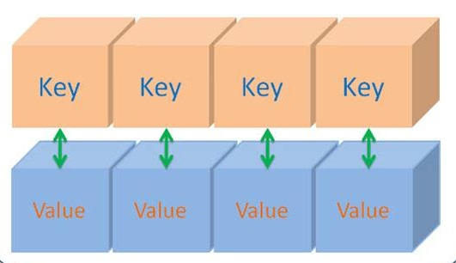

Map
Key value pair
Cannot contain duplicate keys
Independent interface in java collections framework
Duplicate
Unique
Notes:
Description:
Map is a part of collections framework. It is also a kind of collection which is used to store in the form of key value pair format. It represents a mapping between a key and a value. The key is unique but the value gets duplicated. The map interface is not a subtype of the collection interface and so its characteristics and behaviors are different than the other collections like list or set. Thus, it is an independent interface in java collections framework.

Slide 3

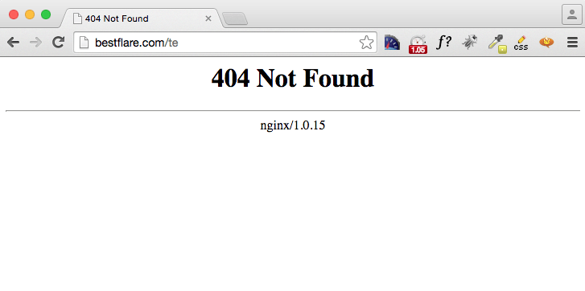
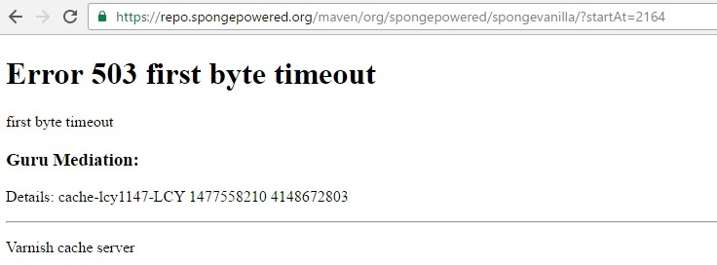
Real time application
Notes:
Description:
The best example is http request. In HTTP, error codes are issued by the server in response to a client’s request when the required address is not found.

Slide 4

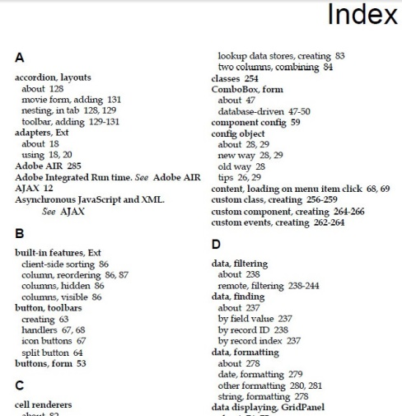
Other Examples
Dictionary
Telephone directory
Book index
Zip code and cities
Notes:
Description:
The maps are used when someone wants to retrieve and update elements by keys. Examples: Consider a dictionary. The words in alphabetical order is unique but the synonyms or the meaning of some words get duplicated. For example, a and an keys in dictionary. Both words give the same value as one. Thus the keys are different and values get imitated. Other examples are telephone directory, book index page and so on.

Slide 5
Collection vs Map
Collection
map
Group of objects
as a single entity
Group of objects as
(Key, value) pair
Bag
Employee
Table
1- Aarav
100- Balvan
Book
Student
200- Faraj
pencil
Notes:
Description:
A collection represents a group of objects, known as its elements. A map cannot contain duplicate keys. Each key can map to at most one value. In collections, we can retrive elements by their index and in map we retrive elements by key. Both Collection and Map are used to collect the object but main difference is, collection classes are used to store object in array format and Map classes are used to store in (KEY,VALUE) pair format. Each key value pair is called entry. Hence, map is considered as a collection of entry objects.

Slide 6
Map
Map
extends
implements
Linked HashMap
HashMap
HashTable
Sorted map
Tree map
Notes:
Description:
Map is an interface. HashMap and HashTable are implementation classes. Map interface extends to Sorted map interface. Tree map implements sorted map. Map does not allow duplicate keys. In map, insertion order is not preserved. HashMap is a class which implements map interface, but it doesn’t maintain any order. It contains only unique elements. Linked HashMap inherits HashMap. It maintains insertion order. TreeMap maintains ascending order.

Slide 7

//Predict the output
import java.util.Map;
import java.util.HashMap;
class Map_Interface
{
public static void main(String args[])
{ Map<Integer,String> map=new HashMap<Integer,String>();
System.out.println(map);
}
}
1
2
3
4
5
6
7
8
9
10
11
12
13
14
15
16
17
18
19
20
21
22
Notes:
Output:
Compilation error

Slide 8
//Predict the output
import java.util.Map;
public class Main
{
public static void main(String args[])
{ Map<Integer,String> map=new Map<Integer,String>();
System.out.println(map);
}
}
1
2
3
4
5
6
7
8
9
10
11
12
13
14
15
16
17
18
19
20
21
22
Notes:
Output:
{}

Slide 9
//Predict the output
import java.util.Map;
import java.util.Map;
import java.util.HashMap;
public class Main
{
public static void main(String args[])
{
Map<Integer,String> map=new HashMap<Integer,String>();
map.put(96,"Merin");
map.put(80,"Dinesh");
map.put(100,"Swathi");
System.out.println(map);
}
}
1
2
3
4
5
6
7
8
9
10
11
12
13
14
15
16
17
18
19
20
21
22
Notes:
Methods:
put(): It is used to insert a key and value.
putAll(): It is used to insert a map.
get(): It is used to return the value of specified key.
remove(): It is used to delete an entry from the map.
containskey(): This method is used to search a specified key from the map
keySet(): Returns the set view containing all the keys.
entrySet(): Returns the set view contains all the keys and values.
ceilingKey(): Returns the least key greater than or equal to the given key
floorKey(): Returns the greatest key less than or equal to given key from the parameter.
Output:
{96=Merin, 80=Dinesh, 100=Swathi}
The output displays with the key and value.

Slide 10
//Example Program
import java.util.Map;
import java.util.Map;
import java.util.HashMap;
public class Main
{
public static void main(String args[])
{
Map<String,String> ob=new HashMap<String,String>();
ob.put("first","way");
ob.put("second","Gate");
ob.put("third","Wall");
ob.put("fourth","person");
System.out.println(ob);
}
}
1
2
3
4
5
6
7
8
9
10
11
12
13
14
15
16
17
18
19
20
21
22
Notes:
Output:
{third=Wall, fourth=person, first=way, second=Gate}
From the above example, we know that the HashMap maintains no proper order while displaying the output. So, use LinkedHashMap which display the output in order

Slide 11
//Predict the output
import java.util.Map;
import java.util.HashMap;
import java.util.LinkedHashMap;
public class Main
{
public static void main(String args[])
{
Map<String,String> ob=new LinkedHashMap<String,String>();
ob.put("first","Norway");
ob.put("second","Germany");
ob.put("third","Canada");
ob.put("fourth","United states");
ob.put("fifth","Netherlands");
System.out.println(ob);
}
}
1
2
3
4
5
6
7
8
9
10
11
12
13
14
15
16
17
18
19
20
21
22
Notes:
Output:
{first=Norway, second=Germany, third=Canada, fourth=United states, fifth=Netherlands}

Slide 12
//Predict the output
import java.util.Map;
import java.util.HashMap;
public class Mapinterface
{
public static void main(String [] args)
{
Map<String,String> map=new HashMap<>();
map.put("Name","Arun Kumar");
map.put("Occupation","Engineer");
map.put("Country","India");
System.out.println(map.get("Name"));
}
}
1
2
3
4
5
6
7
8
9
10
11
12
13
14
15
16
17
18
19
20
21
22
Notes:
Output:
Arun Kumar
By using get() method, we can retrieve a value using key.

Slide 13
//Predict the output
import java.util.Map;
import java.util.HashMap;
public class Main
{
public static void main(String args[])
{
Map<Integer,String> map=new HashMap<Integer,String>();
map.put(96,"Arun Kumar");
map.put(80,"Dinesh");
map.put(100,"Santhosh");
for(Map.Entry m:map.entrySet())
{
System.out.println(m.getKey()+" "+m.getValue());
}
}
}
1
2
3
4
5
6
7
8
9
10
11
12
13
14
15
16
17
18
19
20
21
22
Notes:
Output:
96 Arun Kumar
80 Dinesh
100 Santhosh
To iterate the values one by one, for each loop is used .Entry is nothing but key value pair. It gets iterated over map.entrySet() or we can use iterator also. We can’t traverse the map itself, so entrySet() or keySet() is used to traverse the map.

Slide 14
//Predict the output
import java.util.Map;
import java.util.HashMap;
import java.util.Iterator;
public class Main
{
public static void main(String [] args)
{
Map<String,String> map=new HashMap<String,String>();
map.put("Name","Arun Kumar");
map.put("Occupation","Developer");
map.put("Country","India");
System.out.println(map.get("Name"));
Iterator<String> keySetIterator = map.keySet().iterator();
while(keySetIterator.hasNext())
{
String key = keySetIterator.next();
System.out.println(key +" " + map.get(key));
}
}
}
1
2
3
4
5
6
7
8
9
10
11
12
13
14
15
16
17
18
19
20
21
22
Notes:
Output:
Arun Kumar
Occupation Developer
Country India
Name Arun Kumar
We can also traversing the elements using iterator class in Map.

Slide 15
//Predict the output
import java.util.Map;
import java.util.HashMap;
class Map_Interface
{
public static void main(String args[])
{
Map<Character,String> map=new HashMap<Character,String>();
map.put('a',"Anil");
map.put('b',"Babu");
map.put('c',"Charan");
map.put('d',"Dharani");
map.put('e',"Eniyan");
System.out.println(map);
map.remove('b');
for(Map.Entry m:map.entrySet())
{
System.out.println(m.getKey()+" "+m.getValue());
}
}
}
1
2
3
4
5
6
7
8
9
10
11
12
13
14
15
16
17
18
19
20
21
22
Notes:
Output:
{a=Anil, b=Babu, c=Charan, d=Dharani, e=Eniyan}
a Anil
c Charan
d Dharani
e Eniyan

Slide 16
//Predict the output
import java.util.Map;
import java.util.HashMap;
class Map_Interface
{
public static void main(String args[])
{
Map<Character,String> map=new HashMap<Character,String>();
map.put('a',"Anil");
map.put('b',"Babu");
map.put('c',"Charan");
map.put('d',"Dharani");
map.put('e',"Eniyan");
map.put('c',“cheran");
for(Map.Entry m:map.entrySet())
{
System.out.println(m.getKey()+" "+m.getValue());
}
}
}
1
2
3
4
5
6
7
8
9
10
11
12
13
14
15
16
17
18
19
20
21
22
Notes:
Output:
a Anil
b Babu
c Cheran
d Dharani
e Eniyan
In Map, duplicate keys are not allowed. In the example, Key ‘c’ gets repeated. It chooses the last one which assigns.

Slide 17
//Example Program
import java.util.Map;
import java.util.HashMap;
import java.util.LinkedHashMap;
class Map_Interface
{
public static void main(String args[])
{
Map<Integer,String> map=new LinkedHashMap<Integer,String>();
map.put(1,"one");
map.put(2,null);
map.put(3,"three");
map.put(4,"four");
map.put(null,"five");
map.put(null,"six");
map.put(7,null);
for(Map.Entry m:map.entrySet())
{
System.out.println(m.getKey()+" - "+m.getValue());
}
}
}
1
2
3
4
5
6
7
8
9
10
11
12
13
14
15
16
17
18
19
20
21
22
Notes:
Output:
1 - one
2 – null
3 – three
4 – four
null - six
7 – null
NULL assigns to a variable which has no object. HashMap accepts one null key and one or more null values. The above example has two null keys. But, HashMap displays only one key.

Slide 18
TreeMap
Map
extends
SortedMap
extends
NavigableMap
implements
TreeMap
Notes:
Description:
Treemap implements Sorted map and NavigableMap. It contains value based on key. It maintains ascending order and contains unique elements. It has no null key and many null value. It is capable of storing and sorting the key value pairs (entries). NavigableMap is the sub-interface of SortedMap. It has additional navigation methods and descending views.

Slide 19


Real time application
Notes:
Description:
In amazon and flipkart, the products are arranged in sorting order ie, if we look at some product by giving its brand name or the lowest price, the products available are sort in order which makes easy to choose the best one. This is an example for TreeMap.

Slide 20
HashMap vs TreeMap
HashMap
TreeMap
Maintain no order
One null key and many null value
Maintain ascending order
No null key and many null value
Notes:
Description:
The main difference between HashMap and TreeMap is, HashMap does not maintain order elements. It orders the elements as per the natural ordering, so LinkedHashMap is used to order the map. But, the TreeMap maintains ascending order. Also TreeMap doesn’t allow null key but accept null values. HashMap accept one null key and many null value. TreeMap implements NavigableMap which includes additional methods such as firstEntry(), lastEntry(), subMap and so on.

Slide 21
//Example program
import java.util.SortedMap;
import java.util.TreeMap;
public class Main
{
public static void main(String[] args)
{
SortedMap<String, String> t1 = new TreeMap<String,String>();
t1.put("Father", "Farmer");
t1.put("Mother", "Teacher");
t1.put("Son", "Engineer");
t1.put("Daughter", "Doctor");
t1.put("Cousin", "Manager");
for(SortedMap.Entry m:t1.entrySet())
{
System.out.println(m.getKey()+" "+m.getValue());
}
}
}
1
2
3
4
5
6
7
8
9
10
11
12
13
14
15
16
17
18
19
20
21
22
Notes:
Output:
Cousin Manager
Daughter Doctor
Father Farmer
Mother Teacher
Son Engineer
Description:
TreeMap maintains ascending order and so the entry arranged in alphabetical order in the above example.

Slide 22
//Predict the output
import java.util.SortedMap;
import java.util.TreeMap;
class Main
{
public static void main(String args[])
{
SortedMap<Integer,String> st=new TreeMap<Integer,String>();
st.put(3,"three");
st.put(2,null);
st.put(1,"one");
st.put(4,"four");
st.put(6,"null");
st.put(5,"five");
st.put(7,null);
System.out.println(st);
}
}
1
2
3
4
5
6
7
8
9
10
11
12
13
14
15
16
17
18
19
20
21
22
Notes:
Output:
{1=one, 2=null, 3=three, 4=four, 5=five, 6=null, 7=null}
TreeMap doesn’t allow null key but it allows one or more null values.

Slide 23
//Predict the output
import java.util.NavigableMap;
import java.util.TreeMap;
class Main
{
public static void main(String args[])
{
NavigableMap<Integer,String> httpcode=new TreeMap<Integer,String>();
httpcode.put(200,"ok");
httpcode.put(100,"continue");
httpcode.put(102,"processing");
httpcode.put(201,"created");
httpcode.put(103,"early hints");
System.out.println(httpcode);
System.out.println(httpcode.firstEntry());
System.out.println(httpcode.lastEntry());
}
}
1
2
3
4
5
6
7
8
9
10
11
12
13
14
15
16
17
18
19
20
21
22
Notes:
TreeMap implements NavigableMap which include methods such as
firstEntry(): Returns the first key value pairs in map
lastEntry(): Returns the last entry in the map
pollFirstEntry(): Removes the first entry from the map
pollLastEntry(); Removes the last key value pair in map
subMap(): Return the part or portion of the map
LastKey(): Returns the last key from the map
descendingMap(): returns in reverse order of map
descendingkeySet(): returns keys of map in reverse order
headMap(): Gets all the entries strictly less than the parameter key value
tailMap(): Returns all the entries greater than the parameter key value
Output:
{100=continue, 102=processing, 103=early hints, 200=ok, 201=created}
100=continue
201=created

Slide 24
//Predict the output
import java.util.NavigableMap;
import java.util.NavigableMap;
import java.util.TreeMap;
public class Main
{
public static void main(String args[])
{
NavigableMap<Integer,String> httpcode=new TreeMap<Integer,String>();
httpcode.put(302,"God");
httpcode.put(300,"Save");
httpcode.put(400,"Bad");
httpcode.put(306,"help");
httpcode.put(403,"Forbidden");
httpcode.put(401,"Unauthorised");
System.out.println(httpcode);
System.out.println(httpcode.pollFirstEntry());
System.out.println(httpcode.pollLastEntry());
System.out.println(httpcode);
}
}
1
2
3
4
5
6
7
8
9
10
11
12
13
14
15
16
17
18
19
20
21
22
Notes:
Output:
{300=Save, 302=God, 306=help, 400=Bad, 401=Unauthorised, 403=Forbidden}
300=Save
403=Forbidden
{302=God, 306=help, 400=Bad, 401=Unauthorised}

Slide 25
//Predict the output
import java.util.SortedMap;
import java.util.NavigableMap;
import java.util.TreeMap;
class Main
{
public static void main(String args[])
{
NavigableMap<Character,String> sd=new TreeMap<Character,String>();
sd.put('b',"Barbie");
sd.put('a',"Angel");
sd.put('d',"Dora");
sd.put('c',"Charlie");
sd.put('e',"Emy");
System.out.println(sd);
System.out.println(sd.subMap('b','e'));
}
}
1
2
3
4
5
6
7
8
9
10
11
12
13
14
15
16
17
18
19
20
21
22
Notes:
Output:
{a=Angel, b=Barbie, c=Charlie, d=Dora, e=Emy}
{b=Barbie, c=Charlie, d=Dora}

Slide 26
//Predict the output
import java.util.NavigableMap;
import java.util.TreeMap;
class Navig_map
{
public static void main(String args[])
{
NavigableMap<Character,String> k1=new TreeMap<Character,String>();
k1.put('b',"Barbie");
k1.put('a',"Angel");
k1.put('d',"Dora");
k1.put('c',"Charlie");
k1.put('e',"Emy");
k1.put('t',"Tom");
k1.put('j',"Jerry");
System.out.println(k1);
NavigableMap n1 = k1.descendingMap();
System.out.println(n1);
}
}
1
2
3
4
5
6
7
8
9
10
11
12
13
14
15
16
17
18
19
20
21
22
Notes:
Output:
{a=Angel, b=Barbie, c=Charlie, d=Dora, e=Emy, j=Jerry, t=Tom}
{t=Tom, j=Jerry, e=Emy, d=Dora, c=Charlie, b=Barbie, a=Angel}

Slide 27
//Predict the output
import java.util.NavigableMap;
import java.util.TreeMap;
class Main
{
public static void main(String args[])
{
NavigableMap<Integer,String> b1 = new TreeMap<Integer,String>();
b1.put(4,"Tamilnadu");
b1.put(2,"Gujarat");
b1.put(6,"Orissa");
b1.put(1,"Kerala");
b1.put(5,"Telangana");
b1.put(7,"Karnataka");
b1.put(8,"Mumbai");
b1.put(3,"Meghalaya");
for(NavigableMap.Entry m:b1.entrySet())
{
System.out.println(m.getKey()+" "+m.getValue());
}
1
2
3
4
5
6
7
8
9
10
11
12
13
14
15
16
17
18
19
20
21
22
Notes:
Output:
{a=Angel, b=Barbie, c=Charlie, d=Dora, e=Emy, j=Jerry, t=Tom}
{t=Tom, j=Jerry, e=Emy, d=Dora, c=Charlie, b=Barbie, a=Angel}

Slide 28
System.out.println("\t");
System.out.println(b1.headMap(5));
}
}
1
2
3
4
5
6
7
8
9
10
11
12
13
14
15
16
17
18
19
20
21
22
Notes:
Output:
1 Kerala
2 Gujarat
3 Meghalaya
4 Tamilnadu
5 Telangana
6 Orissa
7 Karnataka
8 Mumbai
{1=Kerala, 2=Gujarat, 3=Meghalaya, 4=Tamilnadu}

Slide 29
//Predict the output
import java.util.SortedMap;
import java.util.NavigableMap;
import java.util.TreeMap;
class map_int
{
public static void main(String args[])
{
NavigableMap<Integer,String> b1=new TreeMap<Integer,String>();
b1.put(3,"Nissan");
b1.put(2,"Toyota");
b1.put(5,"Chrysler");
b1.put(1,"Honda");
b1.put(6,"Chevrolet");
b1.put(7,"Mercedes");
b1.put(4,"Volvo");
b1.put(8,"Volkswagen");
for(NavigableMap.Entry m:b1.entrySet())
{
System.out.println(m.getKey()+" "+m.getValue());
}
1
2
3
4
5
6
7
8
9
10
11
12
13
14
15
16
17
18
19
20
21
22

Slide 30
System.out.println("\t");
SortedMap<Integer,String> n1=new TreeMap<Integer,String>();
n1 = b1.headMap(5);
System.out.println(n1);
SortedMap<Integer,String> m1=new TreeMap<Integer,String>();
m1 = b1.tailMap(5);
System.out.println(m1);
SortedMap<Integer,String> w1=new TreeMap<Integer,String>();
w1 = b1.subMap(3,8);
System.out.println(w1);
}
}
1
2
3
4
5
6
7
8
9
10
11
12
13
14
15
16
17
18
19
20
21
22
Notes:
Output:
1 Honda
2 Toyota
3 Nissan
4 Volvo
5 Chrysler
6 Chevrolet
7 Mercedes
8 Volkswagen
{1=Honda, 2=Toyota, 3=Nissan, 4=Volvo}
{5=Chrysler, 6=Chevrolet, 7=Mercedes, 8=Volkswagen}
{3=Nissan, 4=Volvo, 5=Chrysler, 6=Chevrolet, 7=Mercedes}

Slide 31
//Predict the output
import java.util.*;
class Main
{
public static void main(String args[])
{
Map<String, String> treemap =
new TreeMap<String, String>(Collections.reverseOrder());
treemap.put("1", "Microsoft");
treemap.put("2", "Google");
treemap.put("3", "Samsung");
treemap.put("4", "Nokia");
Set set = treemap.entrySet();
Iterator i = set.iterator();
while (i.hasNext())
{
Map.Entry me = (Map.Entry)i.next();
System.out.print(me.getKey() + ": ");
System.out.println(me.getValue());
}
}
}
1
2
3
4
5
6
7
8
9
10
11
12
13
14
15
16
17
18
19
20
21
22
Notes:
Output:
4: Nokia
3: Samsung
2: Google
1: Microsoft
Description:
This program displays the output in reverse order.

Slide 32

THANK YOU
Notes:
Thank you slide

