Slide 1
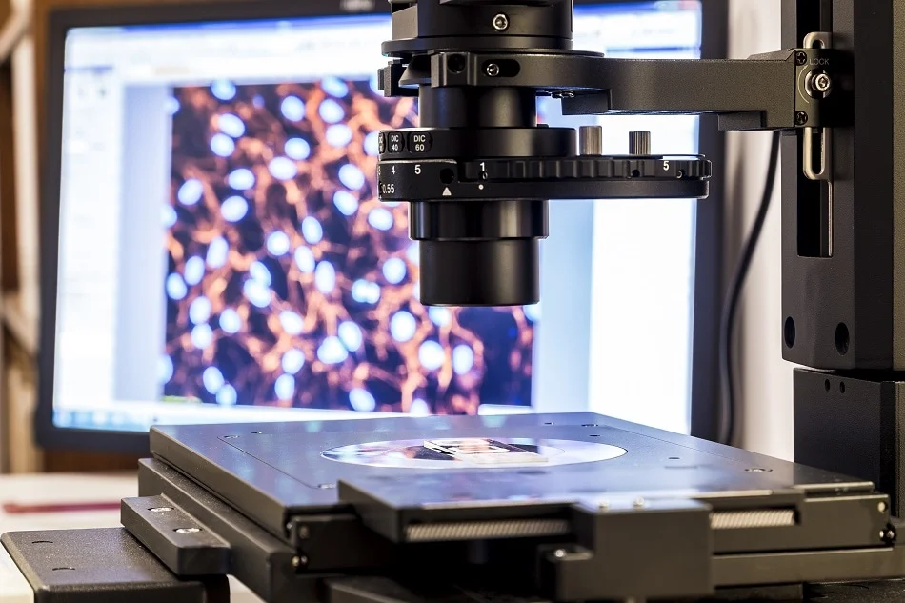
Atomic Force Microscopy [AFM]
AMIT KUMAR SAHU– 18MIS7250

Slide 2
Evolution of AFM
Scanning Tunneling Microscopy
The development of the family of scanning probe microscopes started with the original invention of the STM in 1981. Gerd Binnig and Heinrich Rohrer developed the first working STM while working at IBM Zurich Research Laboratories in Switzerland. This instrument would later win Binnig and Rohrer the Nobel prize in physics in 1986.
Topography imaging alone does not always provide the answers that researchers need and the surface topology often does not correlate to the material properties. For these reasons, advanced imaging modes have been developed to provide quantitative data on a variety of surfaces. Now, many material properties can be determined with AFM techniques, including friction, electrical forces, capacitance, magnetic forces, conductivity, viscoelasticity, surface potential, and resistance.

Slide 3
Atomic Force Microscopy
The Atomic Force Microscopy (AFM) was developed to overcome a basic drawback with STM – it can only image conducting or semiconducting surfaces. The AFM has the advantage of imaging almost any type of surface, including polymers, ceramics, composites, glass, and biological samples.
Binnig, Quate, and Gerber invented the AFM in 1985. Their original AFM consisted of a diamond shard attached to a strip of gold foil. The diamond tip contacted the surface directly, with the interatomic van der Waals forces providing the interaction mechanism.

Slide 4
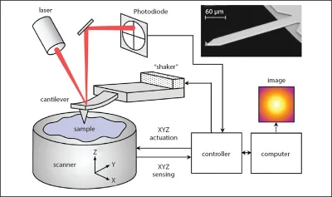
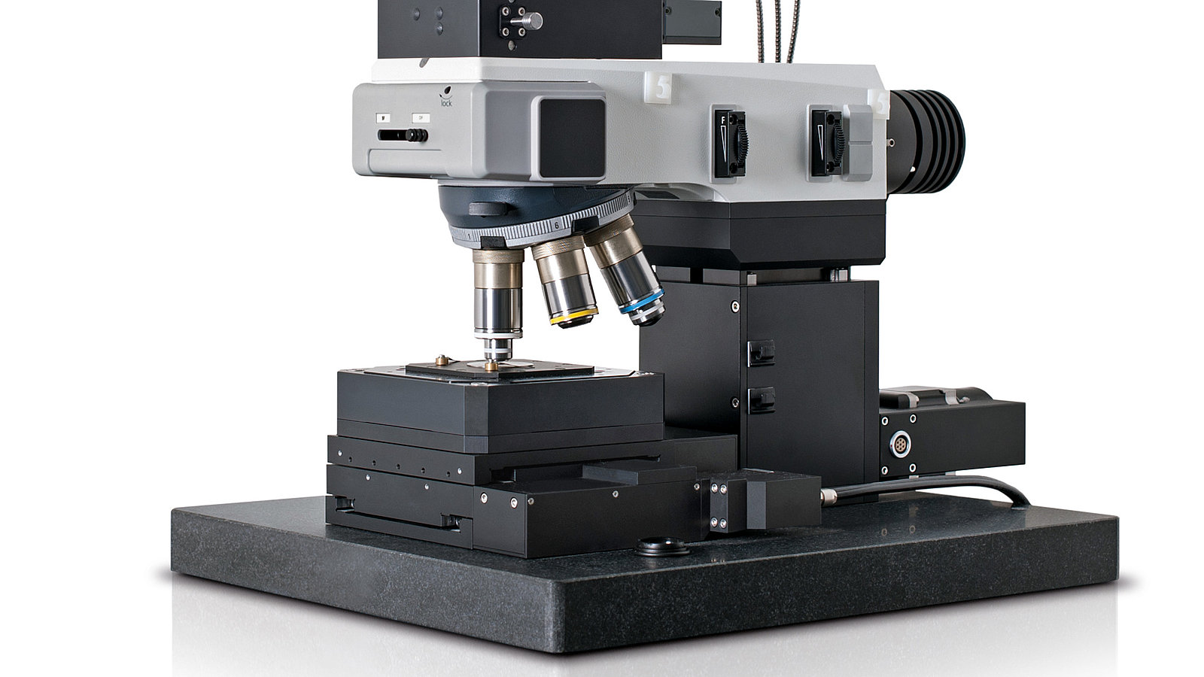
Working Principle

Slide 5

Pros of Using AFM
Easy sample preparation.
Works in Air, Vaccum, and liquids.
Gives an accurate height information of the surface morphology.
Living system can be studied.
Can show 3D imaging.
Best in dynamic environment.
Can show best surface roughness qualification.

Slide 6

Cons of Using AFM
Limited vertical range.
Limited magnification range.
In/out put data not independent of tip.
Tip or sample can be damaged.
Has limited scanning speed.
The AFM can only image a maximum height in the order of micrometers and a maximum scanning area of approximately 150 by 150 micrometers. [The SEM can image an area in the order of millimeters by millimeters with a depth of field in the order of millimeters.]

Slide 7

Recent research article related to AFM!

Slide 8
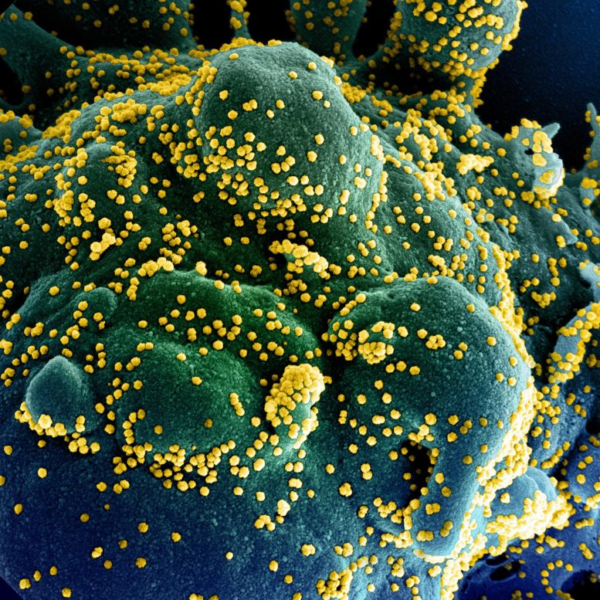
High-Speed AFM Reveals COVID-19 Surface Transmission Mechanism
Paderborn University investigated COVID-19 transmission mechanisms.
Researchers can visualize the so-called adsorption, diffusion, and interaction dynamics
One of the most significant results is that the adsorption of the spike protein on the oxide surfaces is controlled by electrostatic interactions

Slide 9
References
https://scitechdaily.com/high-speed-atomic-force-microscopy-reveals-covid-19-surface-transmission-mechanism/
https://www.sciencedirect.com/topics/chemistry/atomic-force-microscopy
https://www.nanoscience.com/techniques/atomic-force-microscopy/

Slide 10
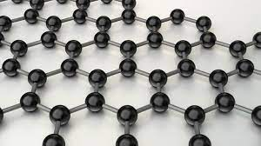
Thank You
for your patience

