Slide 1

FedShield-ID
Privacy-First Identity Trust Platform for Banking Networks
Hackathon Pitch Deck | 21July 2026
Topic: Cybersecurity & Privacy-Preserving AI in Financial Tech
Presented By
Yash Gaikwad
Research, Documentation & Presentation Lead
Kamran Alam
UI/UX Engineer & Frontend Enhancement
Mohd. Amaan Hamid
AI/ML Architect, Full-Stack Developer & Team Lead

Slide 2
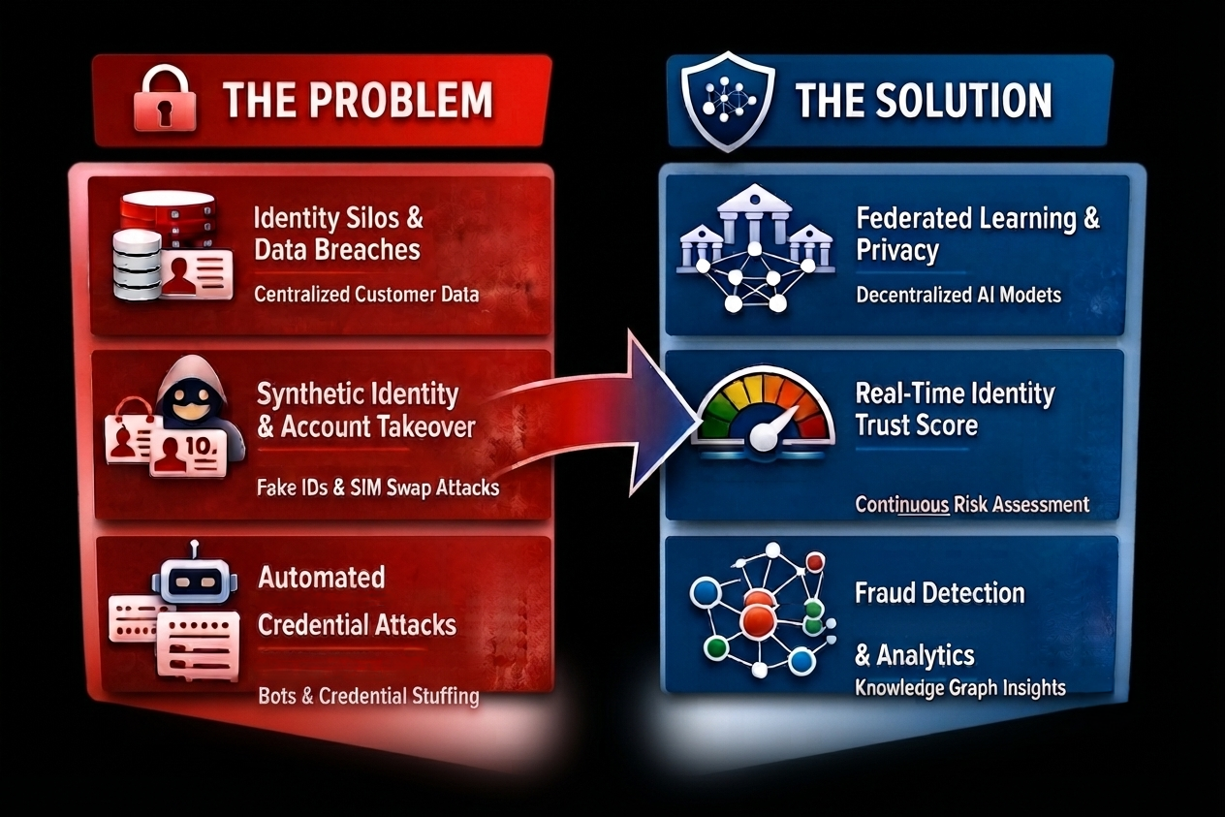
FEDSHIELD-ID | PSB Hackathon Series 2026 – Cybersecurity & Fraud Domain.
Problem & Solution
The Challenge in Banking Systems
🔒 Identity Silos & Centralized Data
Centralized customer data increases breach risks and regulatory compliance challenges.
⚠️ Synthetic Identity & Account Takeover
Synthetic identities, credential theft, and SIM-swap attacks enable unauthorized account access.
🤖 Automated Credential Attacks
Bots perform credential stuffing and automated logins, bypassing traditional authentication mechanisms.
The FedShield-ID Approach
🧠 Privacy-Preserving AI
Federated Learning + Differential Privacy enable collaborative AI without sharing customer data.
🎯 Continuous Identity Trust
Generates a real-time Trust Score (0–100) using behavioral, device, location, and transaction intelligence.
🛡️ Adaptive Authentication
Applies Allow, OTP, Face Verification, or Block based on the user's risk score for secure, frictionless access.
CONFIDENTIAL | PRIVACY-FIRST BANKING IDENTITY TRUST
1

Slide 3
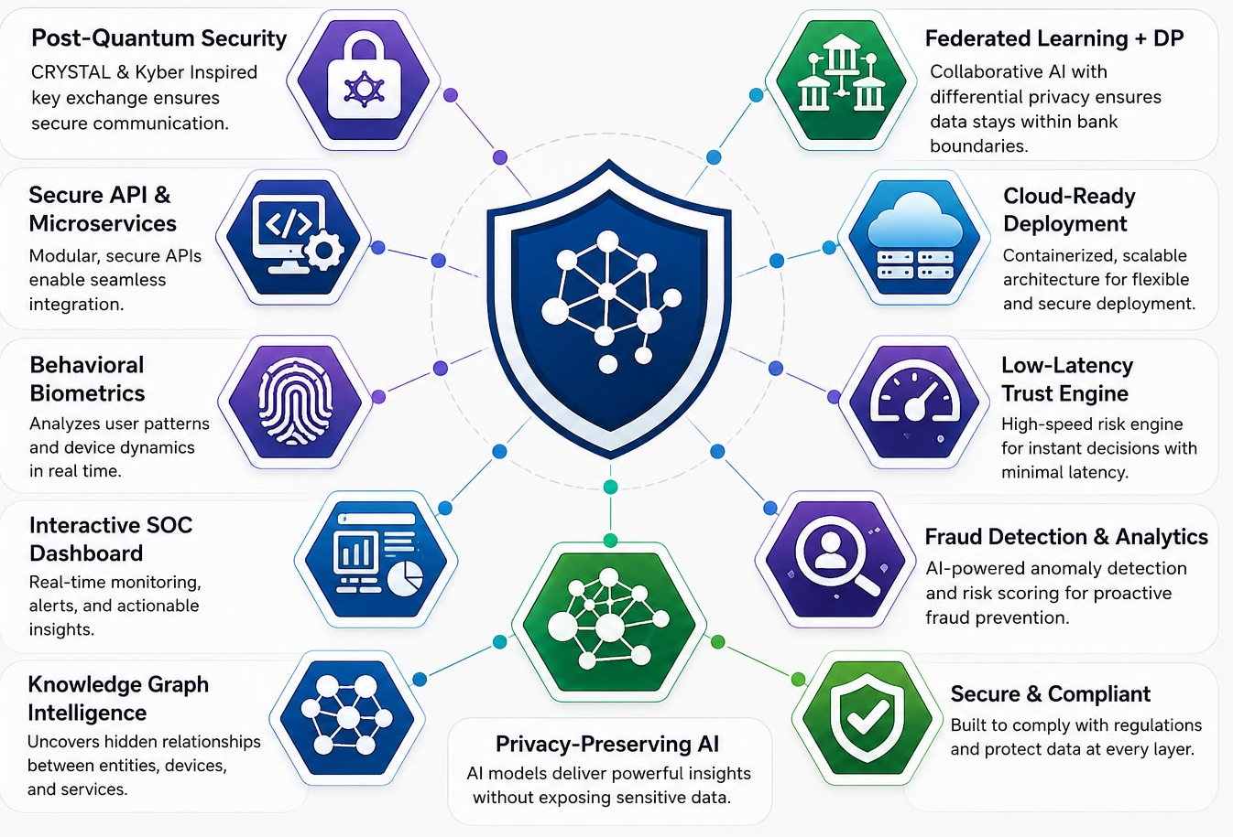
FEDSHIELD-ID | PSB Hackathon Series 2026 – Cybersecurity & Fraud Domain.
Technology & Innovation
System Architecture & Tech Stack
⚙️ Backend & API Layer
FastAPI microservices with SQLAlchemy and PostgreSQL/SQLite for secure, scalable, API-first banking integration.
🧠 AI/ML & Trust Intelligence
Real-time identity risk assessment using Random Forest, SGD, Federated Learning, Differential Privacy, and SHAP Explainability.
📊 Interactive SOC Dashboard
Built with React 18, Tailwind CSS, and a Knowledge Graph for real-time trust monitoring and AI-powered forensic insights.
Core Cryptography & Telemetry
🔐 Post-Quantum Security
CRYSTALS-Kyber-inspired secure key exchange for quantum-resilient inter-bank communication.
🛡️ Privacy-Preserving Intelligence
Federated Learning with Differential Privacy enables collaborative AI without exposing customer data.
👤 Behavioral Biometrics
Monitors typing behavior, mouse dynamics, and device telemetry to detect fraud and anomalous activity in real time.
CONFIDENTIAL | PRIVACY-FIRST BANKING IDENTITY TRUST
2

Slide 4
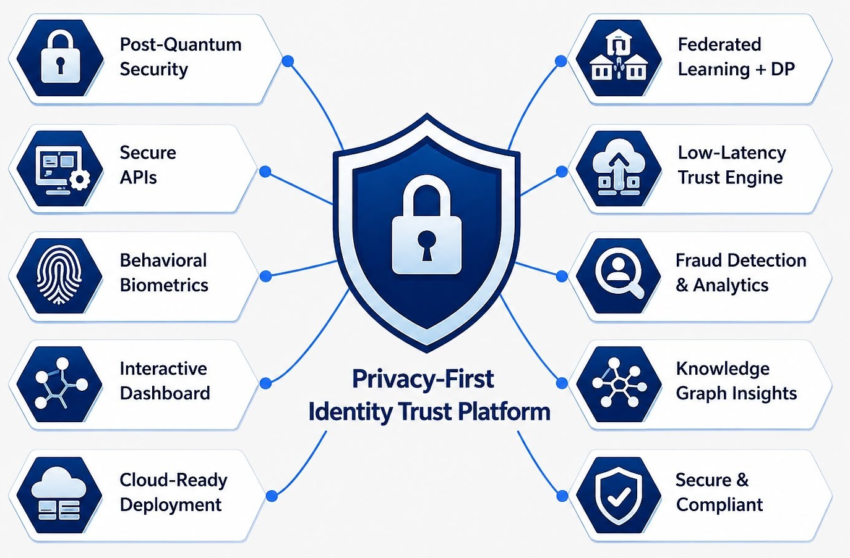
FEDSHIELD-ID | PSB Hackathon Series 2026 – Cybersecurity & Fraud Domain.
Scalability & Deployment
Ecosystem Integration & Feasibility
🔄 Real-Time Integration
Asynchronous telemetry ingestion for continuous behavioral monitoring.
⚡ High-Performance Trust Engine
Low-latency AI inference with real-time Identity Trust Scoring.
☁️ Cloud-Ready Deployment
Docker-based, scalable architecture for seamless cloud and enterprise deployment.
Platform Impact & Scale
🔒 Privacy-First Banking
Federated Learning enables privacy-preserving AI while supporting RBI and DPDP Act compliance.
⚡ AI-Powered Security Operations
Explainable AI generates real-time risk insights and forensic summaries for faster investigations.
🌐 Enterprise Fraud Intelligence
Knowledge Graph uncovers hidden relationships between accounts, devices, and suspicious activities.
CONFIDENTIAL | PRIVACY-FIRST BANKING IDENTITY TRUST
3

Slide 5
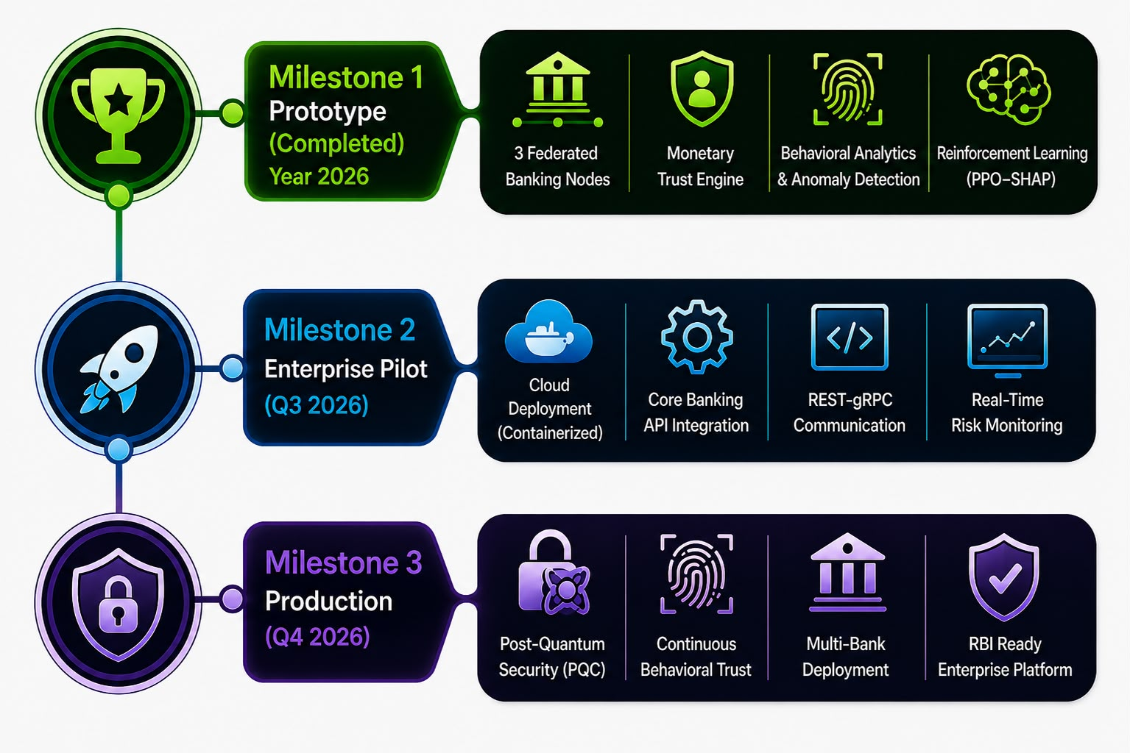
FEDSHIELD-ID | PSB Hackathon Series 2026 – Cybersecurity & Fraud Domain.
Team & Execution Plan
Team Roles & Structure
Mohd. Amaan Hamid
AI/ML Architect, Full-Stack Developer & Team Lead
AI/ML Pipeline • Backend • Frontend • System Architecture • Security Integration
Yash Gaikwad
Research, Documentation & Presentation Lead
Technical Research • Documentation • Presentation • Testing & Validation
Kamran Alam
UI/UX Engineer & Frontend Enhancement
React UI • Tailwind CSS • Dashboard Design • Usability Testing
Development Roadmap & Milestones
✅ Milestone 1 – Prototype (Completed)
3 Federated Banking Nodes
Identity Trust Engine
Behavioral Analytics & Adaptive Authentication
Federated Learning + DP + SHAP
🚀 Milestone 2 – Enterprise Pilot (Q3 2026)
Cloud Deployment (Docker)
Core Banking API Integration
REST/gRPC Communication
Real-Time Risk Monitoring
🌍 Milestone 3 – Production (Q4 2026)
Post-Quantum Security (PQC)
Continuous Behavioral Biometrics
Multi-Bank Deployment
RBI-Ready Enterprise Platform
CONFIDENTIAL | PRIVACY-FIRST BANKING IDENTITY TRUST
4

Slide 6
FEDSHIELD-ID | PSB Hackathon Series 2026 – Cybersecurity & Fraud Domain.
Thank you
We Welcome Your Questions
CONFIDENTIAL | PRIVACY-FIRST BANKING IDENTITY TRUST
5

