Slide 1
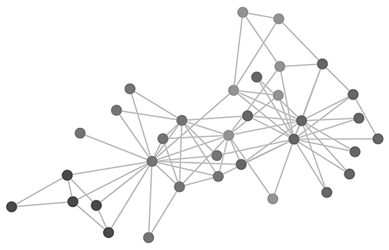
Predictive Models for Data Traffic
seif Kassab 221002051
Ahmed Abdelmoneim 221002230
Maryam Abdallah 221000002
Farida Salah 221000123
NourEldin Ayman 221000001

Slide 2
The idea behind the project
Our data analytics project aims to analyse instances of data disruptions occurring across five applications in two French cities, comparing each application's security in parallel times. Our primary objective is to pinpoint periods characterized by significant deviations in data usage, focusing particularly on identifying instances of heightened security breaches. By employing anomaly detection techniques, we can discern when these breaches occurred and ascertain periods of relative stability.

Slide 3

Table of contents
Data preprocessing
Random forest supervised
K nearest neighbor regressor
Clustering analysis
EDA

Slide 4
Data preprocessing
We streamlined our data analysis by condensing our data into 30-minute intervals, making it more manageable and allowing us to capture significant trends, particularly in time series data such as usage patterns.
We identified outliers using statistical techniques like the Interquartile Range (IQR) method, although we retained some outliers that could signal important anomalies.
Additionally, to gain a comprehensive view of total consumption, we summed usage columns and introduced a new column for this aggregated total.
Lastly, to ensure consistency and enable accurate time-based operations, we standardized date columns using pandas' `to_datetime` function.

Slide 5
Random forest supervised
Random Forest Regression is an ensemble technique in machine learning that employs multiple decision trees.
It utilizes Bootstrap Aggregation (bagging) to solve regression and classification problems.
Random Forest Regression is versatile, handling both regression tasks and indirectly revealing data clustering.
It can detect anomalies by analyzing prediction errors, providing insights into data patterns and behavior.
Valuable for identifying patterns, understanding data behavior, and uncovering potential threats or security breaches in the dataset.

Slide 6
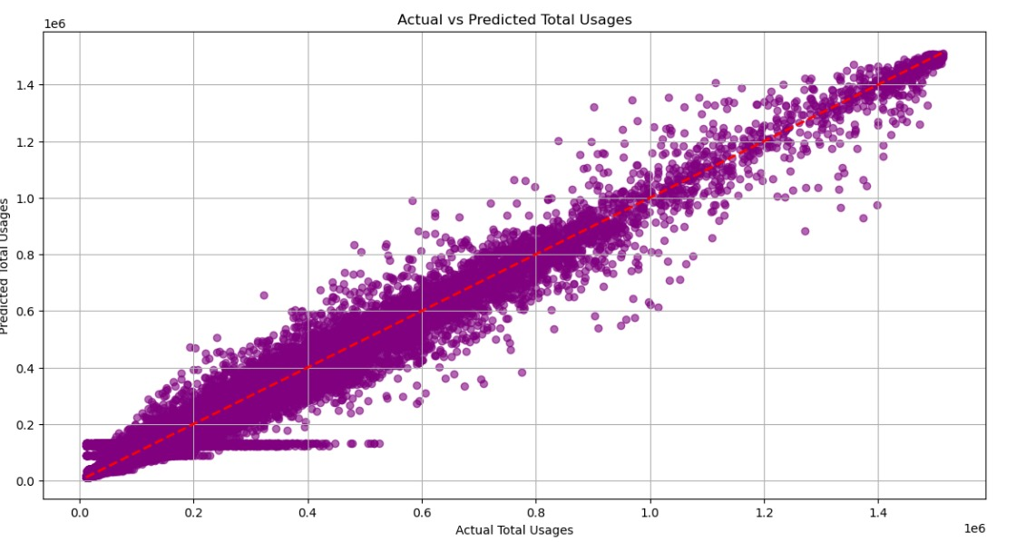
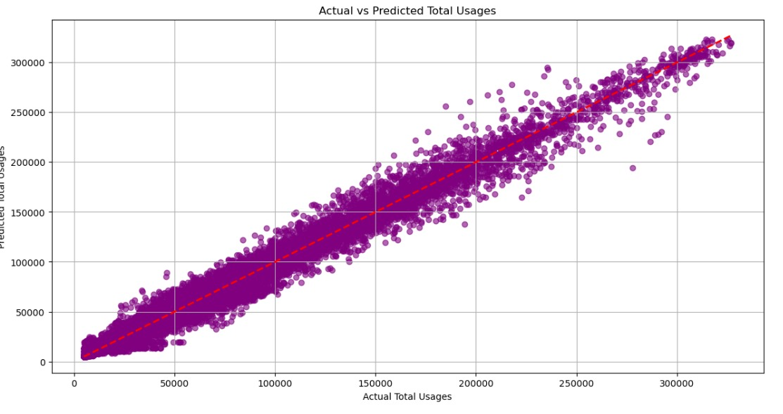
Random forest supervised (GOOGLE APPLICATION)
Toulouse
Dijon

Slide 7
K nearest neighbor regressor
Implemented a K-Nearest Neighbor (KNN) Regressor Distance-Based model for anomaly detection.
Normal data points are expected to be close to their neighbors in the feature space, while anomalies will be farther away.
After predicting the total usages using the KNN model, a threshold value of 5% was defined.
Identified the top 5% of anomalies based on their distance from the nearest neighbors, surpassing the defined threshold.

Slide 8
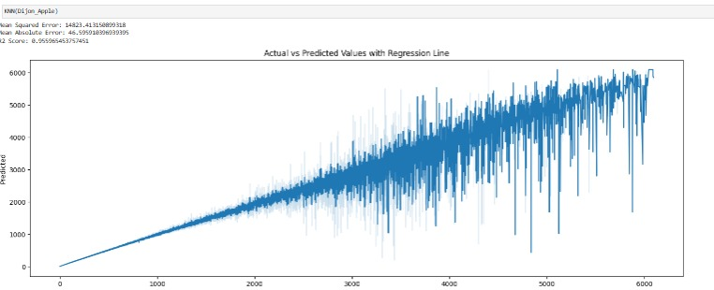
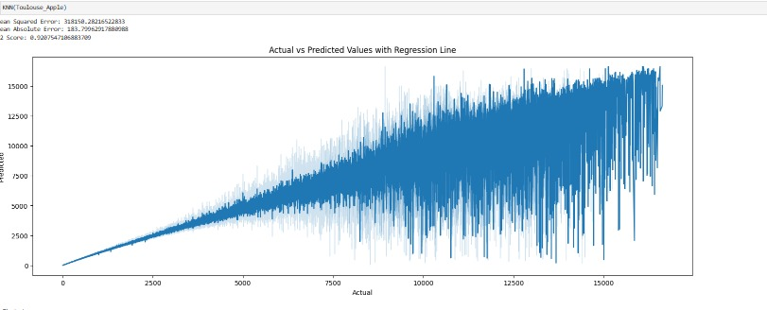
K nearest neighbor regressor (APPLE APPLICATION)
Dijon
Toulouse

Slide 9
clustering analysis
Utilized a potent unsupervised machine learning model to identify clusters of total usages.
Determined instances when total usages are closely clustered together and the specific timing of these clusters.
Points positioned far from the clusters were classified as anomalies.
Aimed at identifying potential threats and security breaches within the dataset.

Slide 10
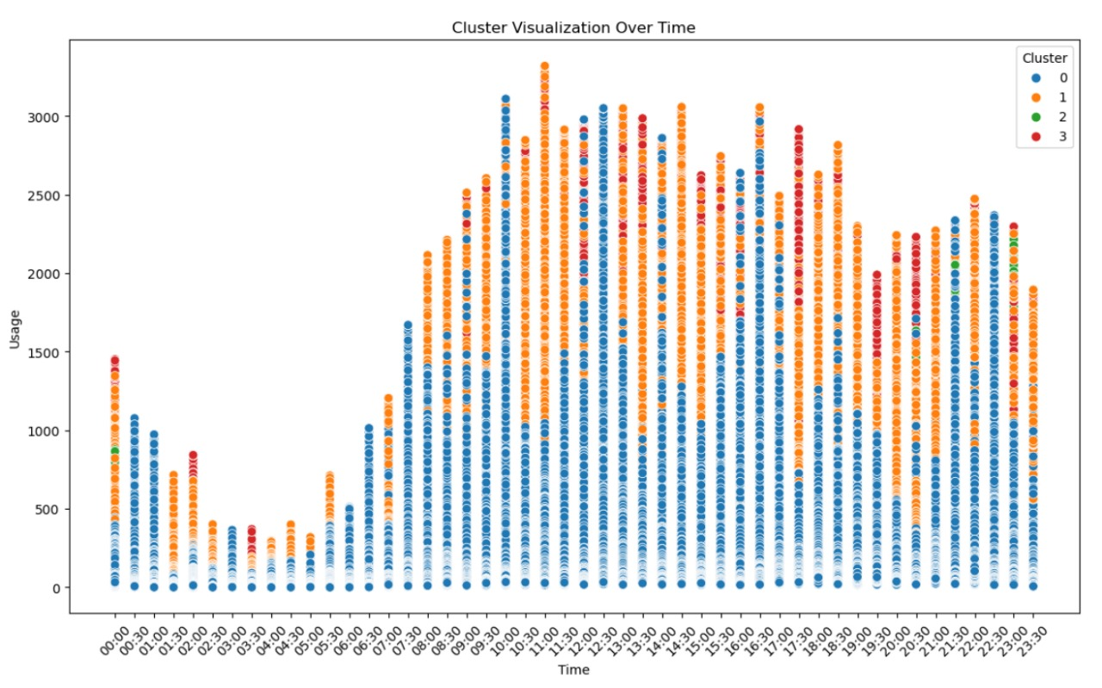
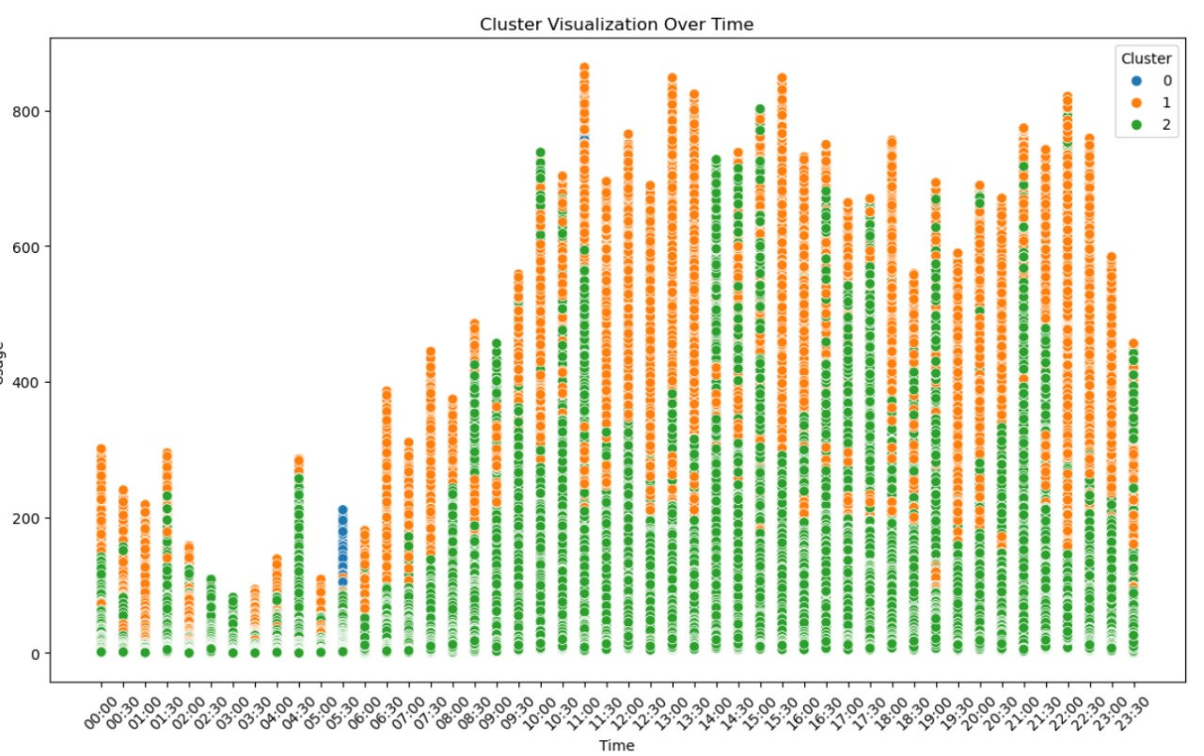
clustering analysis (Amazon APPLICTION)
Toulouse
Dijon

Slide 11
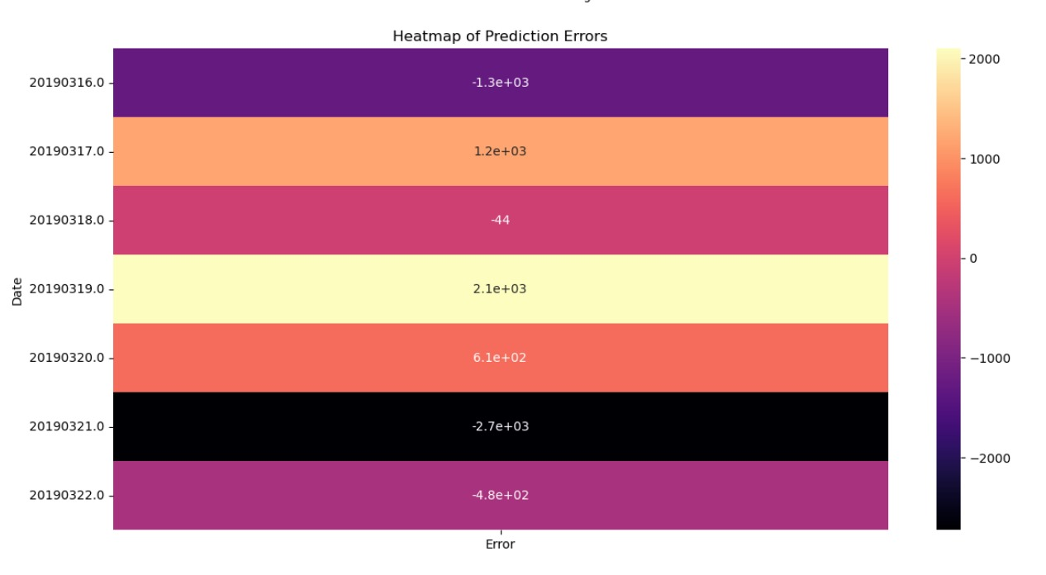
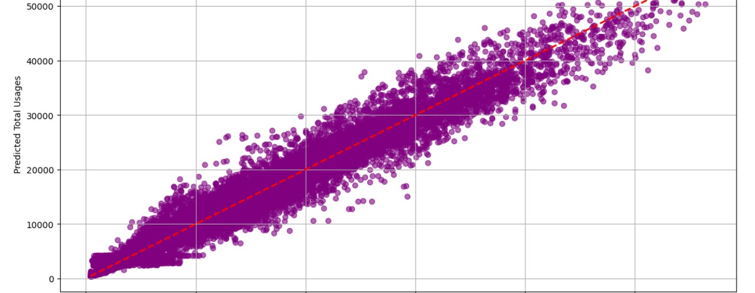
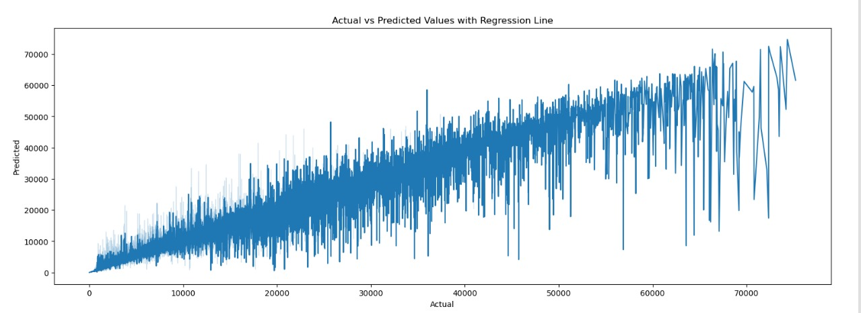
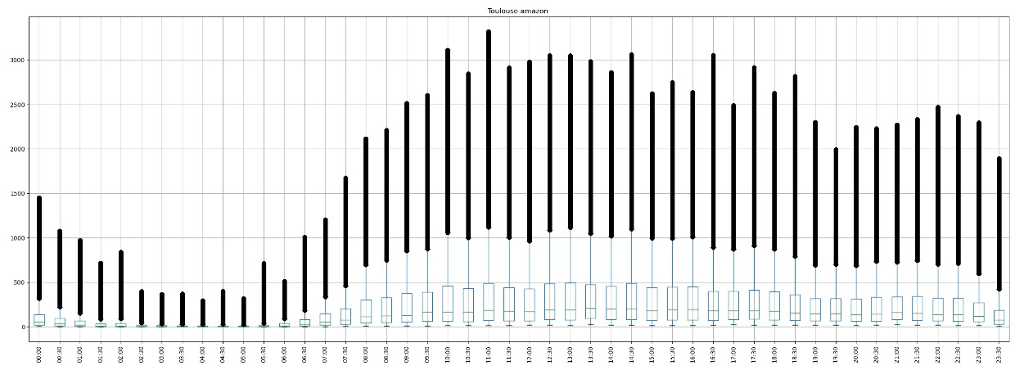
EDA
Heat Map
Scatter_Plot
Line plot
Box_Plot

Slide 12

Thank You!

