Slide 1
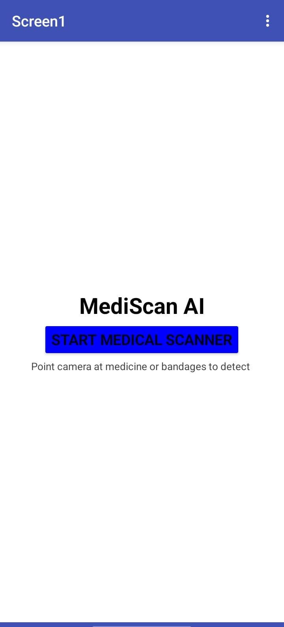
MediScan AI
A Digital Transformation Project using Cloud AI & Mobile IoT
Presented By: AMNA YOUSUF (2022F-BBM-012)
SHAHMEER HUSSAIN (2022F-BBM-014)
SABEEN ANSARI (2022F-BBM-035)

Slide 2
The Problem Statement
Challenges in Healthcare Logistics
Manual Tracking :Identifying and counting supplies is slow and error-prone.
Human Error: Misplaced items or shortages delay patient care.
Lack of Digitization: Most inventory systems are not updated in real-time.
The Need: A portable, automated system to recognize basic medical supplies instantly

Slide 3
Our Solution ( System Overview)
AI-Powered Mobile Scanner
Core Tech: YOLOv11 Object Detection Model.
Platform: Roboflow (Cloud Training & Hosting).
Interface: Mobile App Wrapper for portable "Point-and-Scan" usage.
Target Classes: Medicine (Calpol), Bandage (Saniplast), Thermometer

Slide 4
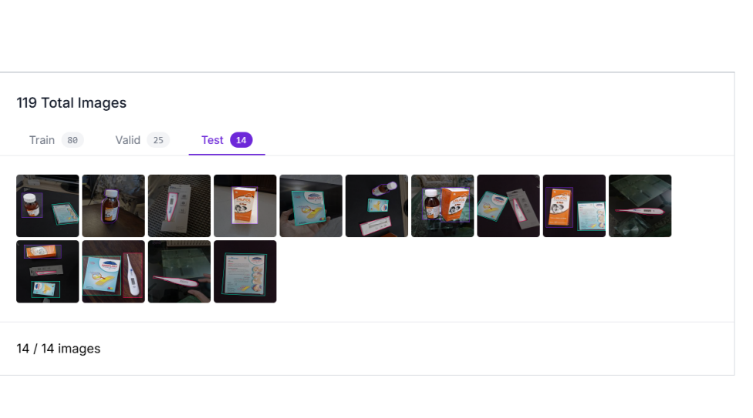
Methodology – Phase 1: Data Engineering
Dataset Curation & Annotation
Total Images: 119 Custom Images (collected in varied lighting/angles).
Classes: Balanced dataset (Medicine: 67, Bandage: 52, Thermometer: 48).
Split: 80 Train / 25 Validation / 14 Test.
Visual:

Slide 5
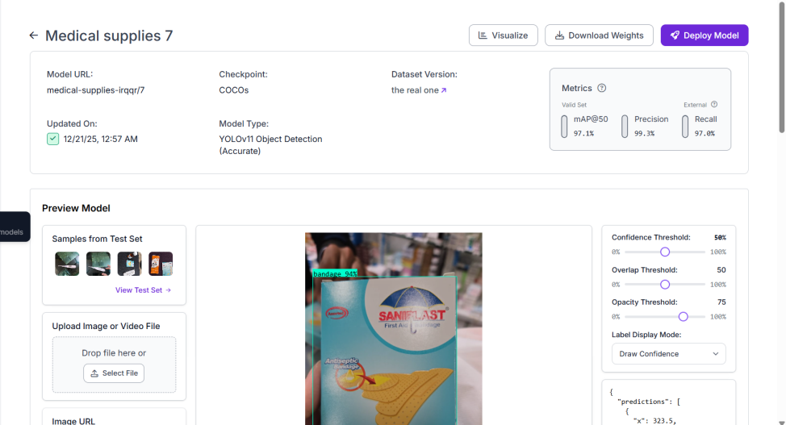
Methodology- Phase 2: Model Architecture
Training with YOLOv11
Architecture: YOLO (You Only Look Once) selected for real-time single-stage detection.
Transfer Learning: Initialized with COCO checkpoints to accelerate learning.
Configuration: Trained for 300 Epochs using the "Accurate" model type

Slide 6
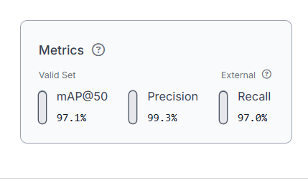
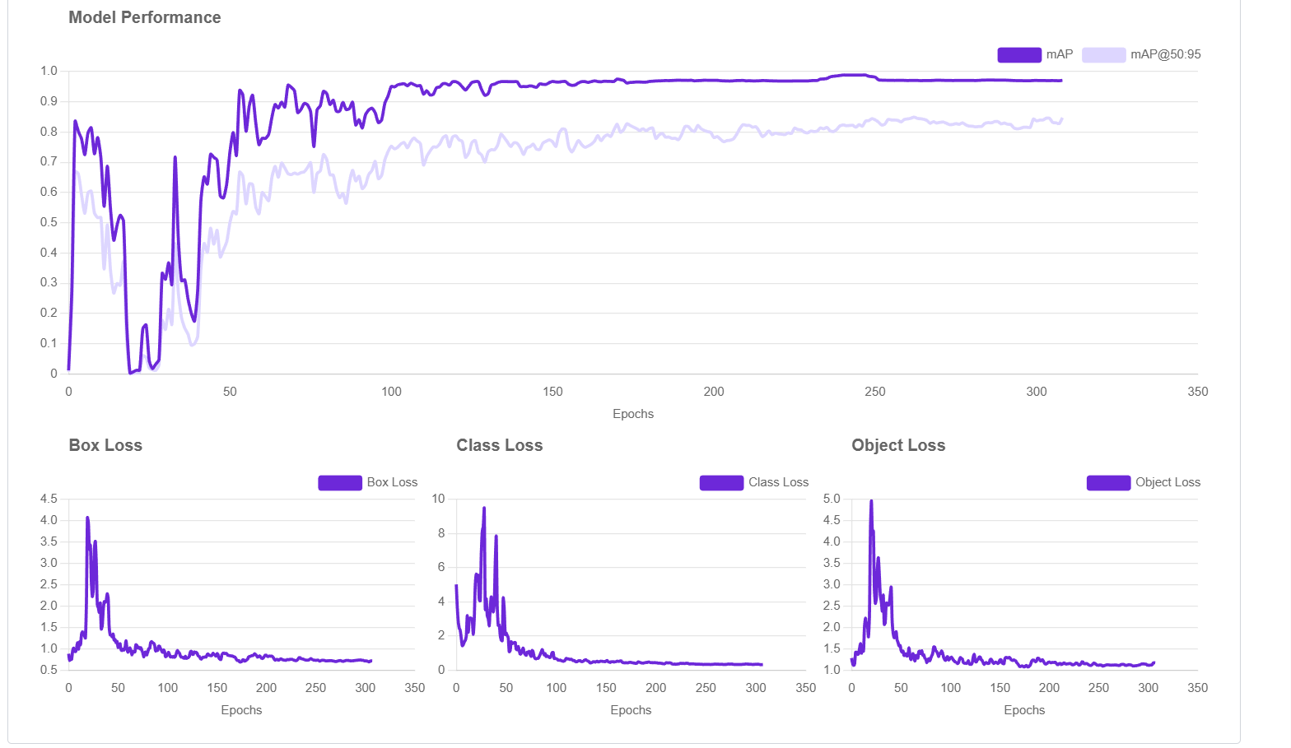
Performance Metrics
Validation Results
.mAP@50: 97.1% (Excellent reliability).
Precision: 99.3% (Very low false positives).
Recall: 97.0% (Detects almost all objects present)

Slide 7
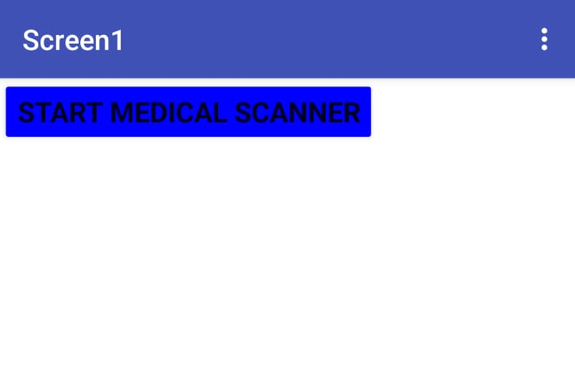
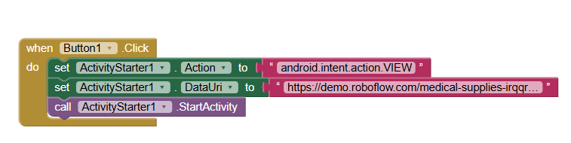
Methodology- Phase 3: Mobile Integration
App Architecture( MIT App Inventor)
Strategy: "Cloud-Edge" synergy. The app acts as a secure launcher.
Logic: Uses an ActivityStarter intent to bridge the Android OS with the AI Web Interface.
Benefit: Decouples the heavy processing from the phone, allowing it to run on older devices

Slide 8
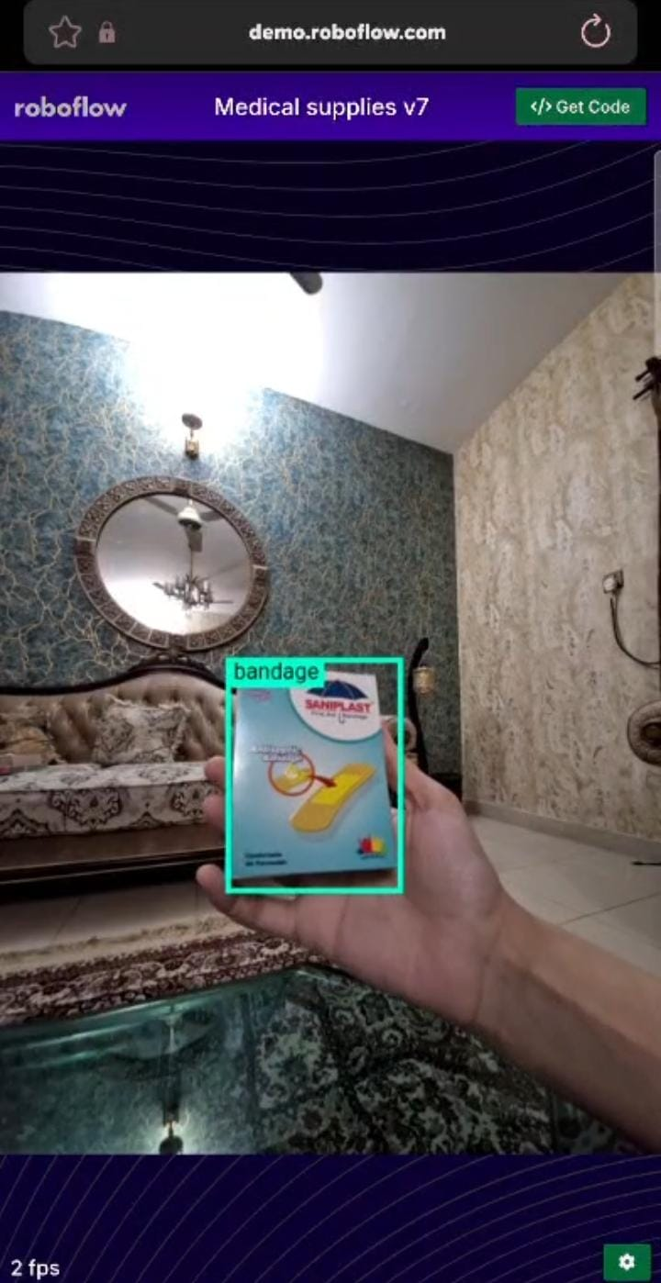
Live Demonstration Results
Real-World Inference
Successful detection in uncontrolled environments (home lighting).
Instant feedback loop (<1 second latency).

Slide 9
Future Scope and Conclusion
Success: Successfully digitized a manual inventory process with 97% accuracy.
Future Upgrade 1: Offline Inference (Edge AI) for use without internet.
Future Upgrade 2: Integration with Hospital SQL databases for automated re-ordering
Impact: A scalable example of Industry 4.0 in Biomedical Engineering.

Slide 10
Thank You

