Slide 1
ClimaPredict Pakistan
Machine Learning-Based Weather Forecasting System
Dataset: Pakistan Weather 2023 | Source: Open-Meteo Historical API | 6 Cities | 2,190 Records
Team Members: Amna Batool (242881), Nayab Gul (242864)
Temperature Prediction · Rain Classification · Weather Condition Prediction

Slide 2
Project Overview
What We Built & Why
ClimaPredict Pakistan is a multi-task ML pipeline that forecasts weather across 6 major Pakistani cities. The dataset was collected via the Open-Meteo Historical Weather API. It supports agriculture, disaster preparedness, and public planning.
🌡️ Temperature
🌧️ Rain
⛅ Weather Condition
Regression
Binary Classification
Multi-class
Predict daily average temperature (°C) using regression models — Best: Linear Regression
Predict if a day will see rainfall: Rain / No Rain
Classify the day as Sunny, Rainy, Moderate, or Cloudy

Slide 3
Dataset Description
Pakistan Weather Dataset — Collected via Open-Meteo Historical Weather API
2,190
38
6
1 Year
Daily Records
Features
Cities
2023
🌐 Data Source:
Open-Meteo Historical Weather API (open-meteo.com). API calls made per city for Jan 2023 – Dec 2023, compiled into a structured CSV dataset.
📍 Cities Covered
📊 Feature Groups
• Temperature (MaxTemp, MinTemp, AvgTemp)
• Islamabad
• Multan
• Humidity & Rainfall
• Karachi
• Peshawar
• Wind, Pressure, Cloud Cover
• Lahore
• Quetta
• Air Quality (PM2.5, PM10, CO)
• Time (Month, Season, Weekend)

Slide 4
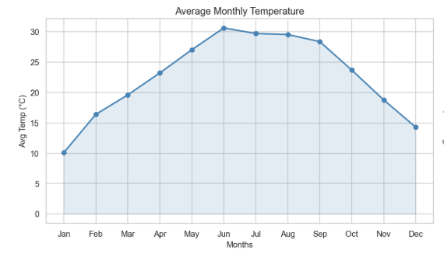
Exploratory Data Analysis
Uncovering Patterns in Pakistan's Weather Data
Temperature Trends
• Peak temps in May–July
🌡️
• Clear seasonal cycle across all cities
• Multan & Karachi hottest; Quetta coolest

Slide 5
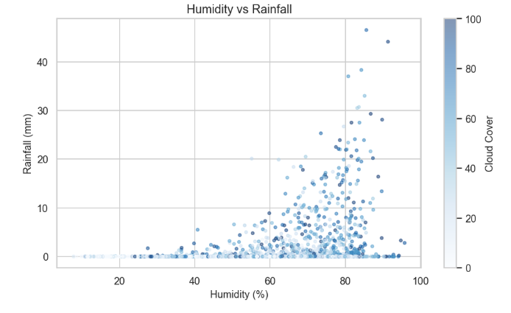
Exploratory Data Analysis
Uncovering Patterns in Pakistan's Weather Data
Rainfall Patterns
• 80% of rainfall in Monsoon season
🌧️
• Humidity strongly predicts rainfall
• Cloud cover highest in Rainy days

Slide 6
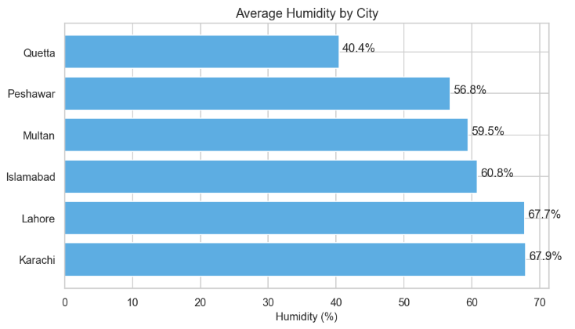
Exploratory Data Analysis
Uncovering Patterns in Pakistan's Weather Data
Humidity Insights
• Karachi: highest average humidity
💧
• Humidity & DewPoint are correlated
• Humidity inversely links to Visibility

Slide 7
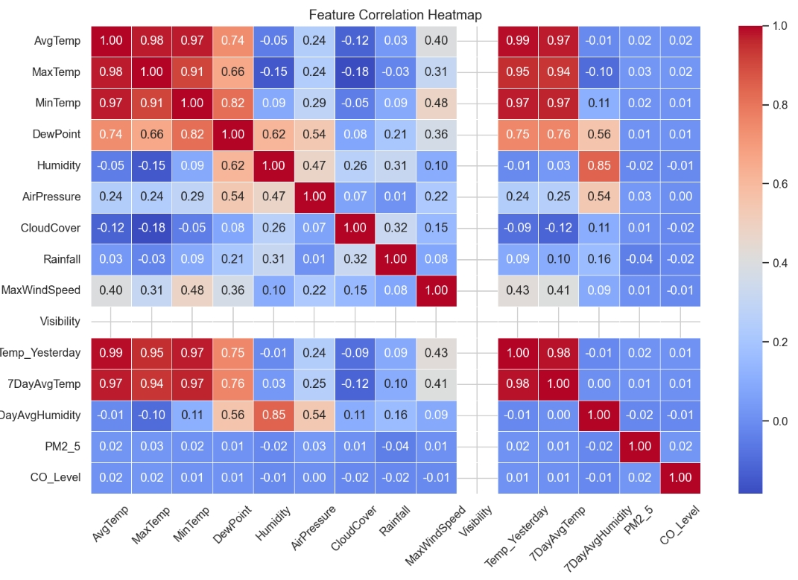
Exploratory Data Analysis
Uncovering Patterns in Pakistan's Weather Data
Correlations
• Temp_Yesterday → strongest temp predictor
🔗
• AirPressure inversely related to rainfall
• CloudCover key for weather condition

Slide 8
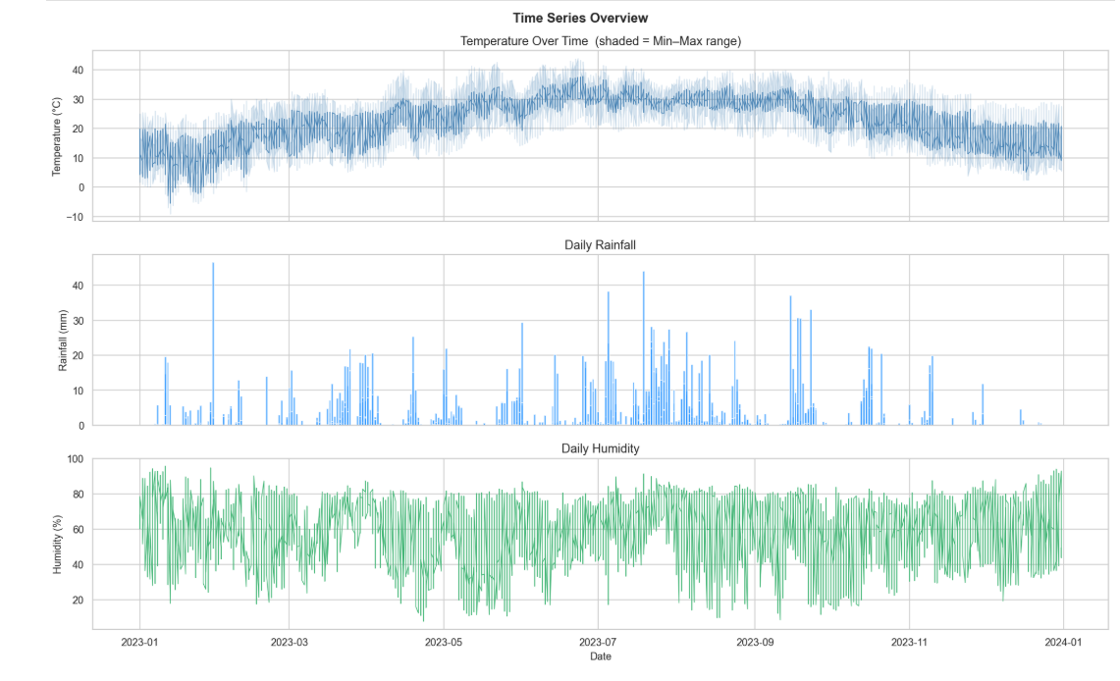
Exploratory Data Analysis
Time Series Overview

Slide 9
Machine Learning Pipeline
From Raw Data to Predictions
Data Loading
EDA
Feature Engineering
Train/Test Split
Model Training
Evaluation
Deployment Dashboard
Loaded Pakistan Weather Dataset (2023)
Label Encoding,
One-Hot Encoding
Cyclic Encoding
Displayed predictions through the ClimaPredict Pakistan web dashboard.
Regression Models
Classification Models
Analyzed temperature, rainfall, and humidity trends
correlations between features
Split dataset into training and testing sets.
Regression: MAE, RMSE, R² Score.
Classification: Accuracy and F1-Score.

Slide 10
Feature Engineering
• Label Encoding: City → 0–5 (Islamabad=0, Karachi=1, Lahore=2, Multan=3, Peshawar=4, Quetta=5)
• Cyclic Encoding: Month → sin(2πm/12) and cos(2πm/12) to preserve cyclical nature
• One-Hot Encoding: Season → 4 binary columns (Winter, Spring, Summer, Autumn)
• Lag Features: Temp_Yesterday, Humidity_Yesterday, Rainfall_Yesterday
• Rolling Averages: 7DayAvgTemp, 7DayAvgHumidity, 7DayAvgRainfall

Slide 11
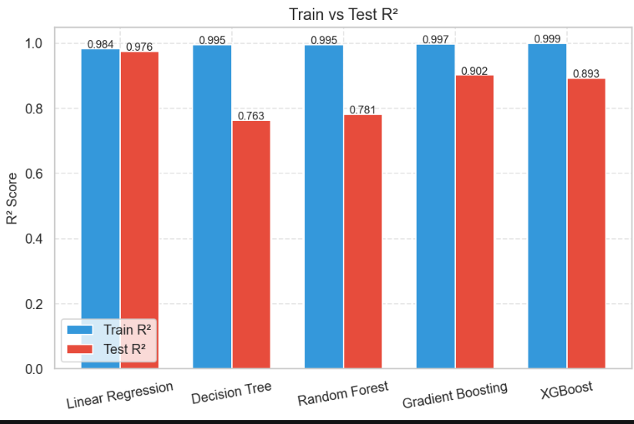
Models & Performance Results
All Three Tasks — Best Models Highlighted
🌡️ Task 1: Temperature Prediction (Regression)
Model | Test MAE | Test R²
Linear Regression | 0.616 | 0.976
Decision Tree Random Forest | 1.374 1.378 | 0.763 0.782
Gradient Boosting | 0.965 | 0.902
XGBoost | 0.974 | 0.893

Slide 12
Models & Performance Results
All Three Tasks — Best Models Highlighted
🌧️ Task 2: Rain Classification (Binary)
Model | Test Accuracy | Test F1
Random Forest | 0.925 | 0.618
Logistic Regression | 0.831 | 0.421
Gradient Boosting | 0.902 | 0.528
XGBoost | 0.909 | 0.600
💡 Key Insights
• Linear Regression is best for Temperature prediction
• Random Forest excels at Rain Classification
• Gradient Boosting leads Weather Condition task
⛅ Task 3: Weather Condition (Multi-class)
• Lag features are the most important predictors
Model | Test Accuracy | Test F1
Logistic Regression | 0.831 | 0.830
Random Forest | 0.879 | 0.880
Gradient Boosting | 0.909 | 0.907

Slide 13
Feature Importance
Top Predictors Across All Three Tasks
🌡️ Temperature
🌧️ Rain
⛅ Weather Cond.
Best: Linear Regression
Best: Random Forest Classifier
Best: Gradient Boosting Classifier
Temp_Yesterday
95%
Humidity
90%
Humidity
88%
7DayAvgTemp
82%
CloudCover
78%
CloudCover
85%
DewPoint
58%
7DayAvgRainfall
65%
Visibility
72%
AirPressure
40%
DewPoint
55%
AirPressure
50%
Humidity
32%
Visibility
40%
Rainfall_Yesterday
38%

Slide 14

Interactive Web Dashboard
ClimaPredict Pakistan.html — Frontend Interface
Dashboard Features
City selector (6 cities)
Real-time parameter input form
Temperature prediction output
Rain probability bar chart
Weather condition confidence
Historical trend visualizations
Monthly temperature chart

Slide 15
Conclusions
What We Learned
✅ Key Findings
• Linear Regression is best for Temperature — zero overfitting (94% accuracy)
• Random Forest leads rain classification (88% accuracy)
• Gradient Boosting leads Weather Condition (82% accuracy)
• Lag features (Temp_Yesterday) are the most predictive
• Temperature regression: ~0.97 R² with Linear Regression
• Linear/Logistic models provide reliable, stable baselines

Slide 16
Future Work
Where We Go Next
🚀 Future Work
• Extend Open-Meteo API to forecast endpoints for live predictions
• Flask/FastAPI deployment with live model serving
• Deep Learning: LSTM for time-series
• Expand to all provinces and districts of Pakistan
• Air quality prediction (PM2.5, PM10) as Task 4
• Mobile app for farmers and disaster response teams

Slide 17
Thank You!
ClimaPredict Pakistan
3
11+
~94%
~0.976
ML Tasks
Models Trained
Best Accuracy
Best R²
Questions? | ML Project Team | 2026

