Slide 1

ME Technologies Website and Admin Panel
Smart Engineering Today. Sustainable Tomorrow.
Name: Amna
Student ID: ET-FSD-AB-07
Advanced module: Module 1, smart quote form
Date: 17 October 2026
Codesaviours E-Training | Internship 2026
Notes:
Hello. My name is Amna and my student ID is ET-FSD-AB-07. This is my project for ME Technologies: a complete website with an admin panel. My advanced module is Module 1, the smart quote form with a solar estimate.

Slide 2


Client and goal
ME Technologies is an engineering consultancy and training company. The website has two business goals.
Win consulting clients
Enroll students
Service pages, the quote form and the contact form turn visitors into leads.
Training pages, batches with seats left and an enroll form.
Six consulting areas
Electrical Engineering
Solar PV
BESS
EV Charging
Architecture and Building Design
Civil and Structural Engineering
Notes:
ME Technologies is an engineering consultancy and training company. The website has two goals: bring in consulting clients, and enroll students in training. Every page I built serves one of these two goals. The company works in six areas, shown at the bottom.

Slide 3




Tech stack
Frontend
Backend
Database
Security
React with Vite
React Router
Tailwind CSS
Node.js and Express
Zod validation
Multer uploads
MongoDB Atlas
Mongoose
8 collections
JWT admin login
bcrypt hashing
Secrets in .env
Reusable components keep pages consistent and fast to build
Simple REST API and one CRUD helper for five resources
Flexible documents suit courses, projects and posts
Admin routes are protected and no secrets reach GitHub
Notes:
For the frontend I used React with Tailwind CSS, so I could reuse components like the lead form. The backend is Node.js with Express and a REST API. Data is stored in MongoDB. Admin login uses JWT and bcrypt, and all secrets stay in the env file, not on GitHub.

Slide 4
Sitemap
Public site (Home)
About
Services
EV Charging
Training
Projects
Blog
Contact
Get a Quote
detail page
detail page
detail page
detail page
Admin panel (/admin)
Dashboard
Leads
Enrollments
Services
Courses
Batches
Projects
Blog posts
Admin login uses a JWT token. Every admin route is protected.
Notes:
This is the sitemap. The top part is the public website: eight pages, and the services, training, projects and blog pages each have a detail page. The bottom part is the admin panel. It needs a login, and from there the admin manages leads, enrollments and all the content.

Slide 5
Database design
users
services
projects
posts
name, email, passwordHash, role
title, slug, icon, shortText, description, order
title, slug, capacity, sector, systemType, city, images
title, slug, category, coverImage, content, publishedAt
courses
batches
enrollments
leads
title, slug, tools, duration, fee, outline, image
course, startDate, mode, totalSeats, seatsTaken
name, phone, email, university, course, batch, status
name, phone, email, city, service, message, source, status
Arrows show references: a batch belongs to a course, and an enrollment points to a course and a batch.
Notes:
The database has eight collections. The main relations are in the bottom row: a batch belongs to a course, and an enrollment points to both a course and a batch. When someone enrolls, the seat count of the batch goes up automatically.

Slide 6
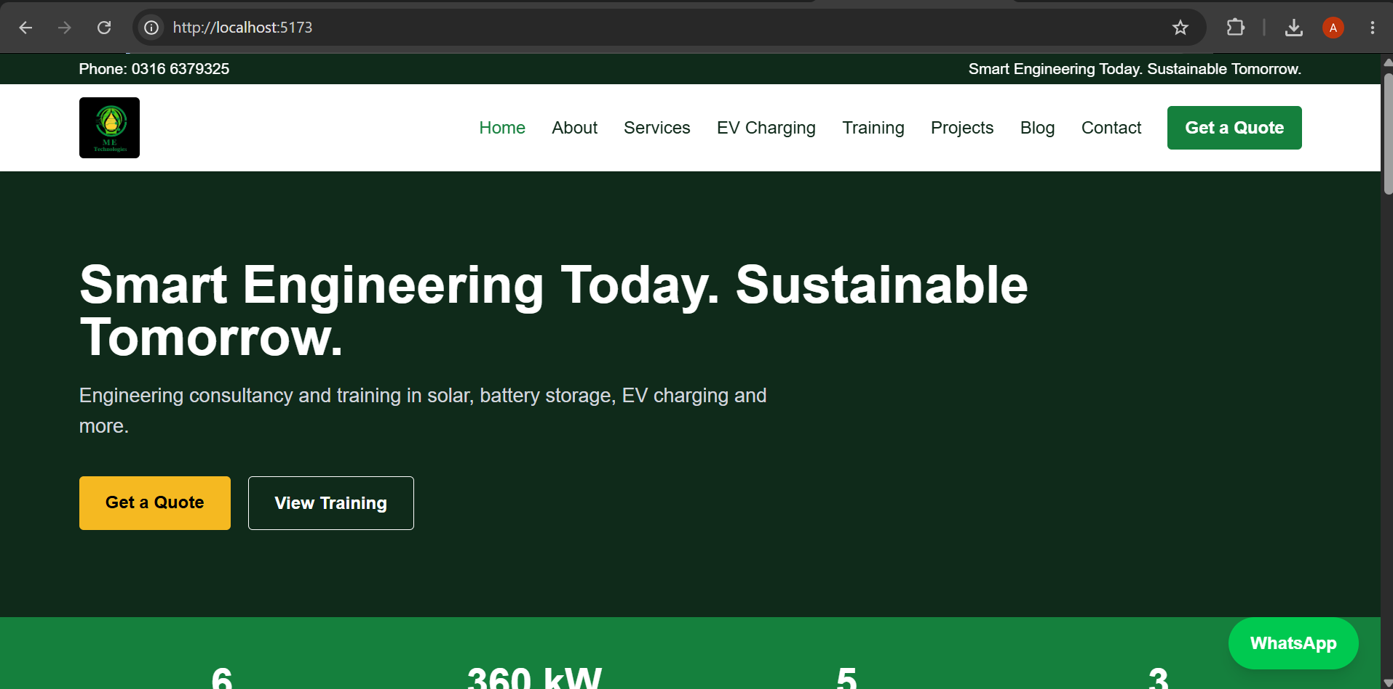
Home page
What it shows
Hero with tagline and two buttons
Animated impact counters
Six service cards from the database
Latest blog posts and a call to action
Notes:
This is the Home page. It has the hero with the company tagline, the animated counters, the six service cards, which come from the database, and the latest blog posts. The green WhatsApp button is on every page.

Slide 7
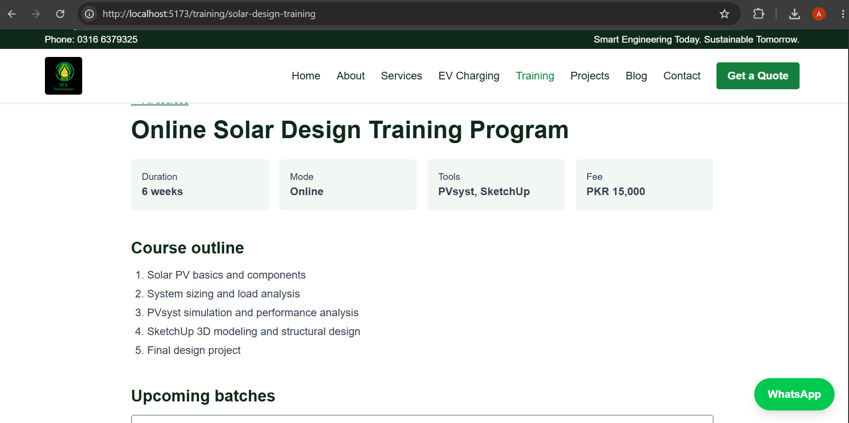
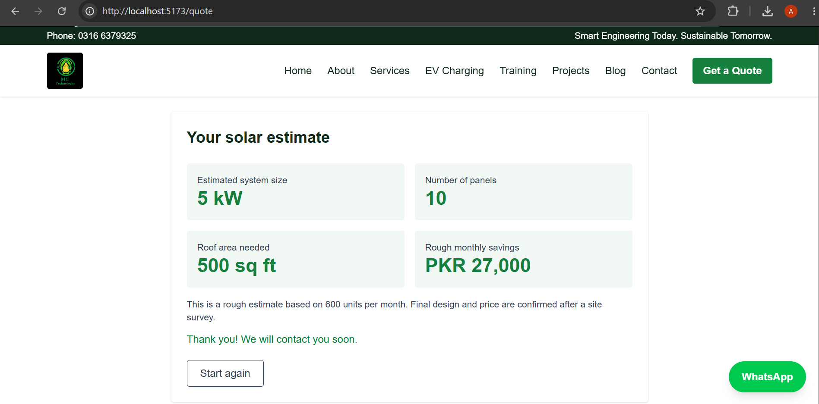
Inner pages
Training course detail
Outline, tools, fee and upcoming batches come from the database.
Smart quote result
System size, panels, roof area and monthly savings (Module 1).
Notes:
Here are two inner pages. On the left is a training course page. It shows the outline, the tools, the fee and the batches. A student can enroll from here. On the right is the result of my smart quote form.

Slide 8
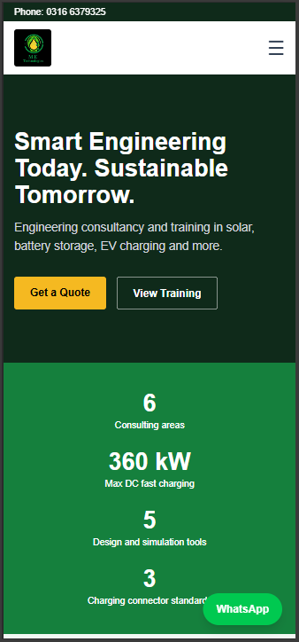
Mobile view
Responsive by design
The menu collapses into a hamburger button on small screens
Cards and sections stack into one column
Buttons stay large enough to tap
The WhatsApp button stays visible on every page
Checked in Chrome DevTools device mode
Notes:
The site is responsive. This screenshot is from the Chrome device mode. On a phone the menu becomes a hamburger button and the sections stack in one column.

Slide 9
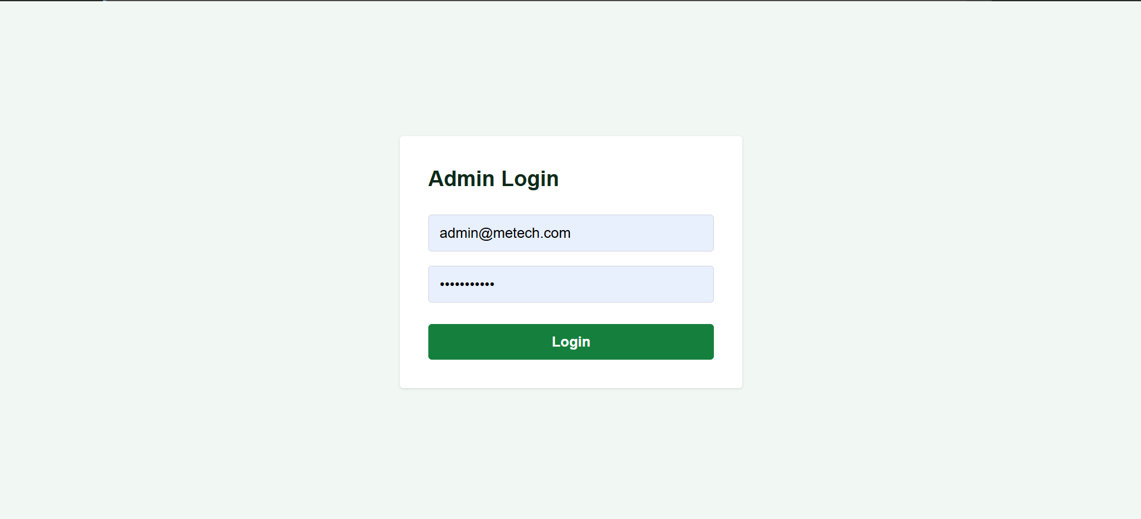
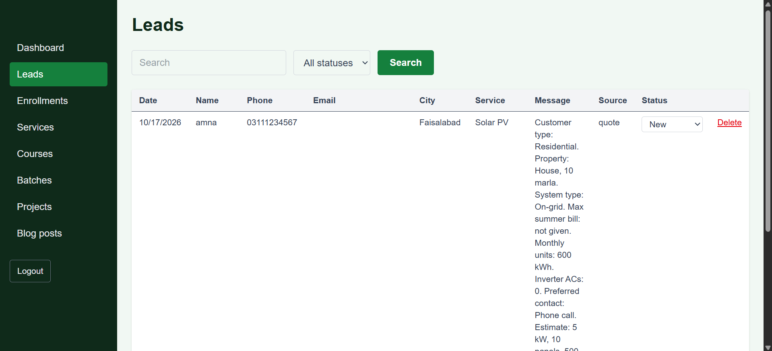
Admin panel
Secure login
JWT token. Every admin route needs it.
Leads management
Search, filter and change status: New, Contacted, Closed.
Also in the admin: dashboard counts, add, edit and delete for services, courses, batches, projects and blog posts, image upload and an enrollments table.
Notes:
This is the admin panel. The admin logs in first. Then the leads table shows every form submission, and the admin can search, filter and change the status. The admin can also add, edit and delete content, and the public website updates straight away.

Slide 10
Module 1: Smart quote form
1
Three-step form
City, property, bill or monthly units, then contact details.
2
One config file
Formula values live in solarConfig.js, so they are easy to adjust.
3
Saved as a lead
600 units per month gives 5 kW
10 panels, 500 sq ft, about PKR 27,000 saved per month
Every submission appears in the admin Leads table.
This is a rough estimate. The tariff value is a placeholder.
Notes:
My advanced module is the smart quote form. The customer answers questions in three steps. The site then shows the system size in kilowatts, the number of panels, the roof area, and rough monthly savings. All the formula values are in one config file, so they are easy to change. Each submission is saved as a lead and appears in the admin panel.

Slide 11



Challenges and learning
Challenges and how I solved them
What I learned
Short timeline
One generic CRUD helper and one admin CrudPage serve five resources.
REST APIs with validation
JWT login and protected routes
MongoDB with Mongoose
React Router and Tailwind
Reusable components
Git setup
The folder was not a repository at first. I ran git init, added the remote and checked .gitignore before pushing.
Keeping secrets safe
The .env file stays local. A .env.example file lists the variables.
Notes:
The project had a short timeline, so I reused code: one CRUD helper on the server and one CrudPage component in the admin. At the start my folder was not a Git repository, so I fixed that and checked that the env file with my database password never went to GitHub. I learned REST APIs, JWT login, MongoDB and React.

Slide 12
Links
GitHub repository
https://github.com/amna-butt-code/codesaviours-ETraining-ET-FSD-AB-07-METechWebsite
Demo video
https://github.com/amna-butt-code/codesaviours-ETraining-ET-FSD-AB-07-METechWebsite/tree/main/demo
Also uploaded to Google Classroom
Thank you
Questions are welcome
Notes:
Here are the links to my GitHub repository and to the demo video. Thank you. I am happy to answer questions.

