Slide 1


Nexmove Physiotherapy Clinic Website
CODESAVIOURS E-TRAINING · FULL STACK INTERNSHIP · TEAM B
A full-stack website with online booking, patient accounts, an admin area and AI-assisted features for a clinic in Faisalabad, Pakistan.
19–31 October 2026
Amna Butt [ET-FSD-AB-07]
Zohaib Khalid [ET-FSD-MZK-08]
Hammad Raza [ET-FSD-HR-06]
Your Next Move Starts Here
Notes:
Welcome everyone. We are Team B from the Codesaviours E-Training full stack internship. Over two weeks we built a website for Nexmove Physiotherapy Clinic in Faisalabad: public information pages, online booking, patient accounts, an admin area and two AI-assisted features. The tagline at the bottom is the clinic’s own.

Slide 2
A new clinic that needs to be found and booked online
THE CLIENT
The client
Today
Our goal
Nexmove Physiotherapy Clinic
Booking by phone or DM
Build trust, explain, book
A rehabilitation and wellness clinic in Faisalabad, treating back and neck pain, joint pain, sciatica and more.
Appointments are arranged through Instagram DM or by calling the clinic.
Build trust, explain services clearly and turn visitors into booked appointments.
Who visits: back, neck, knee and shoulder pain · post-surgery, fracture and stroke recovery · athletes · elderly patients · referring doctors
Published timings: men 9 AM to 1 PM · women and children 1 PM to 10 PM
Nexmove · Team B
02
Notes:
The client is Nexmove Physiotherapy Clinic, a newly opened clinic in Faisalabad with no patients who know it yet. The website has three jobs: build trust, explain the services clearly and turn visitors into booked appointments. Today patients book by Instagram DM or phone. Visitors include people with back, neck, knee or shoulder pain, patients recovering from surgery, fracture or stroke, athletes, elderly patients and referring doctors. The timings are as the clinic published them and still need confirming.

Slide 3
Lead rotation and feature owners
TEAM AND LEADS
Team lead schedule · the lead changes at the end of Day 6 · handover notes in docs/handover/
Days 1–6 · 19–24 Oct · Amna Butt
Days 7–12 · 24–31 Oct · M. Zohaib Khalid
M. Zohaib Khalid
Amna Butt
Hammad Raza
Lead, days 7–12
Lead, days 1–6
Full team member
Public website and styling
Booking page and API integration
Pakistan timezone and slot display
Admin panel and management screens
Team coordination and handover
Integration review and submission
Backend and API integration
Authentication and authorization
Booking engine and validation
Nexmove · Team B
03
Notes:
Team B has four members. Zohaib led days 1 to 6 and Amna led days 7 to 12, with handover notes in docs/handover. Zohaib built the public website and booking interface, Amna the admin area and coordination, Hammad the backend and booking engine. Hadiya: add the feature you own and your student ID before presenting.

Slide 4

How the system fits together
ARCHITECTURE
Browser
Next.js client
Express API
MongoDB
Patients, guests and admins
React 19 · Tailwind CSS v4
Node.js · Express 5
Mongoose models
JWT and bcryptjs
Zod
Nodemailer
Gemini API
Login tokens and hashed passwords
Validates booking and form data
Sends booking confirmation emails
Powers the clinic assistant
Admin requests go through Next.js server routes, which attach the login token from a cookie before calling the Express API.
Nexmove · Team B
04
Notes:
The browser talks to a Next.js client, which talks to an Express API, which stores data in MongoDB through Mongoose. Around that core: JWT and bcrypt for login, Zod for validating requests, Nodemailer for booking emails and the Gemini API for the assistant. Admin calls never go straight from the browser to the API; Next.js server routes add the login token from a cookie first.

Slide 5
Main collections and how they relate
DATABASE DESIGN
People and access
Clinic content
Booking
Feedback
users: patient, therapist and admin roles
therapists: profiles and schedules
services: duration and optional fee
conditions and packages
blog posts and FAQs
appointments: slot, status, patient or guest details
holidays: clinic and therapist closures
reviews: approved before they appear
messages: contact form inbox
How they connect
Appointment links three things
Schedules decide free slots
One rule at the database
A service, a therapist and a patient, who can be a signed-in account or a guest.
Therapist working hours, breaks, holidays and leave are checked before a slot is offered.
A unique index blocks two active appointments for the same therapist and time.
Nexmove · Team B
05
Notes:
The main collections are users, therapists, services, conditions, packages, posts, FAQs, appointments, holidays, reviews and messages. An appointment links a service, a therapist and a patient who is either an account or a guest. Therapist schedules and holidays decide which slots are free, and a unique index at the database level blocks double booking. Check the names against server/models before presenting.

Slide 6
Slot generation and double-booking protection
BOOKING
The patient’s steps
1 · Short lock
Choose a service
Choose a therapist or any available
Choose a date
Server builds the free slots
Enter details and give consent
Server re-checks the slot and books it
Confirmation email, status Pending
Each therapist and day is locked for up to 5 minutes while a booking is processed.
2 · Second check
Free slots come from hours, breaks, holidays and leave; the server re-checks the slot before saving.
3 · Database rule
A unique database index blocks two active appointments at the same therapist and time.
Nexmove · Team B
06
Notes:
This is the journey a patient follows, as a guest or with an account. The important part is on the right: three layers stop two people booking the same slot. A short lock per therapist and day, a second validation of the slot on the server before saving, and a unique database index as the final safety net. New appointments start as Pending and a confirmation email is sent where email is configured.

Slide 7
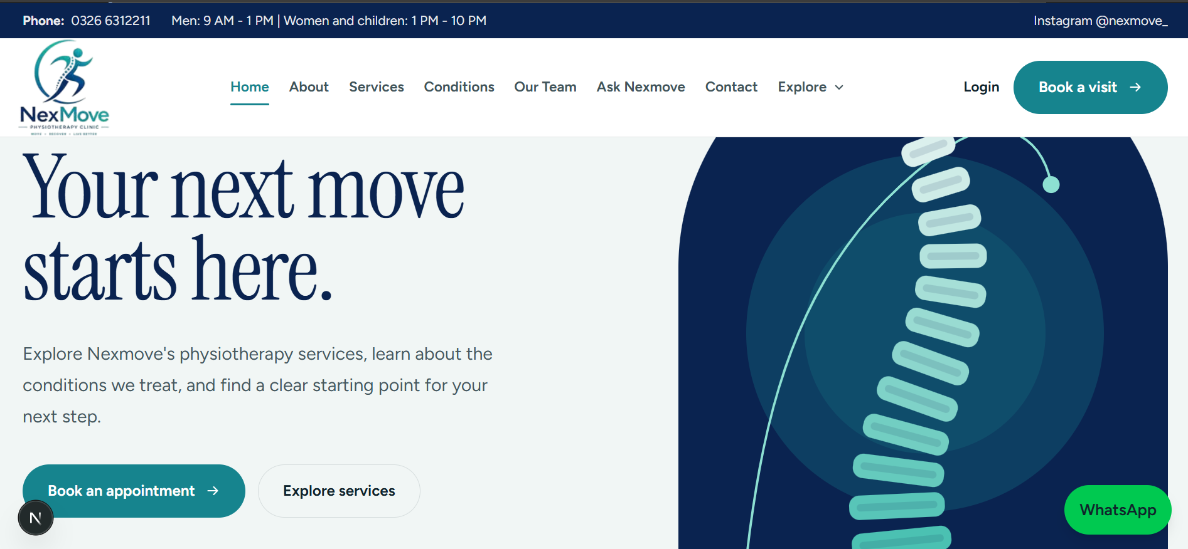
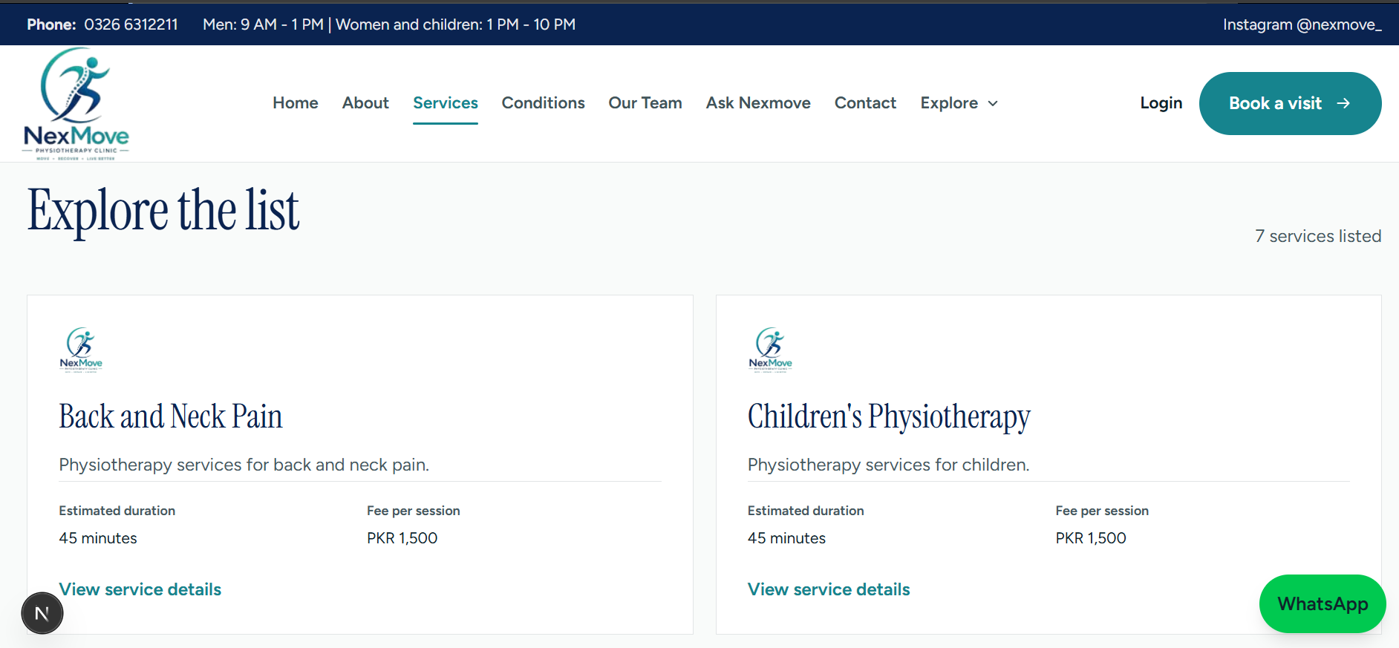
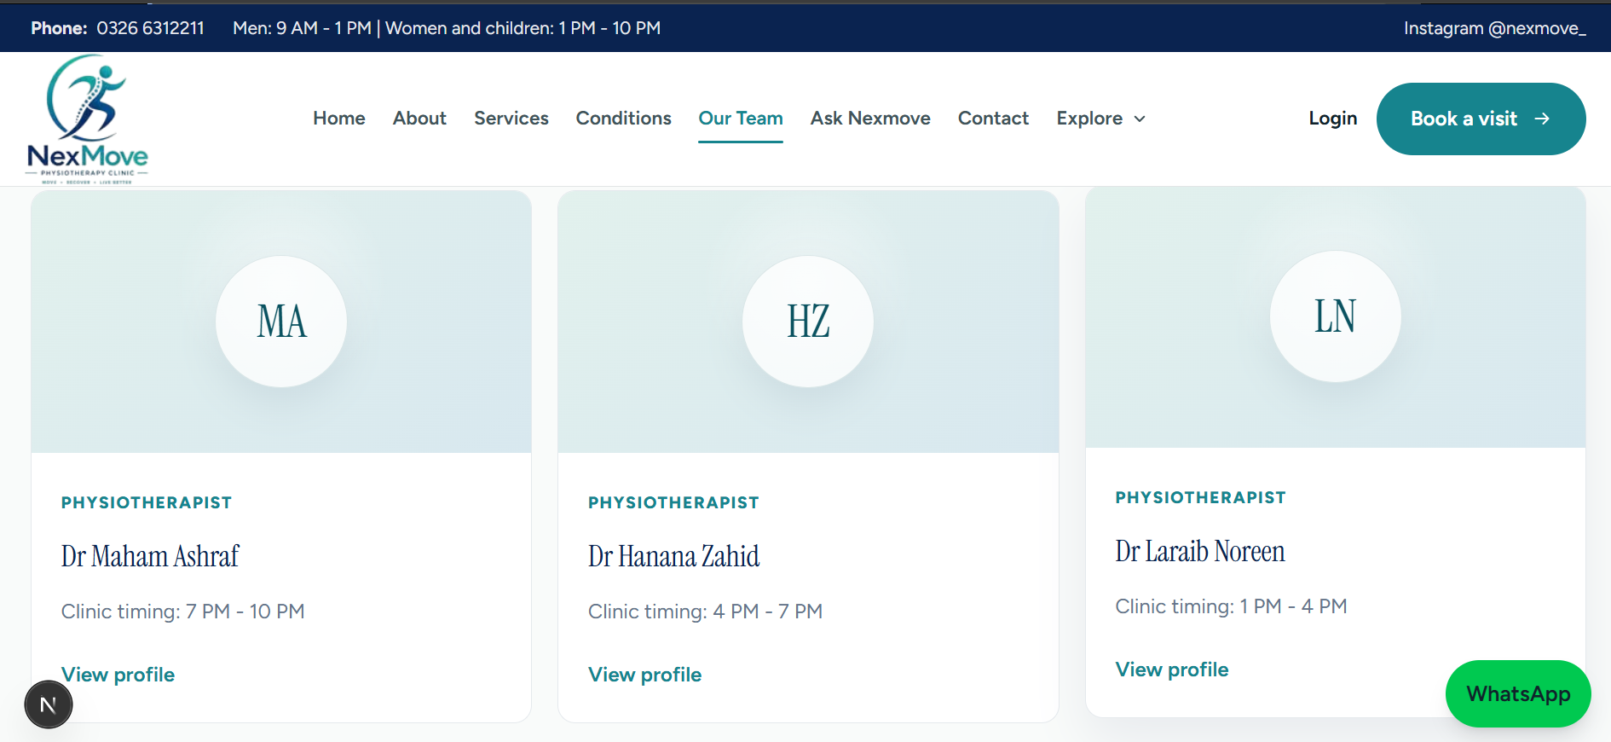
Public website
SCREENSHOTS
Services list
Home page (desktop)
Our team
Nexmove · Team B
07
Notes:
Screenshots of the public website: the home page, the services list and the team page.

Slide 8
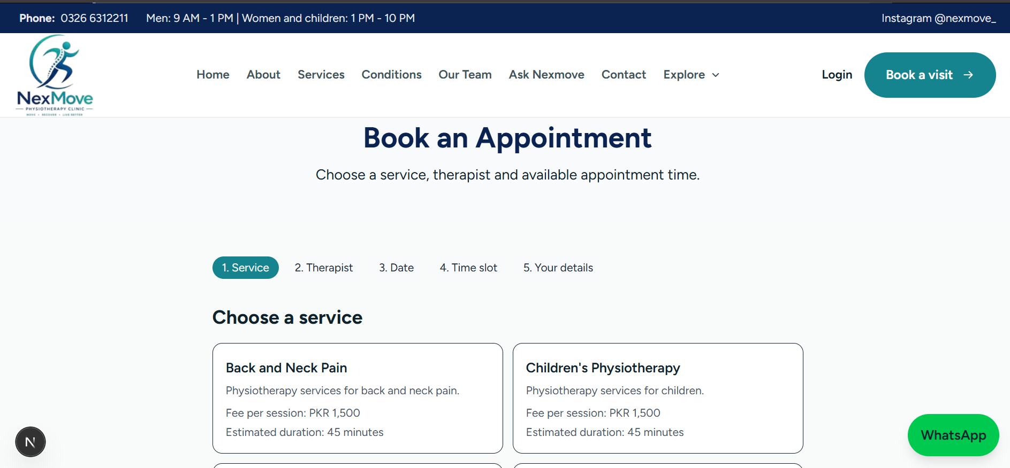
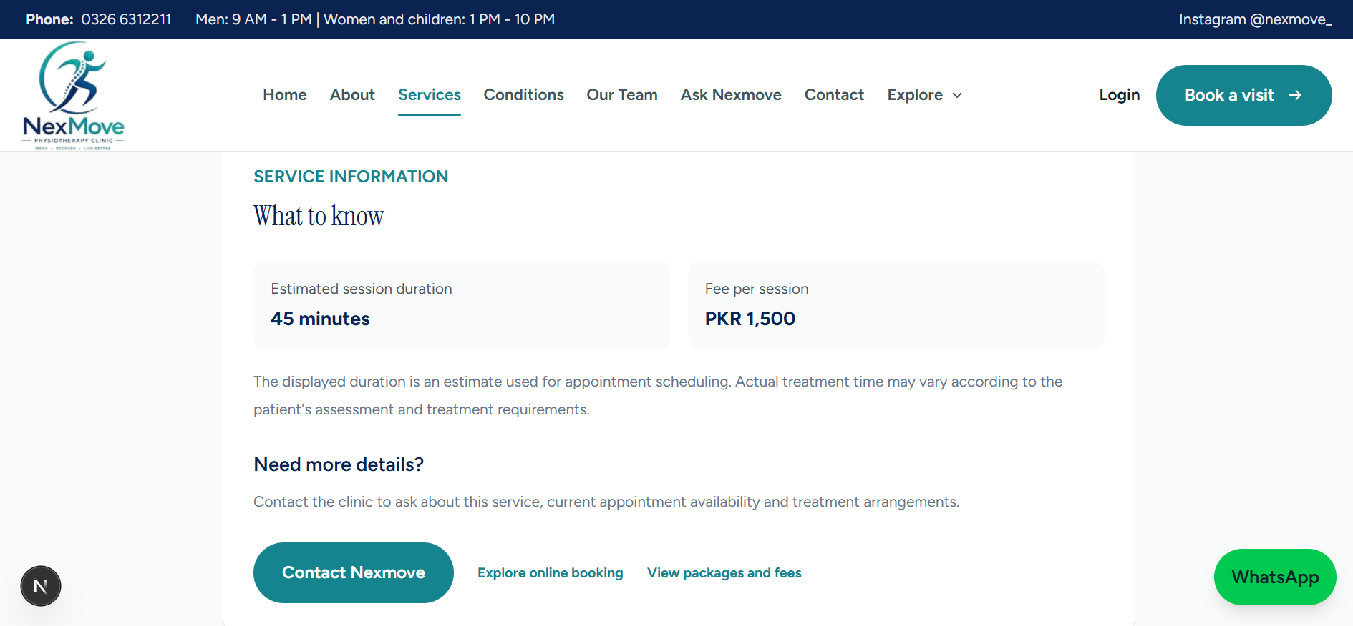
Booking flow and service details
SCREENSHOTS
Booking step 1: choose a service
Service details: duration and fee
Nexmove · Team B
08
Notes:
Screenshots of the booking page and a service detail page with duration and fee. Still to add: slot selection, confirmation and the patient portal.

Slide 9
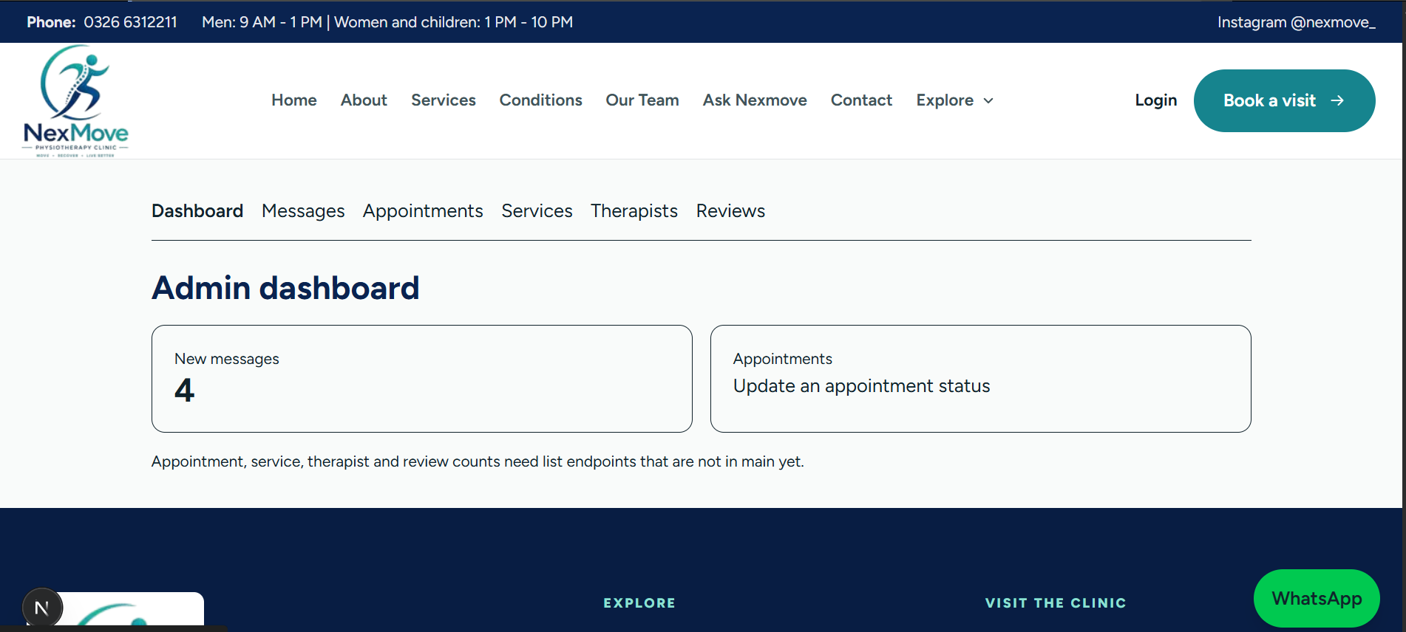
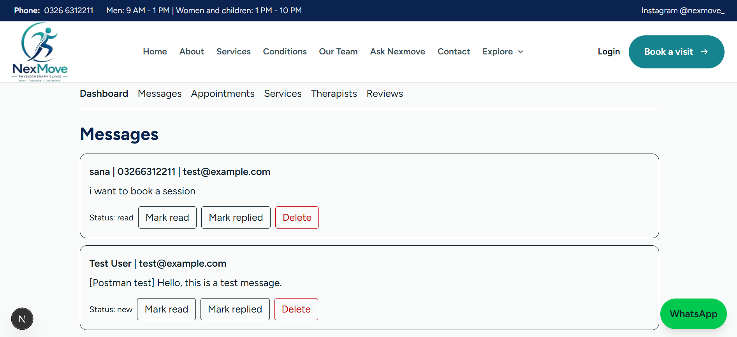
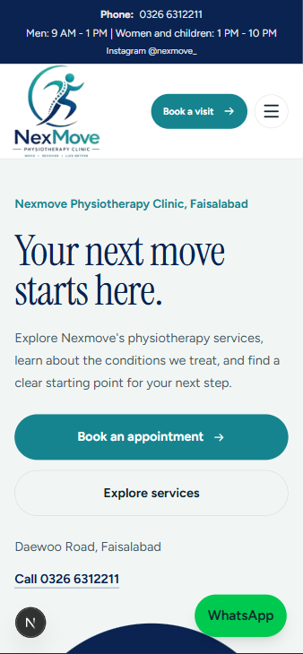
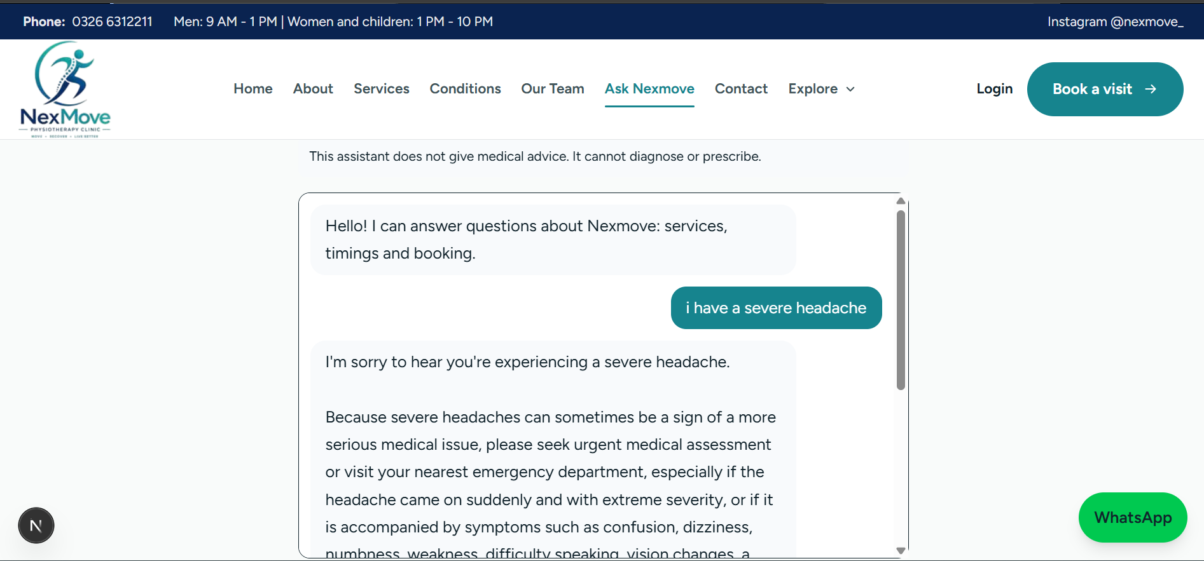
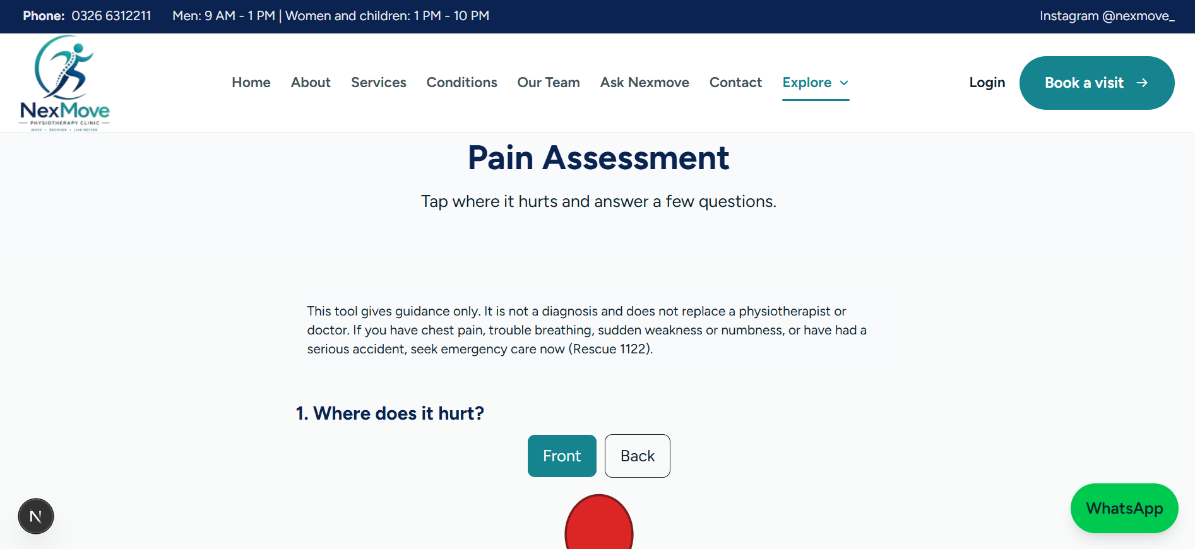
Admin area, AI features and mobile
SCREENSHOTS
Admin dashboard
Admin messages inbox
Clinic assistant (urgent-symptom reply)
Pain assessment with body map
Mobile view (375 px)
Nexmove · Team B
09
Notes:
Screenshots of the admin dashboard and messages inbox, the clinic assistant answering an urgent-symptom message, the pain assessment body map and the site at phone width.

Slide 10


AI features built around patient safety
AI FEATURES
Clinic assistant
Pain assessment
Answers only from verified clinic facts
Never diagnoses, prescribes or gives medical advice
Urgent words such as chest pain trigger emergency advice (Rescue 1122) instead of an AI answer
Limited to 20 messages per hour per visitor
Body map to pick the painful areas
Pain level 0 to 10, duration and what makes it worse
Recent injury, surgery and red-flag questions
Shows an urgent warning and related topics. It is guidance, not a diagnosis
Nexmove · Team B
10
Notes:
Two AI-assisted features. The assistant uses the Gemini API but is tightly limited: it only answers from verified clinic facts, never gives medical advice, and urgent phrases such as chest pain skip the AI entirely and show emergency guidance. The pain assessment collects the painful areas, pain level, duration and red flags, then shows an urgent warning where needed and related topics. Both clearly say they are not a diagnosis.

Slide 11
Security, privacy and quality
SECURITY AND QUALITY
Role-based access
Validated input
Rate limiting
Patient, therapist and admin roles protect every private route.
Zod schemas and server-side checks reject bad requests before they reach the database.
The contact form, chat, booking and password reset all have request limits.
Private data
Honest content
Safety first
Secrets stay in server/.env and are never committed. Messages are visible to admins only.
Only clinic-verified details are shown. Unknown items stay as clear placeholders.
The assistant gives emergency advice for urgent symptoms and never diagnoses.
Nexmove · Team B
11
Notes:
A healthcare site handles personal data, so we treated security as part of the design. Roles protect private routes, input is validated, and rate limits protect the public forms and the booking and password-reset endpoints. Secrets are kept in a local environment file and never committed. We also kept the content honest: anything the clinic has not confirmed, such as fees or an email address, stays as a clear placeholder.

Slide 12
How we worked and what we would improve
TEAMWORK
Coordination
Git workflow
Next time
Lead rotation with handover notes in docs/handover/
Discussion, meeting links and daily activity reports in the team WhatsApp group
Each member owns a feature from backend to frontend
Individual feature branches
Meaningful commit messages such as feat: and fix:
Pull requests into main, and nobody merges their own
No .env, node_modules or real patient data in the repository
Restore and verify the cancel, reschedule and status handlers before integrating
Re-test the full booking journey after every backend change
Get verified clinic schedules and fees earlier
Nexmove · Team B
12
Notes:
Coordination was through the lead rotation with written handover notes, and the team WhatsApp group for discussion, meeting links and daily reports. Work went through feature branches and pull requests, and nobody merged their own. Looking back, we would restore and verify the appointment handlers earlier, re-test booking after every backend change and collect verified clinic data sooner.

Slide 13


Where the project stands
STATUS
Built
Needs the client
Public website pages
Booking with live slots and double-booking protection
Accounts and the patient portal
Contact messages and the admin inbox
The AI assistant
Fees and package prices
Session lengths and weekly schedules
Official email address and days open
Approved photos and credentials
Nexmove · Team B
13
Notes:
An honest status. The core is built: public pages, booking with live slots, accounts, the patient portal, the messages inbox and the assistant. In progress are the remaining admin screens, saving pain assessments to the database, the therapist portal and rescheduling. Some content can only come from the clinic: fees, session lengths, schedules, an official email and approved photos. Until then the site shows clear placeholders instead of invented details.

Slide 14
What makes Team B’s version best for Nexmove
WHY OUR SITE SHOULD WIN
1
Trusted booking
2
AI that stays safe
3
Honest content
Three layers stop double booking: a short lock, a server re-check and a unique database index.
It answers only from verified clinic facts; urgent symptoms get emergency advice.
No invented fees, reviews or credentials. Every gap is a clear placeholder on a list for the client.
4
Secure by design
5
Pakistan time
6
Ready to hand over
Role checks on the server, Zod validation, rate limits, and secrets kept out of Git.
Slots are generated in local time and past or unavailable periods are never offered.
README, environment template, Postman collection, plan and wireframes are in the repository.
Nexmove · Team B
14
Notes:
Why Team B's version should win: booking you can trust, safe AI, honest content, security by design, correct Pakistan time handling and a repository that is ready to hand over to the clinic.

Slide 15
Links and questions
NEXMOVE PHYSIOTHERAPY CLINIC · TEAM B
GitHub: github.com/amna-butt-code/codesaviours-ETraining-TeamB-Nexmove
Docs: README, docs/plan.md and the Postman collection in docs/postman/
Your Next Move Starts Here
Notes:
Thank you. The repository has the source code, README, plan and Postman collection. Add the demo video link before presenting. We are happy to take questions or show any part of the site live.

