Slide 1
Facial Filter Impact
600
on Face Recognition
evaluation pairs
End-to-end computer vision system
6
Dataset → filters → embeddings → evaluation → demo
filter types
Ready
live Gradio demo
Computer Vision | Spring 2026
Facial Filter Impact on Face Recognition
01

Slide 2
Problem Overview
Face filters can change what the model sees
Filters change color, skin texture, eyes, and face shape
Main Question
Humans still recognize the person
How much do filters hurt face verification?
Face models may shift the embedding
This can increase false non-matches
Facial Filter Impact on Face Recognition
02

Slide 3
Research Basis
We reimplemented the paper's evaluation idea
Paper
Our System
Added Work
Filter impact study
LFW dataset
Improved model path
FNMR / FMR metrics
6 simulated filters
Linear corrector
DET curves
Live app demo
Dashboard results
Facial Filter Impact on Face Recognition
03

Slide 4
Methodology and Architecture
One full pipeline from data to demo
LFW data
Filters
Embeddings
Evaluate
Mitigate
Demo
pairs
6 types
512-D
FNMR / DET
correction
Gradio
Scripts: 01 setup → 02 filters → 04 embeddings → 05 evaluation → 06 mitigation → app
Facial Filter Impact on Face Recognition
04

Slide 5
Dataset and Filters
Public data + generated filter variants
13,233
5,749
4,842
600
original LFW images
identities
filtered images
test pairs
Filter set
blur
brightness
skin_smooth
eye_enlarge
face_slim
color_tone
Facial Filter Impact on Face Recognition
05

Slide 6
Live Demo Plan
What I will show in the app
1
Upload two faces
2
Choose settings
3
Verify identity
same or different person
model, mitigation, filter
similarity + verdict
Demo URL: http://127.0.0.1:7860
Facial Filter Impact on Face Recognition
06

Slide 7
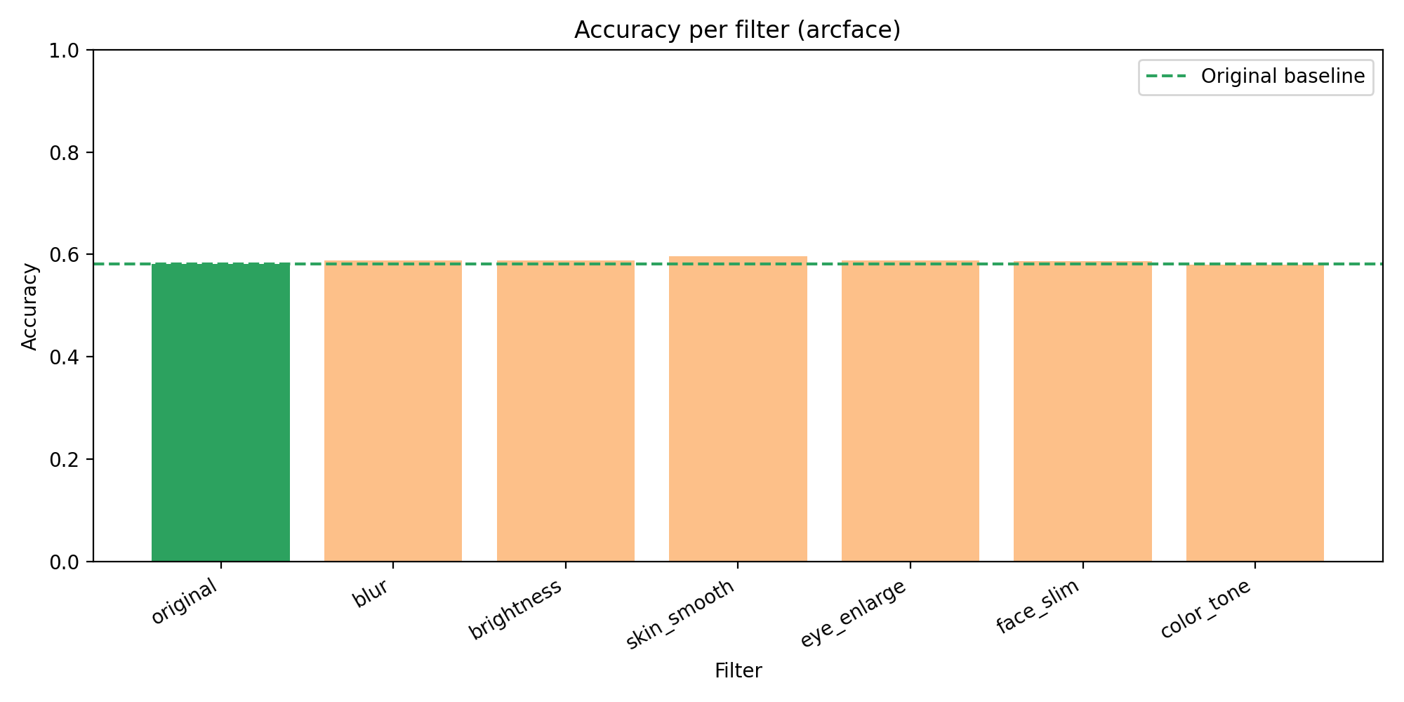
Baseline Results
ArcFace under simulated filters
Key numbers
Average accuracy: 58.81%
Average FNMR@1%: 94.78%
High miss rate
Facial Filter Impact on Face Recognition
07

Slide 8
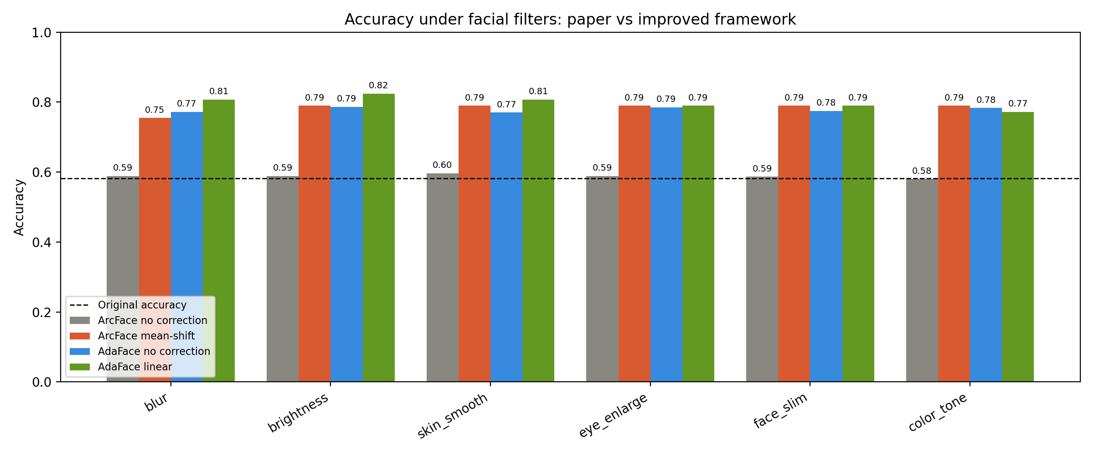
Improved Model Comparison
Better backbone path improves accuracy
Result
58.81% → 77.86%
average filtered accuracy
Facial Filter Impact on Face Recognition
08

Slide 9
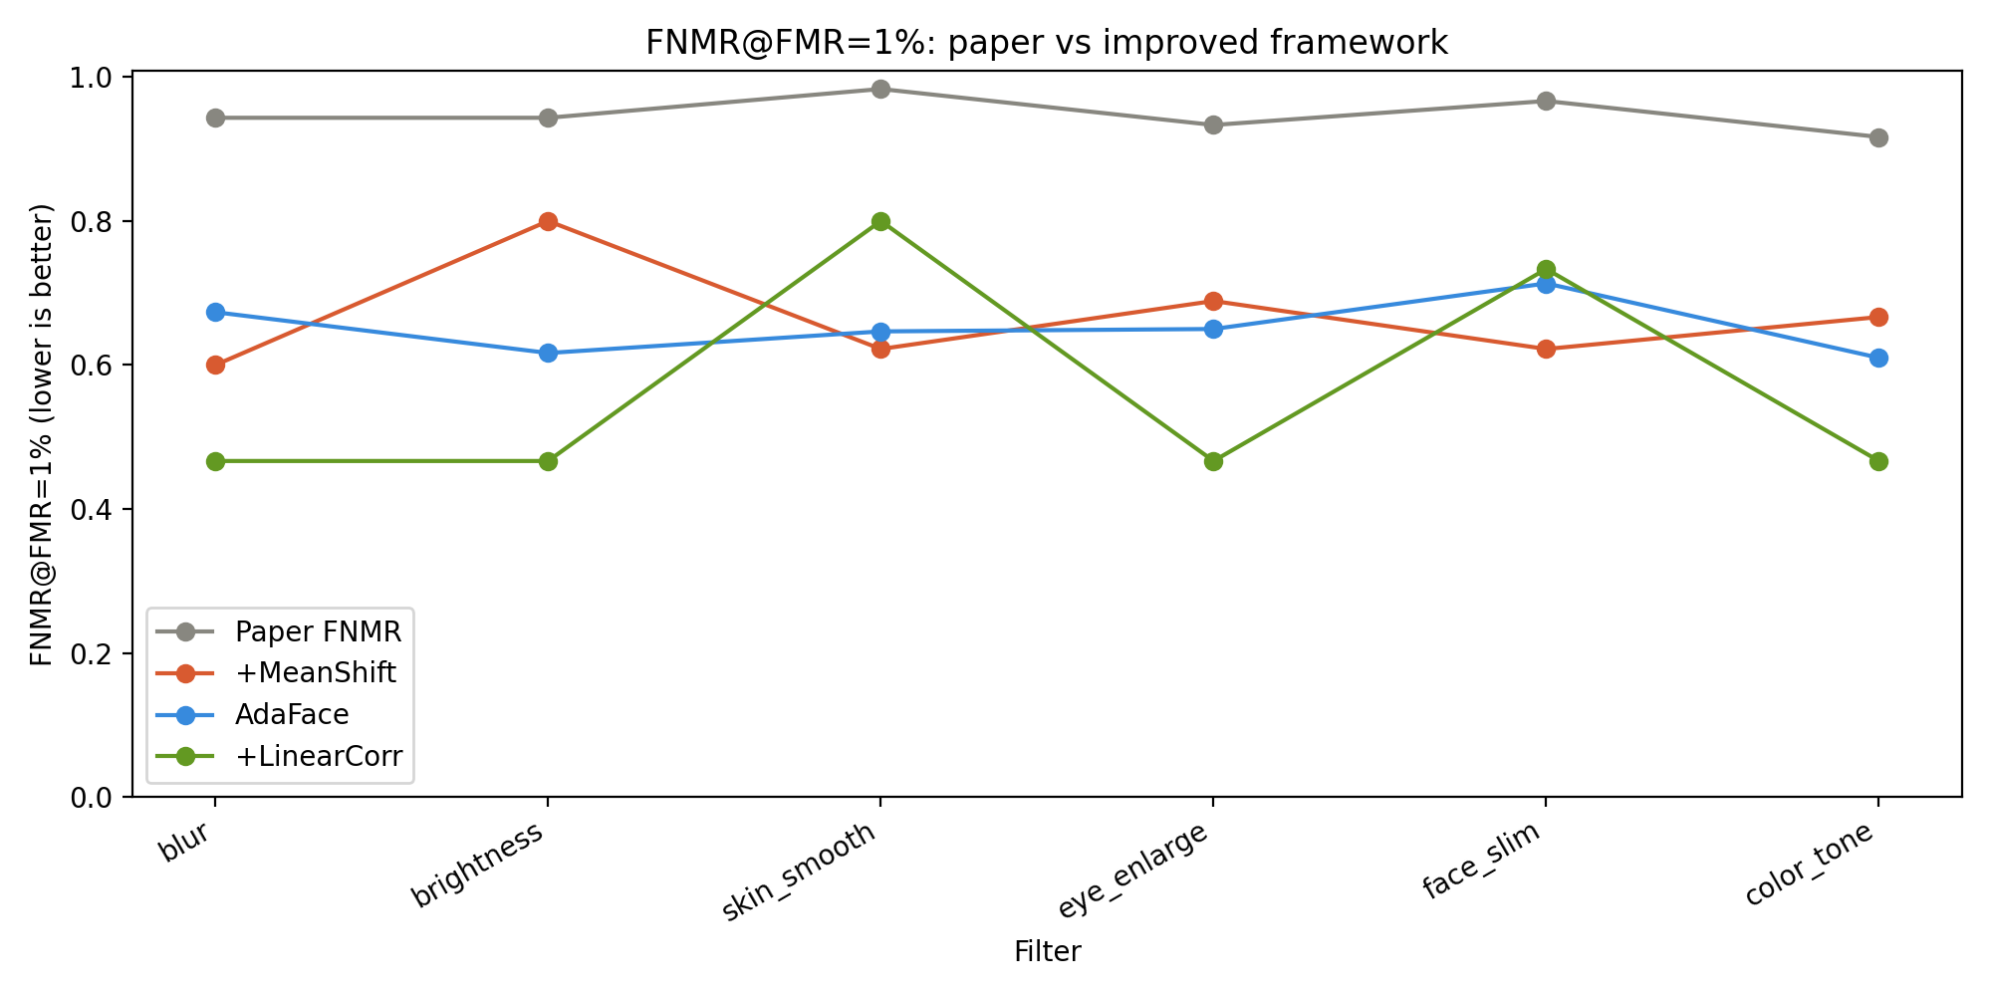
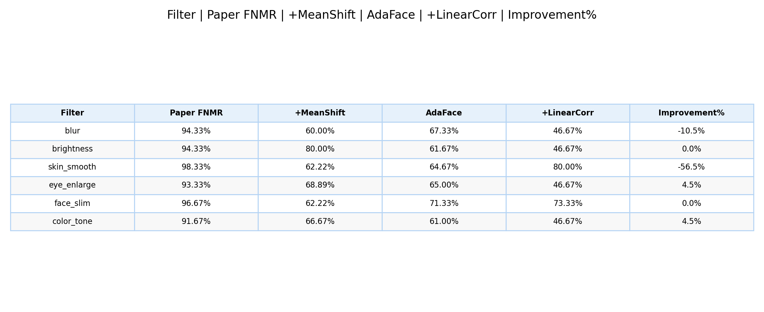
Error Rate and Mitigation
Lower FNMR is better
Average FNMR reduction
40.2% vs ArcFace baseline
Facial Filter Impact on Face Recognition
09

Slide 10
Key Insights
What we learned
1
Filters change embeddings
2
Model choice matters
3
Correction is useful
even when the face still looks clear
the improved path was stronger here
but filter-specific and not perfect
Facial Filter Impact on Face Recognition
10

Slide 11
Limitations and Future Work
Honest scope of this prototype
Limitations
Next Steps
LFW, not FRGC
Use FRGC dataset
Programmatic filters, not real app filters
Apply real AR filters
600 pair subset
Train one filter-agnostic corrector
No fairness testing yet
Study gender and skin tone effects
Facial Filter Impact on Face Recognition
11

Slide 12
Thank You
Ready for demo
Questions?
Upload images
Choose filter
Compare result
http://127.0.0.1:7860
Facial Filter Impact on Face Recognition
12

