Slide 1


Twitter
Sentimental Analysis using Machine Learning

Slide 2
Problem Statement
With the increasing number of social conflicts occurring across the globe, it is becoming ever more crucial to understand the opinions and feelings of the general population around the globe as well. Since the surveying of the whole population would take a lot of resources as well as take a lot of time to complete, it would be better for us to adopt a more modern approach. There is no doubt that the proliferation of social media, especially Micro-Blogs, has expanded the possibilities of raising awareness about issues. The aim of this research is to find emotion and sentiment from microblogging platform Twitter in the form of emotion and sentiment analysis. Currently having over 284 million active monthly users and having 500 million Tweets being generated each day, Twitter is making a significant impact on a significant portion of the population who aren't afraid to share their opinions. Our goal with this project is to provide a fast, accurate, and reliable way for people to extract sentiments and emotions from the data provided by Twitter.

Slide 3
Problem Definition
Our problem is classification- based. The Classification algorithm is a technique of supervised learning which uses training data to analyze new observations and identify the category on the basis of those observations. Classification is the process of learning to classify new observations from the presented dataset and then categorizing the new observations into a number of classes and groups.
Our hypothesis is that “Given a set of tweets that contain multiple features and a wide range of different opinions, the goal is to extract opinions or expressions that describe a target feature, and categorize the opinions positively, neutral or negatively”.
The novelty of proposed work is that this topic is latest topic and not much work is found in literature, as it is ongoing topic and also our proposed method will achieve better results in terms of accuracy.

Slide 4
Why Twitter?
Humans express themselves through blogs, forums, twitter and facebook. Online communications bring the world closer; communication takes just a click.
In today's short messaging, multiple people can send messages at the lowest price, not just to a single recipient. Many websites offer this service, but Twitter was the pioneer.
Currently, tweets are posted by over 500 million users every day i.e. more than a thousand tweets every second.

Slide 5
A large amount of sentiment data, which can be derived from Twitter tweets, is often available upon analysis of the tweets. The purpose of these data is that they can be used to understand what people think about a wide range of topics.
Consequently, in order to compute customer perception, we need to formulate a Machine Learning Sentiment Analysis Model that can help us automate the process.
50
40
40
30
30

Slide 6
Objective
To determine the algorithms and metrics that can be used to evaluate the performance of Machine Learning Classifiers.
The purpose of this study is to identify which algorithm is most appropriate for the sentiment analysis process.
To determine the sentiments of people towards the conflict of Russian Ukraine war.
To determine the emotions of people towards the conflict of Russian Ukraine war.
The objectives are achieved after experiment is conducted examining the performance metrics for the identified algorithms; this is followed by a comparison between the metrics for different algorithms. From the results obtained, the best fit classification algorithm is identified for the sentiment analysis of Twitter data.

Slide 7

Literature Review
An Analysis of Sentiment is a means to segregate positive, negative or neutral sentiments contained in texts based on the way they are expressed in the text. An analysis of sentiment can also be referred to as polarity or opinion mining. A growing number of people are engaging with social media platforms as a result of the advancement and growth of these platforms. 280-character Twitter-like social networking service where users are able to send their It becomes easy for sentiment analysis to analyse tweets because of the small number of characters that they have. for the sentiment analysis. There are 550 million tweets posted every day on Twitter. There is a fair representation of all age groups of people on Twitter as well as people from all genders. Hence, tweet analysis becomes somewhat representative of society's sentiments due to the sentiment analysis of twitter data.

Slide 8
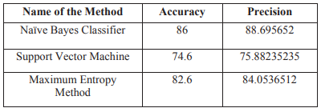
Summary of IEEE paper
This paper [1] aims to provide a comparison between Naive Bayes Classification method, Support Vector Machine Classification method, Maximum Entropy Classification method in order to draw conclusions about the effectiveness of each of these models.
This article discusses the various machine-learning techniques that are used to analyse Twitter data, such as Naive Bayes, SVM, and Maximum Entropy Methods. As part of the twitter analysis, certain aspects are analysed in order to mine sentiments in the text. The goal of this dissertation is to analyse the concept of opinion in relation to Twitter sentiment analysis.
In the study, it was found that the machine learning method, such as Naive Bayes, had the highest level of accuracy and could be considered as an appropriate base learning method. It was found in the study that Maximum Entropy methods can also be very effective in some cases as well. The results are shown:
Comparison of results of machine learning classifiers in paper [1].

Slide 9
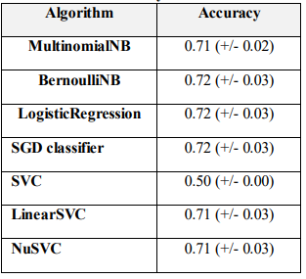
Summary of ACM paper
The focus of this paper [2] is on using machine learning algorithms and Scikit-learn to analyse the sentiment of Twitter data in the sense of sentiment analysis. In order to achieve this, they analysed Twitter datasets which are publicly available via the NLTK Corpora, and take advantage of feature extraction techniques in order to create an efficient feature. They train and test various machine learning classifiers such as Bernoulli NB, SGD classifier, SVM, Multinomial Naïve Bayes, Logistic Regression, LinearSVC and NuSVC. As a result of experiments, it was demonstrated that Logistic Regression, SGD classifiers and BernoulliNB, are capable of achieving classification accuracy of at least 75%. The results are shown below:
Comparison of results of machine learning classifiers in paper [2].

Slide 10
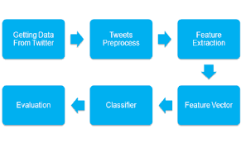
Proposed Methodology
In our work we are using various machine learning algorithms and perform classification.
We have selected a dataset which has more features as compared to above papers. Our twitter dataset is about the tweets regarding conflicts between Russia and Ukraine conflict. We are performing sentimental analysis and also emotion analysis. We will see how people are taking this conflict and what are their emotions by visualizing the results. Our approaches will provide better results and increased accuracy as compared to above papers.
The proposed methodology is shown in next slide:
General steps in twitter sentimental analysis using machine learning.

Slide 11
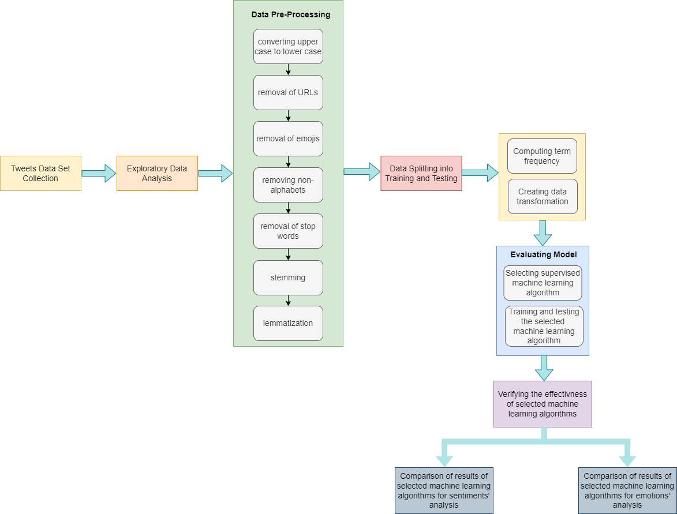
Workflow of proposed methodology.

Slide 12

Dataset Collection
For the proposed project, we have selected dataset on topic of Ukraine-Russia Conflict topic as it is hot topic these days.
“ To analyze the sentiments of people on Ukraine-Russia Conflict”
The dataset is downloaded from Kaggle [3].

Slide 13
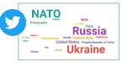
Reason for Choosing Dataset
Ukraine is being supported by many countries by the introduction of economic sanctions against Russia at the moment.
On Twitter there are a lot of tweets related to the conflict between Ukraine and Russia, with people sharing information about what the ground truth is, what their thoughts about it are, as well as who they have decided to support.
So, to find out what the feelings of the people are regarding the Russian crisis and the conflict in Ukraine, we selected this dataset and analyzed the sentiments and emotions on the conflict.

Slide 14
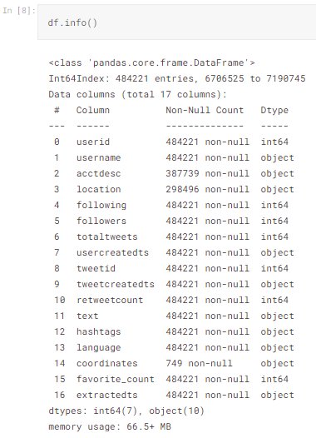
Exploratory Dataset Analysis
There are 20 M tweets in this dataset.
To extract the features required for proposed approach we perform dataset analysis and arrange tweets in following ways:
1. Dataset information
First, we need to see the data in the dataset as follows:
Dataset Information.

Slide 15
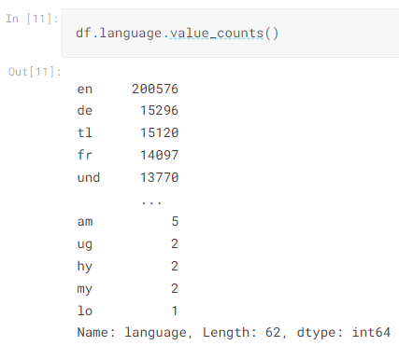
Exploratory Dataset Analysis
2. Arranging tweets according to language
The tweets are then arranged according to language as there are multiple languages in the dataset.
Arrangement of tweets according to language.

Slide 16
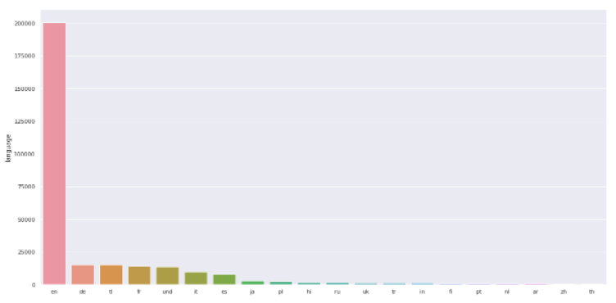
Exploratory Dataset Analysis
3. Plotting the tweets
The tweets are then plotted after arranging.
Plotting of tweets.

Slide 17
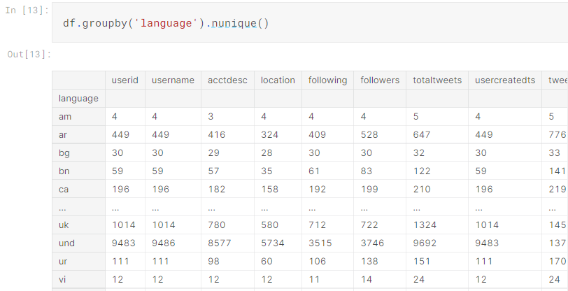
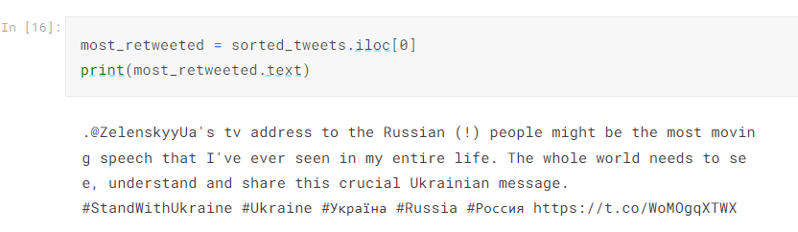
Exploratory Dataset Analysis
4. Language-based unique tweets
5. Most retweeted tweets
Most retweeted tweets in dataset.
Unique tweets based on language.

Slide 18
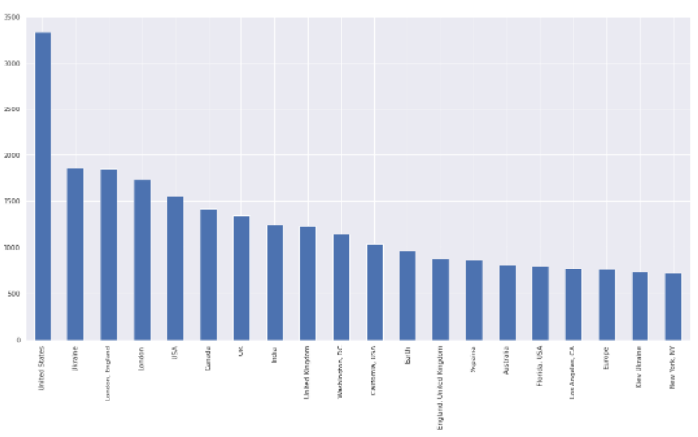
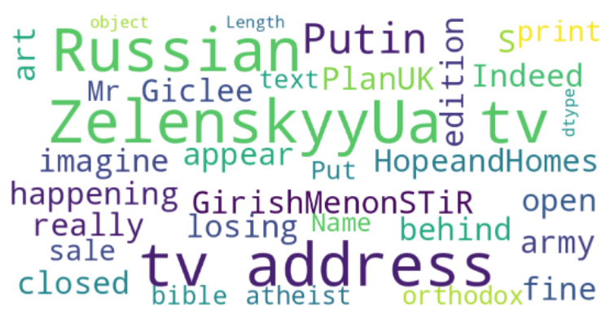
Exploratory Dataset Analysis
6. Word Cloud
The Word Cloud is a type of data visualization that enables, for instance, how to visualize text data, encompassing these very words in a visual representation that indicates their frequency and importance statistically [17].
The word cloud of tweets is shown below:
7. Plotting the tweets according to their location
Word Cloud of tweets.
Plotting of tweets according to location.

Slide 19
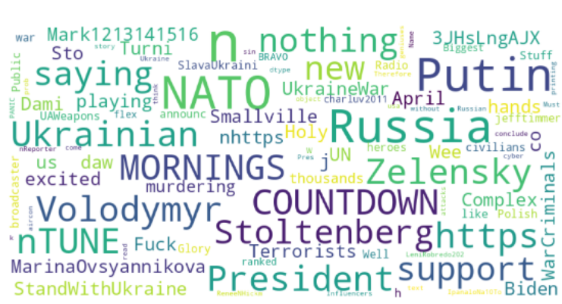
Exploratory Dataset Analysis
8. Word Clouds using based on unique tweets
Word Cloud of unique tweets in dataset.

Slide 20
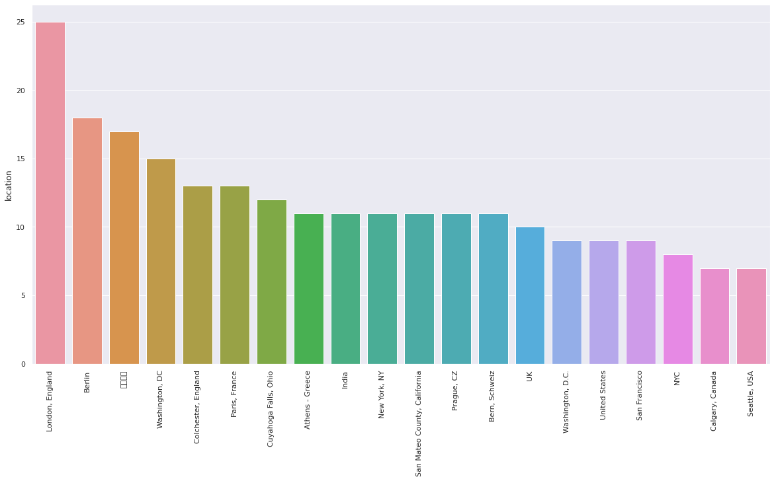
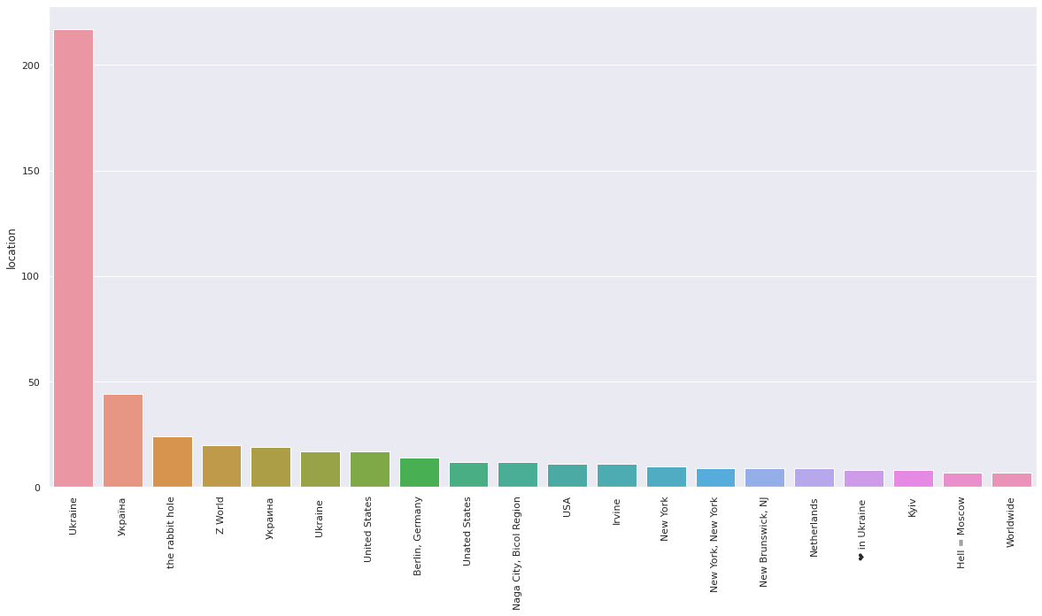
Exploratory Dataset Analysis
9. Bar Plot on User Account Age and classified based on the location of the account
Top 1000 sorted values
Bottom 1000 sorted values

Slide 21
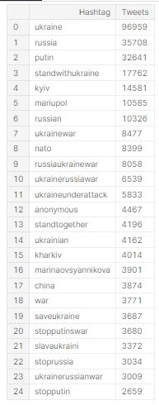
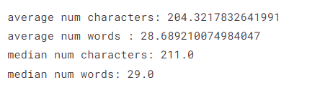
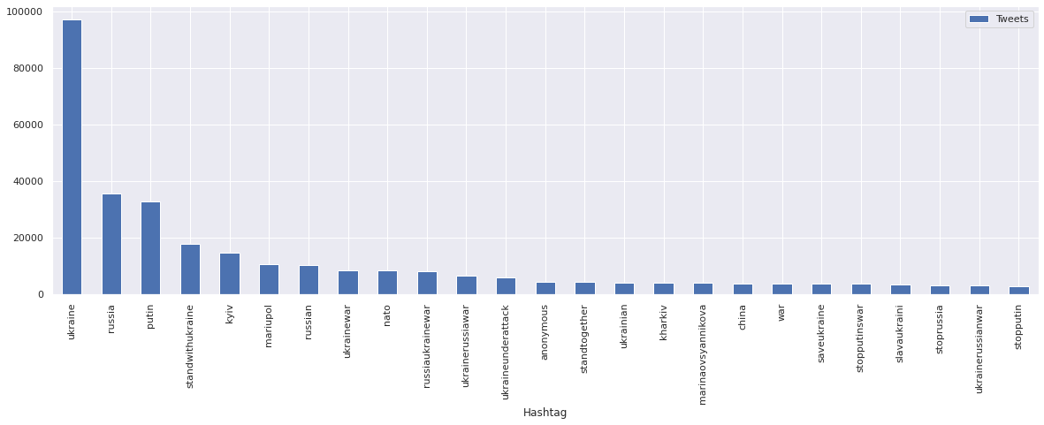
Exploratory Dataset Analysis
10. Hashtag Analysis

Slide 22

Data Pre-Processing
Pre-processing of the text data is an essential step because it prepares the raw text for finding information from it, in other words, it facilitates the extraction of information from the text so that machine learning algorithms can be applied to it. If we skip this first step, then it is more likely that the data you may be working with is noisy and inconsistent.
During this process, the objective is to get rid of noise that doesn’t contribute very much to determining the sentiment of the tweet, including punctuation marks, emojis, special characters, numbers, and terms that don’t carry much weight when considered in context with the tweet itself.

Slide 23
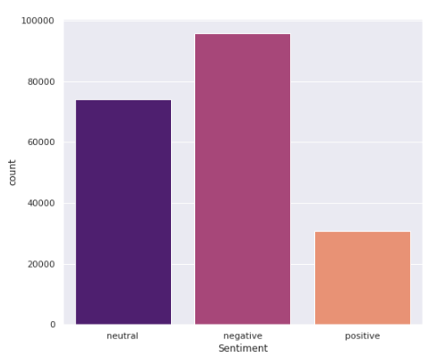
Data Pre-Processing
Before performing data pre-processing, we have added a ‘sentiment’ column in the file. And we have set sentiments for each tweet as ‘positive’, ‘negative’ and ‘neutral’.
Plot for Sentiments
We will first plot for sentiments to get visualization about sentiments’ distribution.
The graph shows that negative sentiments are more in the tweets’ dataset on the selected topic.
Graph showing distribution of sentiments in dataset.

Slide 24
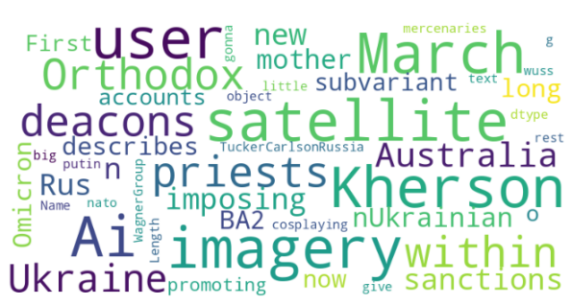
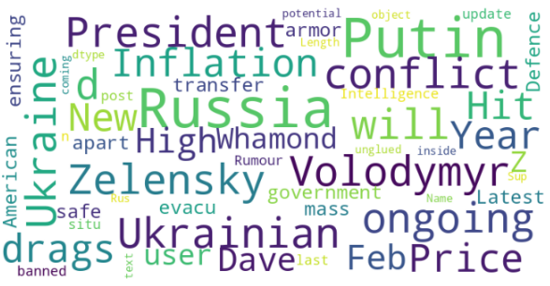
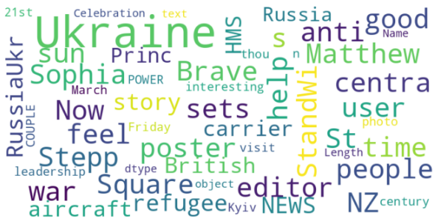
Data Pre-Processing
Word Cloud for Negative Sentiments
Word Cloud for Neutral Sentiments
Word Cloud for Positive Sentiments

Slide 25
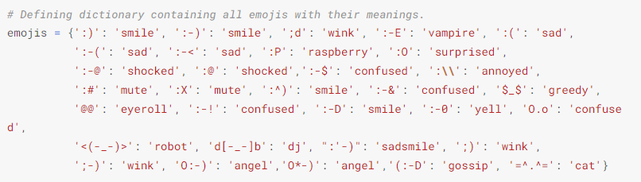
Data Pre-Processing
Steps
We performed following steps for data pre-processing
Converting tweets into lower case
We have first converted tweets into lower case for make it easy to process.
Removing URLs
All the URLs are replaced with URL so that it will not cause any affect on classification.
Removing emojis
We have first defined dictionary in which we have explained meaning of each emoji. Then all emojis are replaced by their meaning.
Removing non-alphabets
We have replaced all non-alphabets.
Defining dictionary containing emojis with their meanings.

Slide 26
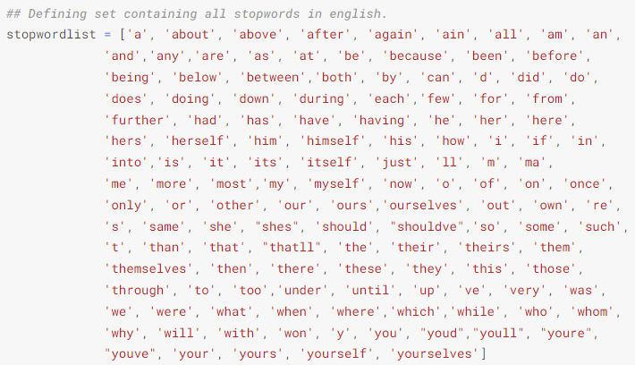
Data Pre-Processing
Removing non-alphabets
We have replaced all non-alphabets.
Removing stop words
A stop word is used to filter out unimportant words, so that the application can deal with the important words instead. We have defined a dictionary of stop words and then applied stop word removal technique.
Stemming
Stemming is the process by which a word is reduced to its root word stem, the part of a word that attaches to prefixes and suffixes and to the roots of words, also referred to as lemma.
Defining set containing all stop words in English.

Slide 27
Data Pre-Processing
Lemmatization
Lemmatization involves the use and analysis of a vocabulary, as well as morphological analyses of words, normally aiming to remove only those that are formed from inflectional elements, returning either the base form or the dictionary form of the word, which is called lemma.
After pre-processing steps, the data is split into training and testing data. then TF-IDF is performed and data is transformed before giving input to machine learning algorithms.
Calculate Term Frequency Inverse Document Frequency
TF-IDF is an acronym that stands for Term Frequency Inverse Document Frequency. The algorithm is very commonly used to transform textual input into meaningful representations of numbers, which are then used to fit a machine learning algorithm.
After performing TF-IDF. the machine learning algorithms are applied and results are observed.

Slide 28
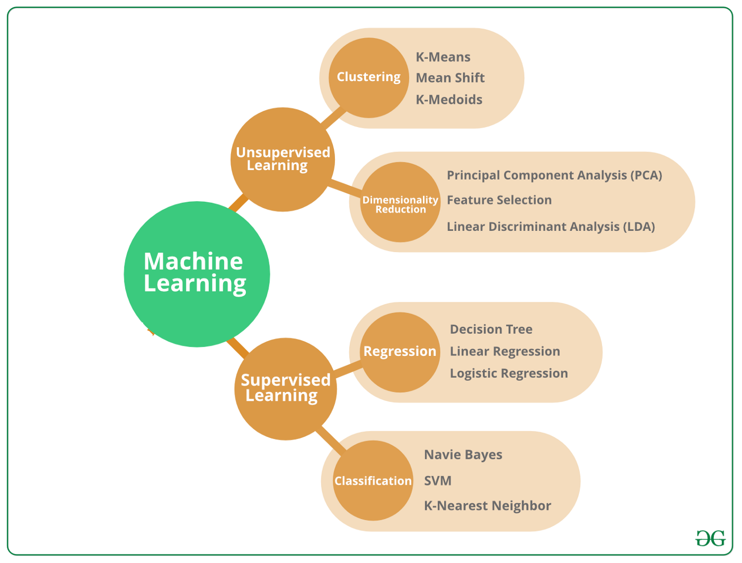
Selected Machine Learning Algorithms
For the proposed project, following machine learning algorithms will be used:
Naïve Bayes
Logistic Regression
Random Forest
Linear Support Vector Machine
K-Nearest Neighbor
Decision Tree

Slide 29

Packages
For the proposed project, we will use Python language.
The code will be written in Jupyter notebook.
The built-in Libraries of Python will be used:
1. NLTK
As the name implies, the Natural Language Toolkit, or NLTK (National Language Toolskit), consists of a set of libraries and programs for processing natural language signals in a symbolic and statistical manner written in the Python
2. SciKit
There is a suite of machine learning tools called SciKit-Learn available as free software to Python programmers. The package includes algorithms for classification, regression, and clustering.

Slide 30
Packages
3. Seaborn
The Seaborn library is a Python library for visualizing data and is based on the matplotlib library. It provides an easy-to-use interface with which to create informative and attractive statistical graphs.
4. Word Cloud
The word cloud is a visual representation of text data which can also be known as a tag cloud or weighted list. It is usually one or more words and the importance of each word is indicated by the size and color of the font. The Python programming language has a built-in word cloud library that makes this a snap.

Slide 31
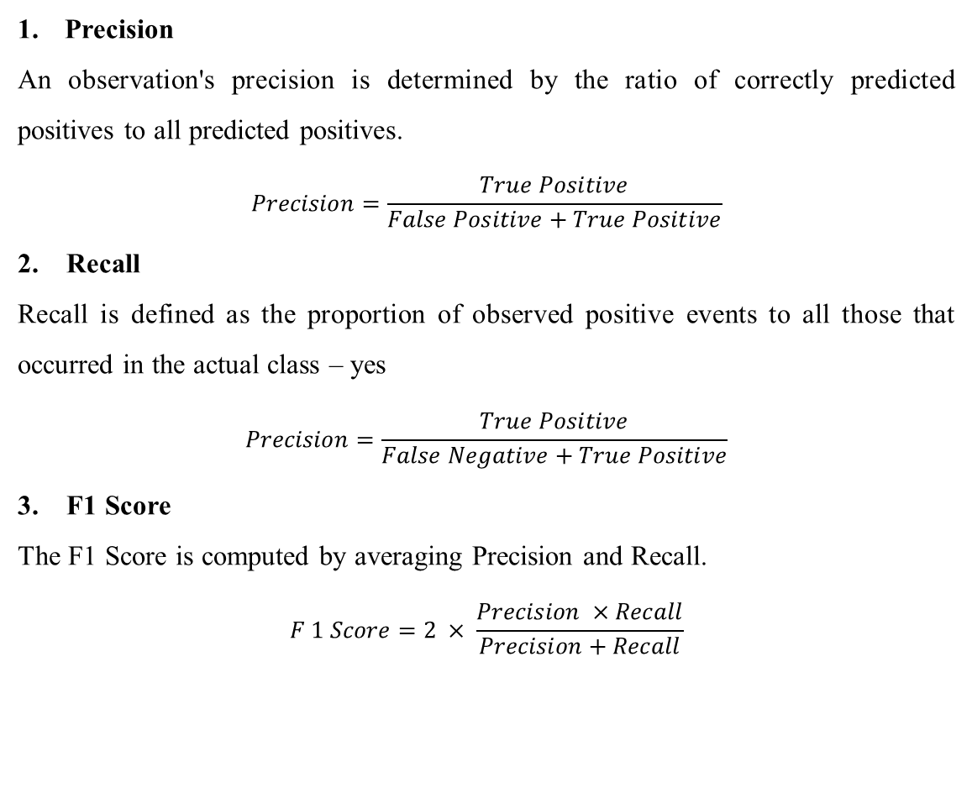
Evaluation Parameters
Precision
An observation's precision is determined by the ratio of correctly predicted positives to all predicted positives.
$$Precision=\frac{True Positive}{False Positive+True Positive}$$
2. Recall
Recall is defined as the proportion of observed positive events to all those that occurred in the actual class – yes
$$Precision=\frac{True Positive}{False Negative+True Positive}$$
3. F1 Score
The F1 Score is computed by averaging Precision and Recall.
$$F 1 Score=2 × \frac{Precision ×Recall}{Precision+Recall}$$

Slide 32
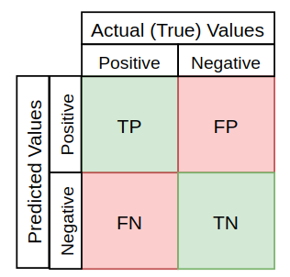
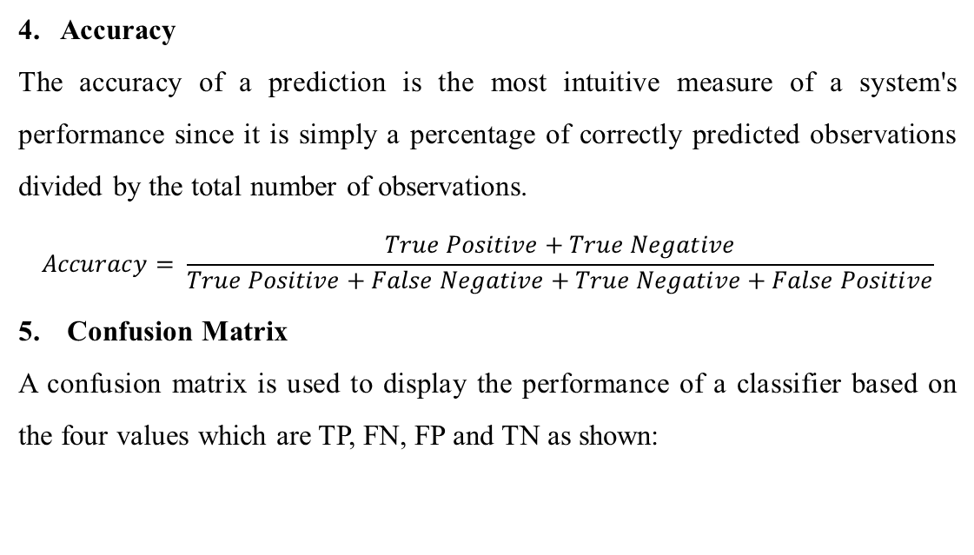
Evaluation Parameters
4. Accuracy
The accuracy of a prediction is the most intuitive measure of a system's performance since it is simply a percentage of correctly predicted observations divided by the total number of observations.
$$Accuracy= \frac{True Positive+True Negative}{True Positive+False Negative+True Negative+False Positive}$$
Confusion Matrix
A confusion matrix is used to display the performance of a classifier based on the four values which are TP, FN, FP and TN as shown:

Slide 33
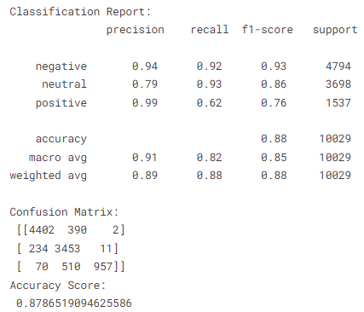
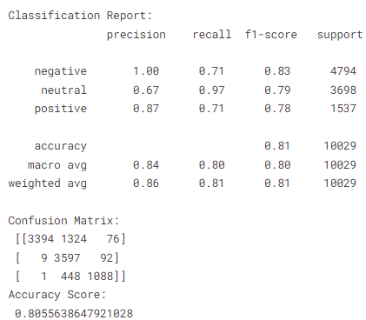
Results
Sentiment Analysis Results
Bernoulli Naive Bayes K Nearest Neighbor

Slide 34
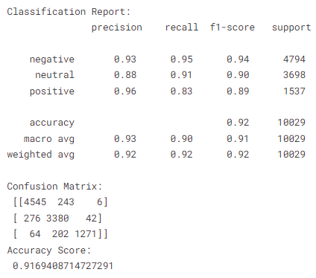
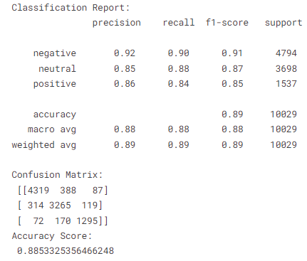
Results
Sentiment Analysis Results
Decision Tree Random Forest

Slide 35
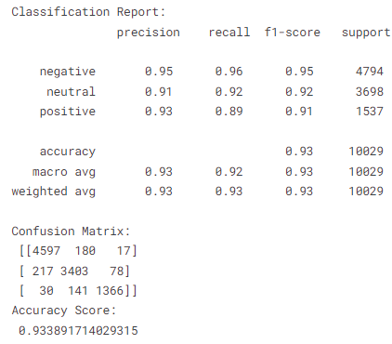
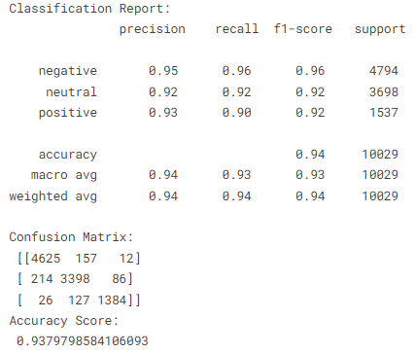
Results
Sentiment Analysis Results
Logistic Regression SVM

Slide 36
Results
Comparison of ML Algorithms for Sentiments’ Analysis
Algorithms | Accuracy
Bernoulli Naïve Bayes | 87%
KNN | 80%
Decision Tree | 88%
Random Forest | 91%
Logistic Regression | 93%
SVM | 93.70%
Comparison of accuracy achieved by machine learning algorithms for sentimental analysis.

Slide 37
Results
From the results it can been seen that SVM performs best as compared to other algorithms. The accuracy of SVM is 93.70%. the logistic regression also performs good as its accuracy is 93%. On other hand, the accuracy of random is 91% that comes at third position. Afterwards decision tree performs well and gave accuracy of 88%. Then Bernoulli Naïve Byes gives us accuracy of 87%. KNN does not perform well and achieve lowest accuracy which is 80%.
Graph showing accuracy achieved by machine learning algorithms for sentimental analysis.

Slide 38
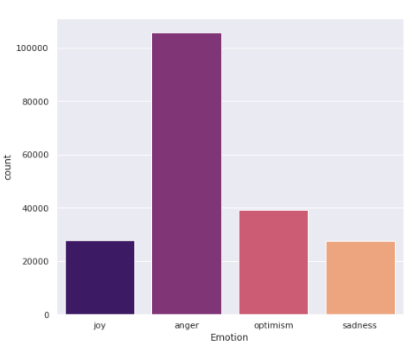
Results
Emotions’ Analysis
We have added a ‘emotion’ column in the file. And we have set sentiments for each tweet as ‘anger’, ‘joy’, ‘optimism’ and ‘sadness’.
Plot for emojis
We will first plot for emotions to get visualization about emotions’ distribution
The graph shows that emotions of people in tweets on the selected topic are more towards anger.
Graph showing distribution of emotions in dataset.

Slide 39
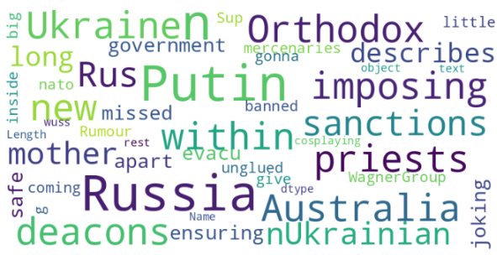
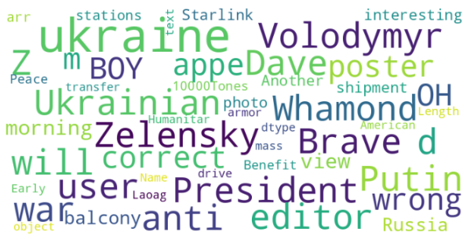
Emotions’ Analysis
Word Cloud for Anger Emotion
Word Cloud for Joy Emotion

Slide 40
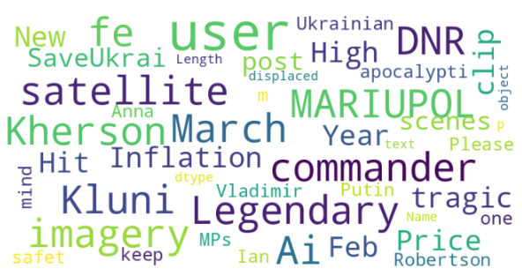
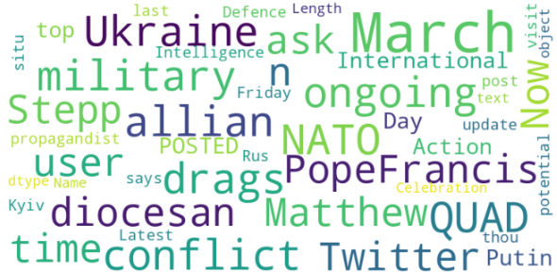
Emotions’ Analysis
Word Cloud for Optimism Emotion
Word Cloud for Sadness Emotion

Slide 41
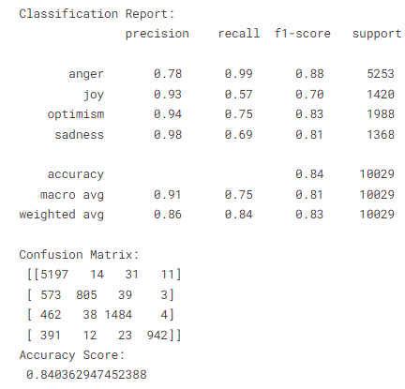
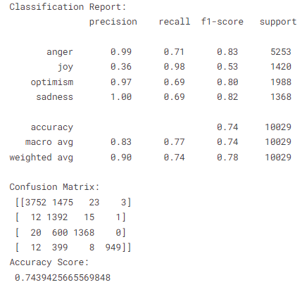
Results
Emotions’ Analysis Results
Bernoulli Naive Bayes K Nearest Neighbor

Slide 42
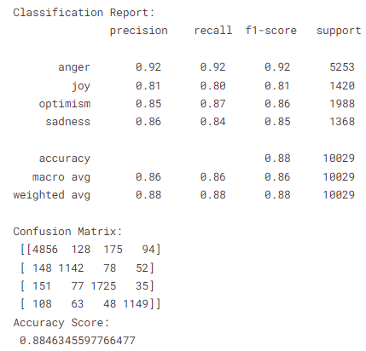
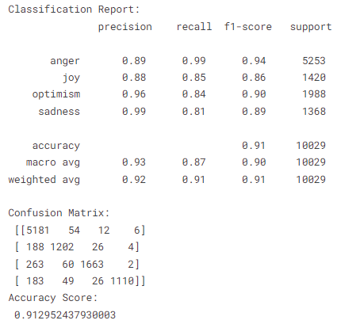
Results
Emotions’ Analysis Results
Decision Tree Random Forest

Slide 43
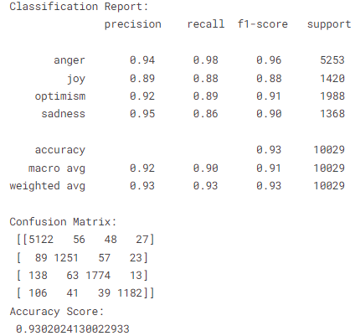
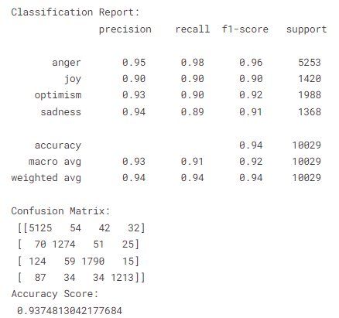
Results
Emotions’ Analysis Results
Logistic Regression SVM

Slide 44
Results
Comparison of ML Algorithms for Emotions’ Analysis
Algorithms | Accuracy
Bernoulli Naïve Bayes | 84%
KNN | 74%
Decision Tree | 88%
Random Forest | 91%
Logistic Regression | 93%
SVM | 93.70%
Comparison of accuracy achieved by machine learning algorithms for emotions’ analysis.

Slide 45
Results
From the results it can been seen that SVM performs best as compared to other algorithms. The accuracy of SVM is 93.70%. the logistic regression also performs good as its accuracy is 93%. On other hand, the accuracy of random is 91% that comes at third position. Afterwards decision tree performs well and gave accuracy of 88%. Then Bernoulli Naïve Byes gives us accuracy of 84%. KNN does not perform well and achieve lowest accuracy which is 74%.
Graph showing the accuracy achieved by machine learning algorithms for emotions’ analysis.

Slide 46
Conclusion
The usage of social media sites like Twitter, Facebook, and WordPress is a major source of information exchange in our society today. As a social network, Twitter primarily relies on the opinions of the public regarding a product, event, or topic and therefore contains large amounts of raw data.
There is a lot of importance and difficulty in synthesising and analyzing this data due to the sheer size of the datasets. An analysis of sentiments is the method that is chosen for this data analysis in that it does not delve into all the tweeted, but rather refers to the sentiments connected with each tweet in terms of positive, negative, and neutral opinions.
An innovative method of using machine learning algorithms to perform sentiment analysis on the twitter data set has been found to be useful in this project. As a result of the implementation of the developed algorithms, noise can be removed or data can be filtered in the form of Natural Language Processing (NLP) techniques, as well as pre-processing to improve output.

Slide 47
Conclusion
Moreover, in order to perform pre-processing or filtering of the textual Twitter data in order to remove noise from it, the process of pre-processing must be performed in a series of steps. This process involves filtering and processing of tweets, in order to reduce the size of dataset. In the first step, dataset was explored to view the distribution of data.
For visualization purpose, word cloud was used which helps to show the frequency of prominent words in dataset. Then tweets were converted into lower case, then URLs, emojis are replaced. afterwards stop words were removed and stemming along with lemmatization was performed.
After pre-processing steps, term frequency was calculated and data was transformed. Then dataset was split into training and testing data. Then data was put as input to classifiers. The selected classifiers were Bernoulli NB, KNN, Logistic Regression, Decision Tree, Random Forest and SVM. Each classifier was trained and tested. then results were evaluated using various evaluation metrics. First, we have performed sentiment analysis using selected classifiers. Then we have performed emotion analysis using selected classifiers. The results showed that SVM classifier outperformed as compared to other algorithms.

Slide 48

References
[1] L. Mandloi and R. Patel, “Twitter sentiments analysis using machine learninig methods,” in 2020 International Conference for Emerging Technology (INCET), 2020, pp. 1–5.
[2] S. Elbagir and J. Yang, “Sentiment analysis of twitter data using machine learning techniques and scikit-learn,” in Proceedings of the 2018 International Conference on Algorithms, Computing and Artificial Intelligence, 2018, pp. 1–5.
[3] “Ukraine Conflict Twitter Dataset (27.98M tweets) | Kaggle.” https://www.kaggle.com/datasets/bwandowando/ukraine-russian-crisis-twitter-dataset-1-2-m-rows (accessed May 06, 2022).

Slide 49
THANK YOU

