Slide 1


Twitter
Sentimental Analysis using Machine Learning

Slide 2
Problem Statement
In the social media revolution of the last few years, huge amounts of data have been collected, including reviews about products and blogs about opinions of the people. With the growth of social media, sentiment analysis has gained a lot of momentum. An organization would like to know the opinions of its customers about the products and services that have been developed by it, so in order to find out their opinions, they conduct surveys of products and opinion research.

Slide 3
Why Twitter?
Humans express themselves through blogs, forums, twitter and facebook. Online communications bring the world closer; communication takes just a click.
In today's short messaging, multiple people can send messages at the lowest price, not just to a single recipient. Many websites offer this service, but Twitter was the pioneer.
Currently, tweets are posted by over 500 million users every day i.e. more than a thousand tweets every second.

Slide 4
A large amount of sentiment data, which can be derived from Twitter tweets, is often available upon analysis of the tweets. The purpose of these data is that they can be used to understand what people think about a wide range of topics.
Consequently, in order to compute customer perception, we need to formulate a Machine Learning Sentiment Analysis Model that can help us automate the process.
50
40
40
30
30

Slide 5
Objective
Given a set of tweets that contain multiple features and a wide range of different opinions, the goal is to extract opinions or expressions that describe a target feature, and categorize the opinions positively or negatively.

Slide 6
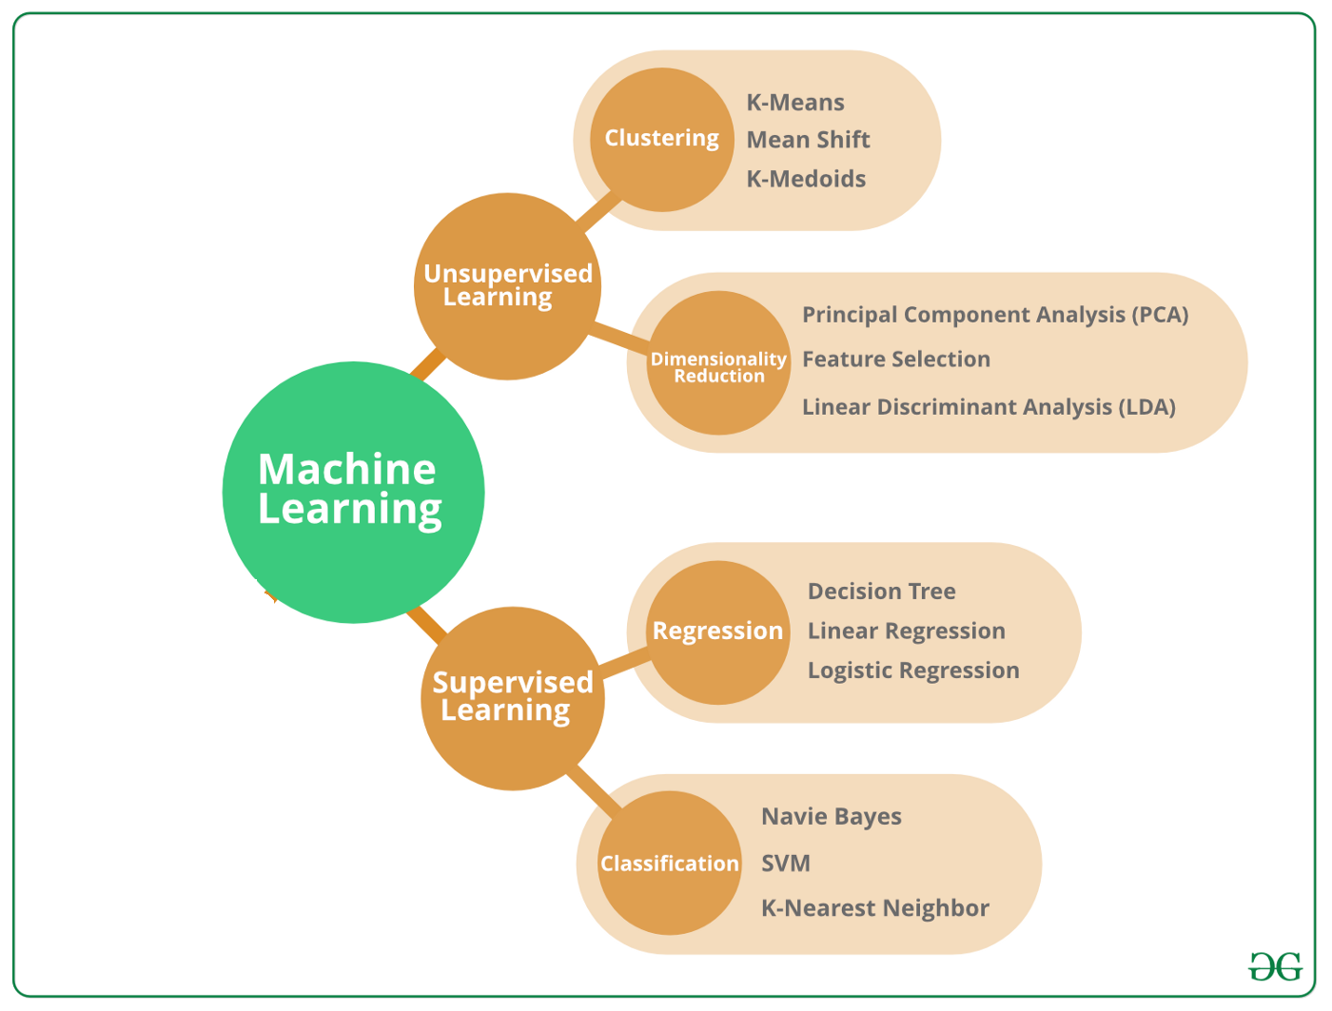
Machine Learning Algorithm
A machine learning algorithm is a way in which a computer system comes up with output values from given input data, thereby predicting output values based on input values that are received.
Algorithms used in the machine learning process (ML) are generally classified in two ways: either supervised, or unsupervised.
During the supervised learning process, input data as well as the output data desired by the algorithm are both pre-labeled, whereas unsupervised algorithms operate on data that does not have any classification and no labeling.

Slide 7
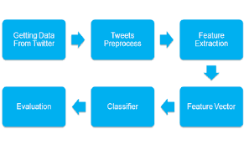
Selected Machine Learning Algorithms
For the proposed project, following machine learning algorithms will be used:
Naïve Bayes
Logistic Regression
Linear Support Vector Machine
K-Nearest Neighbor
Decision Tree

Slide 8

Dataset
For the proposed project, we have selected dataset on topic of Ukraine-Russia Conflict topic as it is hot topic these days.
“ To analyze the sentiments of people on Ukraine-Russia Conflict”
The dataset is downloaded from Kaggle.

Slide 9
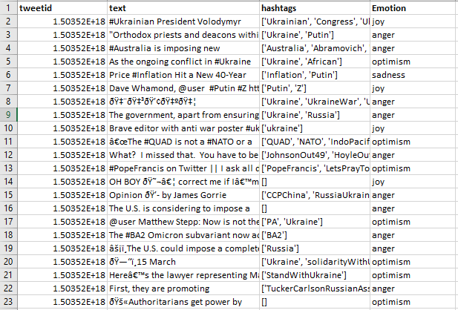
Dataset
There are 20 M tweets in this dataset.
The columns are features and are explained below:
tweetid: it is id of tweet
text: it represents the text of tweet.
Hashtag: only relevant tweets on the selected topic
Emotin: it is target variable that is used to find response of tweet using machine learning.

Slide 10

Packages
For the proposed project, we will use Python language.
The code will be written in Jupyter notebook.
The built-in Libraries of Python will be used:
1. NLTK
As the name implies, the Natural Language Toolkit, or NLTK (National Language Toolskit), consists of a set of libraries and programs for processing natural language signals in a symbolic and statistical manner written in the Python
2. SciKit
There is a suite of machine learning tools called SciKit-Learn available as free software to Python programmers. The package includes algorithms for classification, regression, and clustering.

Slide 11
Steps of Methodology
01
02
03
Pre-Process Dataset
Apply Machine Learning Algorithms
Evaluate and Visualize Results

Slide 12

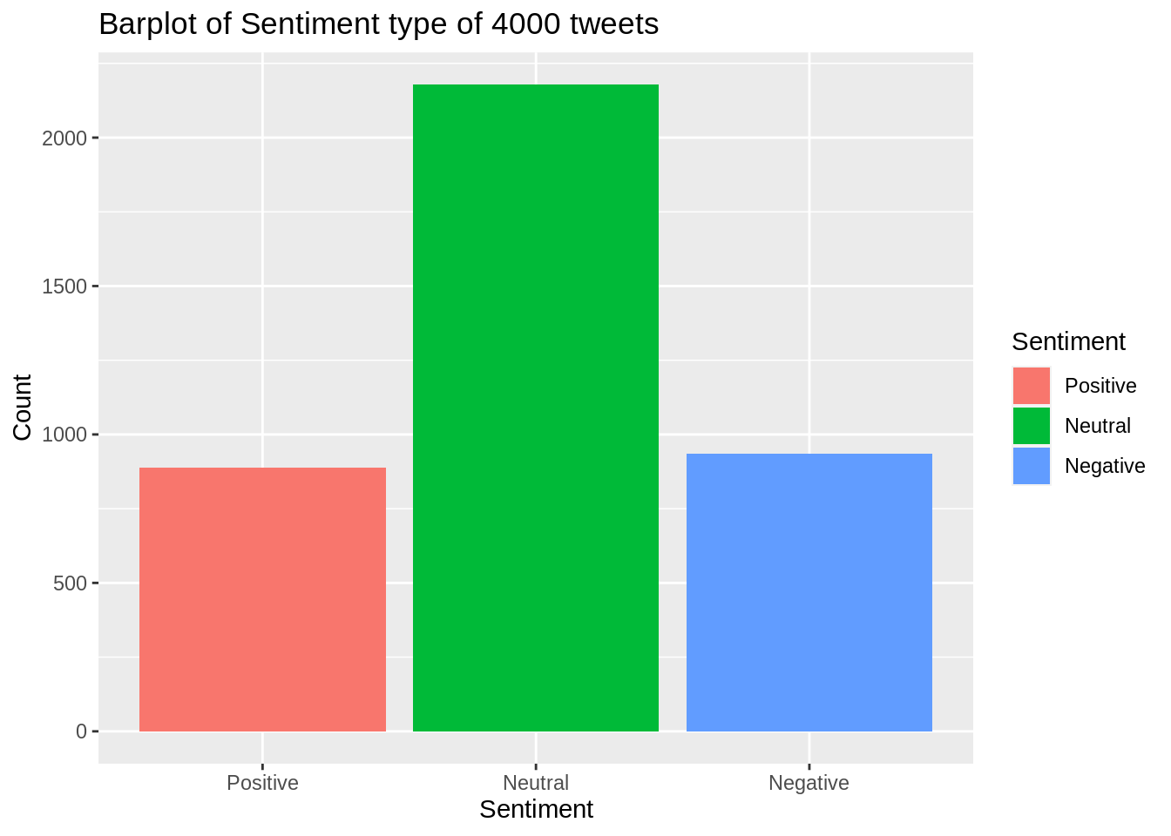
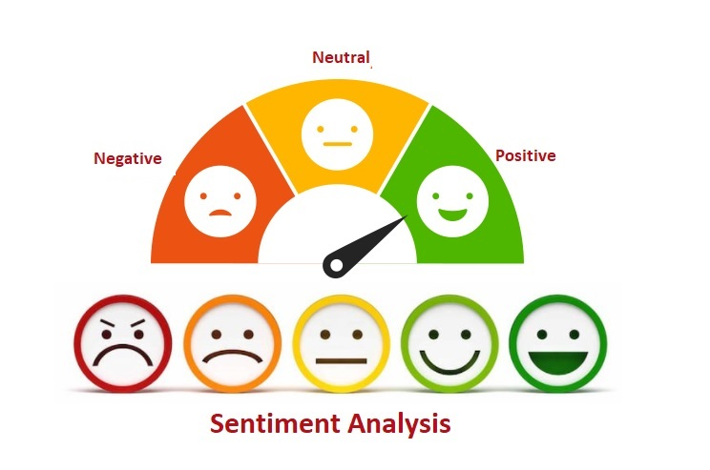
Expected Results Visualization

Slide 13

References
https://www.kaggle.com/datasets/bwandowando/ukraine-russian-crisis-twitter-dataset-1-2-m-rows
https://towardsdatascience.com/machine-learning-algorithms-in-laymans-terms-part-1-d0368d769a7b
https://www.geeksforgeeks.org/twitter-sentiment-analysis-using-python/

Slide 14
THANK YOU

