Slide 1


Slide 2

NAME: AMNA BIBI
PROGRAM:DATA SCIENCE
SUBJECT:ICT LAB
TOPIC
MOTHERBOARD

Slide 3
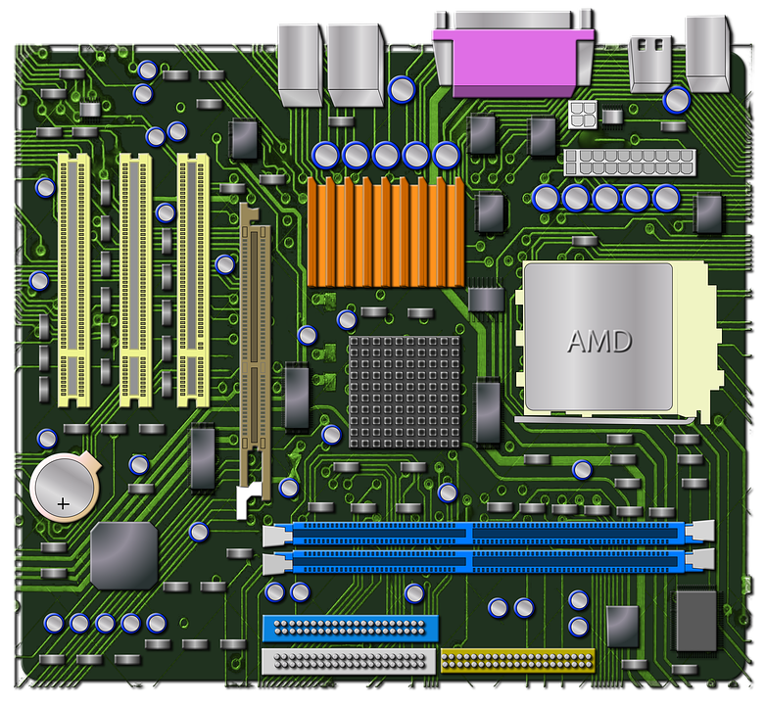
MOTHERBOARD: The HEART OF Computer The main Printed Circuit Board (PCB) Connecting and supporting components

Slide 4
COMPONENTS CPU RAM Chipset (manage data flow between CPU,RAM,and peripherals) Power Supply Expansion slots:(for additional cards e.g graphics,sound) USB ports

Slide 5
FUNCTIONS Connectivity Power distribution Cooling Data Management(facilitates communication between parts)

Slide 6
APPLICATIONS Desktop computers Laptops Smart home devices Servers

Slide 7
SUMMARY The montherboard is foundation of computer system. It provides connectivity and supports to hardware components . It enables communication and power distribution.

