Slide 1
Create Github pages with R bookdown
Amnah Siddiqa
November 17, 2022

Slide 2
Create Github book
https://github.com/jules32/bookdown-tutorial

Slide 3
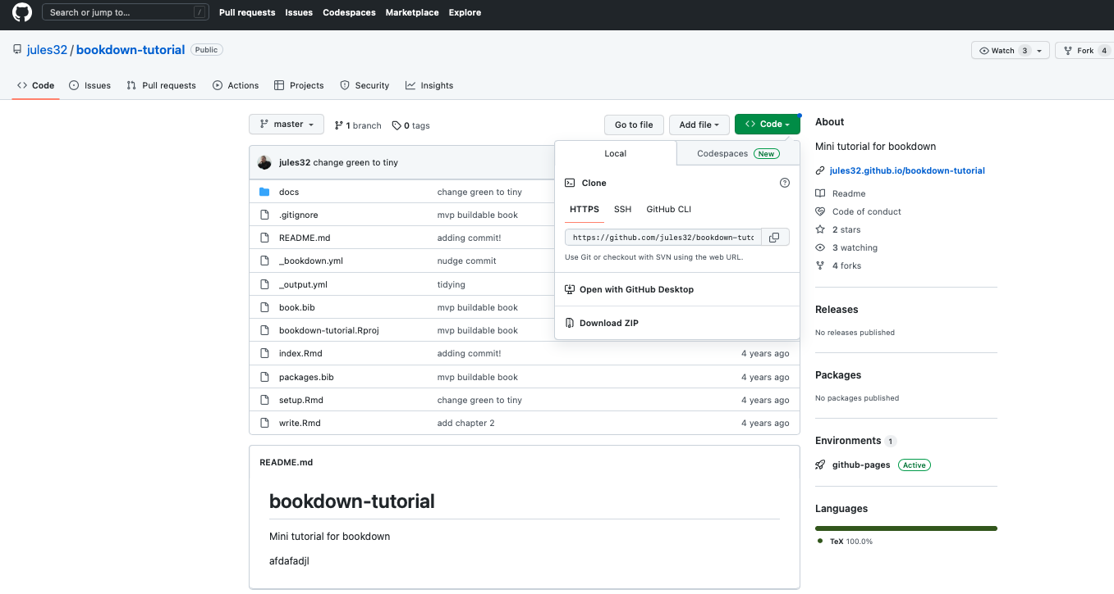
1-Download

Slide 4
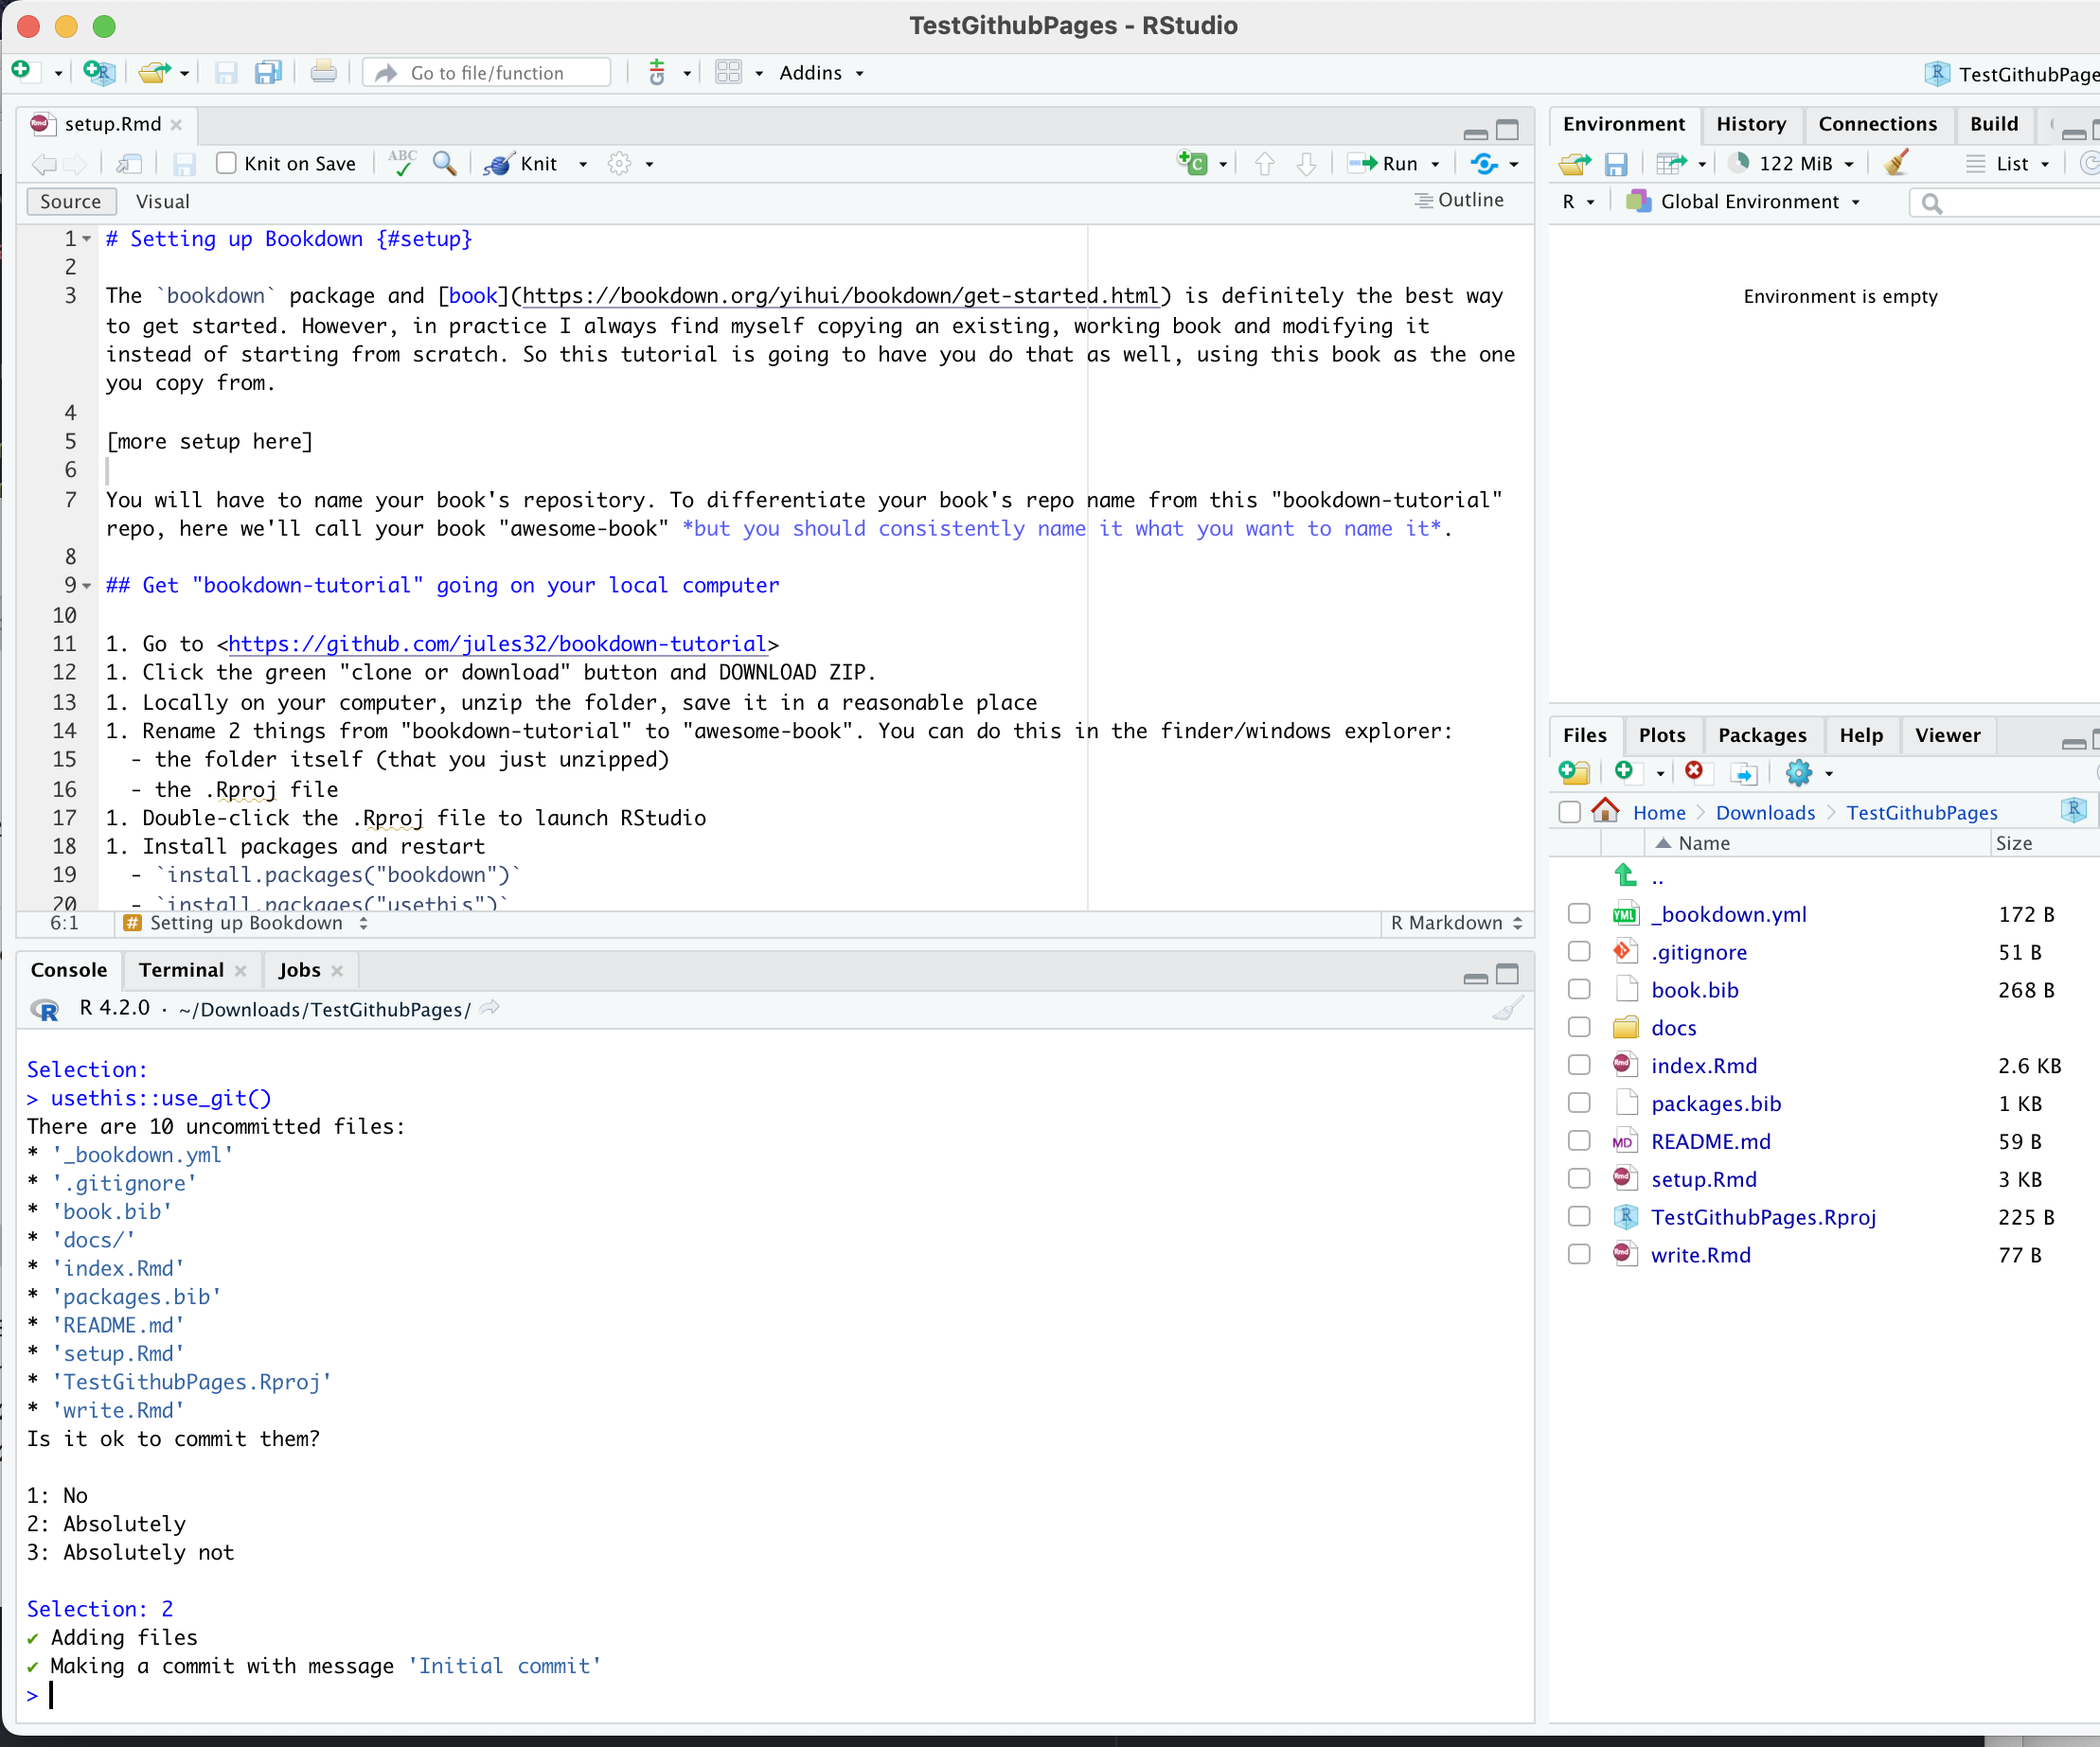
2-Open .Rproj and run usethis::use_git() say 2 to prompt

Slide 5
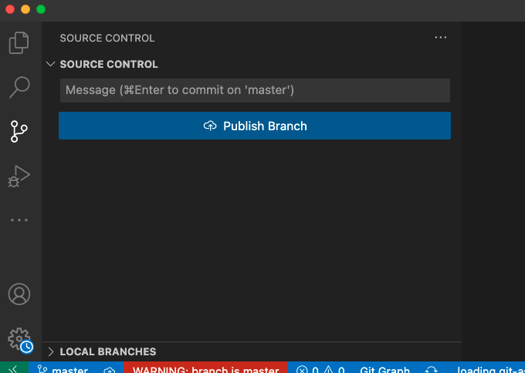
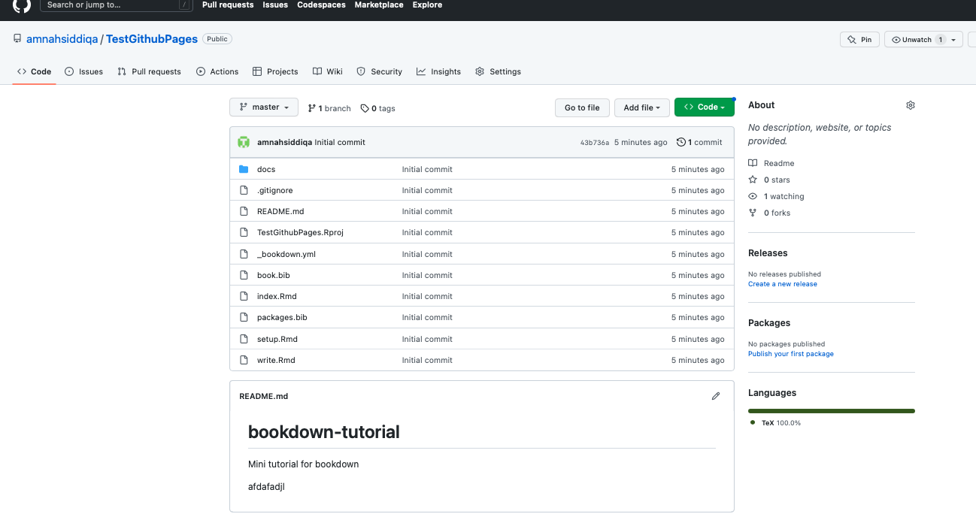
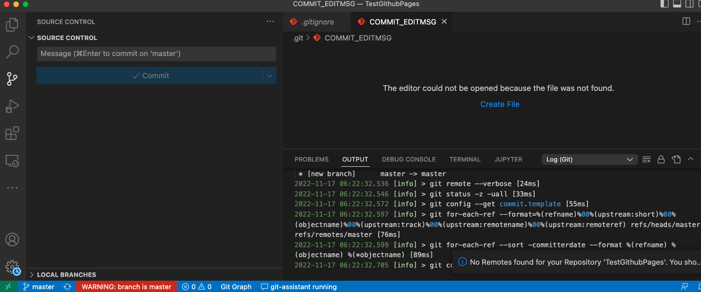
3. Open dir in Vscode ; publish branch on public rename before publishing to main then master
rename before publishing--> to main

Slide 6
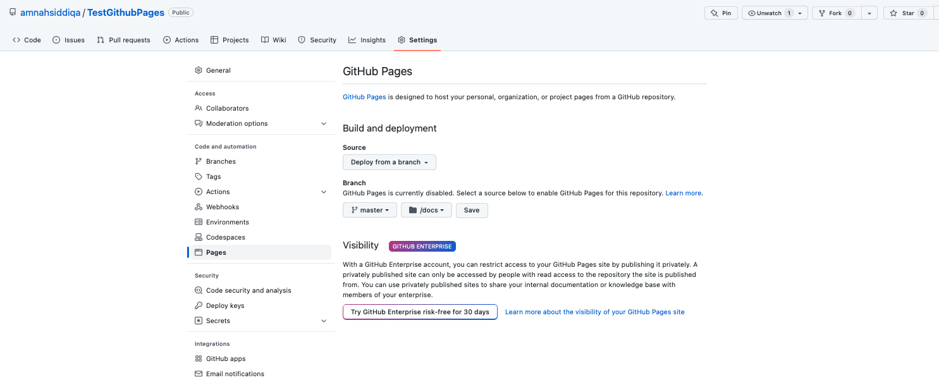
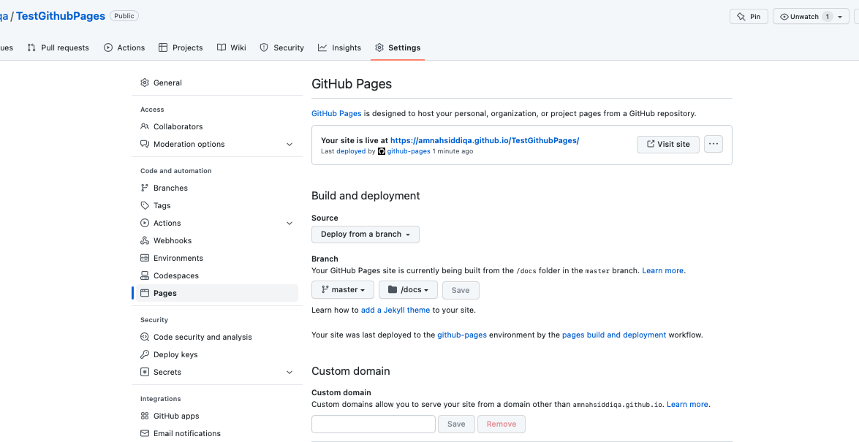
4- Go to github pages and change following settings

