Slide 1
Create Github pages with R bookdown
Amnah Siddiqa
November 17, 2022

Slide 2
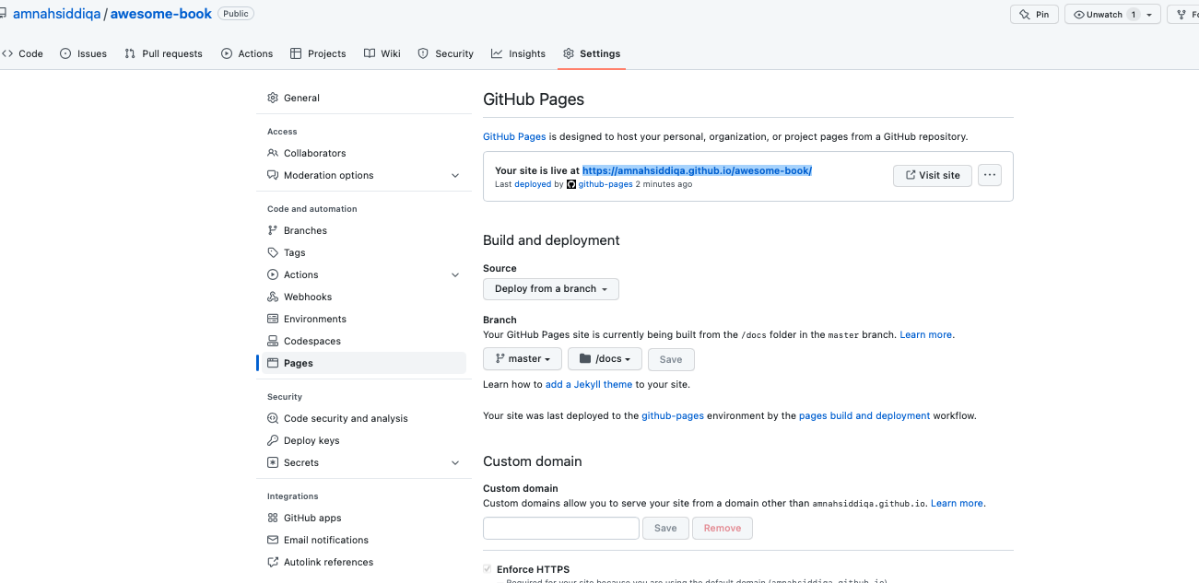

Slide 3
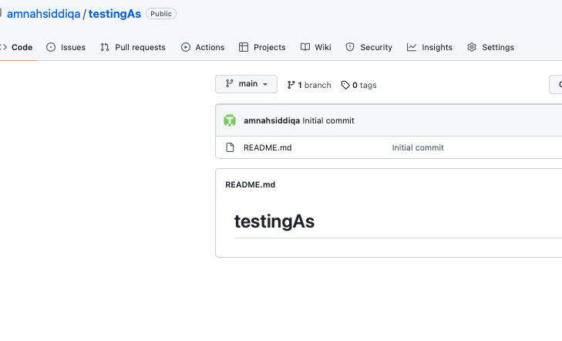
Create Github book
https://github.com/jules32/bookdown-tutorial

Slide 4
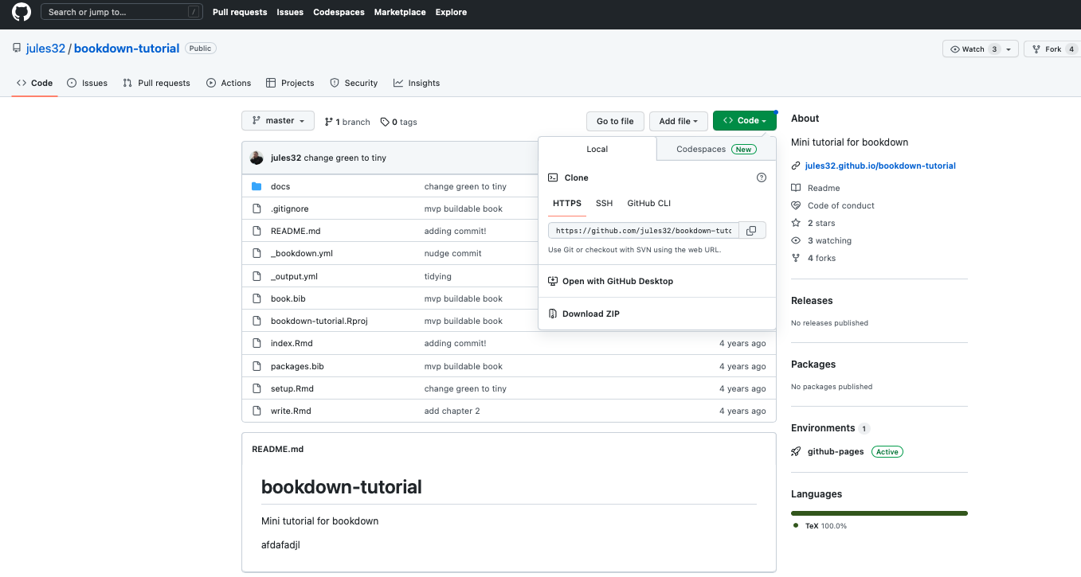
1-Download

Slide 5
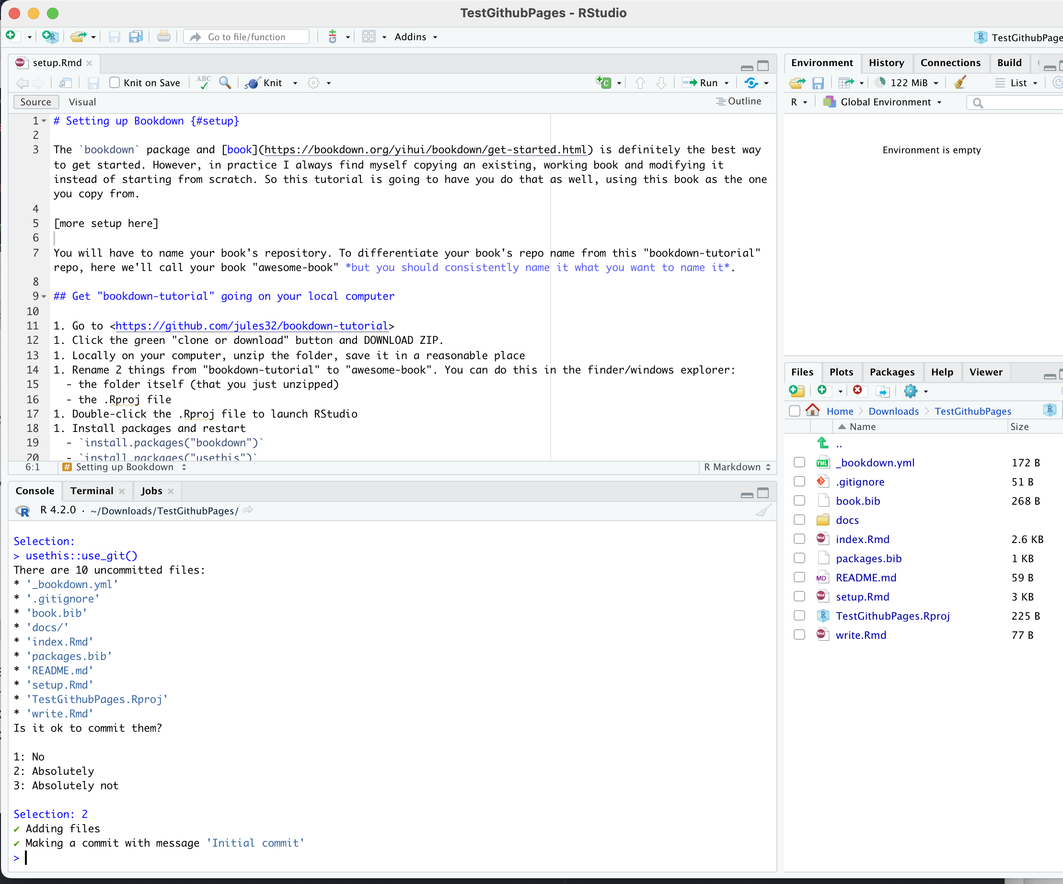
2-Open .Rproj and run usethis::use_git() say 2 to prompt

Slide 6
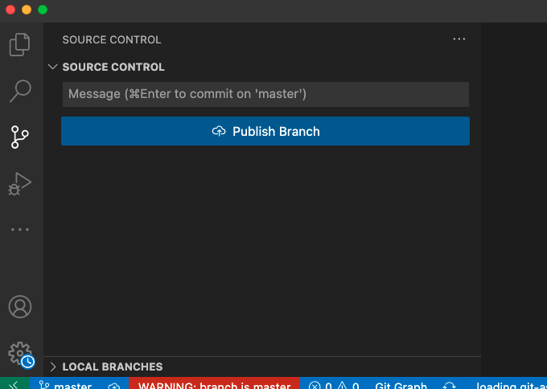
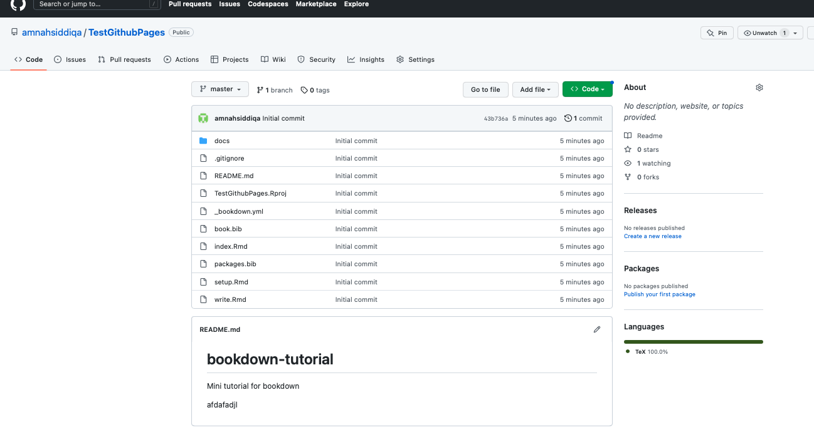
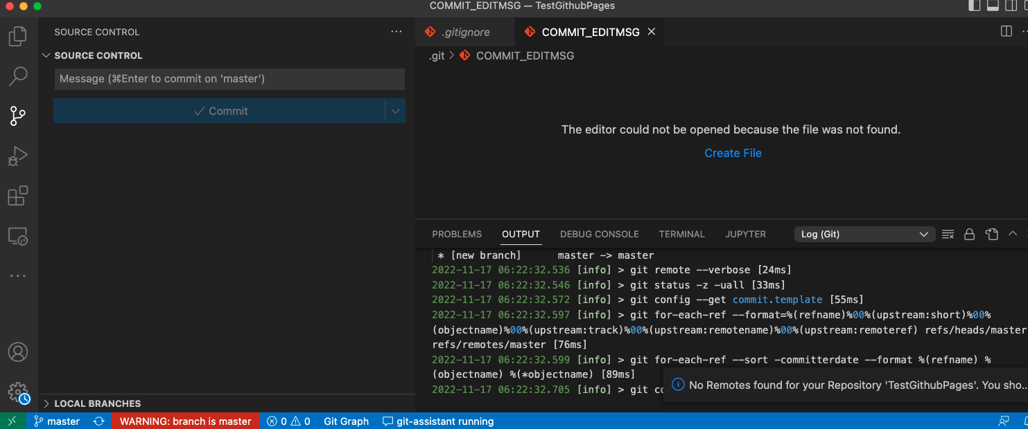
3. Open dir in Vscode ; publish branch on public rename before publishing to main then master
rename before publishing--> to main

Slide 7
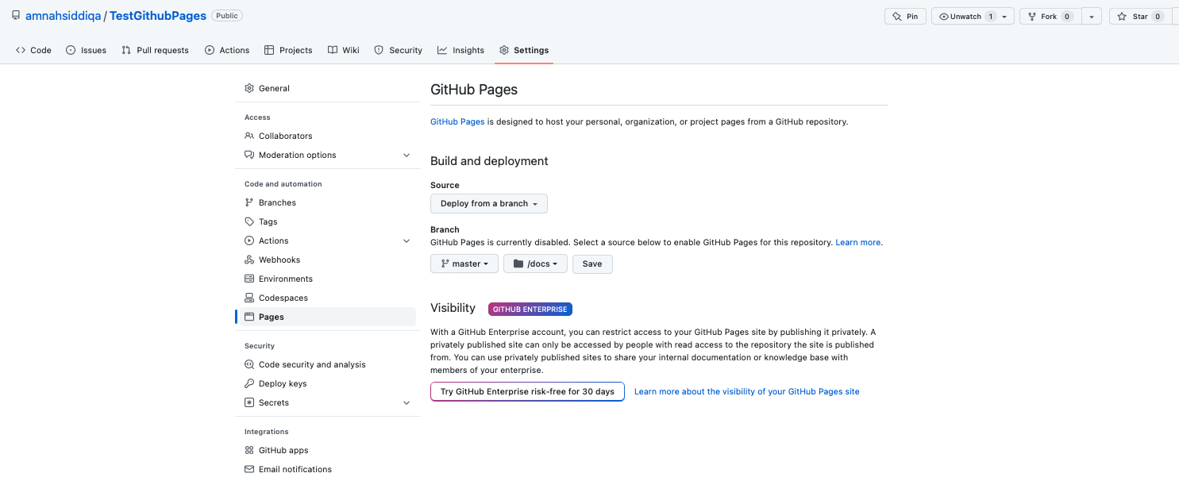
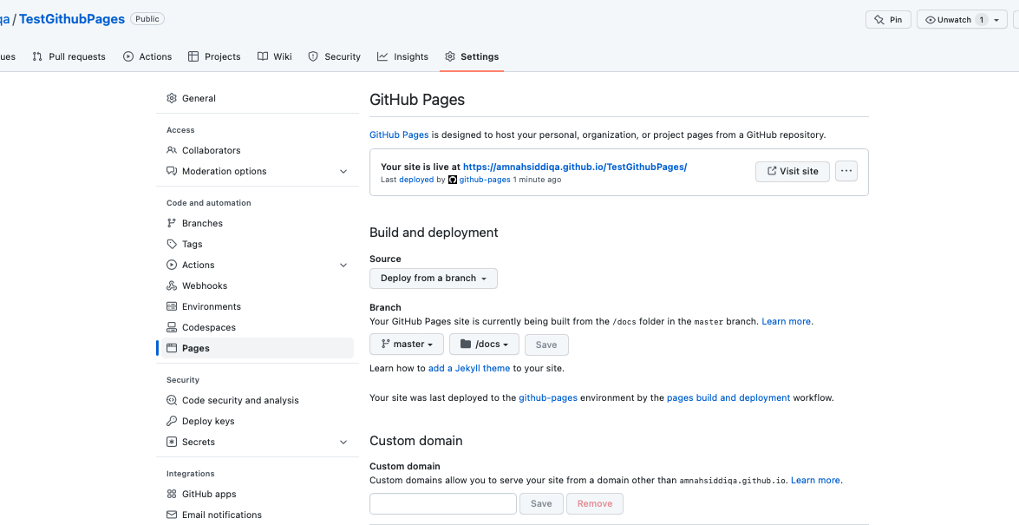
4- Go to github pages and change following settings

Slide 8
