Slide 1


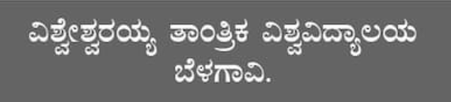
USN: 4NN21IS057, 4NN21IS059, 4NN22IS400, 4NN22IS408 Name: Monisha Kumar, Amna Malaika Macci, Adarsh M R, PranavKrishna S N
NIE Institute of Technology Koorgalli village, Mysuru
BLIND ASSITANCE SYSTEM
Internal Guide –
Name: Dr. Prasanna Kumar.G
Designation: Assistant Professor]
Name of the external:
Mr. Sudeep J [ Dept of ISE NIE-IT, Mysuru-18]

Slide 2
ABSTRACT
It’s a known fact that estimated number of visually impaired person in the world is about 285 million, approximately equal to the 20% of the Indian Population.
They suffer regular and constant challenges in Navigation especially when they are on their own. They are mostly dependent on someone for even accessing their basic day-to-day needs.
So, it’s a quite challenging task and the technological solution for them is of utmost importance and much needed.
One such try from our side is that we came up with an Integrated Machine Learning System which allows the Blind Victims to identify and classify Real Time Based Common day-to-day Objects and generate voice feedbacks .
Calculates distance which produces warnings whether he/she is very close or far away from the object. The same system can be used for Obstacle Detection Mechanism.

Slide 3
INTRODUCTION
Blindness is one of the most frequent and debilitating of the various disabilitiesThe proposed system is designed to aid visually impaired persons with real-time obstacle detection, avoidance, indoors and out navigation, and actual position tracking.
The gadget proposed is a camera-visual detection hybrid that performs well in low light as part of the recommended technique, this method is utilized to detect and avoid impediments, as well as to help blind persons in identifying the environment around them.
A simple and effective method for people with visual impairments to identify things in their environment and convert them into speech for improved comprehension and navigation.
Along with these, the depth estimation, which calculates the safe distance between the object and the person, allowing them to be more self-sufficient and less reliant on others. It was able to achieve this model with the help of Tensor Flow and pre-trained models. The approach we suggest is dependable, inexpensive, practical, and reliable.

Slide 4
Overview
The main purpose of this project is to build a model for the blind people to deduct the object in front of them and to navigate the way with the help of voice feedbacks.
Motivation
The main motive to choose up this project is to help the visually challenged people, so that they can easily find the way and the object in front of them along with warning measures so that it will help them in their safe traversal.
Problem Definition
The visually impaired people suffer regular and constant challenges in navigation especially when they are on their own. In Existing System there is only warning system with the help of buzzers and sensors and there is no proper voice-based system. We have designed a system which will direct the blind people with the help of voice-based feedbacks along with distance calculation.

Slide 5
LITREATURE SURVEY
Project Name with software | Description | Drawback
Detection using Raspberry Pi | This study advocates the creation of an intelligent system to assist blind people with daily tasks.. Those who are profoundly deaf require constant assistance in all situations, particularly during day-to-day activities in many circumstances. | Its slower processor speed hence lag time and working is very time consuming and slow . Its better to use up rock64 media board being more powerfull.
Detection using Pi Cam | Ultra-Sonic Sensor and Open CV Visually impaired people confront a wide range of issues in their everyday lives. . The suggested invention intends to supply voice-controlled wearable visual help for visually impaired persons. It can, among other things, find goods and signboards. | Complications of errors is being defined here . Truncation problems are noticed .

Slide 6
Project Name with software | Description | Drawback
Detection using Arduino Uno | Obstacle detection, obstacle avoidance, interior and outside routing, and true position sharing are among the capabilities planned for the VI (Visually Impaired) Incorporating Advanced. A combo of smart gloves and phone software that performs well in low light is the suggested device . Presented as a method for detecting and avoiding obstacles while also helping visually impaired individuals in recognizing their environment. | With this detetction comes easy overriding firmware and lack of power protection. Limitated in handling LED pins and photo sensors .
Detection using Ultrasonic Sensor and Buzzer | Research was written by Ali Khan and Aftab Khan with the purpose of designing something specifically for the blind. This research culminated in the invention of an ultrasonic obstacle detecting system. A sensor module, as well as a vibration device and a buzzer, are included in the wearable garment. Sensors check the user's surroundings and vibrate and emit a buzzer to alert them to any impediments. | It comes with measurement inaccuracies. Sensor and buzzer would misjudge the object..

Slide 7
Objectives:
Image Capture: Using a webcam or camera to capture real-time images of the surroundings.
2. Networked Server: Sending these images to a central server (typically over a network connection), where the heavy computations such as image processing and object recognition are performed.
3. Object Recognition: The server processes these images to identify objects, people, or other relevant features in the environment.
4. Voice Feedback: After identifying objects, the system converts this information into voice feedback that is sent back to the user in real-time.
This system aims to make visually impaired individuals more independent by enabling them to explore and interact with their environment more effectively. By providing real-time feedback about nearby objects or obstacles, the system enhances their ability to navigate and engage in daily activities autonomously.

Slide 8
Scope of Proposed Work
Problem Definition and Requirements Gathering
Identify User Needs: Conduct surveys and interviews with visually impaired individuals to understand their challenges and requirements.
Define Objectives: Specify the primary goals of the system, such as obstacle detection, object recognition, navigation assistance, and user feedback.
Computer Vision:
Object Detection: Implement models (e.g., YOLO, SSD, Faster R-CNN) for detecting and identifying objects in the user’s path.
Scene Understanding: Develop methods for scene segmentation and context awareness.

Slide 9
Navigation and Guidance:
Path Planning: Design algorithms for route planning and obstacle avoidance..
The scope of work for a blind assistance system is extensive and involves multidisciplinary efforts in hardware design, software development, user experience, and accessibility. The ultimate goal is to create a reliable, efficient, and user-friendly system that significantly improves the quality of life for visually impaired individuals.

Slide 10
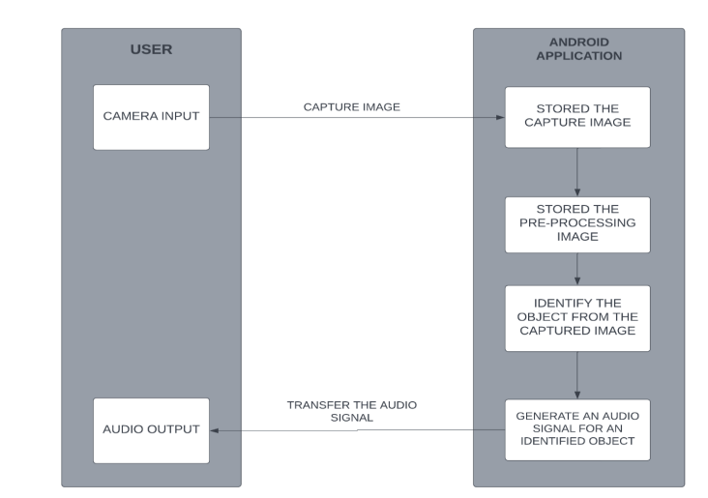
WORKING :

Slide 11
The system is set up in such a way where an android application(assuming you are implementing it on a android device) will capture real-time frames and will send it to a laptop based Networked Server where all the computations take place.
The Laptop Based Server will be using a pre-trained SSD detection model trained on COCO DATASETS. It will then test and the output class will get detected with an accuracy metrics.
After testing with the help of voice modules the class of the object will be converted into a default voice notes which will then be sent to the blind victims for their assistance.
Along with the object detection , we have used an alert system where approximate will get calculated. If that Blind Person is very close to the frame or is far away at a safer place , it will generate voice-based outputs along with distance units.
YOLOv8 (You Only Look Once) is known for its real-time object detection capabilities and is often favored for applications requiring fast inference speed. It's also known for its simplicity and ease of use..
Known for its real-time performance , making it suitable for applications requiring fast inference .
Simplicity :Easier to implement and deploy , requiring less setup and configuration .
Lightweight :Can run efficiently on devices with limited computational resources .

Slide 12
Software requirements:
• PYTHON
PyCharm
Back End
Yolo v8 version
Pycharm
Coco datasets
Hardware requirements:
Processor: Intel core processor (Core i5 processor) RAM: 4 GB and above Hard-disc: 194 MB and above

Slide 13
Proposed Methodology
TRAINING DATA(COCO):Creating a blind assistance system using the COCO (Common Objects in Context) dataset involves developing a methodology that effectively leverages this dataset for training and evaluating object detection models.
Objective Definition
Develop a model to detect and identify objects and contextual information in real-time to assist visually impaired users to daily navigation and interaction.
Dataset Preparation
COCO Dataset Utilization:
Selection: Use the COCO dataset, which contains over 80,000 images with more than 500,000 labeled objects across 80 categories and Filtering:. For required images of blind.
Data Augmentation:
Perform data augmentation to enhance the model's robustness, including transformations like rotation, scaling, and flipping.
Choose a suitable object detection model that balances accuracy and speed, such as:
YOLO (You Only Look Once): Known for its real-time performance.
SSD (Single Shot Multibox Detector): Efficient for mobile and embedded systems.

Slide 14
MODEL:YOLOv8
Objective
Goal: Create a real-time object detection system to assist visually impaired individuals by identifying and describing nearby objects.
2. Dataset Preparation
COCO Dataset: Utilize the COCO dataset for training, focusing on objects relevant to everyday navigation.
Data Augmentation: Apply techniques like rotation, scaling, and flipping to enhance model robustness and generalization.
3. Model Selection
YOLOv8 : Use YOLOv8 for its superior speed and accuracy in real-time object detection.
Transfer Learning: Start with pre-trained weights to expedite training and improve accuracy.
.
Feedback Loop: Use real-world data and user interactions to continuously update and improve the model.
This methodology aims to create an effective and user-friendly blind assistance system using YOLOv8, focusing on real-time performance, usability, and continuous enhancement.

Slide 15
OPENCV(COMPUTER VISION)
To build an OpenCV object detection and tracking system using the COCO dataset and the MobileNet SSD model, we can load the model into memory, capture frames from a video source, preprocess the images, feed them into the model, obtain object detection predictions, filter out detections below a certain confidence ...

Slide 16
SOCIETAL IMPACT
Enhancing Independence
1. Mobility Aids: Developing and providing advanced mobility aids such as smart canes, navigation apps, or wearable technology can greatly enhance the independence of visually impaired individuals, allowing them to navigate public spaces safely and confidently.
2. Assistive Technology: Offering access to assistive technologies like screen readers, braille displays, and voice-controlled devices can empower blind individuals to perform daily tasks more independently and efficiently.
Improving Access to Information
1. Educational Tools: Creating educational resources in accessible formats ensures that visually impaired students have equal opportunities to learn and succeed academically.
2. Digital Accessibility: Promoting and implementing web and app accessibility standards ensures that blind individuals can access information, services, and opportunities online without barriers.
Enhancing Employment Opportunities
1. Skills Training: Providing training programs focused on enhancing skills relevant to the job market can improve employment prospects for visually impaired individuals.
2. Workplace Adaptations: Advocating for and assisting in the implementation of workplace adaptations and accessible technologies can help create inclusive work environments where blind individuals can thrive.

Slide 17
CONCLUSION
A blind assistance system as an Android app the widespread use and accessibility of smartphones to provide essential support for visually impaired individuals.
This app integrates advanced technologies like machine learning, and deep learning to assist users in real-time.
Features typically include voice commands, object recognition, obstacle detection, and navigation aids, all designed to enhance the daily lives of those with visual impairments.
In order to complete this project, we used yolo, SSD architecture, and COCO Dataset.
We used object detection and depth computation to turn the discovered item into speech.
this system helps to be easier for blind people to acquire, analyses, and translate information.
The main purpose is to let visually impaired persons navigate freely so they can move fast while being safe.

Slide 18
REFERENCES
https://hindustanuniv.ac.in/assets/naac/CA/1_3_4/2666_NAVEEN_KUMAR.pdf
https://www.ijraset.com/research-paper/blind-assistance-system-using-image-processing
https://www.journal-dogorangsang.in/no_2_Book_21/60.pdf
https://ijcrt.org/papers/IJCRT2401367.pdf

