Slide 1
E-commerce Analytics
Analytics Report
Generated May 27, 2026

Slide 2
Key Performance Indicators
Total Records
Avg Order Value
Avg Age
Avg Total Orders
5,000
$538.4K
48.16
10.03
Avg Last Purchase
Avg Is Fraudulent
Avg Email Open Rate
Avg Loyalty Score
180.07
0.03
50.73
50.04

Slide 3
Executive Summary
Executive Summary (AI offline — statistical summary) - Total Records: 5,000 - Avg Order Value: $538.4K - Avg Age: 48.16 - Avg Total Orders: 10.03 - Avg Last Purchase: 180.07 - Avg Is Fraudulent: 0.03 Trends: - Age is trending up (+1.5% over period, R²=0.00) - Avg Order Value is trending down (-2.4% over period, R²=0.00) - Total Orders is trending up (+1.1% over period, R²=0.00)

Slide 4
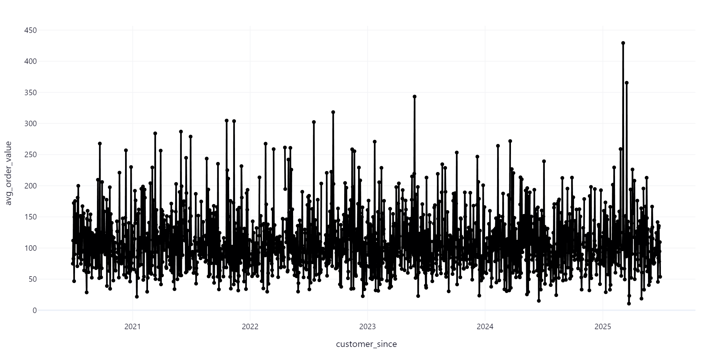
Avg Order Value Over Time

Slide 5
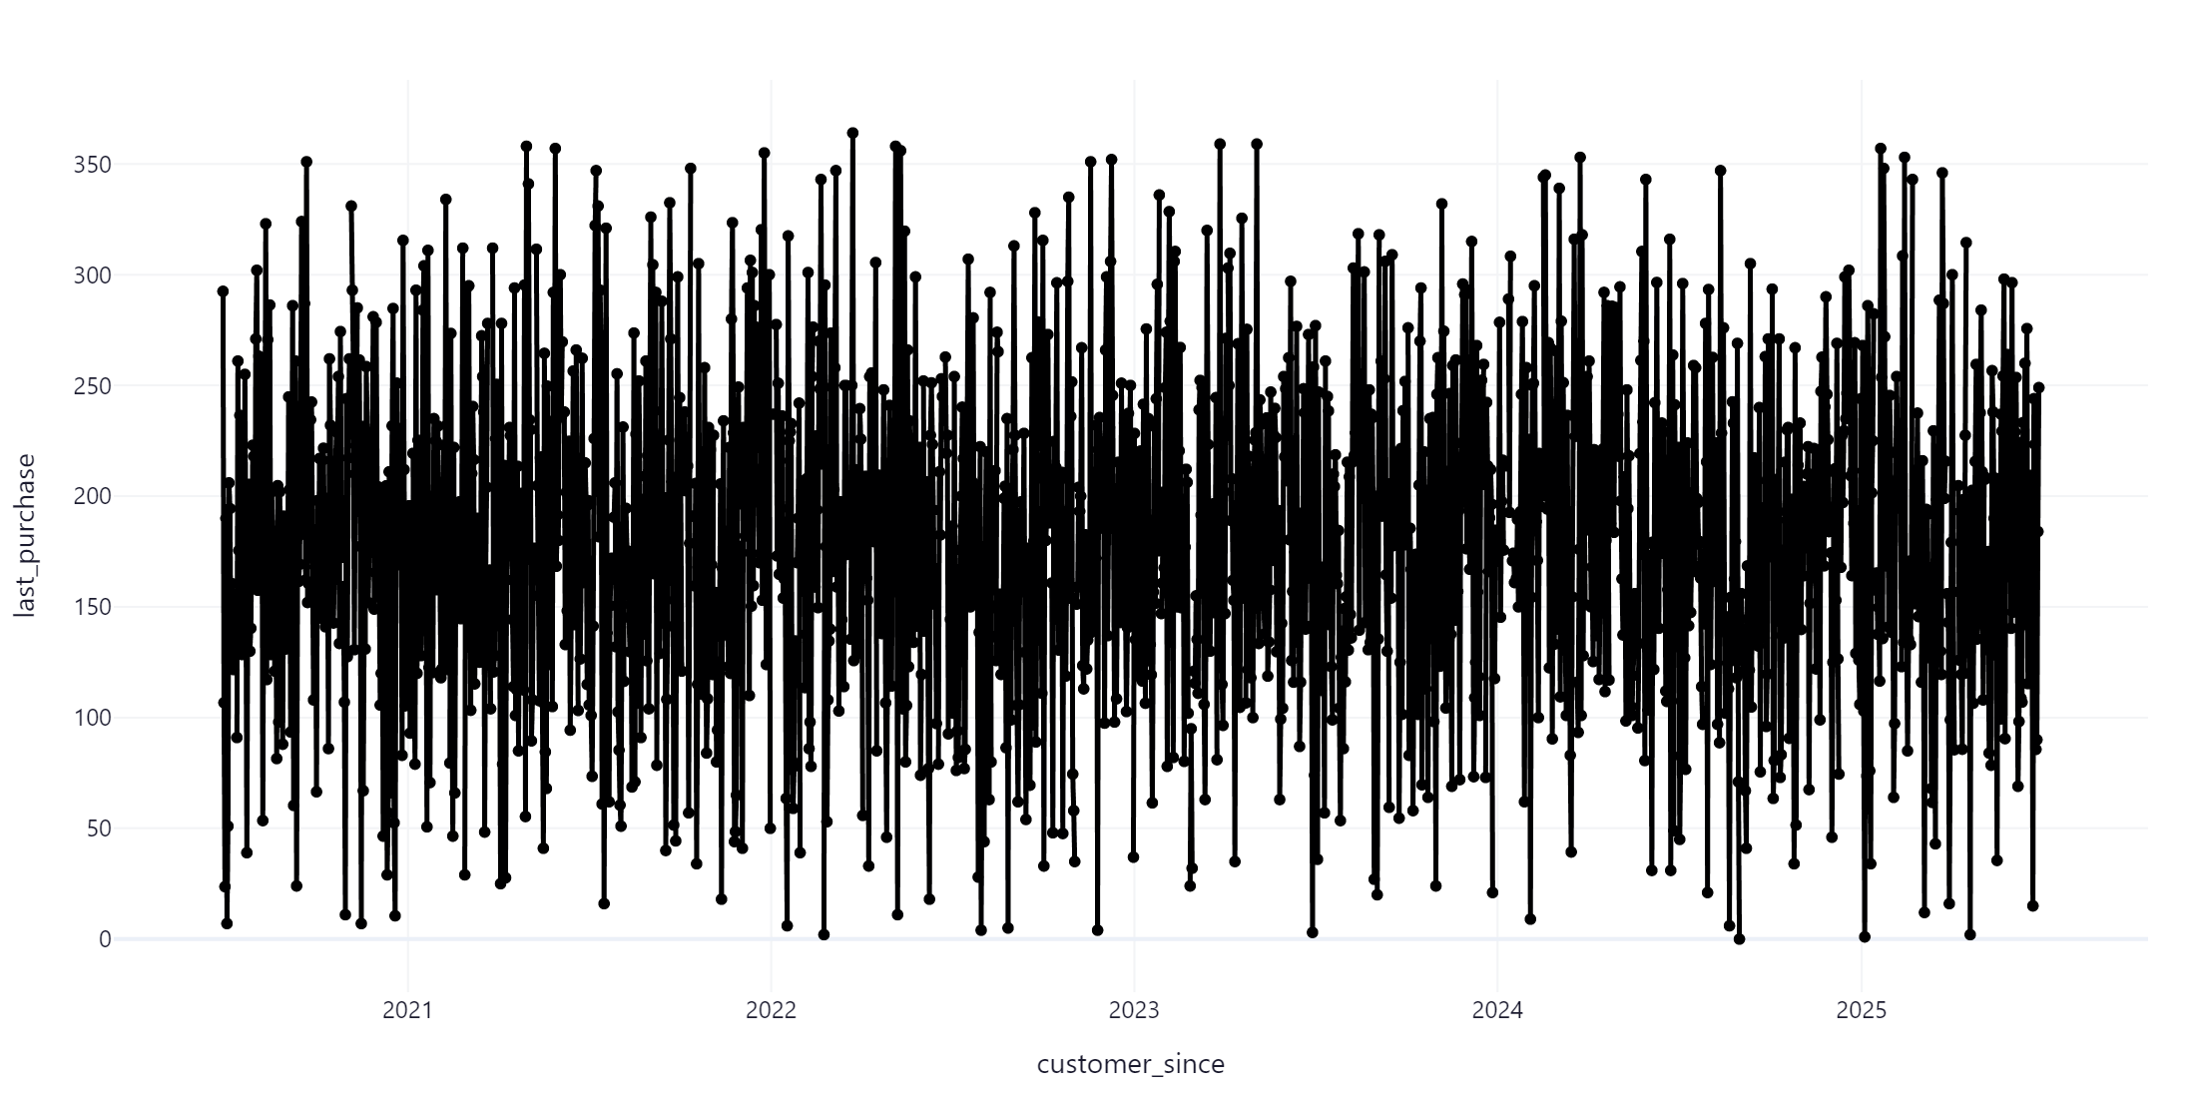
Last Purchase Over Time

Slide 6
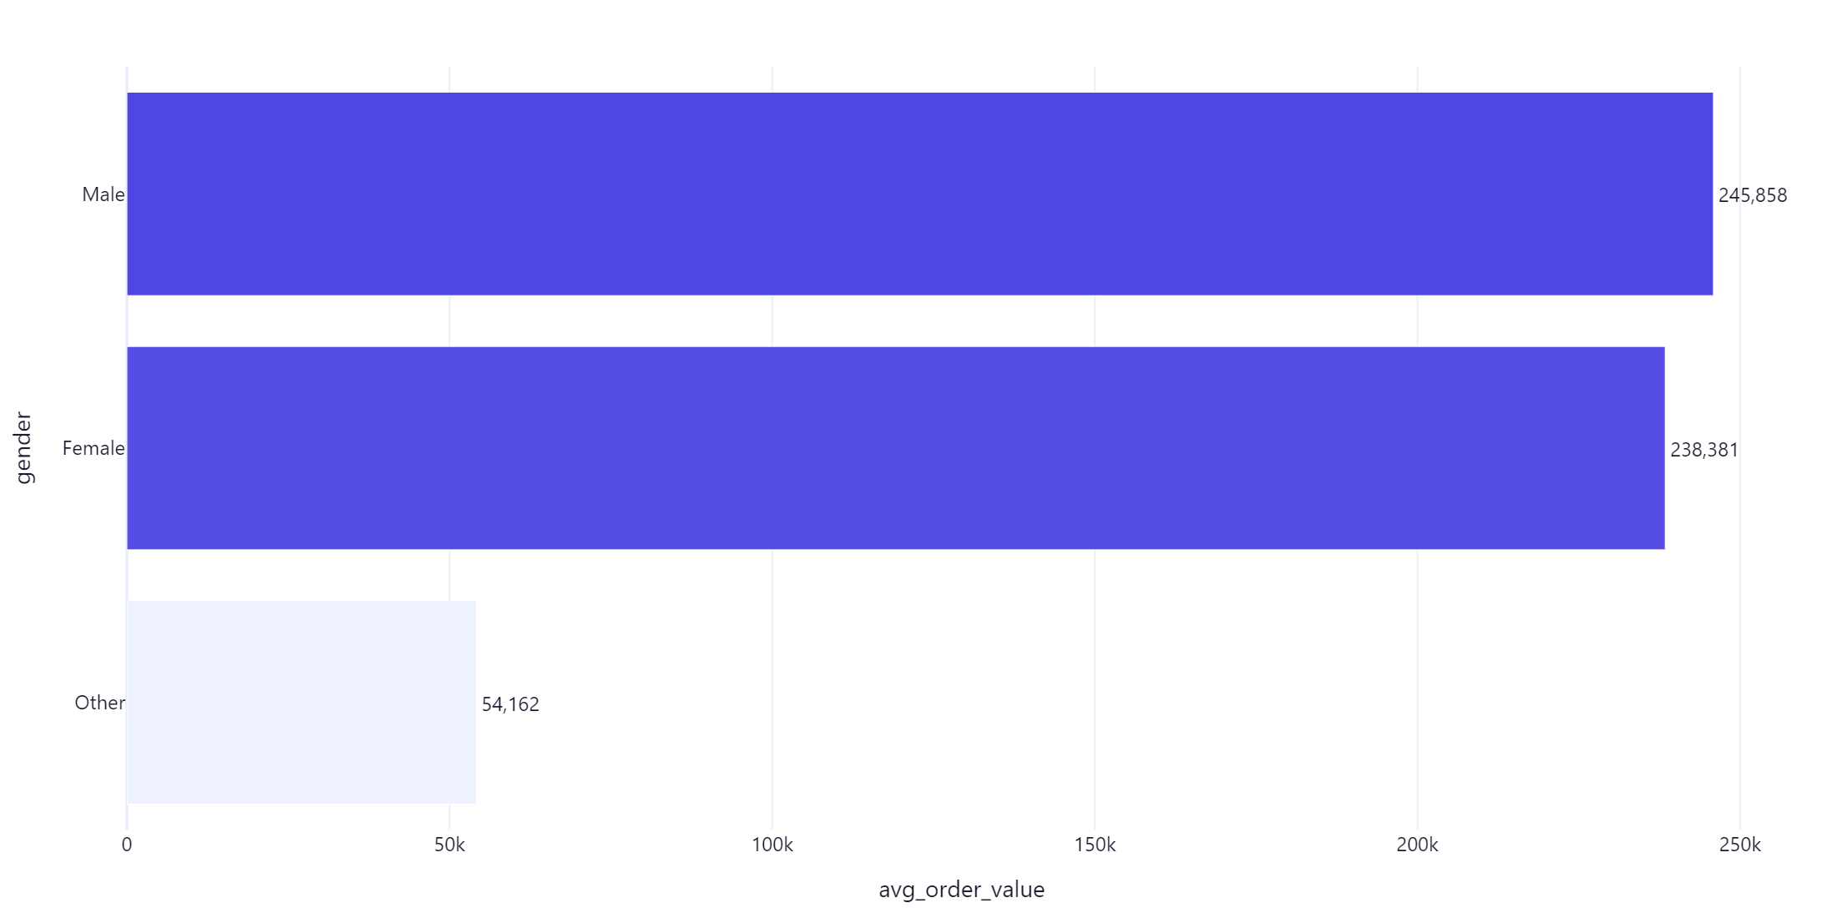
Avg Order Value by Gender

Slide 7
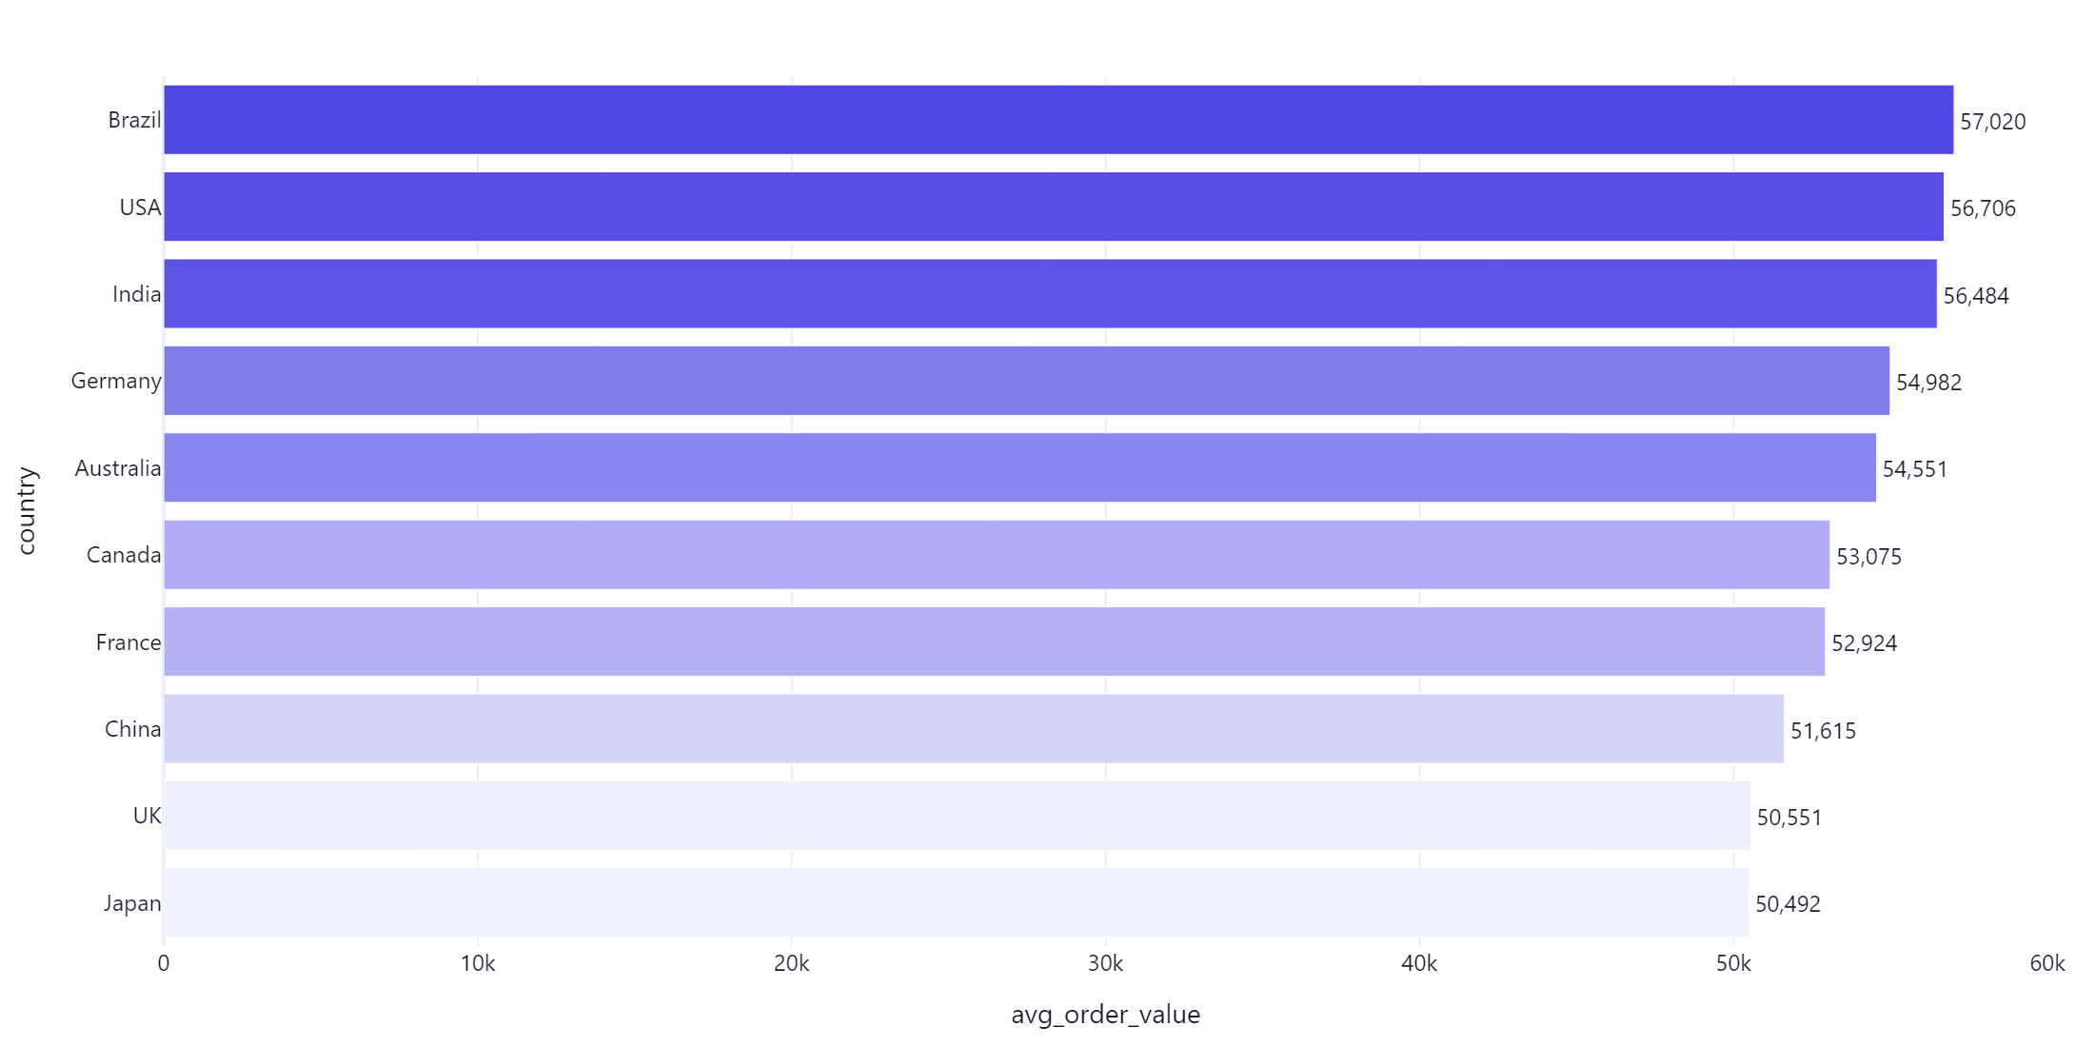
Avg Order Value by Country

