Slide 1
E-commerce Analytics
KPIs · Insights · Visualisations
Analytics Report
Generated May 28, 2026

Slide 2
What's Inside
Key performance indicators at a glance
Executive summary and business insights
Trend and category visualisations
Domain focus: E-commerce Analytics

Slide 3
Key Performance Indicators
Total Revenue
\.4K

Slide 4
Key Insights
Test summary.

Slide 5
Executive Summary
Test summary.

Slide 6
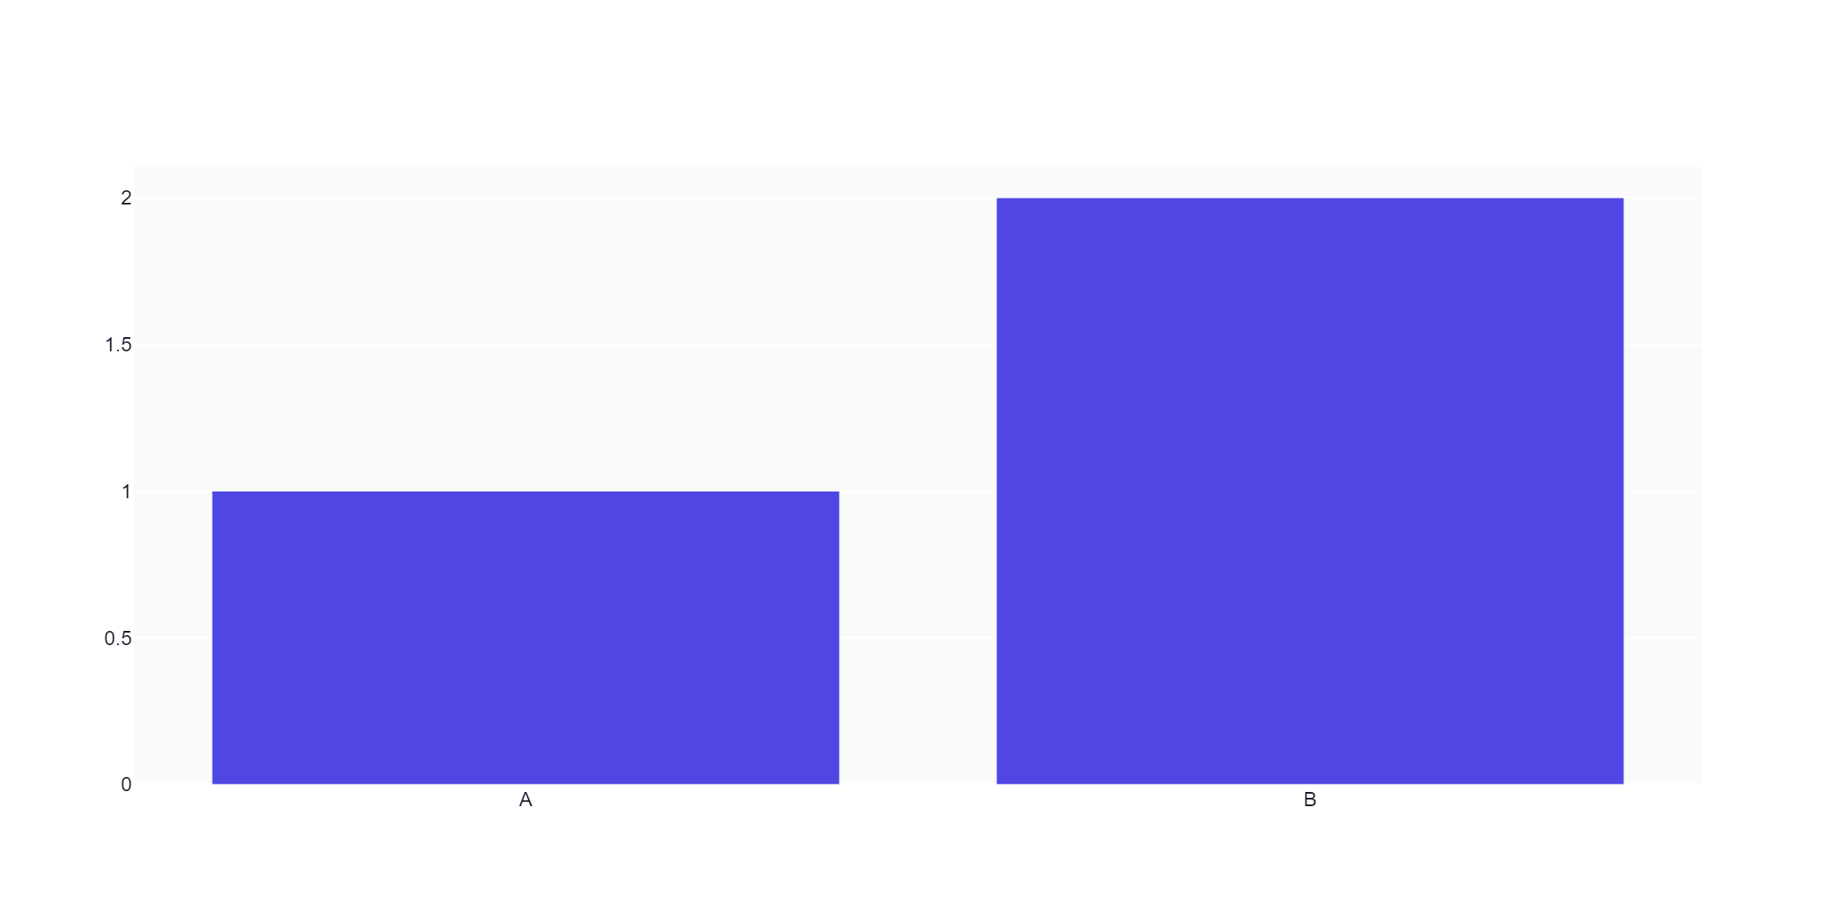
Test Chart

Slide 7
Thank You
E-commerce Analytics
Questions? Review the full dashboard or export additional formats.

