Slide 1
E-commerce Analytics
KPIs · Insights · Visualisations
Analytics Report
Generated May 28, 2026

Slide 2
What's Inside
Key performance indicators at a glance
Executive summary and business insights
Trend and category visualisations
Domain focus: E-commerce Analytics

Slide 3
Key Performance Indicators
Total Records
Avg Order Value
Avg Age
Avg Total Orders
5,000
$538.4K
48.16
10.03
Avg Last Purchase
Avg Is Fraudulent
Avg Email Open Rate
Avg Loyalty Score
180.07
0.03
50.73
50.04

Slide 4
Key Insights
This E-commerce Analytics report analyses synthetic_ecommerce_churn_dataset.
csv, covering 0 records across 0 dimensions.
The dataset has been automatically cleaned, validated, and scored for quality prior to analysis.
Key performance indicators show: Total Records at 5,000, Avg Order Value at $538.
16, Avg Total Orders at 10.

Slide 5
Executive Summary
This E-commerce Analytics report analyses synthetic_ecommerce_churn_dataset.csv, covering 0 records across 0 dimensions. The dataset has been automatically cleaned, validated, and scored for quality prior to analysis. Key performance indicators show: Total Records at 5,000, Avg Order Value at $538.4K, Avg Age at 48.16, Avg Total Orders at 10.03. No strong directional trends were detected in the current dataset. The domain-specific KPI framework applied is aligned to E-commerce Analytics best practices, ensuring that the metrics presented reflect operationally relevant performance indicators rather than generic statistical averages. Anomaly detection flagged 4 area(s) requiring attention. These may indicate data quality issues, outlier events, or genuine business extremes that warrant further investigation before operational decisions are made. Particular attention should be given to columns flagged during quality scoring, as these may affect the reliability of aggregated KPI figures. To unlock AI-generated narrative insights, executive commentary, and natural language recommendations, configure your API key: set ANTHROPIC_API_KEY (Anthropic Claude) or OPENAI_API_KEY (OpenAI GPT-4o) in the .env file and restart the application. The AI layer will then provide domain-specific strategic analysis, anomaly explanations, and prioritised action plans tailored to your E-commerce Anal

Slide 6
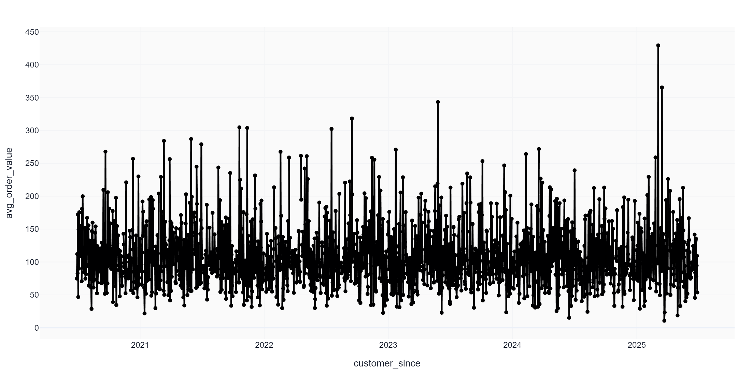
Avg Order Value Over Time

Slide 7
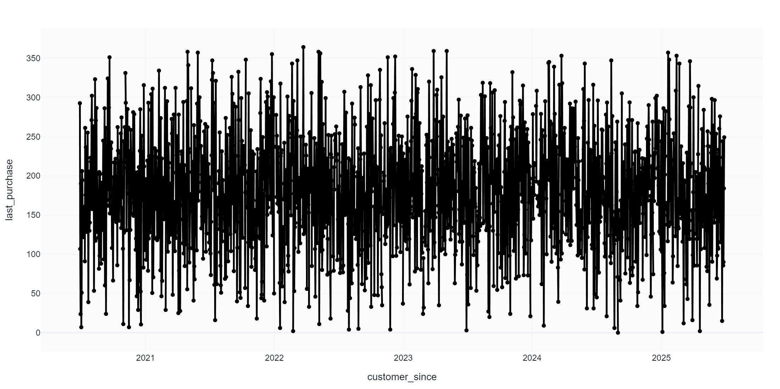
Last Purchase Over Time

Slide 8
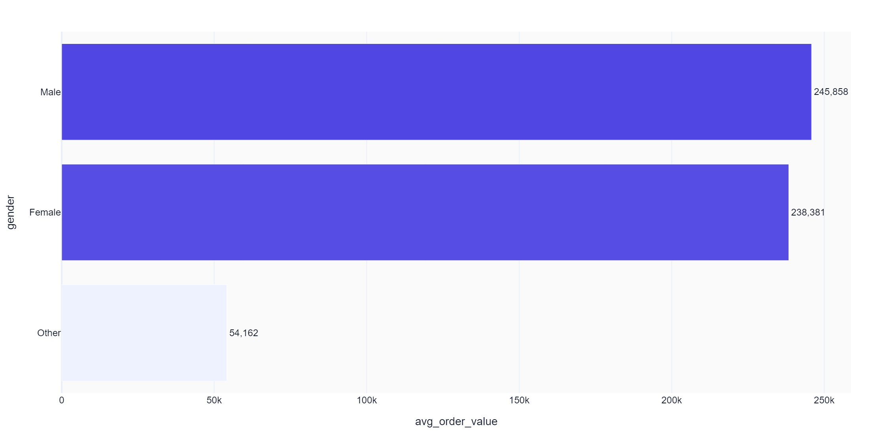
Avg Order Value by Gender

Slide 9
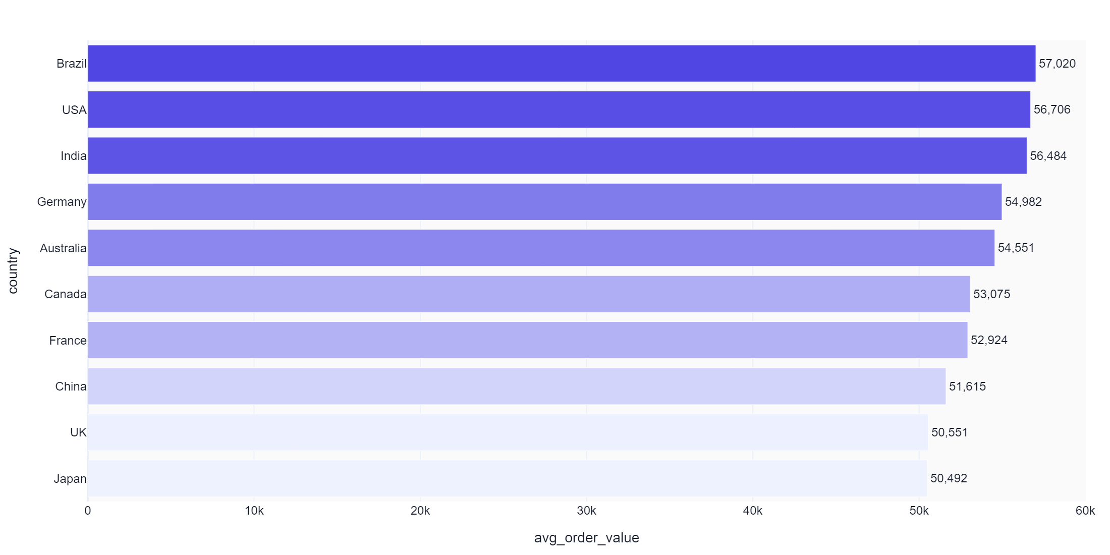
Avg Order Value by Country

Slide 10
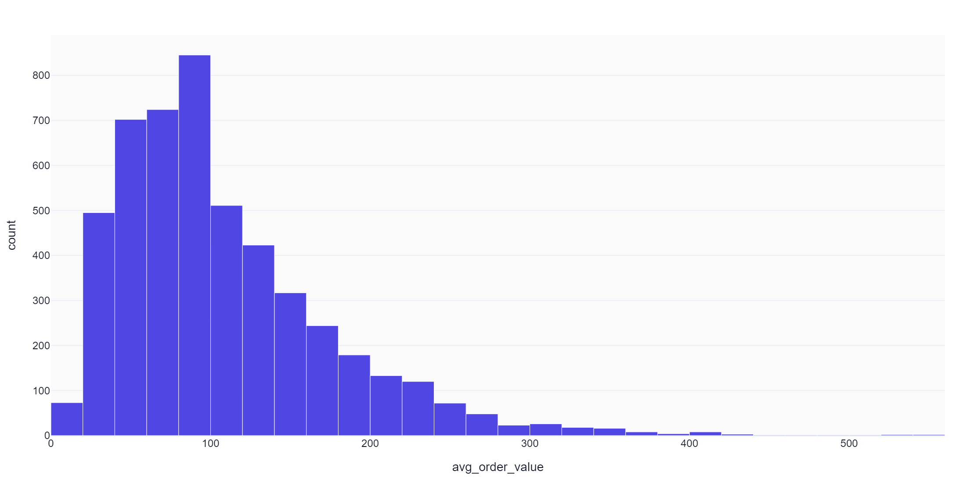
Distribution: Avg Order Value

Slide 11
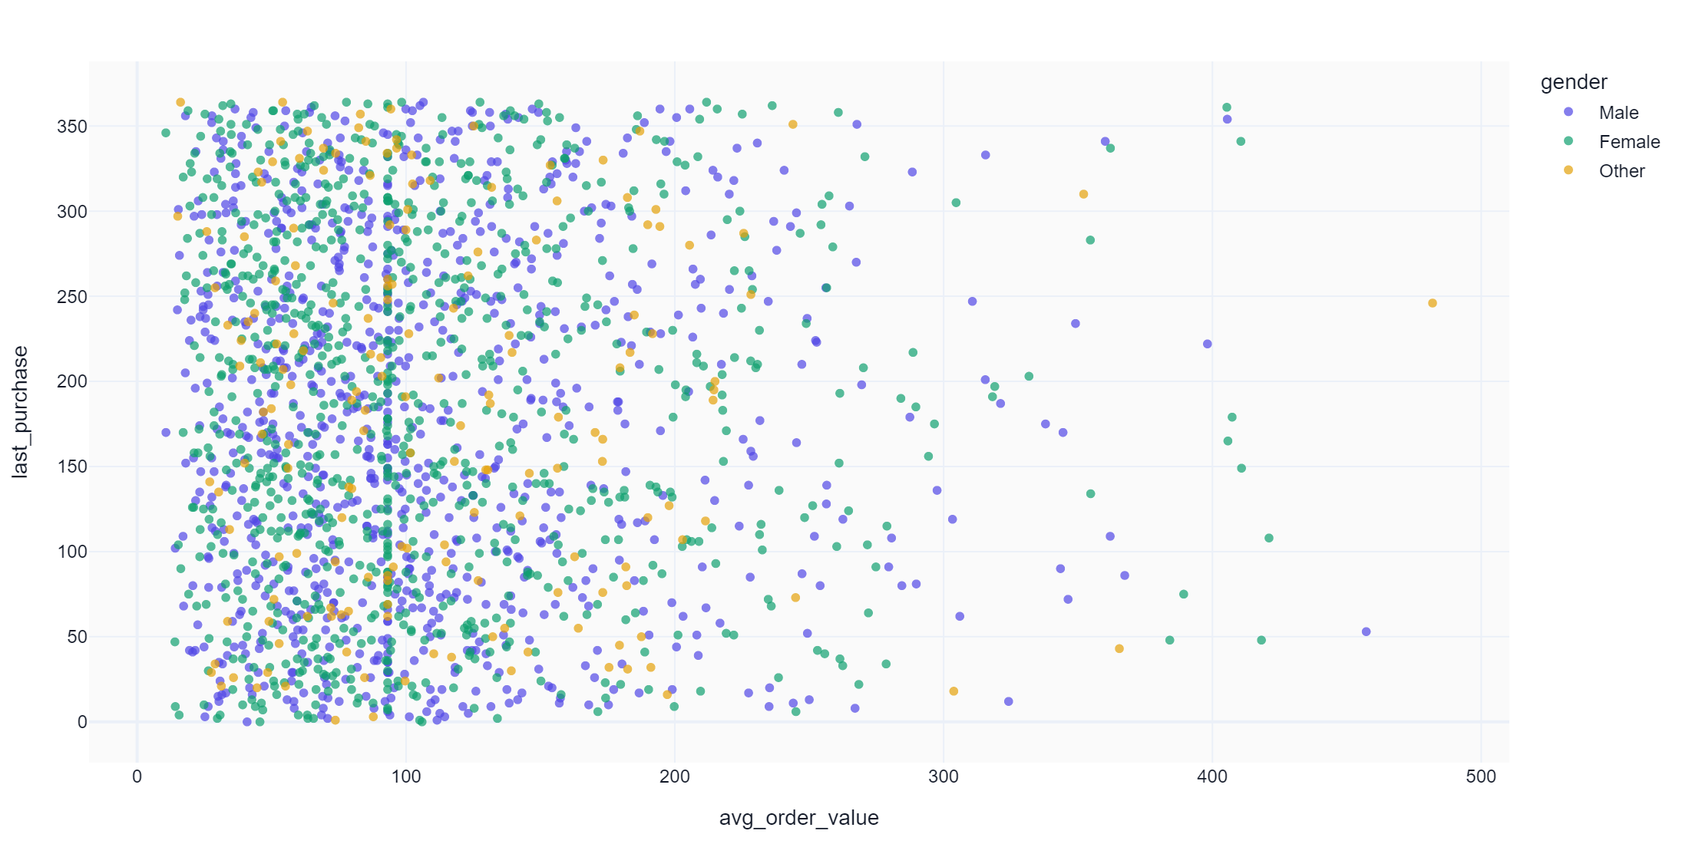
Avg Order Value vs Last Purchase

Slide 12
Thank You
E-commerce Analytics
Questions? Review the full dashboard or export additional formats.

