Slide 1
General Analytics
Analytics Report
Generated May 24, 2026

Slide 2
Key Performance Indicators
Total Records
Avg Age
Avg Daily Social Media Hours
Avg Sleep Hours
1,200
15.93
4.54
6.45
Avg Screen Time Before Sleep
Avg Academic Performance
Avg Physical Activity
Avg Stress Level
1.74
2.99
1.01
5.45

Slide 3
Executive Summary
Executive Summary (AI offline — statistical summary) - Total Records: 1,200 - Avg Age: 15.93 - Avg Daily Social Media Hours: 4.54 - Avg Sleep Hours: 6.45 - Avg Screen Time Before Sleep: 1.74 - Avg Academic Performance: 2.99

Slide 4
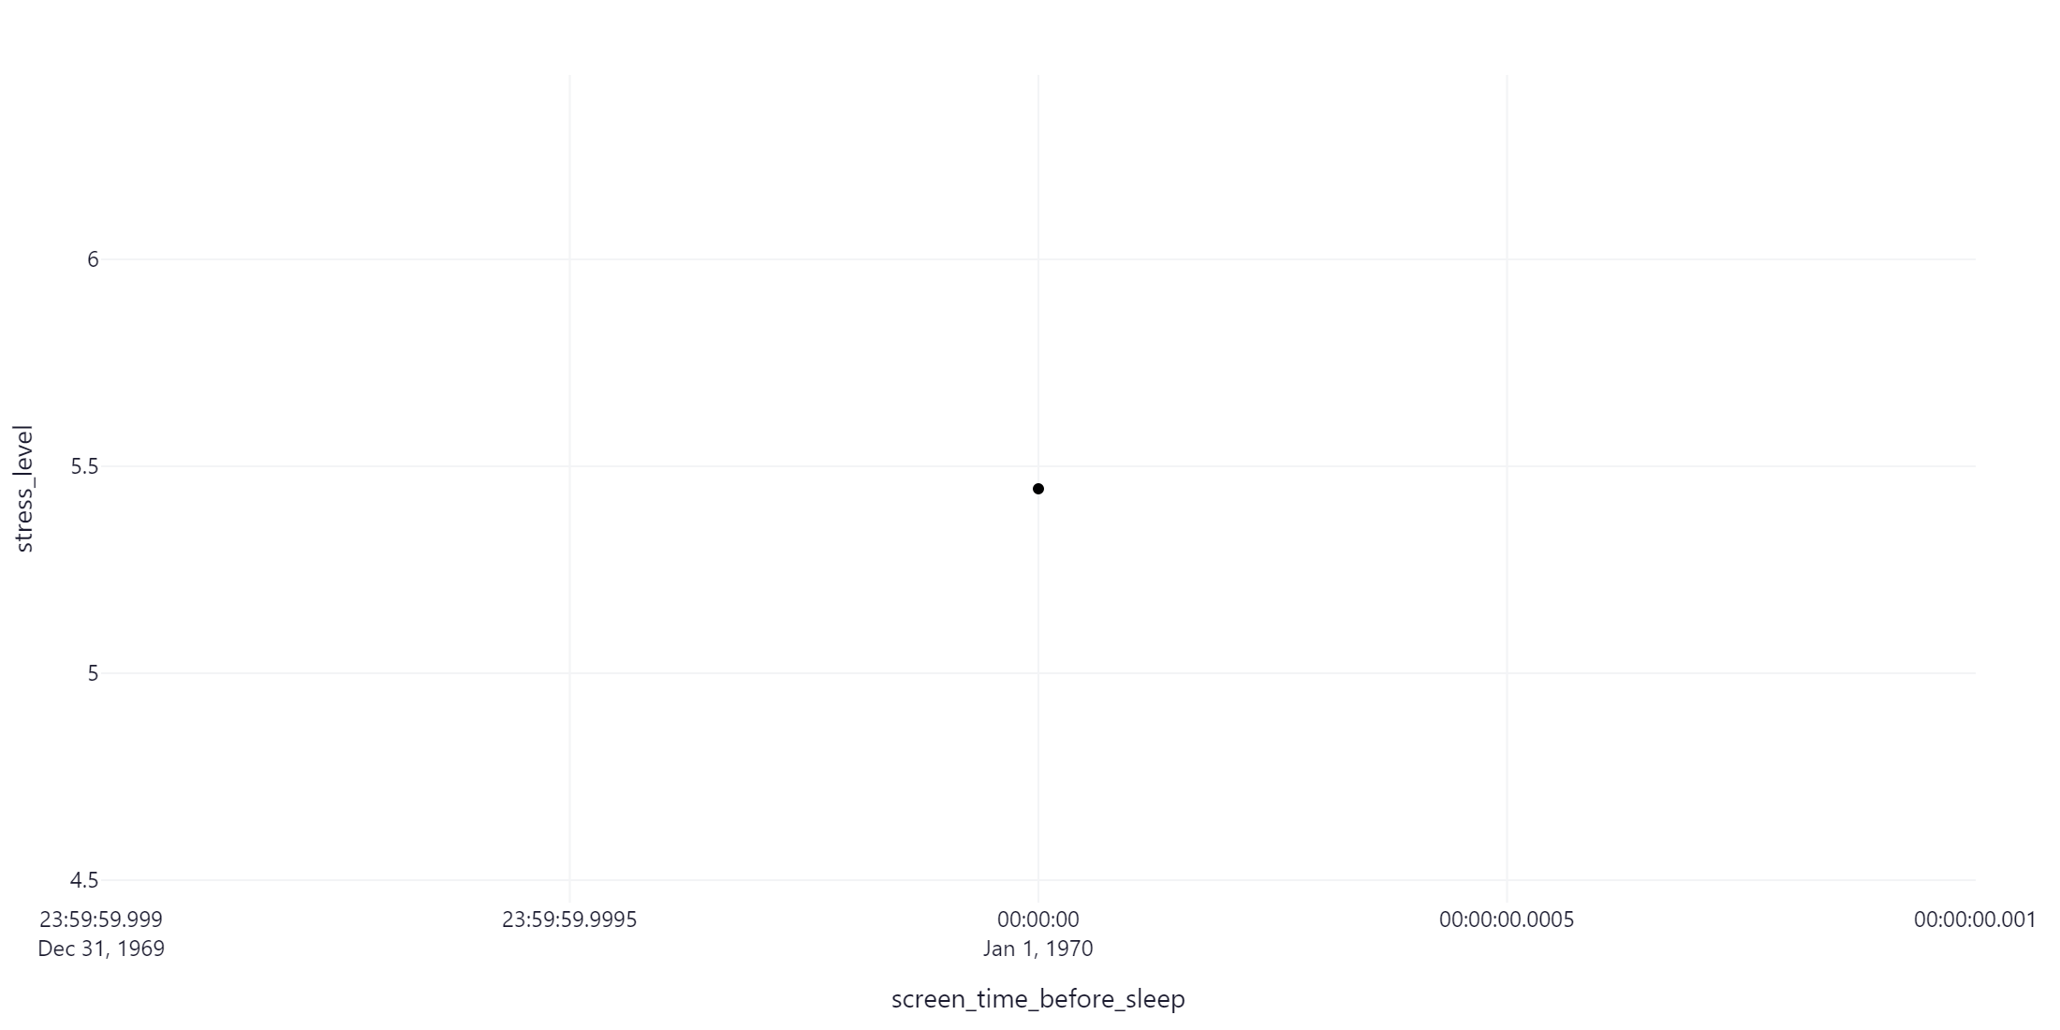
Stress Level Over Time

Slide 5
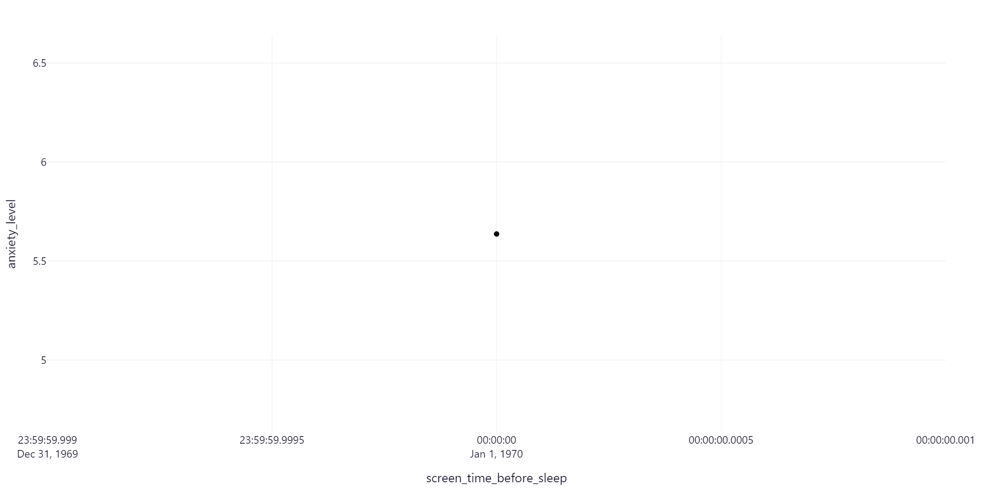
Anxiety Level Over Time

Slide 6
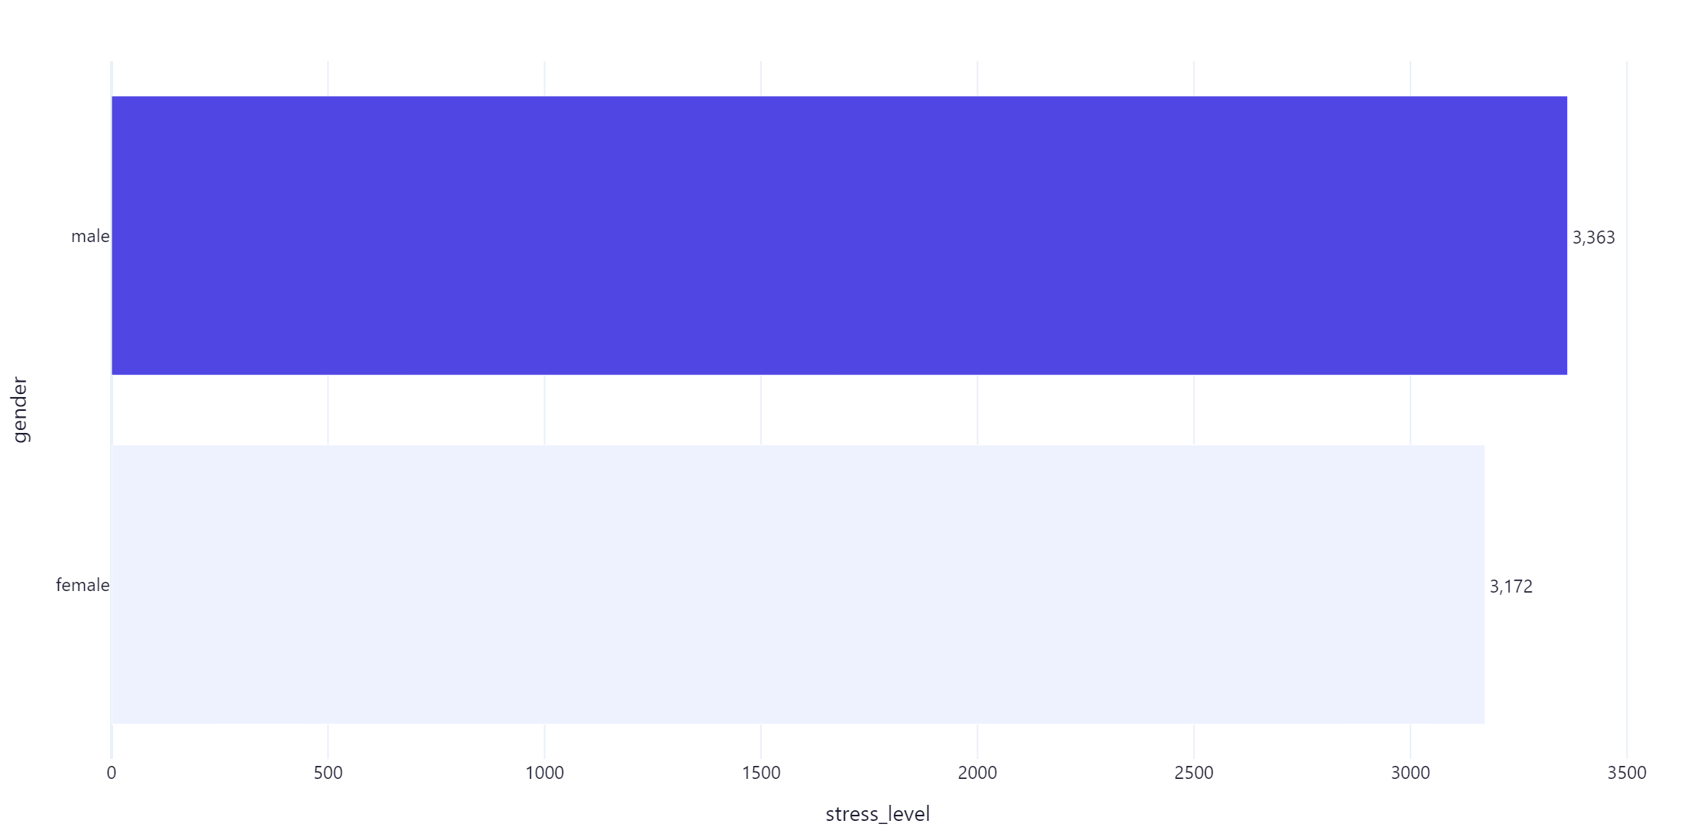
Stress Level by Gender

Slide 7
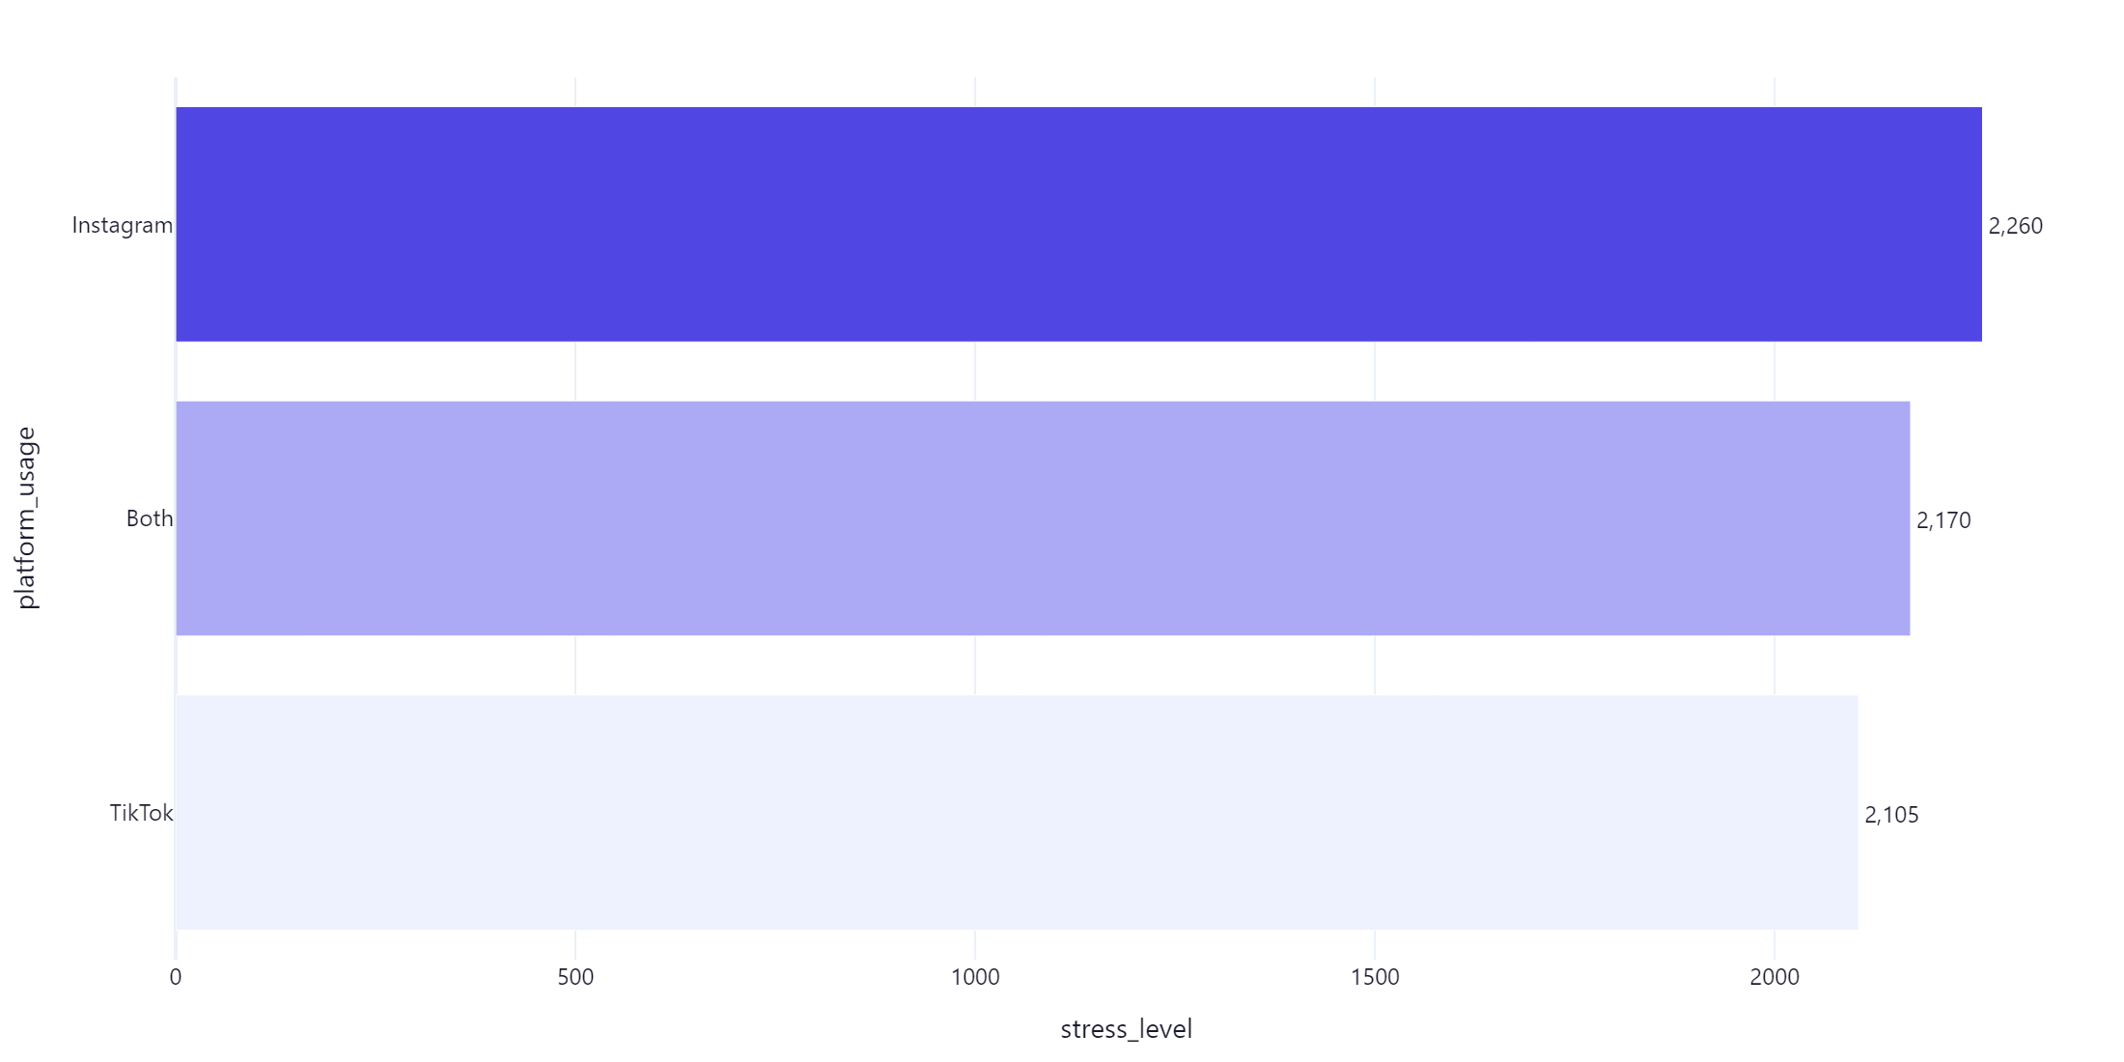
Stress Level by Platform Usage

