Slide 1
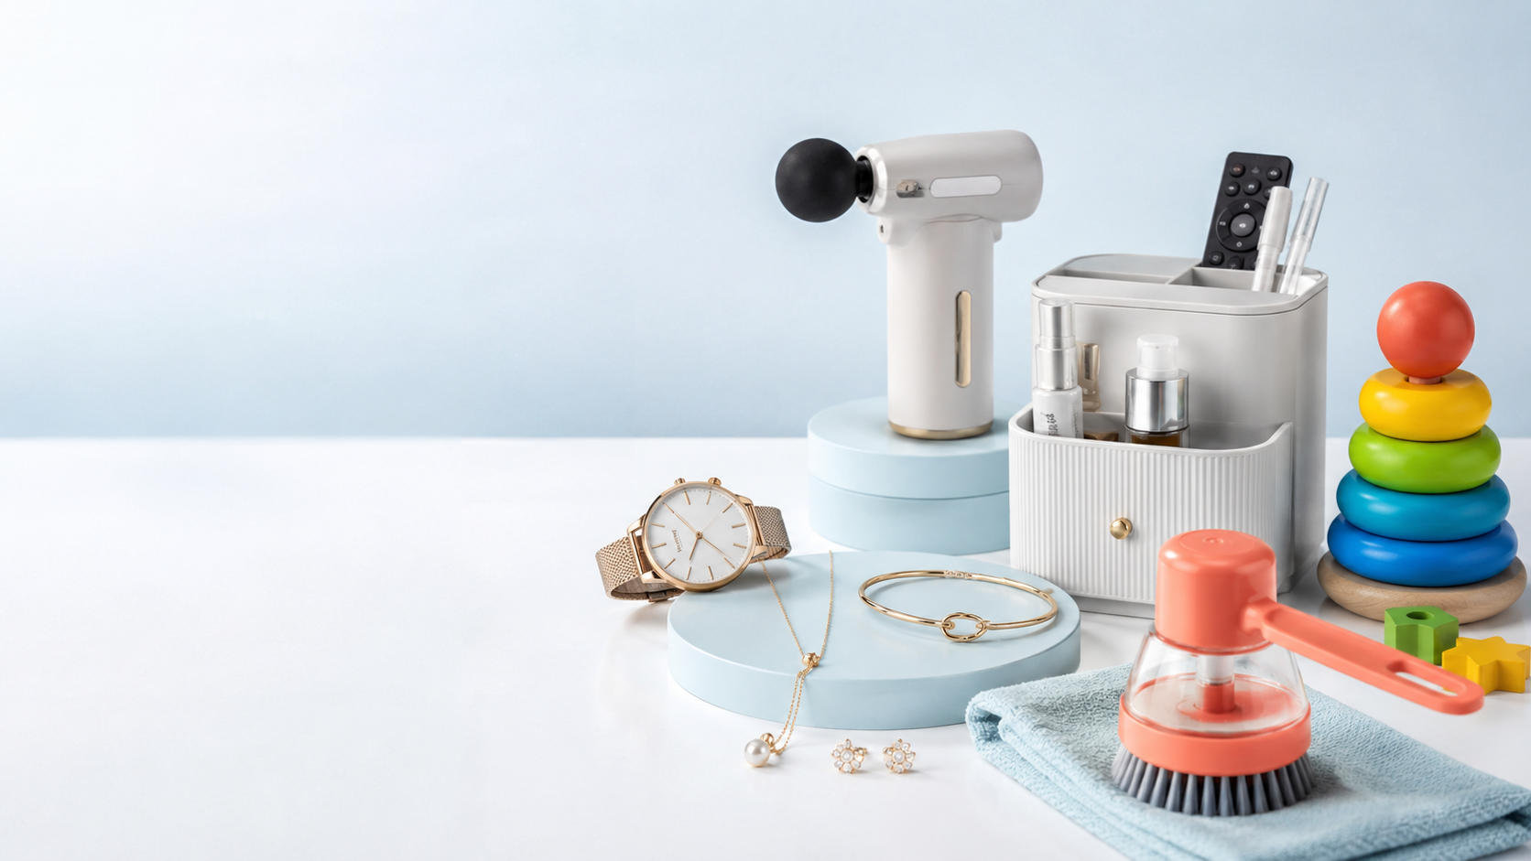
Rhombix technologies internship
Productify
by emay
A direct-sales digital marketing plan for a mixed online catalogue
Prepared by: Amna irfan
Task 1 & 2
Notes:
Assalam-o-Alaikum. Hum Productify by emay ke liye ek complete digital marketing plan present kar rahe hain. Hamara focus simple hai: brand ki mixed product catalogue ko clear campaigns mein divide karke direct online sales increase karna.
[Sources]
- Generated generic product collage; no real product claims or performance results represented.
- User-provided Final Group Project Brief.

Slide 2
OUR STRATEGY
One catalogue. One goal. Clear buying paths.
Mixed catalogue
Focused campaigns
Completed orders
BUSINESS GOAL
Increase direct product sales
Content creates desire · Search captures intent · SEO builds trust · Analytics proves sales
Internship task -Digital Marketing & Freelancing
02
Notes:
Productify by emay mein products bohat different hain. Is liye hum sab ko ek hi ad mein mix nahi karenge. Catalogue broad rahegi, lekin campaign customer ki need ke mutabiq focused hoga. Har member ki strategy completed customer order ko support karegi.
[Sources]
- User-provided Final Group Project Brief and approved project strategy.

Slide 3
1
Research & Strategy Lead
Understands who should buy, why they should care, and where the brand can win.
03
Notes:
Main Member 1 hoon aur mera role business ko marketing se pehle samajhna hai. Main business model, customers, competitors aur hamara overall sales goal explain karungi.
[Sources]
- User-provided Final Group Project Brief and approved project strategy.

Slide 4
· BUSINESS & CUSTOMERS
The brand sells useful discoveries - not random products.
Business model
Online retail store with products across fashion, home, wellness and kids’ needs.
16-30
Trend-led buyers
Watches, jewelry, useful gadgets
Customers buy when a product either solves a daily problem or feels worth discovering.
25-45
Home & family shoppers
Organizers, cleaning tools, toys
30-55
Comfort seekers
Massagers and back-support products
Rhombix internship · Digital Marketing & Freelancing
04
Notes:
Productify by emay ek multi-category online retail brand hai. Lekin hum customer ko ‘har cheez’ nahi bech rahe. Hum useful discoveries bech rahe hain - aisi cheezen jo daily problem solve karein ya customer ko instantly attractive lagen. Teen major direct-buyer segments hain: young trend buyers, home and family shoppers, aur wellness ya comfort seekers.
[Sources]
- https://www.instagram.com/productifybyemay/
- https://www.youtube.com/shorts/wTGGCGHKkR8
- https://www.youtube.com/shorts/pipWRug4k0Q

Slide 5
• COMPETITOR ANALYSIS
Productify can compete through curation and demonstration.
COMPETITOR
WHAT THEY DO WELL
OUR RESPONSE
Daraz
Huge selection, price comparison and visible buyer reviews
Curate fewer useful products and explain them better
HamzaStore.pk
Clear categories across gadgets, home, fashion and toys
Use relatable short demos and personal support
Social resellers
Fast trend adoption and aggressive pricing
Build trust through proof, delivery clarity and consistency
Positioning: Useful products, honestly demonstrated, with an easy buying experience.
05
Notes:
Hamare competitors size aur price par strong hain. Daraz ka benefit variety aur reviews hain. HamzaStore clear multi-category shopping deta hai. Social resellers trends ko jaldi pick karte hain. Productify ka winning point yeh ho sakta hai: products ko carefully select karna, real use demonstrate karna, aur buyer ko personal easy support dena.
[Sources]
- https://www.daraz.pk/
- https://www.hamzastore.pk/
- https://www.instagram.com/productifybyemay/

Slide 6
· OVERALL GOAL
The plan is designed around one measurable result.
PRIMARY GOAL
Increase completed direct orders
Not followers. Not views alone. Sales.
Show products through short problem-solution content
Capture high-intent searches with category-based ads
Build trust with product pages, reviews and delivery information
06
Notes:
Hamara single overall goal completed direct orders increase karna hai. Followers aur views useful ho sakte hain, lekin woh final result nahi. Content demand create karega, Google Ads existing buying intent capture karega, aur SEO plus trust elements customer ko order complete karne mein help karenge.
[Sources]
- User-provided Final Group Project Brief and approved project strategy.

Slide 7
2
Content & Video Lead
Turns everyday product problems into content people want to watch - and buy from.
07
Notes:
Main Member 2 hoon. Mera role aisa content create karna hai jo customer ko product samjhaye, interest build kare aur clear call-to-action ke through order tak le jaye.
[Sources]
- User-provided Final Group Project Brief and approved project strategy.

Slide 8
• VIDEO CONCEPT
One repeatable video format can sell the whole catalogue.
Cover idea
WORKING TITLE
5 Products That Make Everyday Life Easier
BEFORE
AFTER
Daily frustration
Product solves it
30-45 sec Reel / Short
Hook → Demo → Benefit → Price → Order CTA
Large product close-up + short benefit line; no cluttered collage
08
Notes:
Hamara main video format hoga ‘5 Products That Make Everyday Life Easier.’ Video 30 se 45 seconds ka hoga. Start mein common problem ka hook, phir quick product demo, clear benefit, price aur end mein order CTA. Thumbnail ya cover par before-and-after feeling hogi, lekin design simple rakhenge.
[Sources]
- User-provided Final Group Project Brief and approved project strategy.

Slide 9
· CONTENT PLAN
Content moves the customer from curiosity to checkout.
1
2
3
4
HOOK
DEMO
PROOF
ACTION
“Still struggling with this?”
Show the product in real use
Close-ups, features, buyer feedback
Price + delivery + order link
Every post ends with one action: Shop now / WhatsApp to order.
09
Notes:
Content ka kaam sirf views lena nahi. Pehle curiosity create hogi, phir real demo, phir proof aur last mein action. Hum weekly content mein fashion, home, wellness aur kids categories rotate karenge, lekin har individual video mein sirf ek clear problem aur ek clear CTA hoga. Is tarah content direct sales goal ko support karega.
[Sources]
- User-provided Final Group Project Brief and approved project strategy.

Slide 10
3
Google Ads & SEO Lead
Captures people already searching - and makes every landing page easier to trust.
10
Notes:
Main Member 3 hoon. Mera role Google Search campaign aur SEO structure design karna hai, taake buying intent wale customers relevant category page par aayein.
[Sources]
- User-provided Final Group Project Brief and approved project strategy.

Slide 11
• GOOGLE ADS STRUCTURE
Search ads must follow customer intent - not catalogue size.
Objective: Sales | Campaign: Search | Location: Pakistan | Destination: Matching category pages
AD GROUP 1 · FASHION ACCESSORIES
AD GROUP 2 · WELLNESS ESSENTIALS
[watches for women]
[body massager pakistan]
"fashion jewellery pakistan"
"back support belt"
[bracelets online pakistan]
[massage gun price pakistan]
"trendy accessories online"
"pain relief massager"
[watches online pakistan]
[back belt price pakistan]
"pinterest jewellery pakistan"
"neck massager online"
[exact match] “phrase match”
Open the matching category - not the homepage.
11
Notes:
Campaign objective Sales hoga aur campaign type Search. Mixed catalogue ke bawajood hum ad groups need ke mutabiq separate rakhenge. Pehla fashion accessories, doosra wellness essentials. Square brackets exact match hain aur quotation marks phrase match. Har keyword customer ko relevant category page par bhejega, homepage par nahi.
[Sources]
- User-provided Final Group Project Brief and approved project strategy.

Slide 12
· SEARCH AD & NEGATIVES
The ad promises relevance, trust and an easy order.
Responsive Search Ad · Fashion Accessories
NEGATIVE KEYWORDS
Headlines
free
1. Shop Trendy Accessories
jobs
2. Watches & Jewelry Online
3. Style Finds Across Pakistan
wholesale
4. Easy Ordering & Delivery
repair
5. Discover Your Next Favorite
used
Descriptions
Shop watches, jewelry and useful style finds. Order online with easy support.
Discover affordable accessories selected for everyday style and gifting.
12
Notes:
Yeh responsive search ad fashion accessories ad group ke liye hai. Headlines product category, delivery aur discovery benefit ko communicate karti hain. Descriptions clear ordering support mention karti hain. Negative keywords free, jobs, wholesale, repair aur used irrelevant clicks ko block karenge, taake budget buying customers par spend ho.
[Sources]
- User-provided Final Group Project Brief and approved project strategy.

Slide 13
· SEO PLAN
SEO turns product pages into useful answers.
ON-PAGE
01
Search-friendly category titles
OFF-PAGE IDEA
e.g. Women’s Watches Online in Pakistan
Verified customer reviews
02
Unique product descriptions
Request reviews after delivery and repurpose genuine feedback on Google Business Profile and social pages.
Benefits, use, size, delivery and care
03
Trust-rich product pages
Clear photos, FAQs, reviews and WhatsApp CTA
SEO goal: Relevant traffic + stronger trust
13
Notes:
On-page SEO mein category title search-friendly hoga, har product ki unique benefit-based description hogi, aur product page par photos, FAQ, reviews aur clear WhatsApp CTA hoga. Off-page ke liye delivery ke baad genuine customer review request ki jayegi. Fake reviews use nahi honge. Is se search visibility ke saath trust bhi improve hoga.
[Sources]
- User-provided Final Group Project Brief and approved project strategy.

Slide 14
4
Analytics & Client Pitch Lead
Defines what success means, reports it clearly, and turns the plan into a professional offer.
14
Notes:
Main Member 4 hoon. Mera role conversion define karna, weekly performance track karna aur client ko price, timeline aur payment plan ke saath complete offer present karna hai.
[Sources]
- User-provided Final Group Project Brief and approved project strategy.

Slide 15
· CONVERSION & TRACKING
Success means a confirmed customer order.
ONE CONVERSION
A completed and confirmed direct order
01
02
03
Orders
Cost per sale
ROAS
How many confirmed sales?
How much marketing spend produced each order?
How much revenue returned for every ad rupee?
Review weekly. Improve creative, keywords or landing pages - not the goal.
15
Notes:
Hamari single conversion completed aur confirmed order hai. Har week teen numbers report honge: total orders, cost per sale, aur ROAS yani ad spend ke muqablay mein revenue. Agar result weak ho to hum creative, keywords ya landing page improve karenge - goal ko followers par shift nahi karenge.
[Sources]
- User-provided Final Group Project Brief and approved project strategy.

Slide 16
· PRICE, TIMELINE & PAYMENT
A 30-day pilot makes the plan practical and measurable.
TIMELINE
30-DAY PILOT
PKR 45,000
Week 1
Research, tracking and setup
Agency service fee
Week 2
Content and campaign launch
Strategy & campaign setup
Week 3
Testing and optimisation
8 short-form content pieces
Week 4
Report and next-month plan
Search Ads + SEO setup
Weekly performance report
Ad spend paid separately by client
Payment: 50% advance · 50% after launch
16
Notes:
Hum client ko 30-day pilot offer karenge. Service fee 45,000 rupees hogi; ad spend client separately pay karega. Package mein strategy, setup, eight short-form content pieces, Search Ads, basic SEO aur weekly reporting included hain. Payment 50 percent advance aur 50 percent campaign launch ke baad bank transfer ya digital payment se hogi.
[Sources]
- User-provided Final Group Project Brief and approved project strategy.

Slide 17
OUR RECOMMENDATION
Sell the solution.
Prove the result.
Productify by emay can grow direct sales by pairing relatable product demos with focused search campaigns, trustworthy pages and weekly sales reporting.
One catalogue · Clear campaigns · More completed orders
Questions?
Notes:
Hamari recommendation yeh hai ke Productify by emay apni mixed catalogue ko strength rakhe, lekin marketing ko focused rakhe. Relatable demos demand create karenge, Search Ads buying intent capture karenge, trusted pages conversion improve karenge aur weekly reports client ko real business result dikhayengi. Thank you - ab hum aap ke questions answer karenge.
[Sources]
- User-provided Final Group Project Brief and approved project strategy.

