Slide 1
Fracture Vision Automated Forensic Glass Fracture Analysis
Group Members:
Amina Saif
Laiba Maqbool

Slide 2
Manual Analysis
Manual visual estimation is slow and subjective
Cognitive Bias and perceptual variability can cause inconsistency
Detailed mapping can take hours per sample
Outcomes depend on examiner experience

Slide 3
Objectives
Identifying the impact time seprating fast ballistic hits and slow blunt force
Mathematically finding the exact point of impact without touching the glass
Reduce processing time by 95 % while keeping measurements pixel accurate

Slide 4
Methodolgy
Preprocessing
Feature Extraction
Inference
Localization

Slide 5
Preprocessing
Gray scale conversion and guassian blur is used to wipe out random camera noise
Canny edge detection to trace and lock sharp crack edges
Thickens the lines to reconnect any gaps caused by bright light reflections
Thins the whole network of cracks into ultra precise one pixel wide lines for analysis

Slide 6
ResNet-50 Backbone and Training
ResNet 50 is used to capture multi scale texture and line features while avoiding overfitting
Traning Phase
System Completes head warmup phase for 12 epochs while keeping backbone frozen
Code unfreezes the top 60 layers to fine tune the model with low learning rate
Architecture Head
GAP → Dense(512) → Dense(256) → Softmax(2)
Regularisation methods like dropout and L2 are used on dense layers to stop overfitting

Slide 7
POI Localization
System uses a probabilistic tool to spot and extract individual radial crack
Converts those detected line segments into standard parametric equations
Mathematical least squares formula runs to find the exact point where all the lines crash together
System maps out a forensic confidence zone that shows a scatter plot of any uncertainty

Slide 8
Dataset
Total: 205 images for controlled variety (impact angle, lighting, glass thickness)
Training: 156 images (77 hv / 79 lv)
Validation: 15 images (7 hv / 8 lv)
Test: 34 images (17 hv / 17 lv)

Slide 9
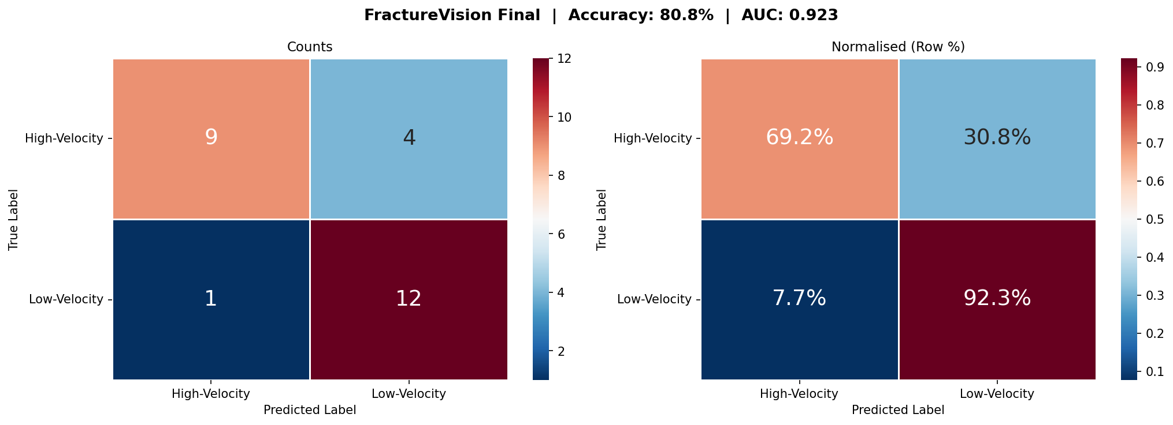
Confusion Matrix

Slide 10
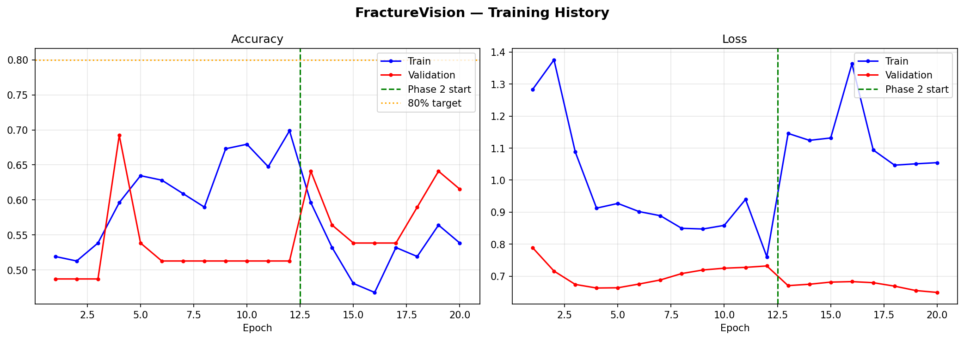
Training Curves

Slide 11
Experimental Result
Overall accuracy: 80.8 %
AUC-ROC: 0.923 high discriminative power
Low Velocity: 92.3 % realiable at filtering non ballistic breaks
High Velocity: 90 % conservative and forensic safe detections

Slide 12
ANY QUESTIONS?

