Slide 1
Particle Tracking team meeting
Contents from Sicong Lin

Slide 2
Introduction of and recent progress from Sicong Lin
Personal introduction
2nd year master student at TU Delft in applied mathematics;
Doing my master thesis at Deltares with Prof. Martin Verlaan
Obtained bachelor degree in mechanics; thesis project about turbulence
Thesis topic: model salt intrusion using a 3D particle model in the Rhine-Meuse delta
Challenges
adapt particle models to large-scale parallel computation;
model the surpressed vertical mixing;
application of the model to understand the physics of the intrusion phenomena.
Recent work on literature review
application of particle model to track drifters: Ruiter(2020) & Meyerjürgens(2018)
general knowledge about a particle model: Sebille et. al.(2018) and several other reports from previous student
components of the particle model: Particles.jl

Slide 3
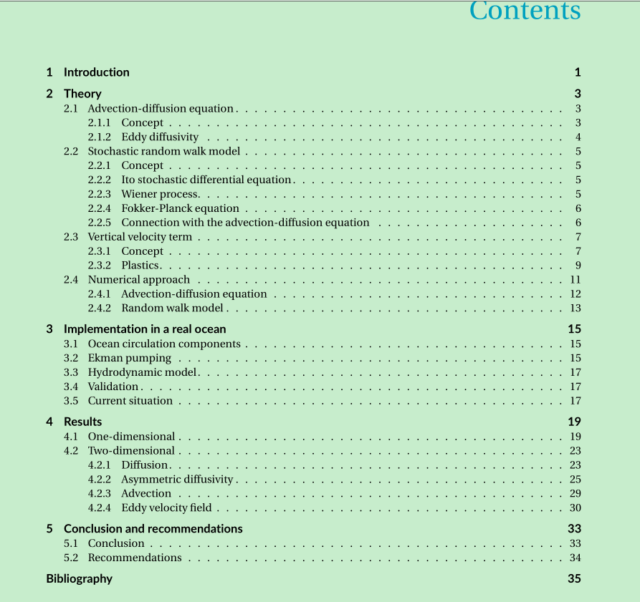

Slide 4

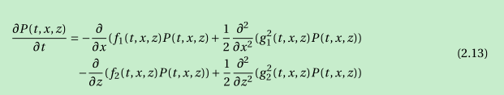

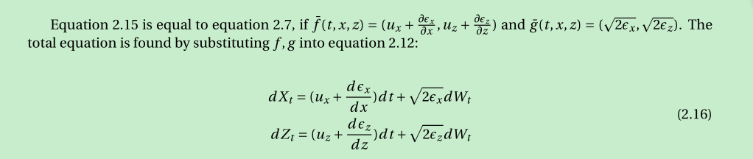

Slide 5
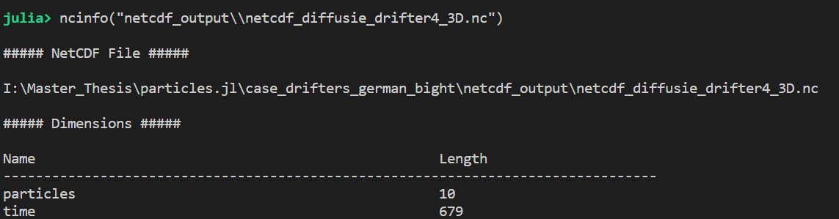
julia> filename = "data\\dcsm-fm_201703\\DCSM-FM_05nm_0001_map.nc"
"data\\dcsm-fm_201703\\DCSM-FM_05nm_0001_map.nc"
julia> filepath = joinpath(@__DIR__, filename)
"I:\\Master_Thesis\\particles.jl\\case_drifters_german_bight\\data\\dcsm-fm_201703\\DCSM-FM_05nm_0001_map.nc"
julia> ncinfo(filename)

Slide 6
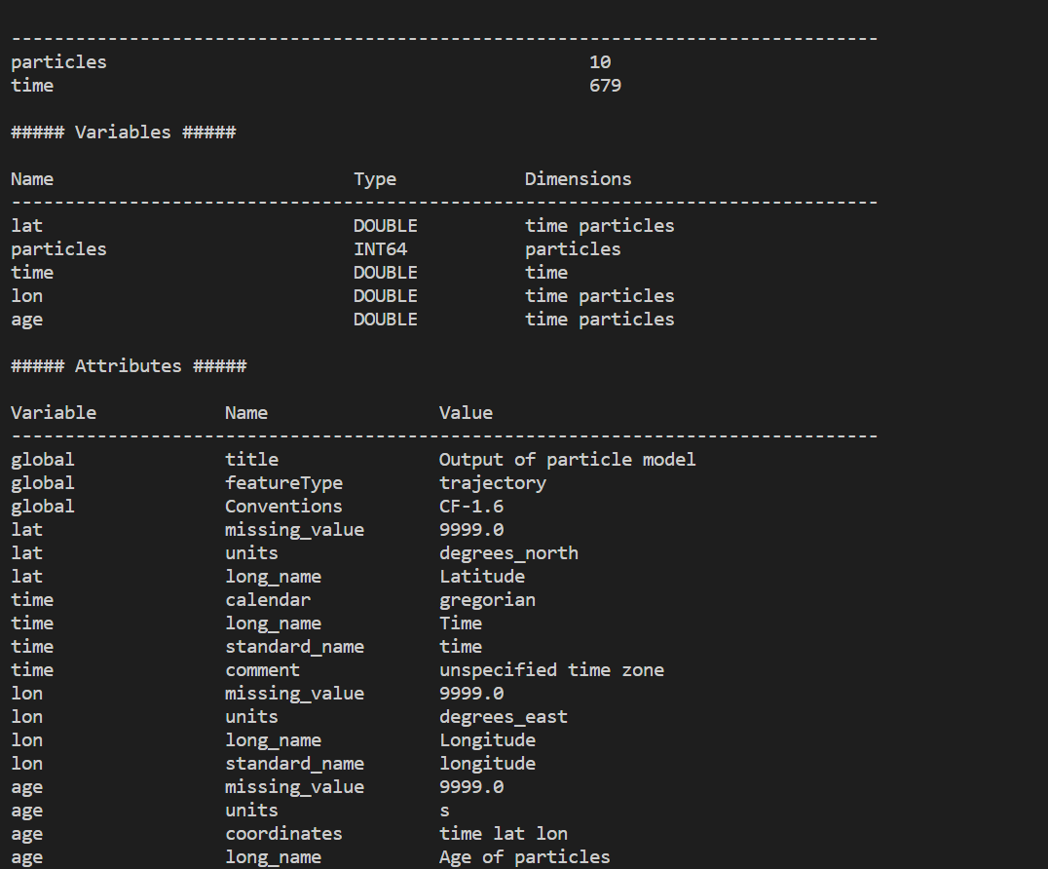
julia> filename = "data\\dcsm-fm_201703\\DCSM-FM_05nm_0001_map.nc"
"data\\dcsm-fm_201703\\DCSM-FM_05nm_0001_map.nc"
julia> filepath = joinpath(@__DIR__, filename)
"I:\\Master_Thesis\\particles.jl\\case_drifters_german_bight\\data\\dcsm-fm_201703\\DCSM-FM_05nm_0001_map.nc"
julia> ncinfo(filename)

Slide 7
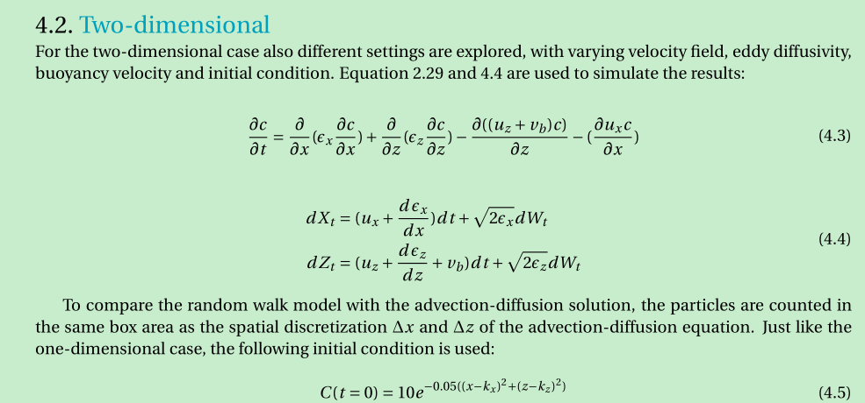
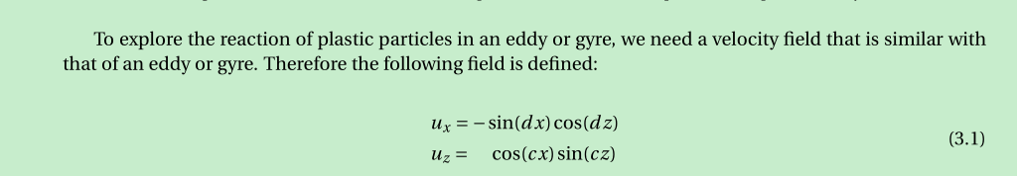

Slide 8
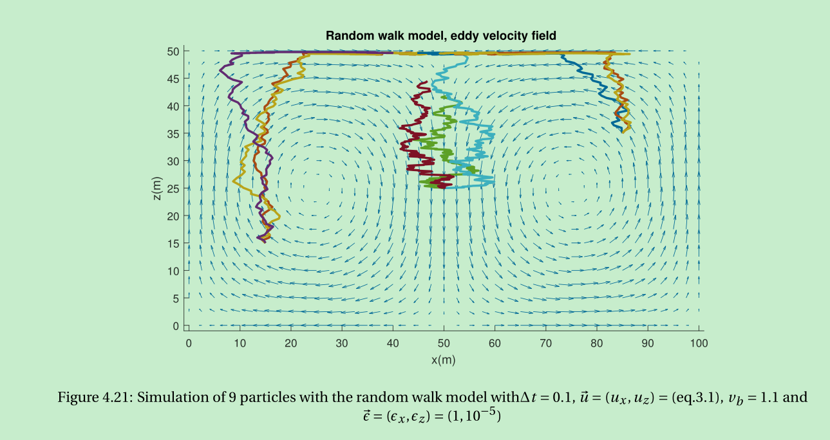

Slide 9
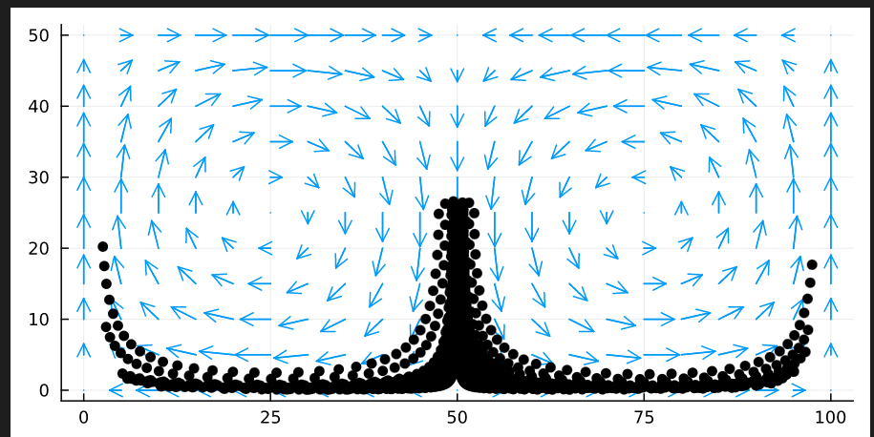

Slide 10
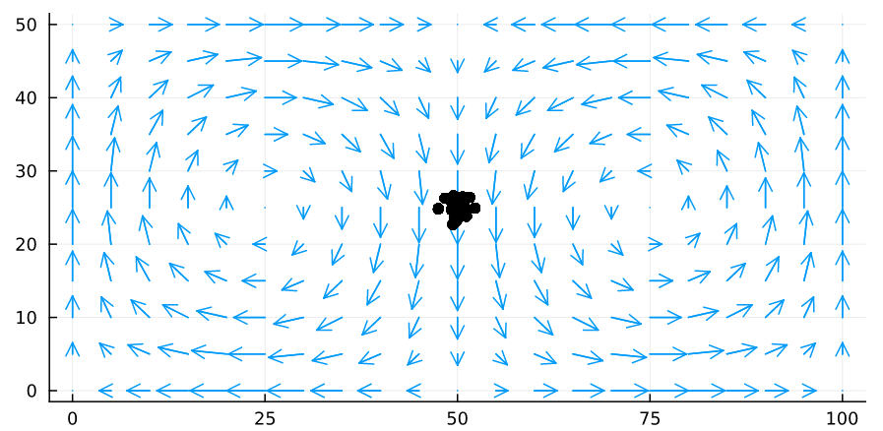

Slide 11
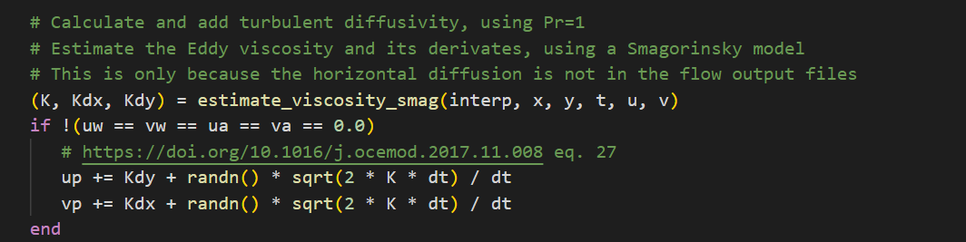
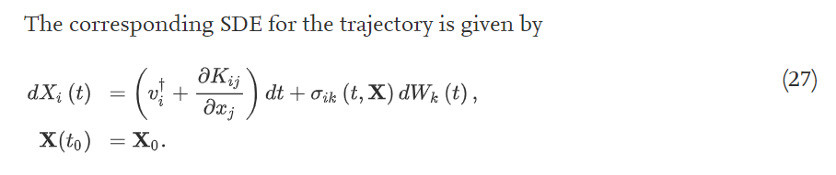
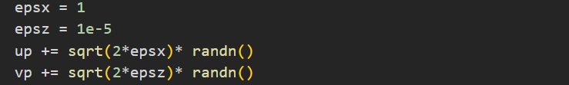
Is adding Brownian process done correctly here?

Slide 12
22.12.01
Reproducing Nelleke’s experiment
Plot the lock-exchange flow

Slide 14
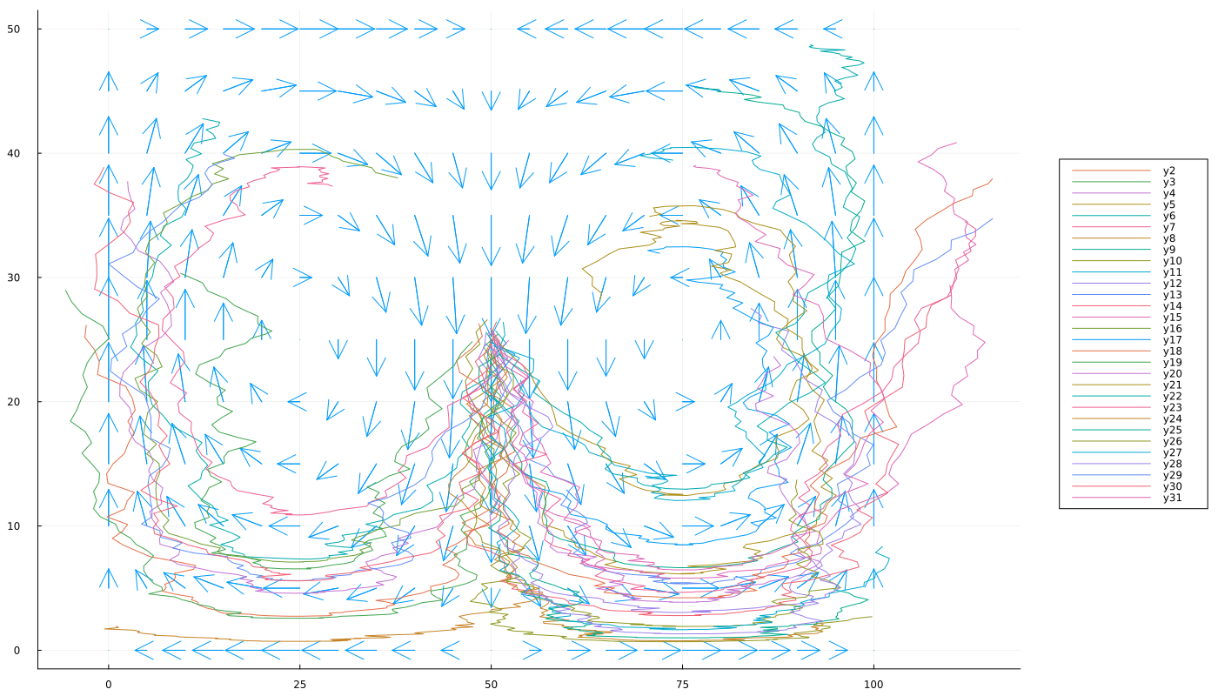

Slide 15
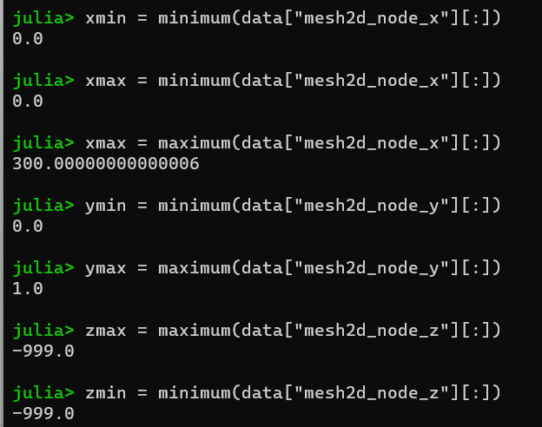



Slide 16
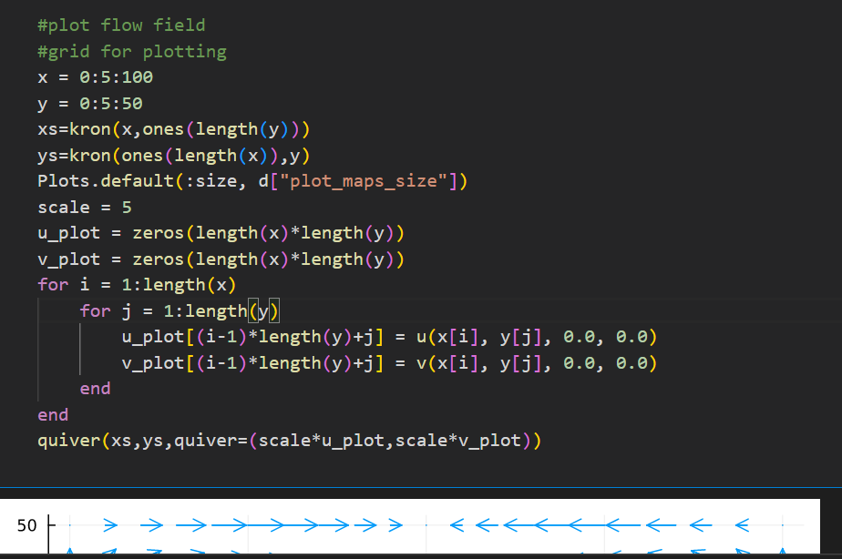


Slide 17
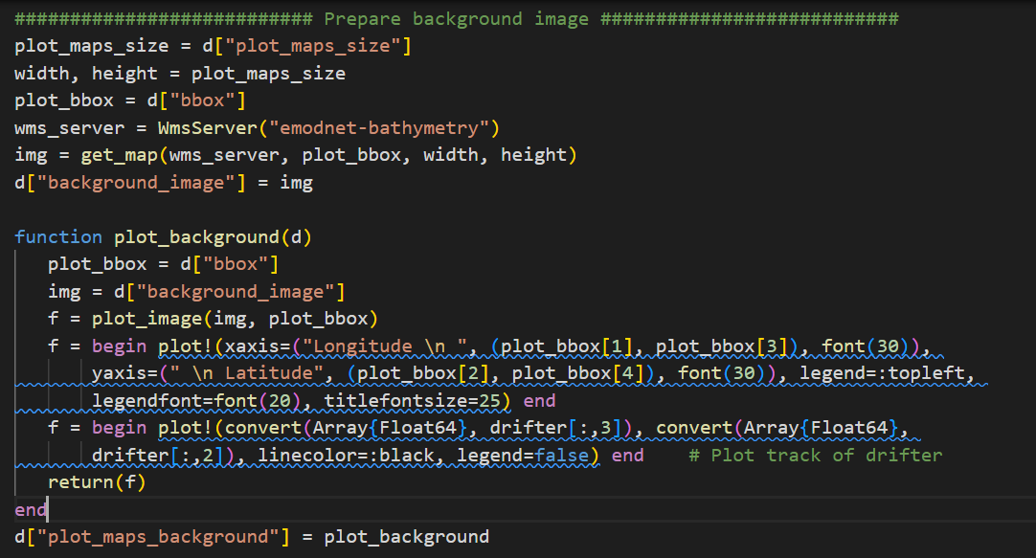


Slide 18

