Slide 1

CENG 789 – Digital Geometry Processing
13- Least-Squares, RANSAC, Hough Transform
Prof. Dr. Yusuf Sahillioğlu
Computer Eng. Dept, , Turkey

Slide 2
Outline
<number> / 21
In this class we will fit primitives to geometric data through
  Least-squares.
  RANSAC.
  Hough Transform.
    Surface Recon. ~ arbitrary models, not just basic primitives.
Bonus material on some other geometric problems (distance, intersection) appended.

Slide 3
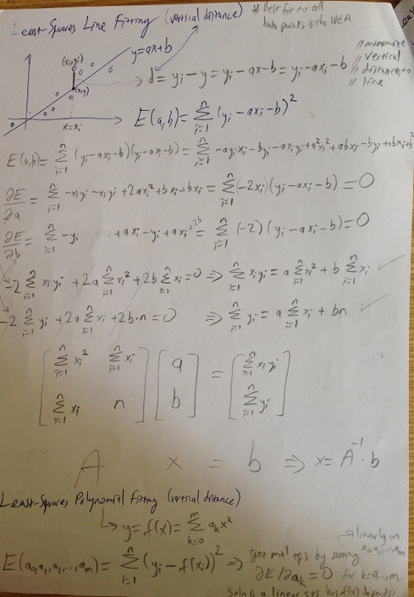
<number> / 21
For x=xi, where
I have data, a&b
give me y, which
is different from yi.
Minimize sum of
these differences.

Slide 4
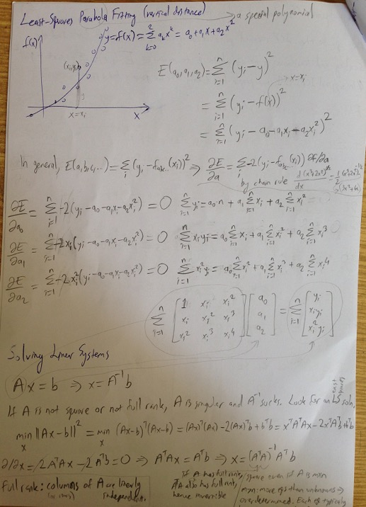
<number> / 21
___
pseudo-inv of A.

Slide 5
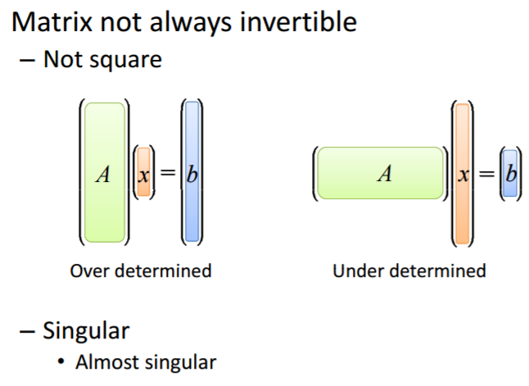

<number> / 21
# unknowns & eqs same ➔ single unique soln: x=A⁻¹b.
x=1, x=2 //no exact soln.
x=1, 2x=2 //exact soln.
x+y+z=1, x+y+z=3 //no soln.
x+y+z=1, x+y+2z=3 //inf. many
Use least-squares for approx. or exact solutions in either case.

Slide 6
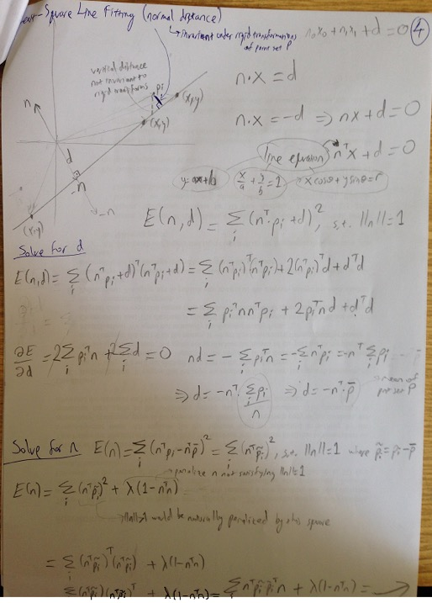
<number> / 21

Slide 7
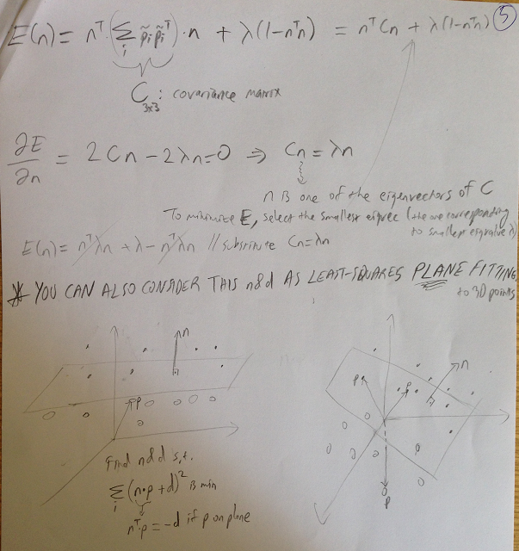
<number> / 21

Slide 8
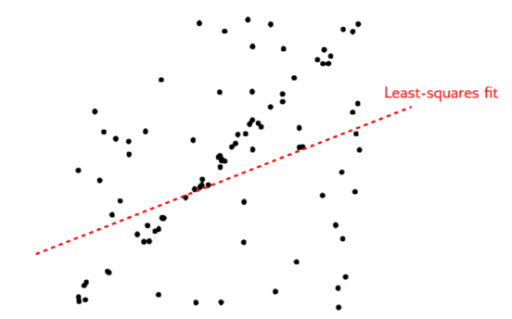
Other Fitting Approaches
<number> / 21
RANSAC: Randomized Sample Consensus.
Robust to outliers ☺.
Not good for models represented w/ many parameters ☹.
Here least-squares approach fails due to outliers.

Slide 9
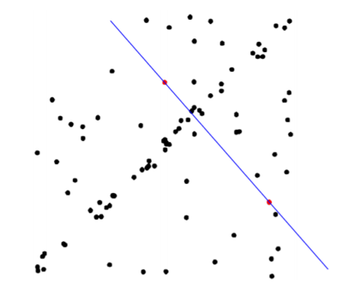
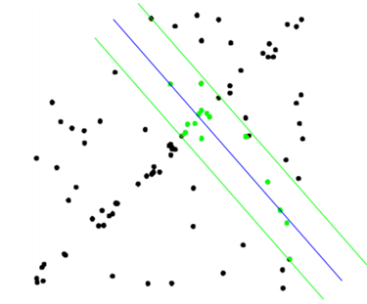
Other Fitting Approaches
<number> / 21
RANSAC: Randomized Sample Consensus.
Robust to outliers ☺.
Not good for models represented w/ many parameters ☹.
Fit model to d (=2 for line-fitting) random pnts, check # inliers (low).

Slide 10
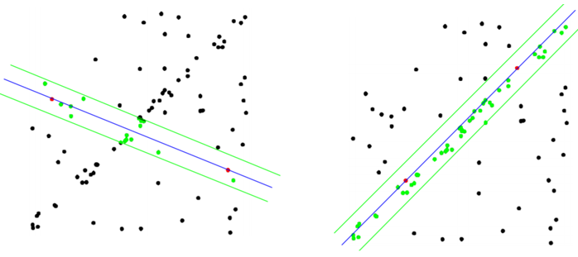
Other Fitting Approaches
<number> / 21
RANSAC: Randomized Sample Consensus.
Robust to outliers ☺.
Not good for models represented w/ many parameters ☹.
Threshold for inliers ☹.
Sufficient inliers at right so stop.

Slide 11
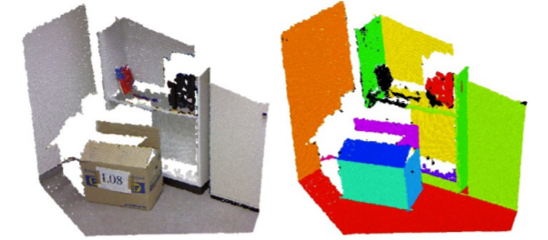
Other Fitting Approaches
<number> / 21
RANSAC: Randomized Sample Consensus.
Robust to outliers ☺.
Not good for models represented w/ many parameters ☹.
Popular in dominant plane detection in 3D scenes.

Slide 12
Other Fitting Approaches
<number> / 21
Hough Transform: each sample votes for all models (line, plane, ..) it supports. Vote is cast in the space of model parameters. Look for the model parameters w/ many votes.
Robust to outliers ☺.
Not good for models represented w/ many parameters ☹.
Possible optimization for point clouds: at each point, vote only for planes that are roughly aligned with the estimated local normal.

Slide 13
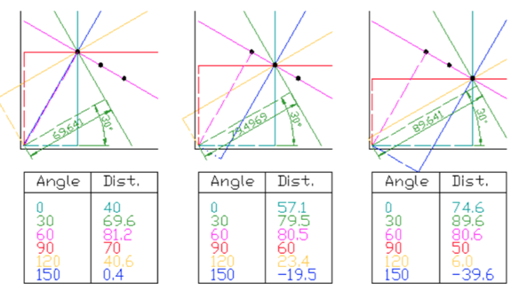
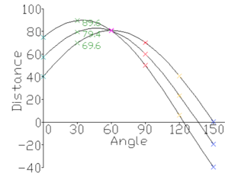
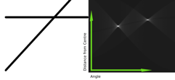
Other Fitting Approaches
<number> / 21
Hough Transform: each sample votes for all models (line, plane, ..) it supports. Look for the model parameters w/ many votes.
Cool demo by Wikipedia (parameters: angle & distance from origin):

Slide 14
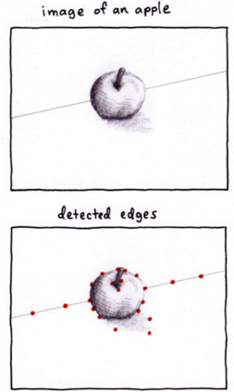
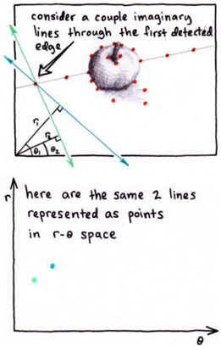
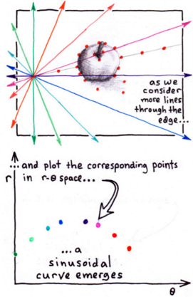
Other Fitting Approaches
<number> / 21
Hough Transform: each sample votes for all models (line, plane, ..) it supports. Look for the model parameters w/ many votes.
Cool demonstration by S. Chaudhuri:

Slide 15
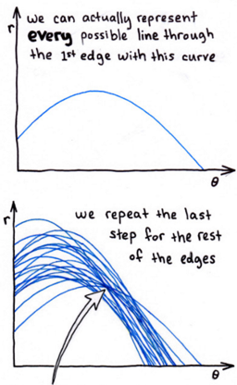
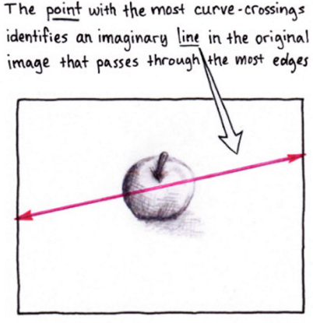
Other Fitting Approaches
<number> / 21
Hough Transform: each sample votes for all models (line, plane, ..) it supports. Look for the model parameters w/ many votes.
Cool demonstration by S. Chaudhuri:

Slide 16
Fitting Approaches Summary
<number> / 21
Least-squares.
  Closed-form solution – superfast.
  Robust to noise.
  Not robust to outliers.
RANSAC.
  Robust to noise and outliers.
  Support models w/ a moderate # parameters, 1-8.
Hough transform.
  Robust to noise and outliers.
  Support models w/ a few # parameters, 1-4.

Slide 17
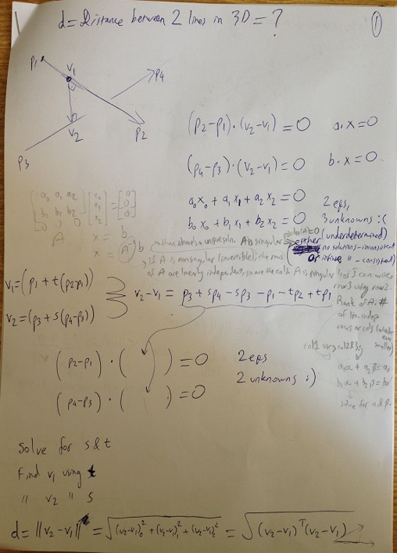
<number> / 21

Slide 18
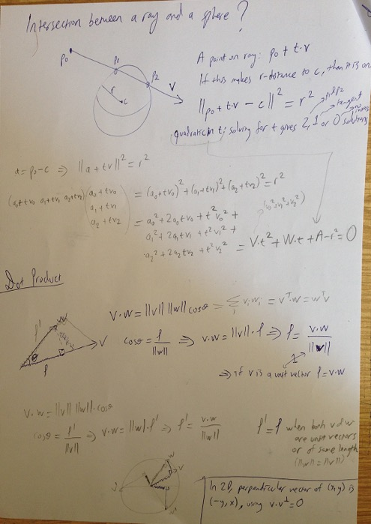
<number> / 21

Slide 19
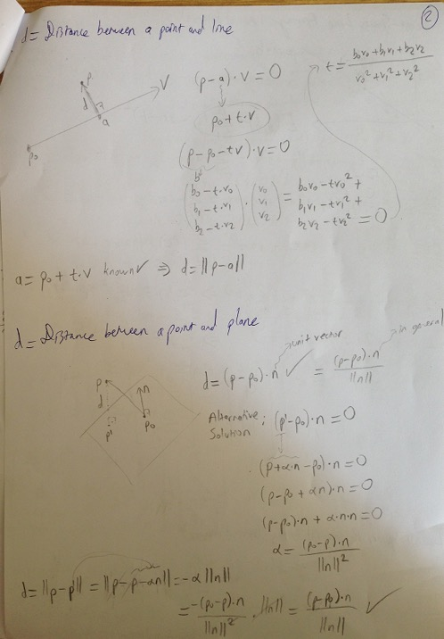
<number> / 21
Important to keep n unit
but not (p-p0); see next
slide

Slide 20
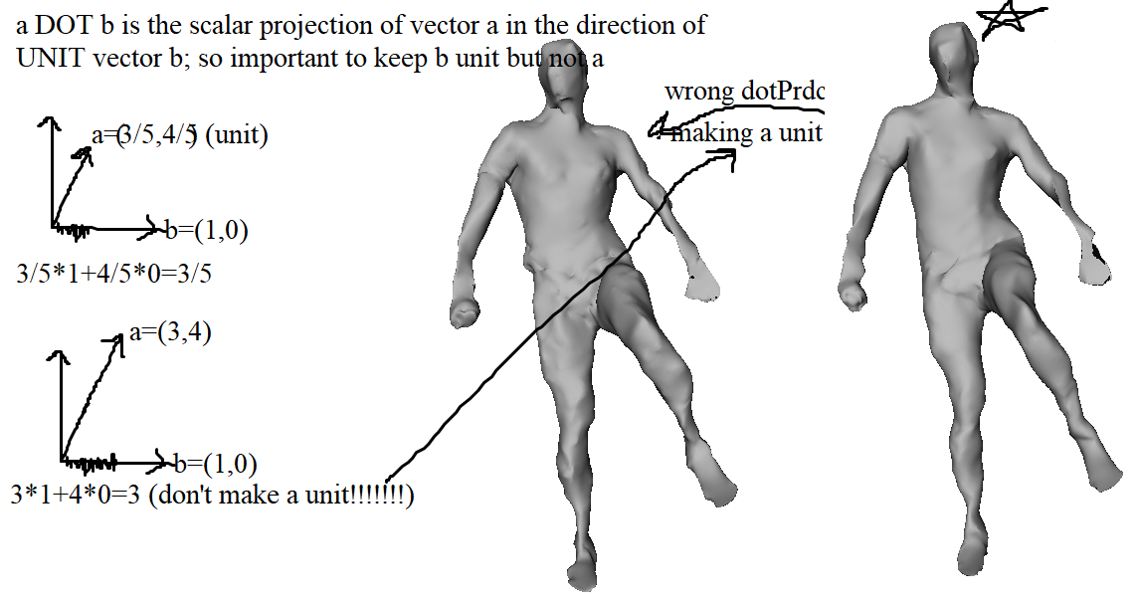
<number> / 21

Slide 21
Potential Project Topics
<number> / 21
Compare least-squares, RANSAC, and Hough plane fits to 3D data.
Implement the Least-Squares Meshes paper or any other related paper.
Hough transform meets Deep learning; implement the paper titled Deep Hough Voting for 3D Object Detection in Point Clouds.

