Slide 1
COMP 2766: Linux Fundamentals
Session 1

Slide 2

1969: UNIX is born
Ken Thompson & Dennis Ritchie (AT&T)

Slide 3
1969: UNIX is born
Ken Thompson & Dennis Ritchie (AT&T)
UNIX:
has many different variants (ex: HP-UX, AIX)
is trademarked and a specification
must be certified by Open Group consortium
came in two popular versions: SystemV & BSD.

Slide 4
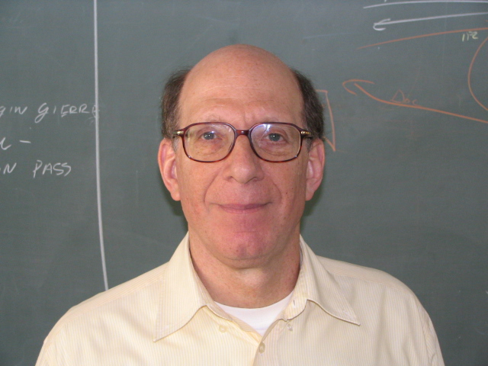
1987: MINIX is born
Andrew Tanenbaum

Slide 5
1987: MINIX is born
Andrew Tanenbaum
MINIX:
is UNIX-like
was meant for academic use
was 16-bit
had limited distribution and forking.

Slide 6
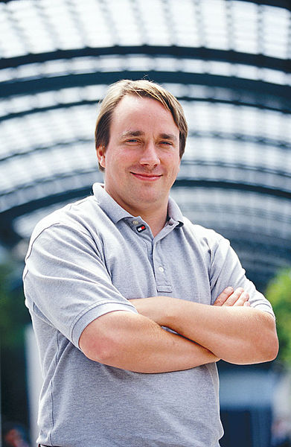

1991: Linux
Linus Torvalds

Slide 7
1991: Linux
Linus Torvalds
Linux:
is UNIX-like
was originally 32-bit
is open-source
has many distributions (flavours).

Slide 8
The Bash shell
The shell:
is a command line interpreter
allows scripting, aliases, variables.

Slide 9

Command Line Grammar
Every command line:
  MUST begin with a command
  might contain options (a.k.a. switches)
  might contain argument
  is case-sensitive.

Slide 10
Command Line Grammar
  Examples:
  ls -l
  cp –v foo /tmp

Slide 11
Command Line Grammar
Command line grammar:
[bob@localhost]$ ls -i /usr
[bob@localhost]$ ls -isw 40 /usr

Slide 12
Command Line Grammar
Command line options (a.k.a. switches) can be:
short
  single letter preceded by -
  ex: –w
long
  composed of words
  preceded by --
  ex: --size

Slide 13
Command Line Grammar
Switch arguments:
short
  must immediately follow switch (ex: -w40)
  space allowed after switch
long
  specify using = sign or a space
  (ex: --width=40 OR --width 40).

Slide 14
Command Line History
Additional history examples:
Syntax | Meaning
history 5 | Show the last 5 commands entered
!! | Execute the previous command again
!8 | Execute the 8th command in history
!-3 | Execute the 3rd command from the bottom in history
!ls | Execute the most recent ls command line in history

