Slide 1
COMP 2766
Session 3

Slide 2
Filesystem Hierarchy
In Linux, files are:
  stored in a hierarchical directory tree
  named using an absolute or relative pathname.

Slide 3
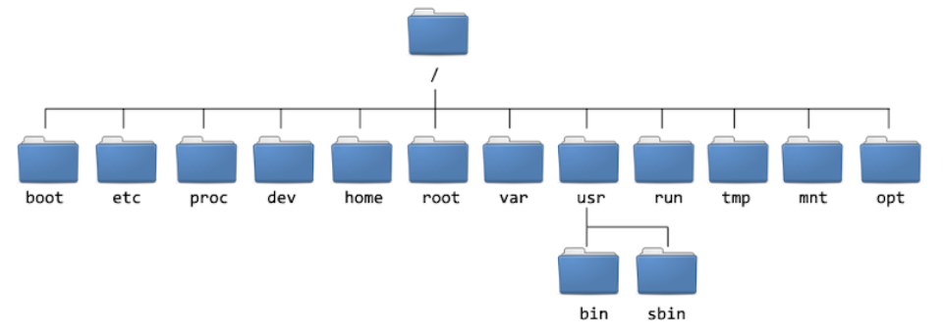
Filesystem Hierarchy
The Linux filesystem hierarchy

Slide 4
Filesystem Hierarchy
root directory vs. /root
  root directory is top of the filesystem directory tree
  root directory is represented by /
  /root is the root user’s home directory.

Slide 5
Filesystem Hierarchy
A home directory:
  is private space assigned to each user
  is where a user is placed upon login
  stores user-specific config files
  is represented by ~
  is usually in /home for a non-root user
  (ex: /home/student).

Slide 6
Filesystem Hierarchy
/home
  contains non-root users’ home directories
  the parent to non-root user’s home directories.

Slide 7
Filesystem Hierarchy
/boot
  contains files to start the boot process, including the bootloader and kernel

Slide 8
Filesystem Hierarchy
/dev
  holds device files system uses to access hardware (ex: /dev/sda2 is 2nd partition on 1st SATA disk)

Slide 9
Filesystem Hierarchy
/etc
  holds configuration files such as /etc/passwd
  files, here, can only be changed by root

Slide 10
Filesystem Hierarchy
/tmp
  space where all users can create files
  space beyond a user’s quota
  needed to run some services and programs
  untouched files deleted automatically after 10 days.

Slide 11
Filesystem Hierarchy
/bin & /usr/bin
  /bin is a link to /usr/bin
  holds commands for ordinary users
  (ex: ls, cd, cp)

Slide 12
Filesystem Hierarchy
/sbin & /usr/sbin
  /sbin is a link to /usr/sbin
  holds superuser (that is, root user) commands

Slide 13
Filesystem Hierarchy
/var
  contains variable content files such as databases, email, logs

Slide 14
Filesystem Hierarchy
Directories:
  are a type of file
  can be appended with a / for emphasis:
    Ex: /tmp/

Slide 15
Filesystem Hierarchy
Use the cd command to change the present working directory to:
  cd ~ (current user’s home directory)
  cd (current user’s home directory)
  cd .. (parent directory)
  cd . (current/present working directory)

Slide 16
Filesystem Hierarchy
Absolute pathnames:
are relative to root directory
always start with / or ~ (a tilde)
ex:
    /etc/passwd
    /home/bob/resume
    ~/resume
    ~jennifer/photo.png

Slide 17
Filesystem Hierarchy
Relative pathnames:
are relative to present working directory
start with a character other than / and ~
ex:
    passwd (works if pwd is /etc/)
    student (works if pwd is /home/)
    student/.bashrc (works if pwd is /home/)

Slide 18
Filesystem Hierarchy
Q: Should you use an absolute or relative pathname?
A: It depends on:
  your pwd (present working directory)
  the location of the file you want to access.
NOTE: you can always use an absolute pathname from anywhere, but it might not be shorter.

Slide 19
Filesystem Hierarchy
Example 1:
Your pwd is /etc/
You want to access /etc/passwd
As /etc/ and /etc/passwd are on the same branch of the tree, use a relative pathname as it’s shorter:
cat passwd
The alternative absolute pathname is longer:
cat /etc/passwd

Slide 20
Filesystem Hierarchy
Example 2:
Your pwd is /home/chantelle/
You want to access /etc/passwd
As /home/chantelle/ and /etc/passwd are on different branches of the tree, use an absolute pathname:
cat /etc/passwd
The alternative relative pathname is longer:
cat ../../etc/passwd

Slide 21
Filesystem Hierarchy
Q: In general, should you use an absolute or relative pathname?
A:
If your pwd and the file that you want to access are on the same branch, use a relative pathname.
If your pwd and the file that you want to access are on different branches, use an absolute pathname.
NOTE: you can always use an absolute pathname from anywhere, but it might not be the shortest.

Slide 22
File Globbing
File Globbing:
  matches file names
  used with the ls, rm, cp, mv, mkdir, rmdir and other file management commands
  uses characters that have special meanings.

Slide 23
File Globbing
Example #1: Output only visible files
ls *
* is a wildcard character, like the Joker.

Slide 24
File Globbing
Example #2: Output only hidden files
ls .*
hidden files are usually system files
in Linux, names of hidden files begin with a dot
* is a wildcard character, like the Joker
here, * means something or nothing.

Slide 25
File Globbing
Note the difference between these two command lines:
ls .*
ls -d .*
  here, -d is the directory switch
  we want a directory file, itself, not its contents
  always use –d with ls when file globbing.

Slide 26
File Globbing
Practice Question #1:
Output all files only in the pwd using a command line switch.

Slide 27
File Globbing
Practice Question #2:
Output all files in the pwd without using a command line switch.

Slide 28
File Globbing
Example #3: Output only files in /etc whose name begins with a lowercase p
ls -d p*
write the file globbing pattern from left to right
first character in the file’s name must be p
* means something or nothing after the p.

Slide 29
File Globbing
Practice Question #3:
Output only files in /etc whose name starts with your first initial, lowercase.

Slide 30
File Globbing
Example #4: Output only visible files in /etc whose name ends with a lowercase p
ls -d *p
write the file globbing pattern from left to right
last character in the file’s name must be p
* means something or nothing before the p
does NOT match hidden files.

Slide 31
File Globbing
Practice Question #4:
Output only visible files in /etc whose name ends with your last initial, lowercase.

Slide 32
File Globbing
Enter these command lines and compare their output:
touch .hiddenp
ls -d *p
ls -d .*p
  in Linux, hidden file names begin with a dot
  to match hidden files, use a dot at the start of the file globbing pattern
  the * at the beginning does not match hidden files.

Slide 33
File Globbing
Example #5: Output only visible files in /etc whose name contains a lowercase p :
ls -d *p*
write the character that must be contained in the name
* means something or nothing
there could be something or nothing before the p
there could be something or nothing after the p
does NOT match hidden files.

Slide 34
File Globbing
Practice Question #5:
Output only visible files in /etc whose name contains your first initial, lowercase.

Slide 35
File Globbing
Example #6: Output only visible files in /etc whose name begins with a lowercase a, b, or c:
ls -d a* b* c*
use three file globbing patterns (three arguments)
* means something or nothing
there could be something or nothing after the a, b, or c.

Slide 36
File Globbing
Example #6: Output only visible files in /etc whose name begins with a lowercase a, b, or c:
ls -d [abc]*
square brackets enclose the possible first characters
the first character must be a lowercase a, b, or c
* means something or nothing
there could be something or nothing after the a, b, or c.

Slide 37
File Globbing
Practice Question #6a:
Output only files in /etc whose name starts with either of your initials, lowercase.

Slide 38
File Globbing
Practice Question #6b:
Output only visible files in /etc whose name ends with either of your initials, lowercase.

Slide 39
File Globbing
Practice Question #6c:
Output only visible files in /etc whose name contains either of your initials, lowercase.

Slide 40
File Globbing
Question:
What do you think of this?
ls –d [a]*

Slide 41
File Globbing
Example #7: Output only files in /etc whose name does NOT begin with a lowercase p
ls -d [^p]*
ls -d [!p]*
when ^ or ! is the first character inside [ ], it means NOT
the ^ and ! negate everything after it inside the [ ]

Slide 42
File Globbing
Practice Question #7:
Output only visible files in /etc whose name does NOT begin with your first initial, lowercase.

Slide 43
File Globbing
Example #8: Output only visible files in /etc whose name does NOT begin with a lowercase a, b, or c
ls -d [^abc]*
ls -d [!abc]*
when ^ or ! is the first character inside [ ], it means NOT
the ^ and ! negate everything after it inside the [ ]

Slide 44
File Globbing
Practice Question #8:
Output only visible files in /etc whose name does NOT begin with your either of your initials, lowercase.

