Slide 1
Planning the Project
Cost Management

Slide 2
Learning objectives
You will be able to:
  Define project cost management
  Project cost management process
    Perform resource planning
    Perform cost estimating
      Types of cost estimating
      Overview of cost estimating techniques
    Perform cost budgeting
      What does the budget consist of?

Slide 3
Project cost management process

Slide 4
Steps in performing PCM
PCM encompasses:
    Resource planning
    Cost estimating
    Cost budgeting
    Cost control
    Change control

Slide 5
Resource Planning

Slide 6
Resource Planning
Some questions to consider:
  How difficult will it be to do specific tasks on the project?
  What is the organization’s history in doing similar tasks?
  Is there anything unique in this project’s scope statement that will affect resources?
  Does the organization have or can they acquire the people, equipment, and materials that are capable and available for performing the work?

Slide 7
Types of Cost Estimating

Slide 8
Detailed or "bottom up" estimate
Detailed or "bottom up" estimate
  An estimate based on the detailed tasks of the project
  Usually used when undertaking a complex project
  Can be very time consuming
  Target range: -5% to +10%

Slide 9
Historical estimate
Historical estimate
  An estimate based on experience gained on projects in the past
  Target range: -15% to +25%

Slide 10
Principles for Estimating
Base the estimates on the performance of average staff
Ensure that all estimates are completed by those who will or are qualified to do the work
Reflect the most likely cost and not a "padded" cost
Allowance needs to be made for:
  Contingencies
  High risks
  Unknowns
  Scope changes
Have the estimates reviewed by knowledgeable/experienced people

Slide 11
Challenges of estimating

Slide 12
Typical Problems with IT Cost Estimates
Developing an estimate for a large projects is a complex task requiring a significant amount of effort
Many people doing estimates have little experience doing them
People have a bias toward underestimation
Advantages of learning curve effects

Slide 13
Danger areas of IT Cost Estimates
Price escalation
Exchange rates
Requirements unclear
Scope creep
Technical complexity
Historical data
Integration
New technology
External dependencies

Slide 14
Cost Budgeting

Slide 15
What does a Project budget consist of…
Direct costs
  Staff charges
    Charge rates of the resources X time spent on activity
  Expenses
    Include items such as travel expenses, training etc
Indirect costs
  Stationery
  Paper towels
  etc
Capital costs
  Include items such as equipment e.g. servers, printers etc

Slide 16
Altering the Project Budget
Staff rates
  Change staff charge out rates
  Use lower cost people
  Change rates before changing duration
Expenses
  Expenses can be reduced e.g. training could be performed in house therefore reducing cost
Capital Costs
  Negotiate the best price
  Amortization of the equipment

Slide 17
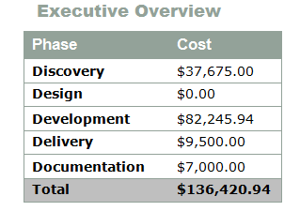

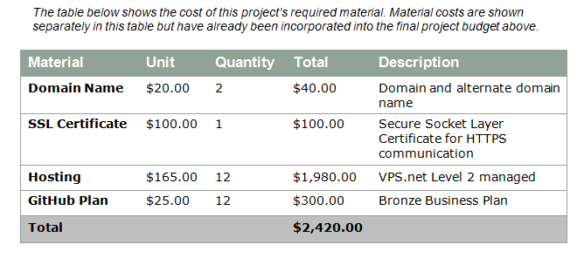
Example

Slide 18
What you have learnt
You are now able to:
  Define project cost management
  Project cost management process
    Perform resource planning
    Perform cost estimating
      Types of cost estimating
      Overview of cost estimating techniques
    Perform cost budgeting
      What does the budget consist of?

