Slide 1
Planning a Project
Risk Management

Slide 2
Learning objectives
You will be able to:
  Define project risks
  Risk management process
    Identify risks
    Quantify risks (categorizing)
    Respond to risks
    Manage risks

Slide 3
Risk management process

Slide 4
Risk Management Process
Risk Identification
Risk Quantification (categorising risks)
Risk Response Development
Risk Response Control

Slide 5
Risk identification

Slide 6
Risk identification
A good rule of thumb is to identify risks using logical categories such as:
  Technical
  Business
  Legal
  etc

Slide 7
Examples of risk events

Slide 8
Examples of risk events
Scope creep
Server downtime
Server purchasing delays
Don’t cooperation from departments\users
Etc.

Slide 9
Risk Quantification
(categorising risks)

Slide 10
Ranking project risks
To determine the project risk ranking determine the following:
  The probability of its occurrence
  The impact or the amount at stake
  The severity (category) of the risk

Slide 11
Risk: Impact & Probability
 |  | Impact
Probability | High | Medium | Low
High | Extreme | High | Medium
Medium | High | Medium | Low
Low | Medium | Low | Minimal

Slide 12
Risk response

Slide 13
Risk Response
Once the risks have been categorized a response/s for each risk is required
E.g. of a risk and a response:

Slide 14
The Effects of Project Risk Allocation
Note:
  Most responses to project risk events involve
    More time
    More money
    More effort
    Or all three

Slide 15
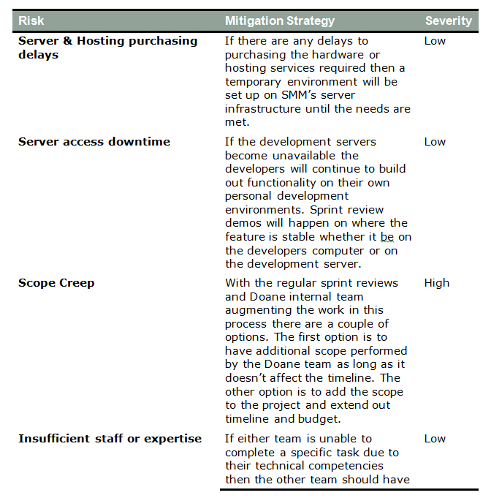
Example

Slide 16
Risk management

Slide 17
Managing risk
Having satisfied some corporate edict
  Many project risk analyses and plans are simply filed away in the project archives
    That's not a good return on investment for the effort expended
  As with most of the other project functions, the plan provides the basis for monitoring and control
    Especially during project execution
Make sure the plan is distributed to stakeholders
  And that someone takes responsibility for it!

Slide 18
What you have learnt
You are now able to:
  Define project risks
  Risk management process
    Identify risks
    Quantify risks (categorizing)
    Respond to risks
    Manage risks

