Slide 1
Project Planning
Communication Management

Slide 2
Learning Objectives
You will be able to:
  Define the project communication process:
    Plan for communicating on a project
    Plan for information distribution
    Status Meetings (Reports)

Slide 3
Importance of Communication
3 major factors related to project success are
  user involvement
  executive management support and
  clear requirements gathering
All of these rely heavily on project team members being able to effectively communicate (Standish Group)
Good communication skills are essential especially with non information technology personnel
Strong verbal skills are a key factor in career advancement for IT professionals

Slide 4
PM Communication Process

Slide 5
Project Management Communications Process
Communications planning
Information distribution
Performance reporting

Slide 6
Communication Planning

Slide 7
Communications Management Planning includes
A filing structure
  gathering and storing various types of information
A distribution structure
  what information goes to whom, when, and how
A format for communicating key project information
A project schedule for producing the information
Access methods for obtaining the information
A method for updating the communications management plans as the project progresses
A stakeholder communications analysis

Slide 8
Information Distribution

Slide 9
Information Distribution
Getting the right information to the right people at the right time and in a useful format is just as important as developing the information in the first place
Stakeholder analysis assists in disseminating the information
Important considerations include
  using technology – email, MSProject
  formal – status meetings
  informal methods – one on one discussions over coffee

Slide 10
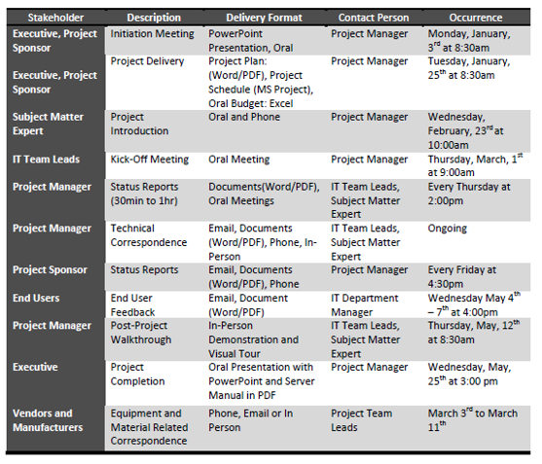
Example of communication matrix

Slide 11
Project Meetings\Reports

Slide 12
Project Meetings
Team meetings
  kick off meeting to get everyone up to speed on the project
Status meetings (Status Report)
  share and receive data to make group decisions critical to the project plan and this includes:
    updates on the tasks, resource, and budget
    risk updates and identification
    changes to scope
    issue identification and resolution
Executive Meetings (Progress Report)
  reporting progress of the project to the Project sponsor and/or steering committee

Slide 13
Steps to Planning a Successful Meeting
Define your outcome
Select your attendees
Plan the agenda
Notes:
Conversion Notes
The phases correspond to the following fourth edition terms:
Preliminary investigation = former survey phase
Problem analysis = former study phase
Requirements analysis = former definition phase
Decision analysis = former configuration phase

Slide 14
What you have learnt
You are now able to:
  Define the project communication process:
    Plan for communicating on a project
    Plan for information distribution
    Devise reports

