Slide 1
Chapter 17: File Permissions
Every file in Linux has:
  a user owner
  a group owner (to facilitate file sharing).
The defaults:
  user owner is the file’s creator
  group owner is the creator’s primary group.
A user’s primary group:
  is the group that owns files that a user creates
  is the user’s private group (UPG), by default.

Slide 2
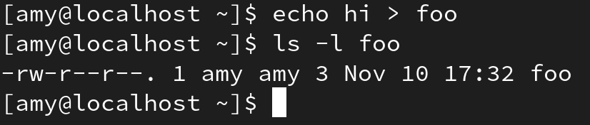
Chapter 17: File Permissions
Example:
user owner is amy (the 1st amy in the long listing)
group owner is amy’s user private group (UPG).
To determine user amy’s primary group, use id:

Slide 3
Chapter 17: File Permissions
The chown command:
  can change a file’s user owner
  ex: chown anna file1
  works only if run by root, not user owner. Why?
  can also change a file’s group owner
  ex: chown :comp2766 file1
  chown .comp2766 file1
  can change both user owner and group owner
  ex: chown anna:comp2766 file1
  chown anna.comp2766 file1

Slide 4
Chapter 17: File Permissions
Practice:
  as user student, create an empty file named foo5
  change foo5’s user owner to another user.

Slide 5
Chapter 17: File Permissions
The chgrp command:
  changes a file’s group owner
  works only if run by:
    root
    user owner (only to groups user belongs to).
  ex: chgrp music file1

Slide 6
Chapter 17: File Permissions
3 regular file permissions:
  r (read) : view the file’s contents
  w (write) : modify the file’s contents
  x (execute): use the file as a command

Slide 7
Chapter 17: File Permissions
3 user classes (a.k.a. permission groups)
  u (user owner)
  g (group owner)
  o (other; a.k.a. the world)

Slide 8

Chapter 17: File Permissions
Interpreting file permissions:
user who owns the file can only read & write
members of group that owns the file can read & write
all other users can read only.

Slide 9
Chapter 17: File Permissions
To determine what access a user has to a file, Linux asks:
Who is trying to access the file?
Is that user the user owner of the file? If yes, the user owner permissions apply; else, go to next question.
Is that user a member of the group that owns the file? If yes, the group owner permissions apply; else, the other user class (a.k.a. the world) permissions apply.

Slide 10
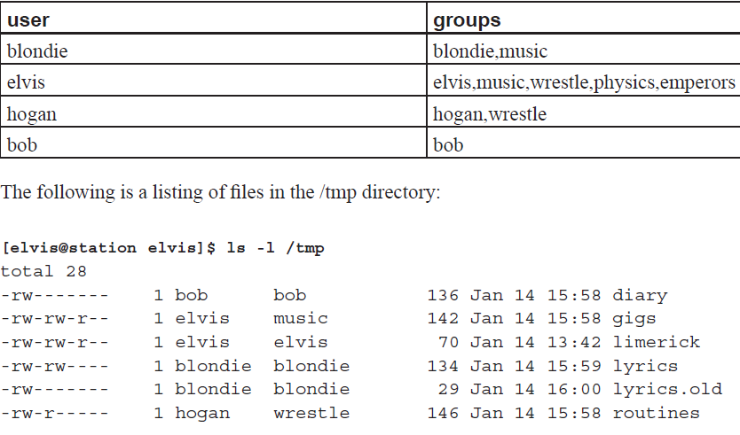
Chapter 17: File Permissions

Slide 11
Chapter 17: File Permissions
Q: What can hogan, who is a member of group wrestle,
do with the routines file now?

Slide 12
Chapter 17: File Permissions
Practice:
Write the Practice File Permissions Quiz in Learning Hub

Slide 13
Chapter 17: File Permissions
permission | regular file operations | directory file operations
r | cat, less, more, cp, head, tail | ls, use globbing characters
w | nano, vi, gedit, >> | create, rm, mv
x | execute/run | access

Slide 14
Chapter 17: File Permissions
3 directory permissions:
  r (read) : list directory’s contents
  w (write) : add or remove files to/from directory
  x (execute): access a directory.
Directory permissions needed:
to do a basic listing: r
to do a long listing: r and x
to create or delete a file: w and x

Slide 15
Chapter 17: File Permissions
Note the w permission for:
  a directory file
    lets you create/remove files in/from directory,
    if you also have the directory’s x permission
  a regular file
    lets you edit the regular file’s contents
    does not let you delete the regular file.

Slide 16
Chapter 17: File Permissions
The chmod command:
  changes a file’s permissions
  works only if run by root or the user owner.

Slide 17
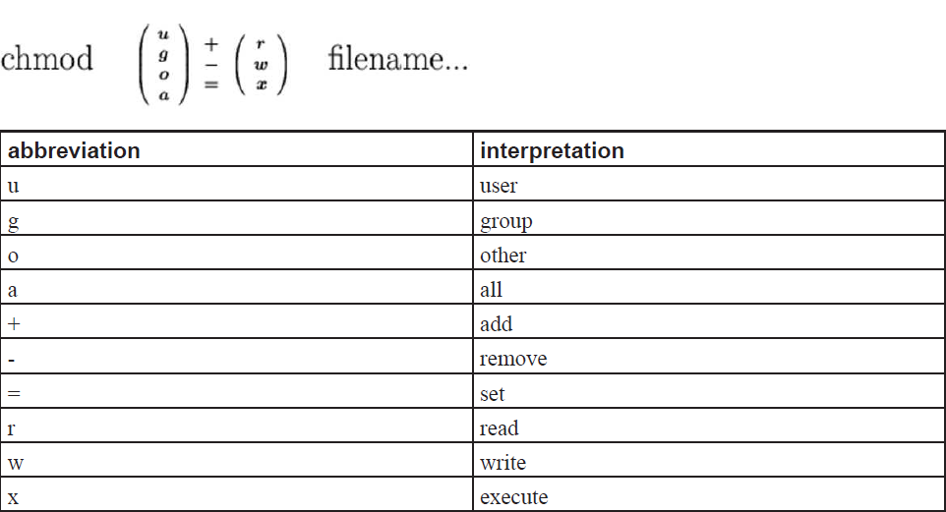
Chapter 17: File Permissions

Slide 18
Chapter 17: File Permissions
Example #1:
foo’s Initial Permissions | Command Line | foo’s Resulting Permissions
rw-rw-r-- | chmod o-r foo | rw-rw----

Slide 19
Chapter 17: File Permissions
Example #2:
foo’s Initial Permissions | Command Line | foo’s Resulting Permissions
rw-r----- | chmod o+rw foo | rw-r--rw-

Slide 20
Chapter 17: File Permissions
Example #3:
foo’s Initial Permissions | Command Line | foo’s Resulting Permissions
rw-rw-r-- | chmod ugo+x foo | rwxrwxr-x

Slide 21
Chapter 17: File Permissions
Example #4:
foo’s Initial Permissions | Command Line | foo’s Resulting Permissions
rw-rw-r-- | chmod a+x foo | rwxrwxr-x

Slide 22
Chapter 17: File Permissions
Example #5:
foo’s Initial Permissions | Command Line | foo’s Resulting Permissions
rwxrw--wx | chmod u-rwx,g-rw,o-wx foo | ---------

Slide 23
Chapter 17: File Permissions
Example #6:
foo’s Initial Permissions | Command Line | foo’s Resulting Permissions
rw-r--r-- | chmod ugo=rw foo | rw-rw-rw-

Slide 24
Chapter 17: File Permissions
Example #7:
foo’s Initial Permissions | Command Line | foo’s Resulting Permissions
rw-rw-rw- | chmod ug=r foo | r--r--rw-
Note: = affects only the access classes specified

Slide 25
Chapter 17: File Permissions
Example #8:
foo’s Initial Permissions | Command Line | foo’s Resulting Permissions
rw-r--r-- | chmod +x foo | rwxr-xr-x
Note: +x is the same as a+x

Slide 26
Chapter 17: File Permissions
Example #9:
foo’s Initial Permissions | Command Line | foo’s Resulting Permissions
r--r--r-- | chmod +w foo | rw-r--r--
Note: As the w permission can potential cause damage, it is granted only to user owner.

Slide 27
Chapter 17: File Permissions
When using octal notation with chmod, use a 3 digit octal number, 1 digit for each of the 3 access classes.
Ex: chmod 664 myFile
group owner
user owner
other

Slide 28
Chapter 17: File Permissions
Permissions have corresponding octal & binary values.
Permission | Binary Value | Octal Value
r | 100 | 4
w | 010 | 2
x | 001 | 1
- | 000 | 0

Slide 29
Chapter 17: File Permissions
Each digit in the 3 digit octal number indicates which permissions are to be granted a particular access class.
Permissions for an access class | Binary | Octal
--- | 000 | 0 = 0 + 0 + 0
--x | 001 | 1 = 0 + 0 + 1
-w- | 010 | 2 = 0 + 2 + 0
-wx | 011 | 3 = 0 + 2 + 1
r-- | 100 | 4 = 4 + 0 + 0
r-x | 101 | 5 = 4 + 0 + 1
rw- | 110 | 6 = 4 + 2 + 0
rwx | 111 | 7 = 4 + 2 + 1

Slide 30
Chapter 17: File Permissions
Example #1:
Command Line | foo’s Resulting Permissions
chmod 662 foo | rw-rw--w-
6 = 4 + 2 + 0 = rw- for (u)ser owner
6 = 4 + 2 + 0 = rw- for (g)roup owner
2 = 0 + 2 + 0 = -w- for (o)ther

Slide 31
Chapter 17: File Permissions
Example #2: (allowing others to access a home directory to access a publicly accessible subdirectory)
Command Line | pub’s Resulting Permissions
chmod 701 ~ | rwx-----x
7 = 4 + 2 + 1 = rwx for (u)ser owner
0 = 0 + 0 + 0 = --- for (g)roup owner
1 = 0 + 0 + 1 = --x for (o)ther

Slide 32
Chapter 17: File Permissions
Example #3: (assigning default directory permissions)
Command Line | foo’s Resulting Permissions
chmod 755 foo | rwxr-xr-x
7 = 4 + 2 + 1 = rwx for (u)ser owner
5 = 4 + 0 + 1 = r-x for (g)roup owner
5 = 4 + 0 + 1 = r-x for (o)ther

Slide 33
Chapter 17: File Permissions
When a new file is created in Linux, the kernel assigns it a set of default permissions:
 | Directory file | Ordinary file
Kernel default permissions | rwxrwxrwx | rw-rw-rw-

Slide 34
Chapter 17: File Permissions
Since we often want a different set of permissions than the kernel’s default set, we can apply a umask value (default is 022 for all users):
 | Directory file
Kernel default permissions Default umask (all users) -------------------------------------- Effective default permissions | rwxrwxrwx → 777 ––––w–-w– → 022 ------------------------------ rwxr–xr–x → 755

Slide 35
Chapter 17: File Permissions
Since we often want a different set of permissions than the kernel’s default set, we can apply a umask value (default is 022 for all users):
 | Ordinary file
Kernel default permissions Default umask (all users) -------------------------------------- Effective default permissions | rw–rw–rw– → 666 ––––w–-w– → 022 ------------------------------ rw–r––r–– → 644

Slide 36
Chapter 17: File Permissions
To determine your shell’s current umask value:
umask
To change your shell’s umask value for the duration that the shell is open:
umask NNN (where NNN is an octal number)
To automatically change the bash shell’s umask value upon login:
add umask NNN to ~/.bashrc

