Slide 1
Planning the Project

Slide 2
Groups
One important component of Project Management is working with people
We will work in groups to build project plan
  Groups assembly
  Weekly quick group updates
  Evaluation forms
  Final marks for assignment depends on evaluation form and quality of project plan

Slide 3
Learning Objectives
You will be able to:
  Plan a project which includes:
    Devising a project plan which includes,
      Background to projects
      Project stakeholders and project organization
      Scope
      Deliverables
      Assumptions
      The WBS
      Cost management
      Risk management
      Quality management
      Communication

Slide 4
The Project Plan

Slide 5
Background

Slide 6
Background
Determine what industry the company is in
Give brief description of the companies business
What were the business conditions that prompted someone to propose the project?

Slide 7
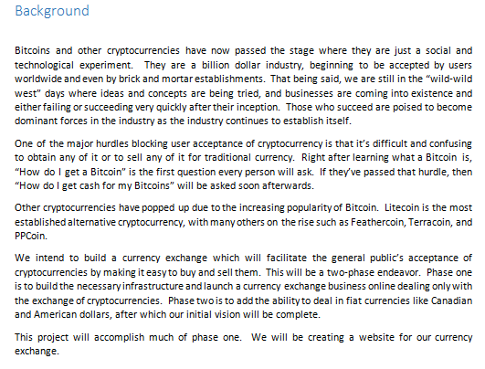
Example

Slide 8
Stakeholders

Slide 9
Project Stakeholders
Stakeholders are the people involved in or affected by project activities
There are 2 types of stakeholders
  Internal – directly involved in the project
  External – are not involved in the project at all, however, indirectly could affect the projects outcome
To lead the participants in a project effectively, you must understand who the stakeholders are and what their attitudes are toward the project.

Slide 10
Stakeholders include …
LABOUR
UNIONS
CONSUMER
GROUPS
GOVERNMENT
OWNERS
USERS
SPECIAL
INTEREST
GROUPS
EXTERNAL
CUSTOMERS
PROJECT
SPONSOR
TEAM
MEMBERS
FINANCIAL
INSTITUTIONS
SUPPLIERS

Slide 11
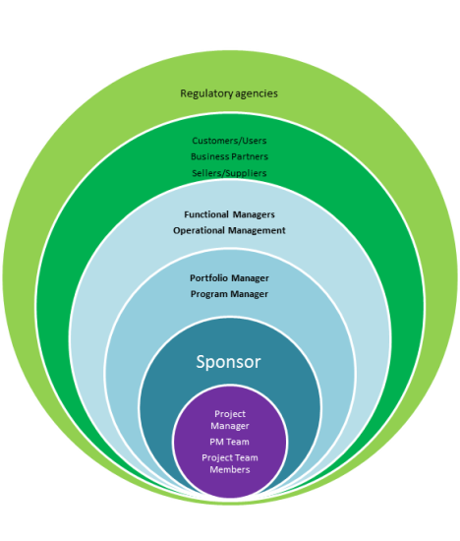

Stakeholders
Internal stakeholders include:
    Owners
    Users
    Project sponsor
    Project team members
External stakeholders include:
    Labor unions
    Government
    External customers
    Financial institutions
    Consumer groups
    Special interest groups
    Suppliers
5th Edition PMBOK® Guide—Chapter 2: Stakeholders
Notes:
Page <number>

Slide 12
Project Roles
Critical project roles:
  Sponsor
  Steering Committee
  PMO
  Project Manager
  Team Lead
  Subject Matter Expert
  Project Team Member
  Users
Notes:
Presenter’s notes:
“There are a number of key positions that are important to the success of any project.” following slides have a brief description of the roles
Page <number>

Slide 13
Project Sponsor
Senior manager in organization
Roles:
  guardian of the “business vision”
  resource allocation
  negotiator
  clarify critical issues
  communication link to executive management
Evaluator
Resolves conflicts, to “make it happen”
Notes:
31

Slide 14
Users
Users
The people responsible for the day-to-day details and decisions in the project
The people who will eventually use the service being offered

Slide 15
Project Manager
Project Manager
Primary contact between consulting firm and the client organization
Has the authority to approve deliverables or to resolve issues
Is responsible for the budget, human resources and schedule
Is responsible for making the project a success

Slide 16
Team leaders
Team leaders
Responsible for a group team members within a specialized area e.g. system architect or programming team lead
Responsible for ensuring deliverables are met
Liaises with other team leads and the client
Liaises with the client
Has input into the solution

Slide 17
Team members
Team members
Responsible for day to day delivery of tasks
Responsible for status updates
Has input into the solution

Slide 18
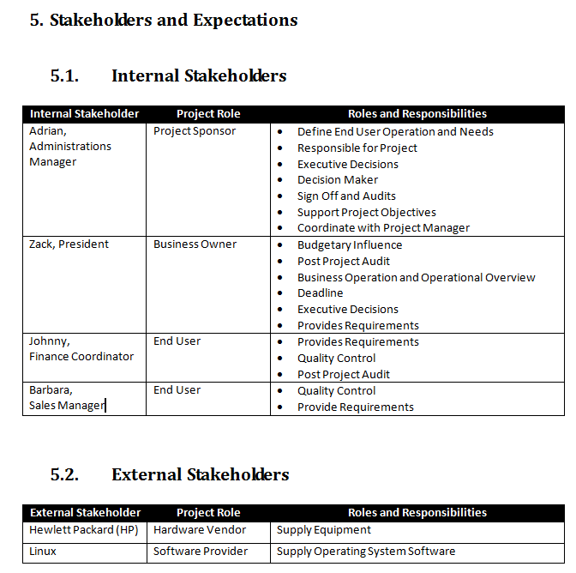
Example

Slide 19
Roles and Responsibilities
Project organization

Slide 20
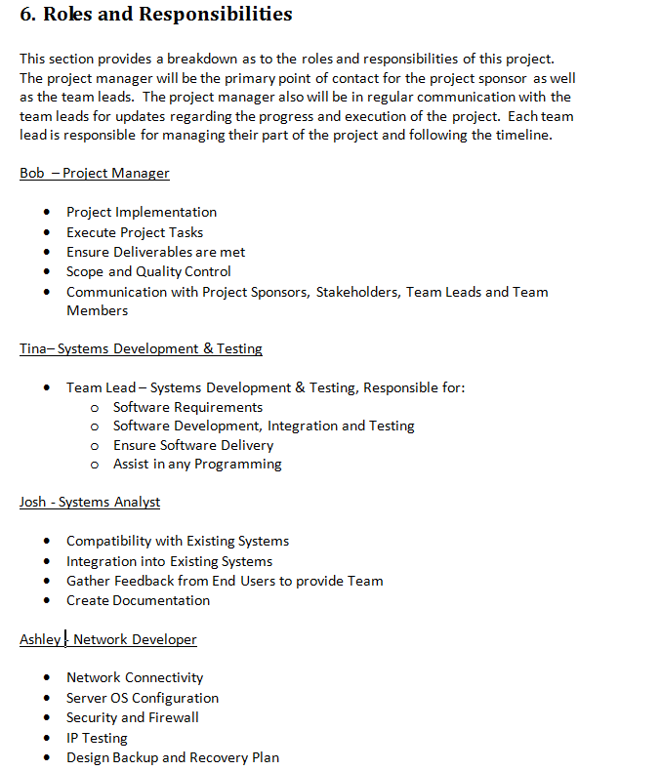
Example

Slide 21
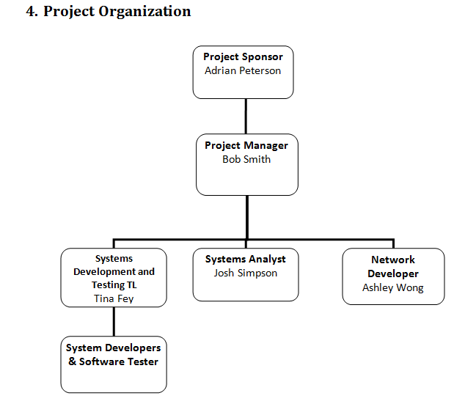
Example

Slide 22
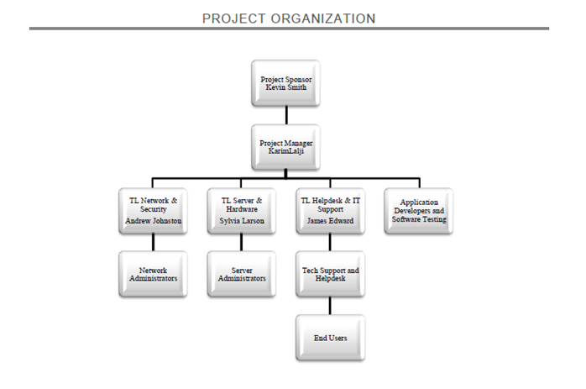
Example

Slide 23
Scope

Slide 24
Scope
The project's scope is the combination of all project goals and tasks, and the work required to accomplish them

Slide 25
Questions to assist with scope management
What marks the end of the project?
What lies within the scope of the project?
What definitely does not lie within the scope?
What are the project quality measures?
Define what is NOT in scope

Slide 26
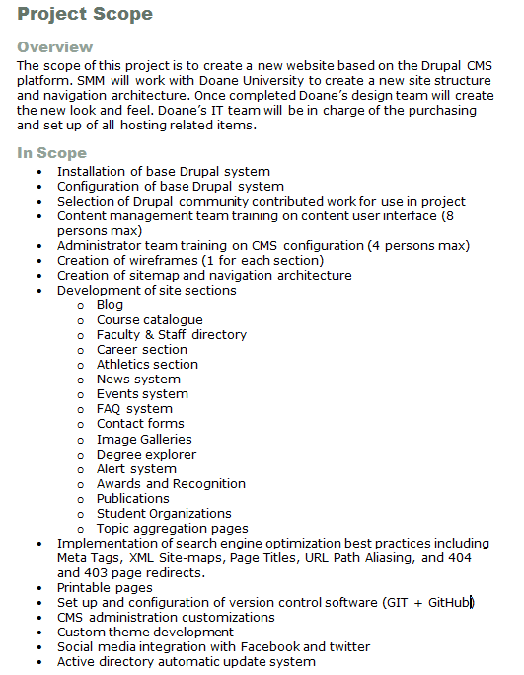

Examples of scope statements

Slide 27
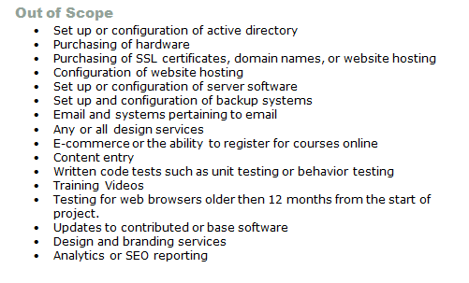
Examples of out of scope statements

Slide 28
Scope changes
Scope change control document
  Define scope change
  Which person\team is going to perform change
  How long is it going to take?
  Calculate the cost of the change
  Determine if change is business critical
  What is the status of the existing scope and is team already working at 100% capacity to meet existing deadlines
  Recommend yes\no to perform the scope change based on criteria above
  If recommendation no and and agreed by Project Sponsor then change can be revisited after initial scope complete

Slide 29
Deliverables

Slide 30
Deliverables
Definition of a project deliverable
  It consists of a list, with a brief description, of everything tangible that the project will produce
Deliverables have an agreed upon grade and quality that set appropriate expectations for its completion

Slide 31
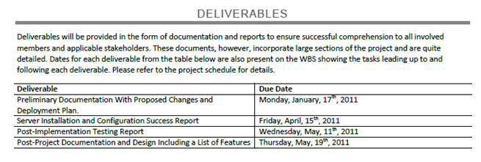
Examples

Slide 32
Project assumptions

Slide 33
Assumptions
If you don’t identify assumptions and they happen to occur the project will suffer, and, conversely, if there are assumptions you identify, the project will usually benefit
  E.g., if you assume that the client mainframe will be available twenty-four hours a day, the project will suffer if the client restricts the team to a normal eight-hour day

Slide 34
Sample List of Project Assumptions
Resources
  Project staff resources will be available when and as they are needed.
  At least n percent of the project staff will be experienced with the development environment
Delivery
  Deliverables submitted for approval will be returned within n working days.
Environmental
  No industrial action will be taken that will affect the project.
Budgetary
  No outside consulting will be required, or Outside consulting will be limited to n days at $n per day.
Functionality
  The scope of the project is limited to …

Slide 35
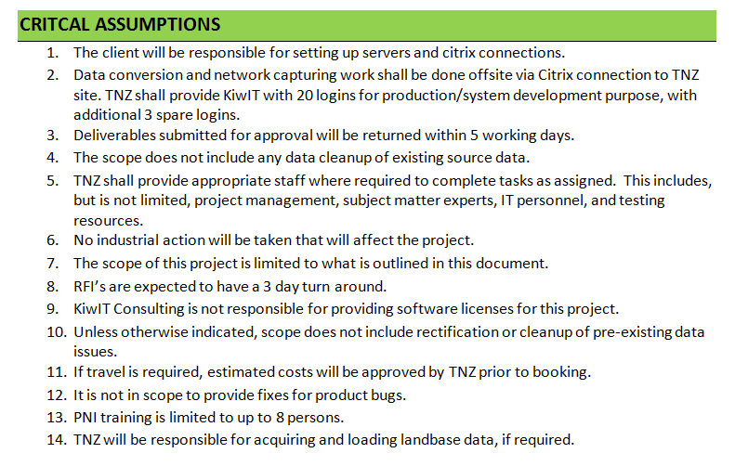
Examples

Slide 36
Methodology

Slide 37
Generic PM Methodology
Analysis
Design
Implementation/construction
Testing
Maintenance and support

Slide 38
Project Management Methodologies
Waterfall: planning projects fully, then executing through phases
Agile: collaborating to iteratively deliver whatever works
Lean: streamlining and eliminating waste to deliver more with less
Scrum: enabling a small, cross-functional, self-managing team to deliver fast
Kanban: improving speed and quality of delivery by increasing visibility of work in progress, and limiting multi-tasking
Propel: uses the design of best practices in the COTS technology solutions. Essential to this approach is building working teams of joint resources between business and solution SMEs.
Notes:
5 phases which we will be discussing in more detail
PRINCE2 – controlled project management that leaves nothing to chance
PMI’s PMBOK – applying universal standards to waterfall project management
Page <number>

Slide 39
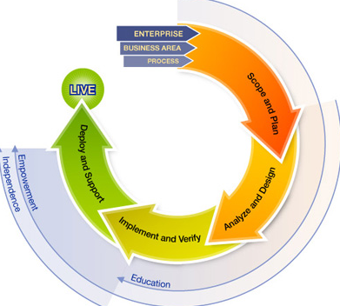
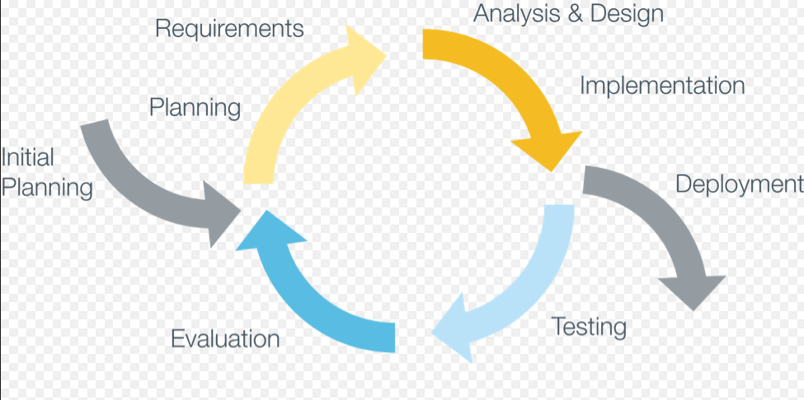
Examples

Slide 40
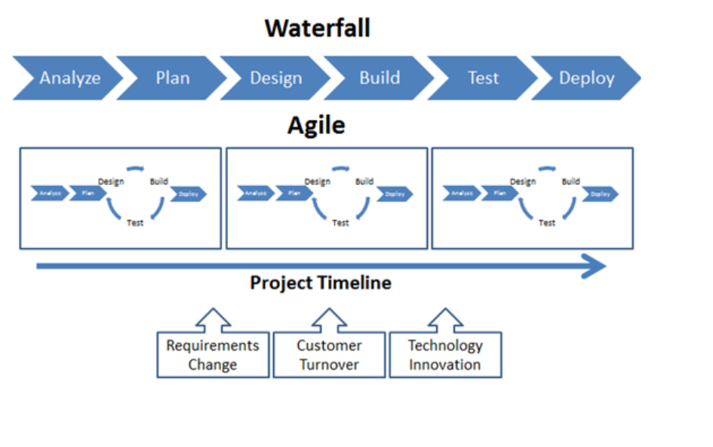
Execution – Waterfall vs. Agile
* Pinterest\ neo-globe-consulting
Notes:
Page <number>

Slide 41
Propel Project Phases for COTS
COTS (Commercial Off The Shelf) Project Phases
Plan
Analyze & Design
Configure & Develop
Test and Train
Deploy and Optimize
Notes:
Propel methodology
The cornerstone of the methodology is the process-centric approach, which means that the implementation team understands and learns about the business environment and focuses implementation activities on business process followed by the design of best practices in the COTS technology solutions. This process-centric approach looks at a whole business process - not just the tasks that are automated - and includes all parties involved in or affected by that process. It requires to examine how it operates today and to envision how business can best operate in the future using the new technology. The objective is to facilitate a vision for process improvement and to determine how the technology can be optimized to realize that vision.
Essential to this approach is building working teams of joint resources between business and solution SMEs. In this way, the business will have a hands-on experience which facilitates knowledge transfer. This approach is continuous throughout the upgrade, and engages project managers, functional, and technical resources.
Propel methodology features five distinct phases
Phase I – Plan
Phase II – Analyze & Design
Phase III – Configure & Develop
Phase IV – Test and Train
Phase V – Deploy & Optimize
Page <number>

Slide 42
Propel Project Phases for COTS
COTS (Commercial Off The Shelf) & RICE items
When replacing a system with COTS solution, plan for RICE:
Reports - compare
Interfaces – iterative approach
Conversions – iterative approach
Enhancements – minimize
Notes:
Page <number>

Slide 43
The WBS

Slide 44
What is a WBS?
Breaking down an activity into smaller chunks
The process continues through successively lower levels until the activities are "small enough.“
The result is the work breakdown structure (WBS).
Notes:
Structures the activities, deliverables, and components to be included in the Detailed Plan
Organizes and defines the total scope of the project in terms of a deliverable-oriented grouping of project elements
Meets the project’s internal and external management reporting and control requirements

Slide 45
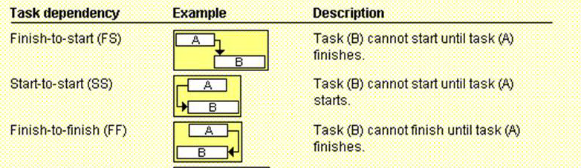
Task dependency types

Slide 46
Lead/Lag time
Lead Time
  Lead time is overlap between tasks that have a dependency
  Example, if a task can start when its predecessor is half finished, you can specify a finish-to-start dependency with a lead time of 50% for the successor task
  Enter lead time as a negative lag value in MSProject
Lag Time
  Lag time is a delay between tasks that have a dependency
  Example, if you need a two-day delay between the finish of one task and the start of another, you can establish a finish-to-start dependency and specify two days of lag time
  Enter lag time as a positive value in MSProject

Slide 47
Preparing a WBS
First step is to identify the major sets of activities
  Example
    A typical systems development project that also requires selection of hardware or software gives one possible list of major activities e.g.
  Typical Major Activity Groups
      Activities that provide management, coordination, and control
      Activities to select and acquire hardware or software
      Activities to build and unit test the system
      Activities to integrate and systems test the system
      Activities that involve the users
      Activities to implement the system

Slide 48
Preparing a WBS
The second step is to break the major activities down further
The third step is to allocate duration to the tasks
The fourth step is to determine the dependencies between the activities

Slide 49
You are now able to
You are now able to:
  Plan a project which includes:
    Devising a project plan which includes,
      Background to projects
      Project stakeholders and project organization
      Scope
      Deliverables
      Assumptions
      The WBS

