Slide 1
Project Planning
Quality Management

Slide 2
Learning objectives
You will be able to:
  Define project quality
  Quality Management Process
    Plan for quality
    Control quality
    Improve quality by using different techniques
  Define the cost of quality
  Determine the reality of quality

Slide 3
Introduction to Project Quality

Slide 4
What Is Quality?
How would you define quality?
What are some examples of good quality?
When does something have poor quality?

Slide 5
Definition of Quality
“The degree of excellence of a thing” (Webster’s Dictionary)
Conformance to requirements
  Meets written specifications
Fitness for use
  Can be used as was intended
Errors should be kept to a minimum

Slide 6
Modern Quality Management requires…
Customer satisfaction
Prefers prevention rather than inspection
Recognizes management responsibility for quality

Slide 7
Characteristics of Quality

Slide 8
Characteristics of Quality
1. Reliability and Durability
  product will operate over time
2. Conformance
  meets pre-established standards
3. Serviceability
  ease of getting repairs, speed & competence of repairs
4. Aesthetics
  acceptable look, feel, sound
5. Timeliness
  completed on time
6. Cost
  completed within allotted budget

Slide 9
Quality Management Process

Slide 10
Quality Planning

Slide 11
Quality Planning
When planning for quality:
  Determine quality standards/rules/guidelines
  Seek to prevent from the outset
  Communicate factors to the team
Quality is part of every team members daily activity – they become responsible for their deliverables

Slide 12
Setting standards with measurements
Set standards (rules or guidelines) based on categories such as:
  Technology
    The infrastructure will be up 99.95% of the time
  Deliverables
    Reviewed at least twice before submitted for approval
    Will be submitted by the due date according to the WBS
  Documentation
    Folders will start PM03…e.g. PM03Technical Design
    Standard templates to be used for all documentation
    All diagrams will be performed in Visio

Slide 13
Setting standards with measurements
  Training
    Level of proficiency of user set
  Project
    Tasks actual duration will be measured against the budgeted duration
These standards would be tied to the scope of the project

Slide 14
Quality Assurance/Control

Slide 15
Quality Control
Quality control involves the monitoring of specific project results to ensure that they comply with the relevant quality standards
Quality control takes place throughout the project lifecycle and not just at the end
Quality control leads to:
  Acceptance decisions (accept or reject work)
  Rework to achieve compliance
  Process adjustment to prevent future problems

Slide 16
Quality Assurance/Control Tools

Slide 17
Quality Control Tools
Quality audits/ Peer reviews
Testing

Slide 18
Quality Audits (Reviews)
Characteristics
  Structured & formal
  May be scheduled or done randomly
  May be done in-house or by 3rd party
Goals
  Assess progress on meeting quality goals
  Identify areas for improvement or change

Slide 19
Peer review
Review of a persons deliverable by:
  Technical Project peers – operational, security, network etc
  Exclude management and clients from these reviews
Include time for peer reviews of deliverables such as:
  Requirement analysis
  Systems architecture design
  Functional specifications
  Implementation plans
  Test plans
No deliverable will be considered complete until it has been reviewed

Slide 20
Documentation Reviews
When reviewing documents take the following into account
  Are requirements met
  Spelling
  Grammar
  Layout
  etc

Slide 21
Testing

Slide 22
Testing
Testing should occur at multiple stages during the project life cycle
Entails planning, preparation & execution
Doing it properly requires significant effort, but the returns in term of ensuring quality far outweigh the costs
Testing typical situations is more important than rarely used functionality

Slide 23
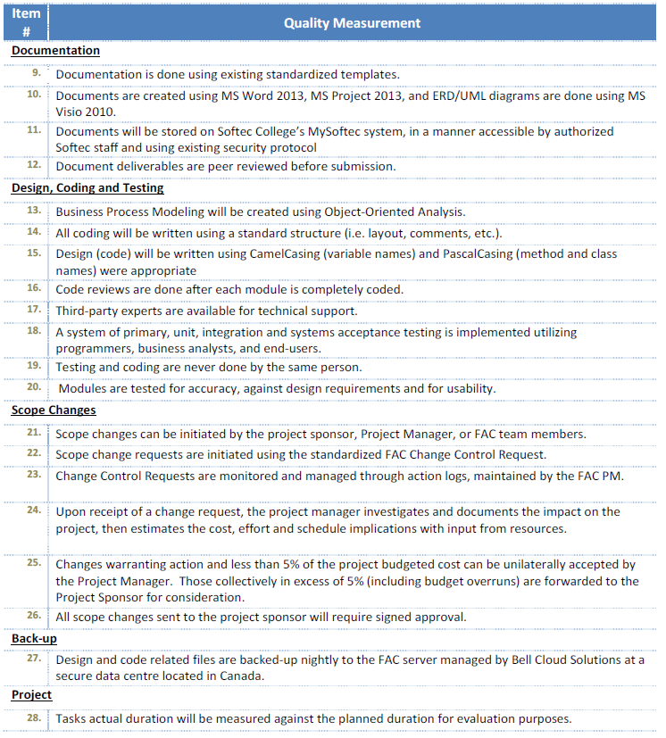
Example

Slide 24
Cost of Quality

Slide 25
Cost of poor Quality
Rework
Lost hours
Customer ill will
Lost sales
Warranty costs

Slide 26
Reality of Quality

Slide 27
The reality of quality
After the project is completed
  Time, scope and cost are of historic interest only
  However, of all four objectives: scope, quality, time and cost
    Quality is most closely related to customer satisfaction and therefore is the most enduring

Slide 28
Quality?
“Good enough? The customer (and the skill of the team) will decide!

Slide 29
What you have learnt
You will be able to:
  Define project quality
  Quality Management Process
    Plan for quality
    Control quality
    Improve quality by using different techniques
  Define the cost of quality
  Determine the reality of quality

