Slide 1
Meteorite Mineral Mapping
Clyde Shaffer , Xiaoyun Yang
https://github.com/HackTheSolarSystem/meteorite-mineral-mapping

Slide 2
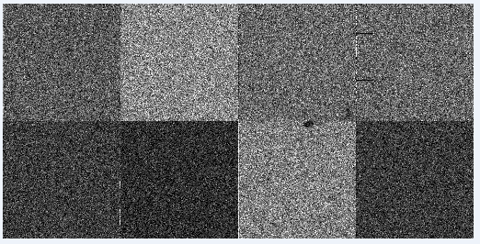
Phase 1 - Get Conversion factor
Known Mineral weight%
Calibrator
weight%-to-intensity conversion factor

Slide 3
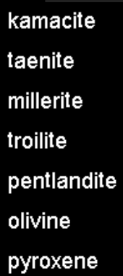
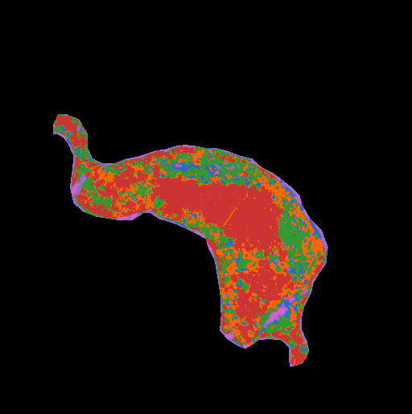
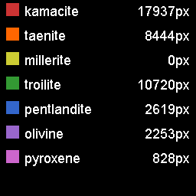
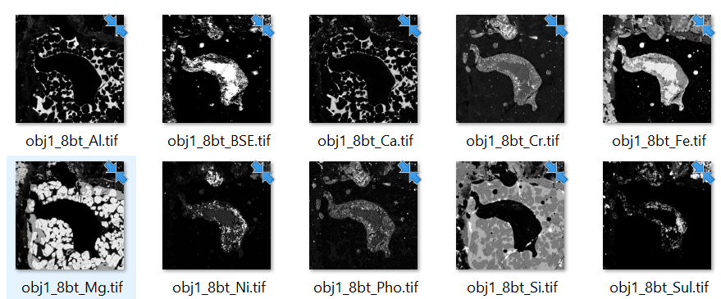
Phase 2 - Test for Minerals in samples
weight%-to-intensity conversion factor
Identifier
Minerals to test for
Sample

Slide 4
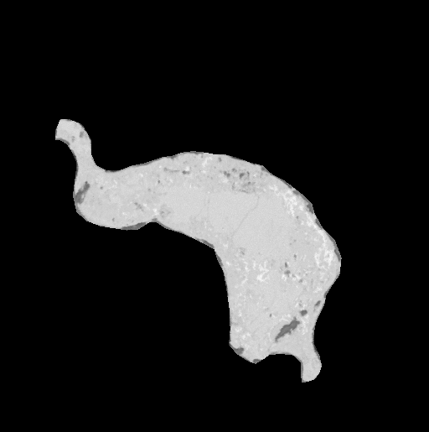

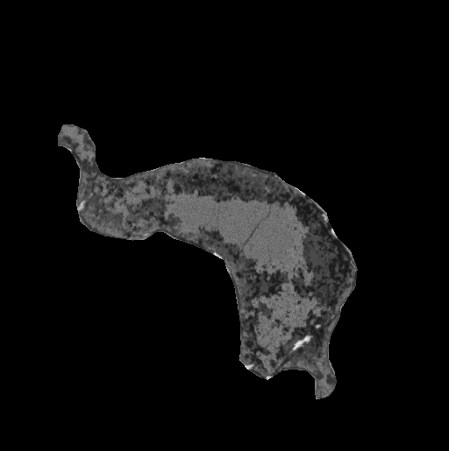
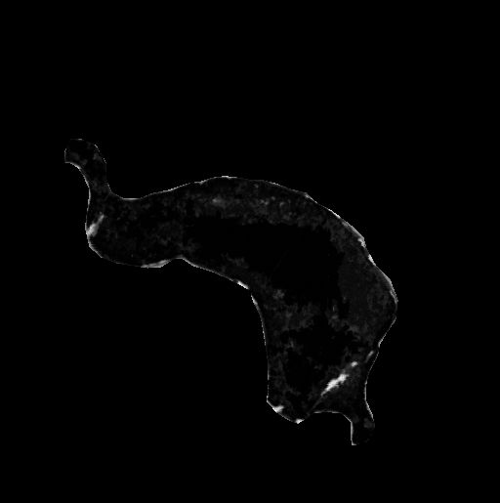
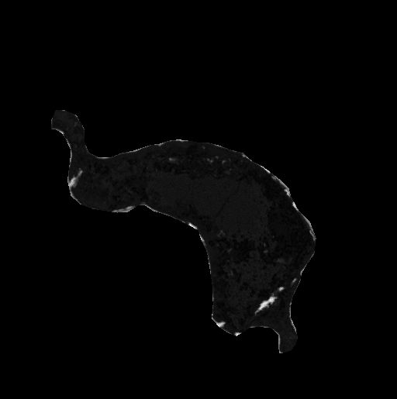

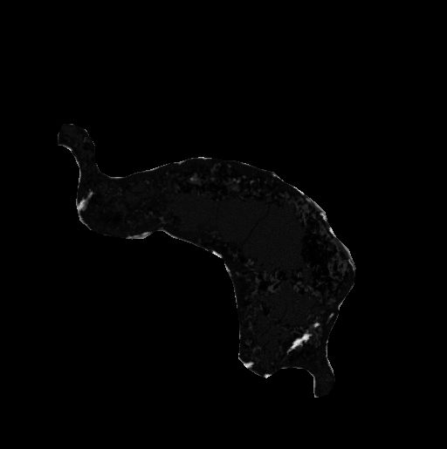
Intensity Delta
Olivine
Pyroxene
Millerite
Kamacite
Pentadite
Taenite
Troilite
Darker (i.e., smaller Delta) means
more likely to be that mineral

Slide 5
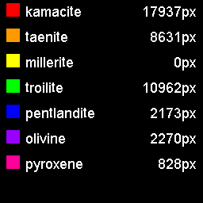
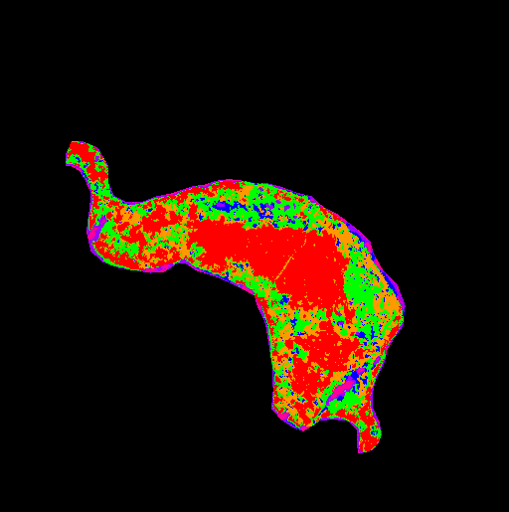
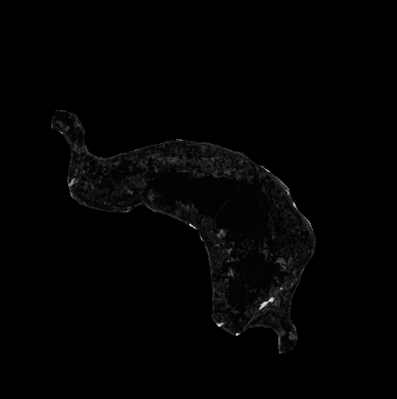

Slide 6
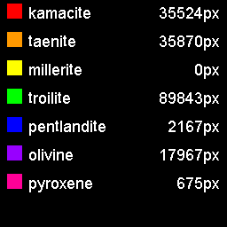
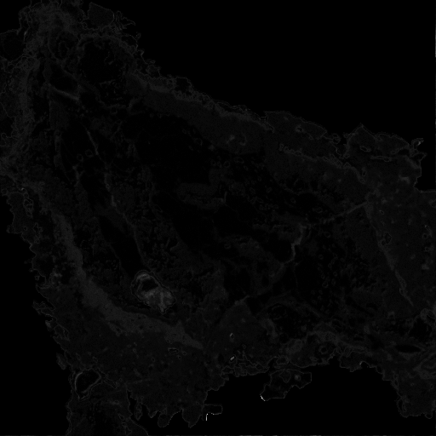
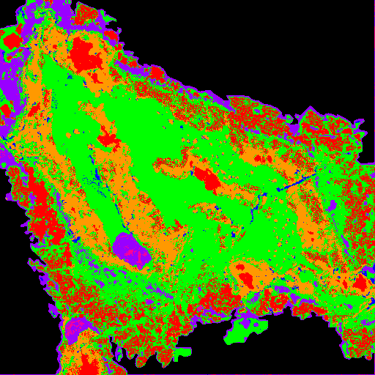

Slide 7
Final Notes
Seems odd that millerite is 0. Could be that its vector is too close to something else? Or the millerite vector was scaled too large?
Program only selects the likely “dominant” mineral per pixel. Bright spots in confidence map could mean multiple or untracked minerals
Program was implemented in python using Numby/CUDA for zippy execution, but non-CUDA scripts are provided in case your computer doesn’t support it

