Slide 1
Lapis
Group members:
Dave Kwon
Hannah Quirk
Minh Nguyen
Minyoung Na
Sophie Jaro

Slide 2
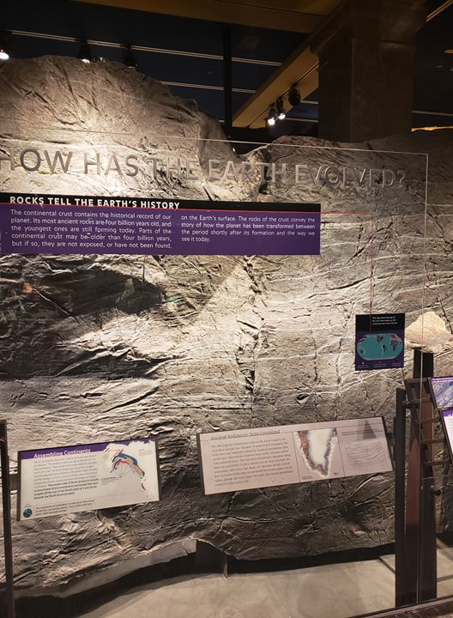
Premise
Meteorite Mineral Mapping
Studying the meteorites can tell us a lot of info.
Distant celestial objects and
Home, Earth.
But identifying elements can be often challenging. Electron probes aren’t always accurate and some complex minerals may have overlapping compound which would conflate the results.
Challenge owners: Marina Gemma and Samuel Alpert

Slide 3
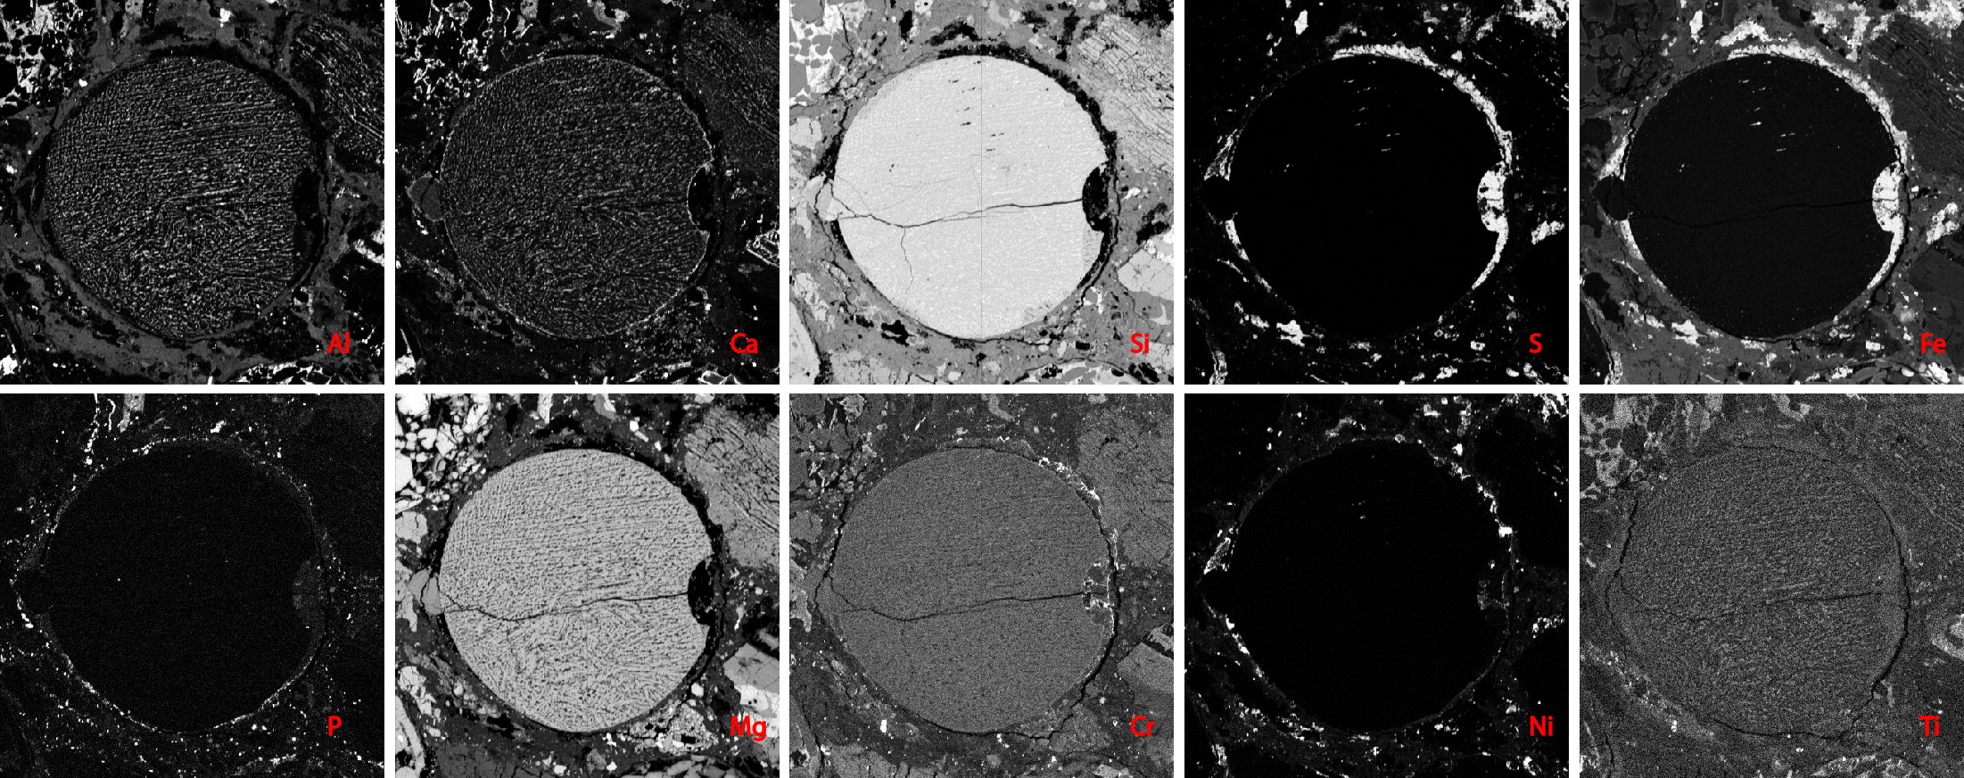
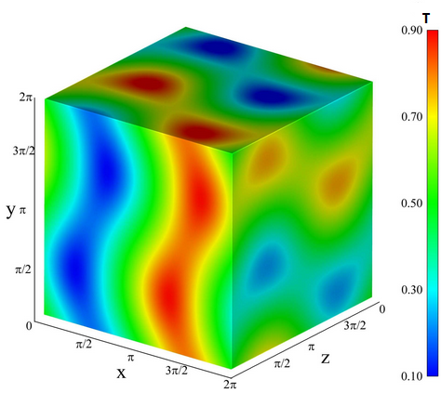
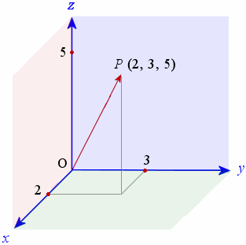
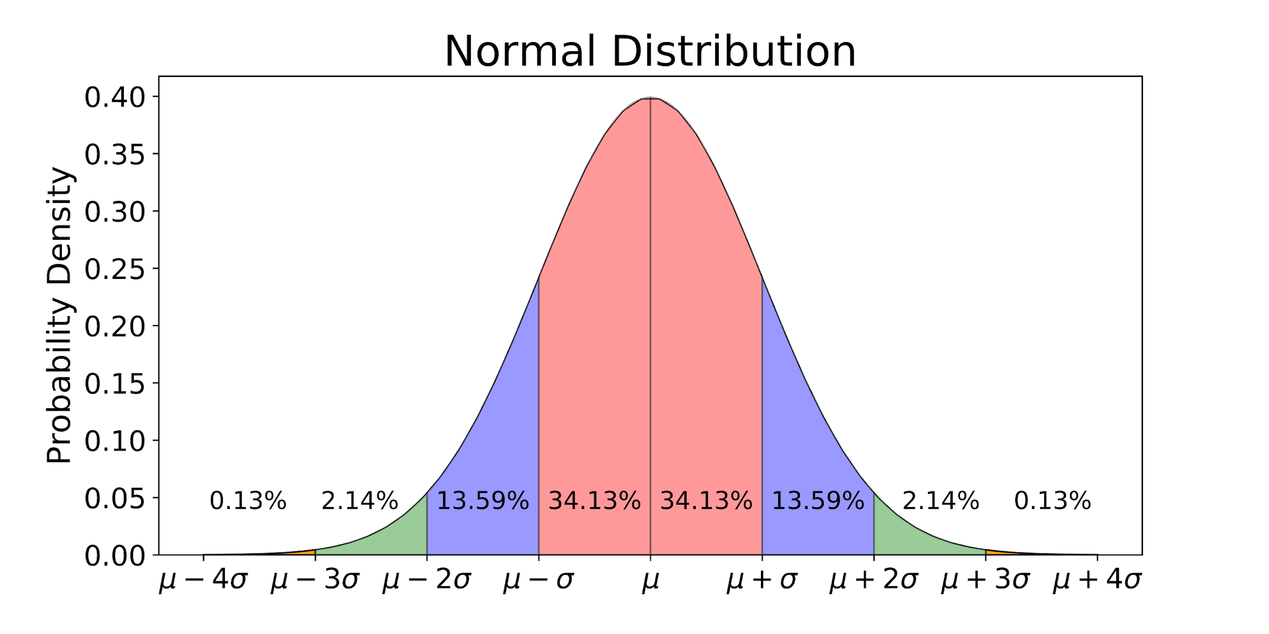
Vectorization/ Distribution
How do we solve this ?
By using vectors ( aka rank 1 tensors )
10 Standard elements / grayscale
10d vectors at a pixel ( hard to visualize )
Iterate through each pixel in a desired grayscale

Slide 4
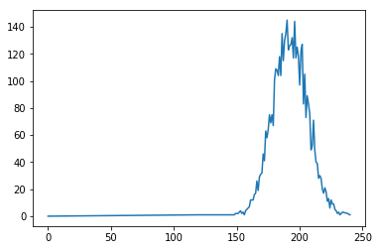
Challenges
Implementation
Noise
Data interpretation
Tweaking the distribution
Graphical interpretation
Debugging
etc.
Communication
'NiS']['Ni']

Slide 5
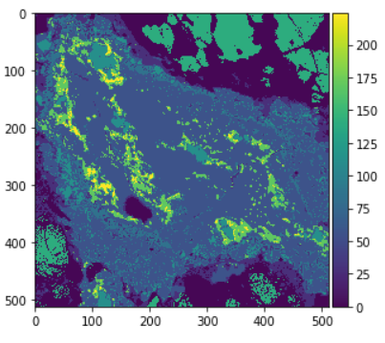
Results

Slide 6

Overambitious?
-Rooms for improvements
Originality is good, but…
Differing working environment ( Jupyter, IDE , text-editor…)

