Slide 1
Be a Star!
A mixed reality action game about stars and gravity
#AMNH Hack the Solar System 2019 Anna Leonenko, Peggy Li, Vivien Ngo, Cameron Yick

Slide 2
Design Goals
Teach intuitions about gravity
Teach about star life cycle
Create a multi-user experience
Ensure accessibility on multiple platforms
Make something fun with real-time mixed reality
Learn and develop something new

Slide 3
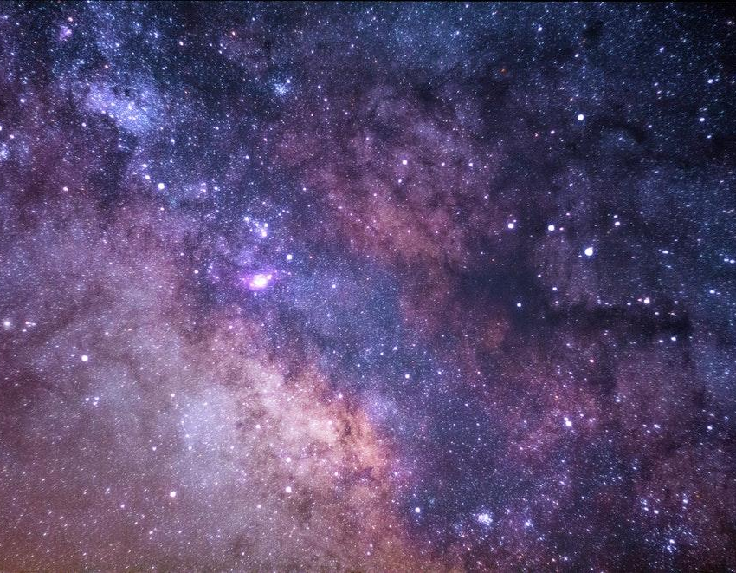
Be a Star!

Slide 4
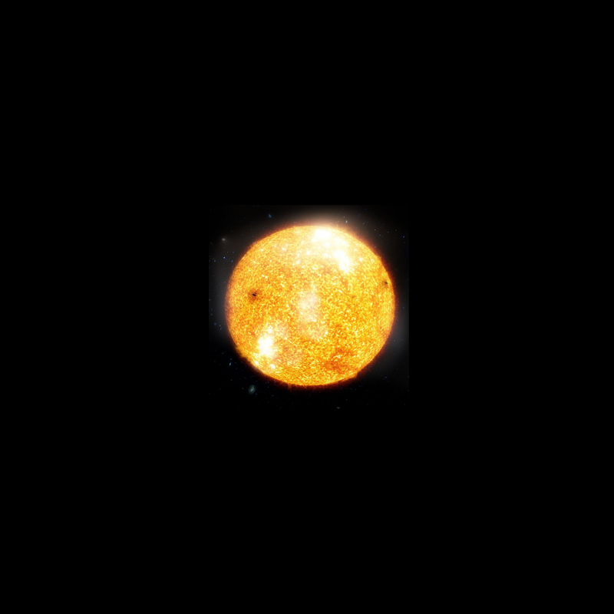
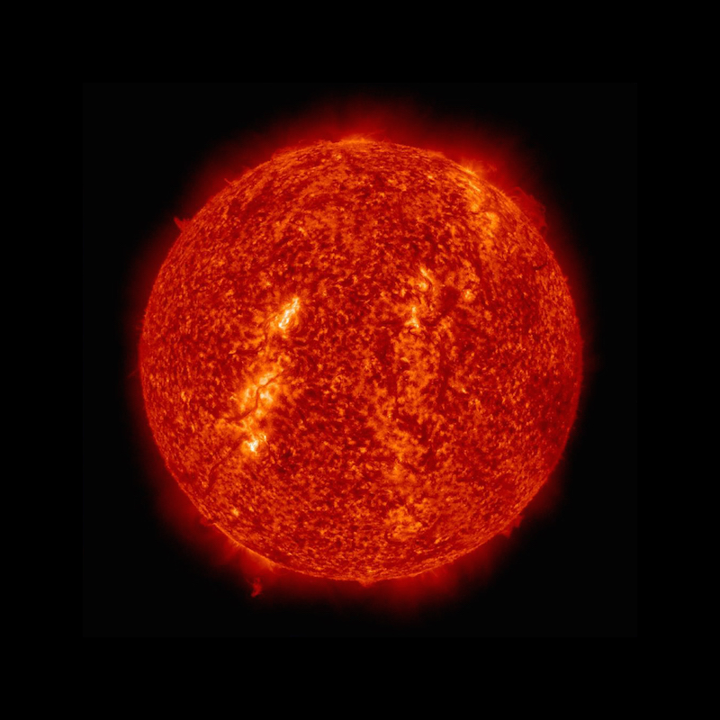
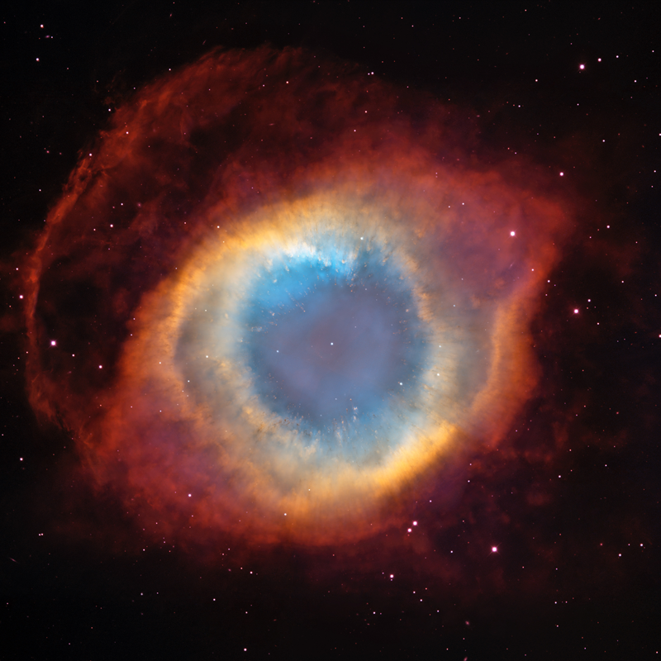
Mechanics

Slide 5
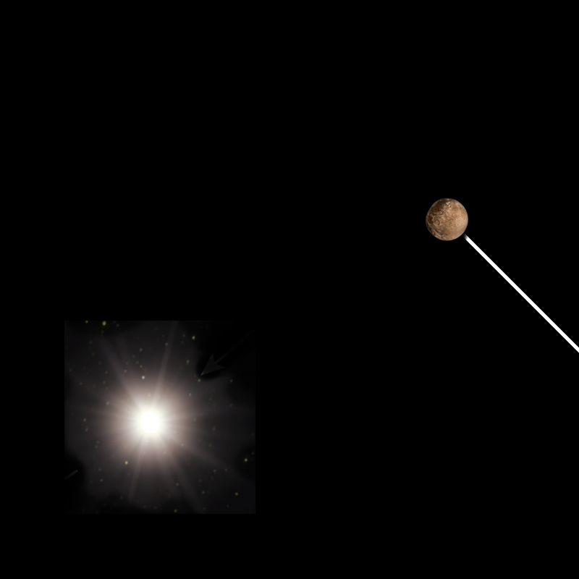
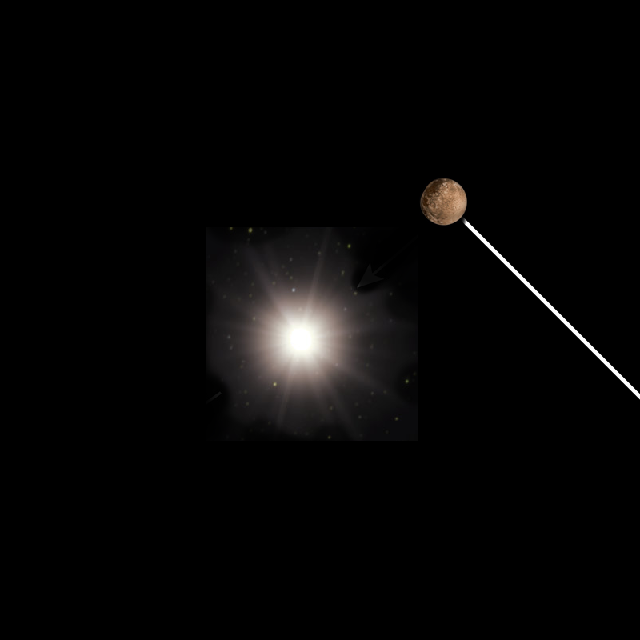
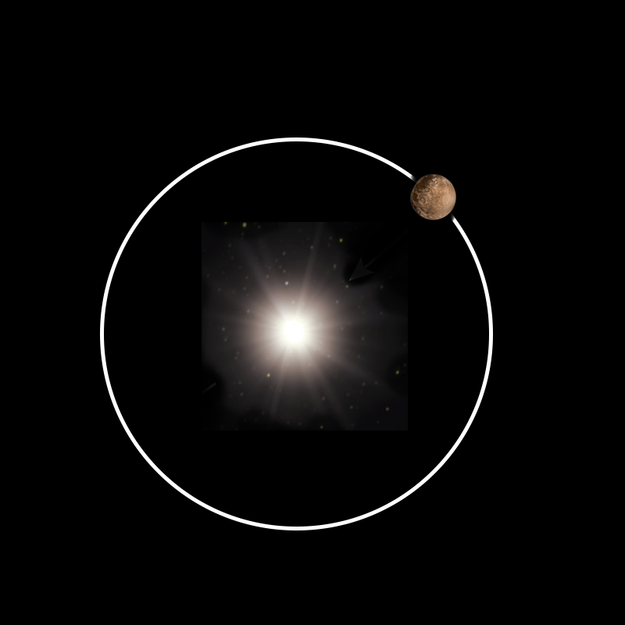
Mechanics

Slide 6
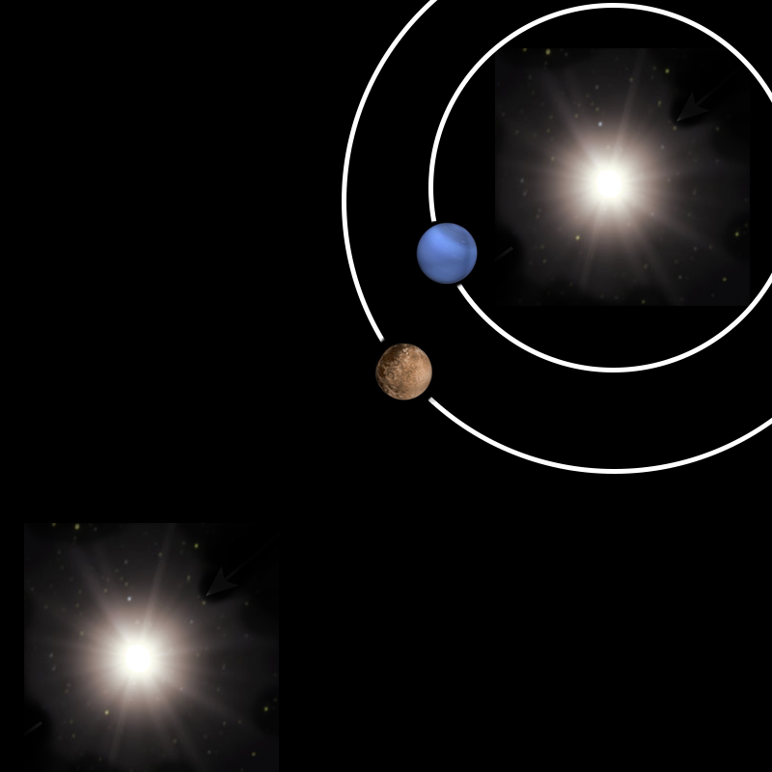
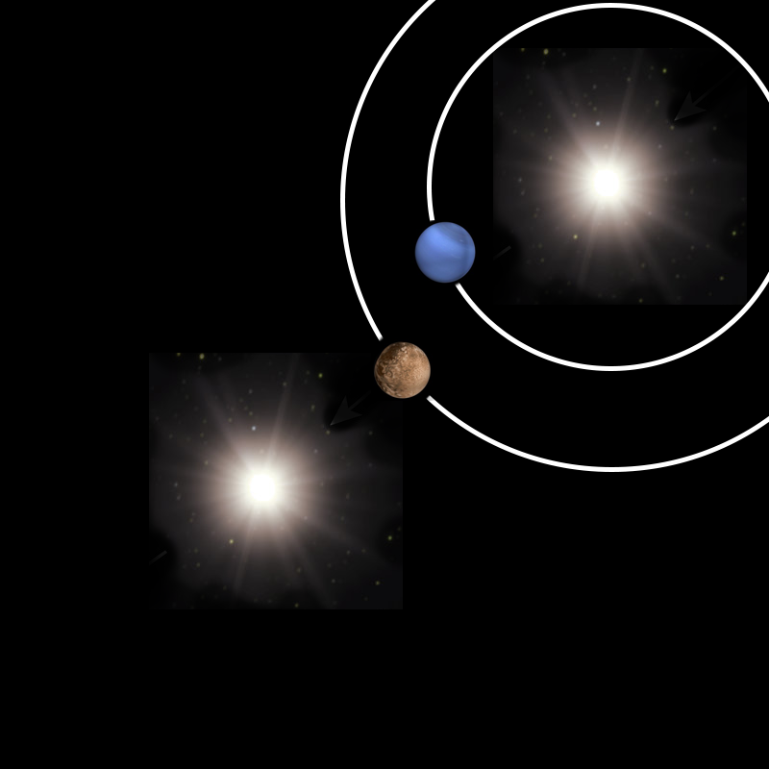
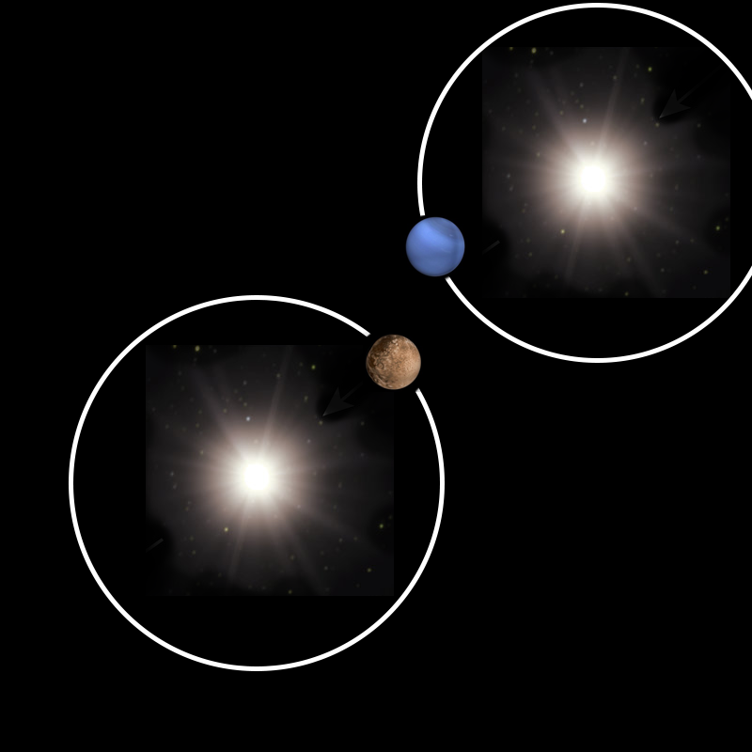
Mechanics

Slide 7
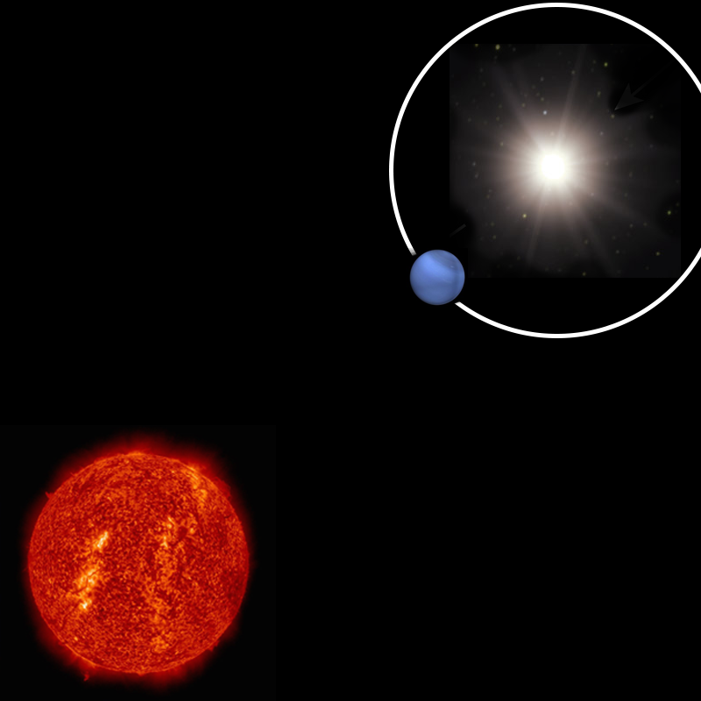
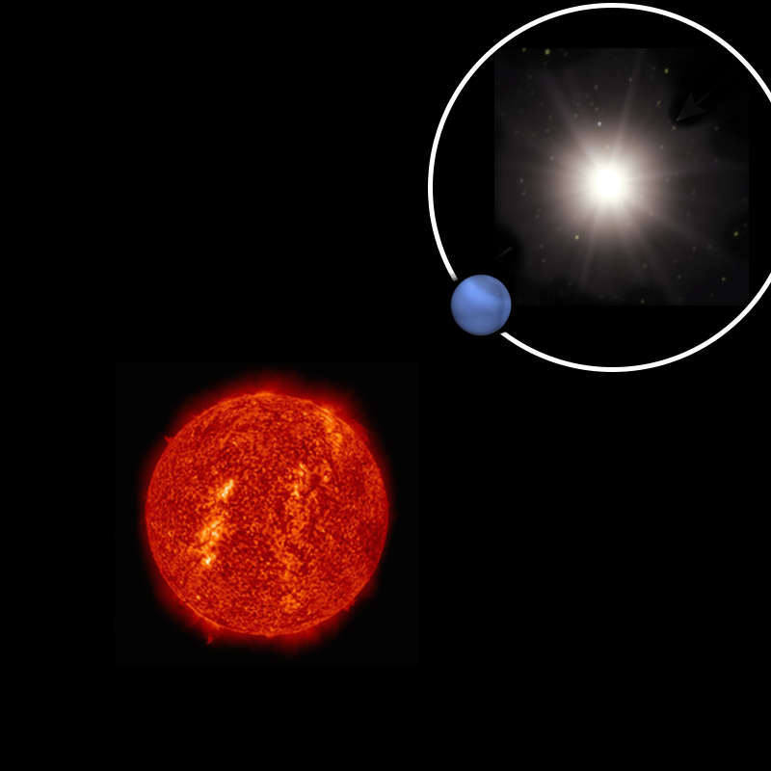
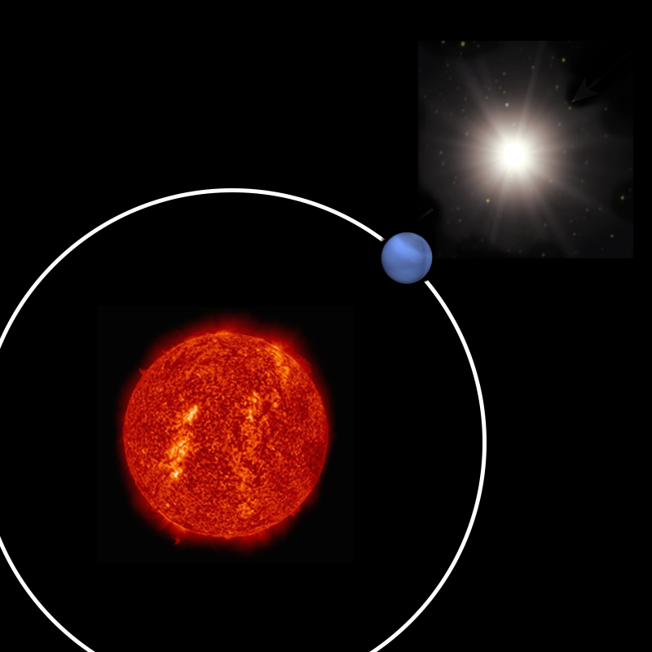
Mechanics

Slide 8
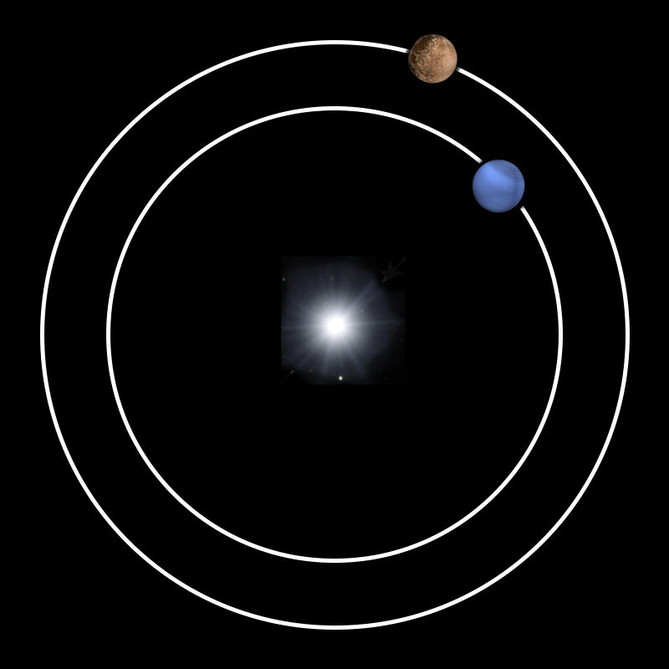
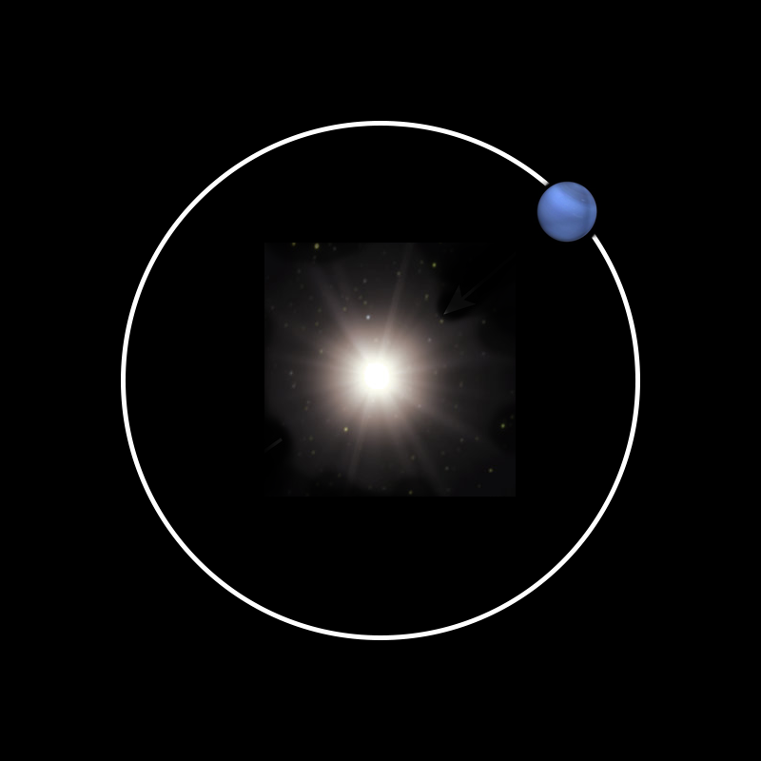
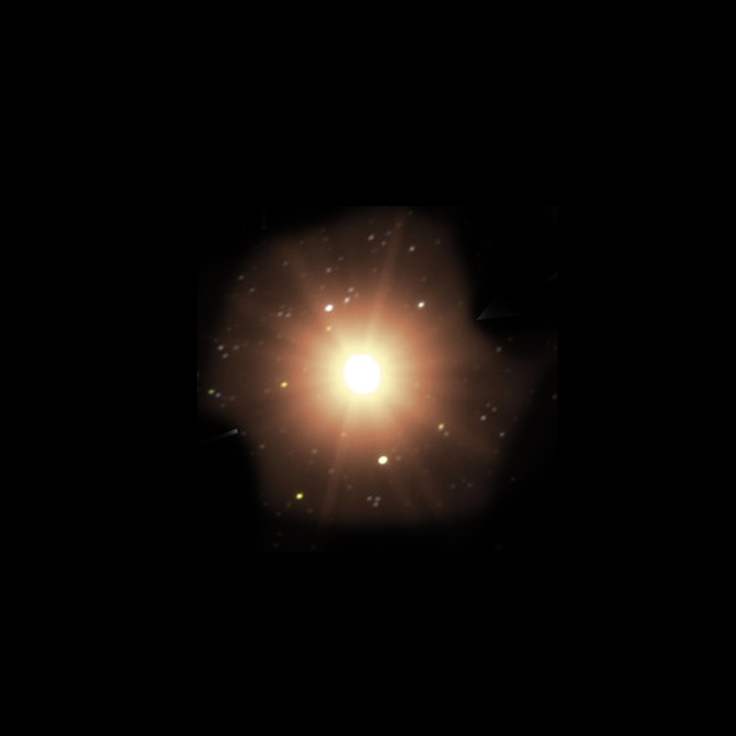
Mechanics

Slide 9

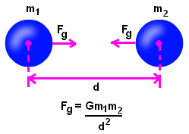
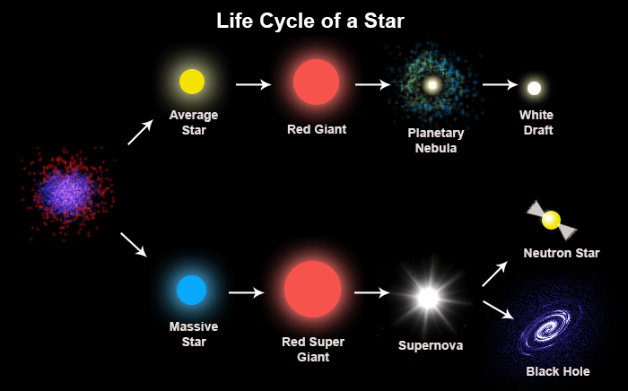
High School Science Standards
Law of Gravity for 2 Masses (HS-ESS1-3)
(Point Mass Universe)
images: Tutorvista.com, society of physics students (SPS)
Notes:
https://www.nextgenscience.org/topic-arrangement/hsspace-systems

Slide 10
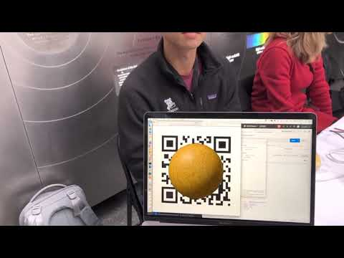

Tap to Eat - DEMO
Notes:
Rules: People like games were you control something that eats other things and slowly grows
User may select a real star, with planets orbiting you
You may “walk” freely around the universe
If you get close enough to another star, the star with a higher mass will “take” a planet from the other’s orbit
Twists
Stars lose mass when they move towards other stars
Masses randomly zip into universe, if your mass is high enough, they’ll join you in orbit

Slide 11
Next Steps
Improve location measuring
Precision: Overhead camera or Bluetooth (iBeacons)
Decay: moving costs mass
Scoreboard for spectators without smartphones
Fly-by asteroids
Use facial recognition instead of QR codes

Slide 12
Lessons Learned
Used Mixed Reality + React Native for the first time
Viro: 10/10, would use again
Others: ExpoVR, AR.JS
Documentation makes a library hackathon-friendly
Picking the right image markers is hard
How to build a project with Node.js

Slide 13
Thank you!
Vivien, Peggy, Anna, and Cameron
https://github.com/HackTheSolarSystem/beAStar-front
https://github.com/HackTheSolarSystem/beAStar-back

