Slide 1
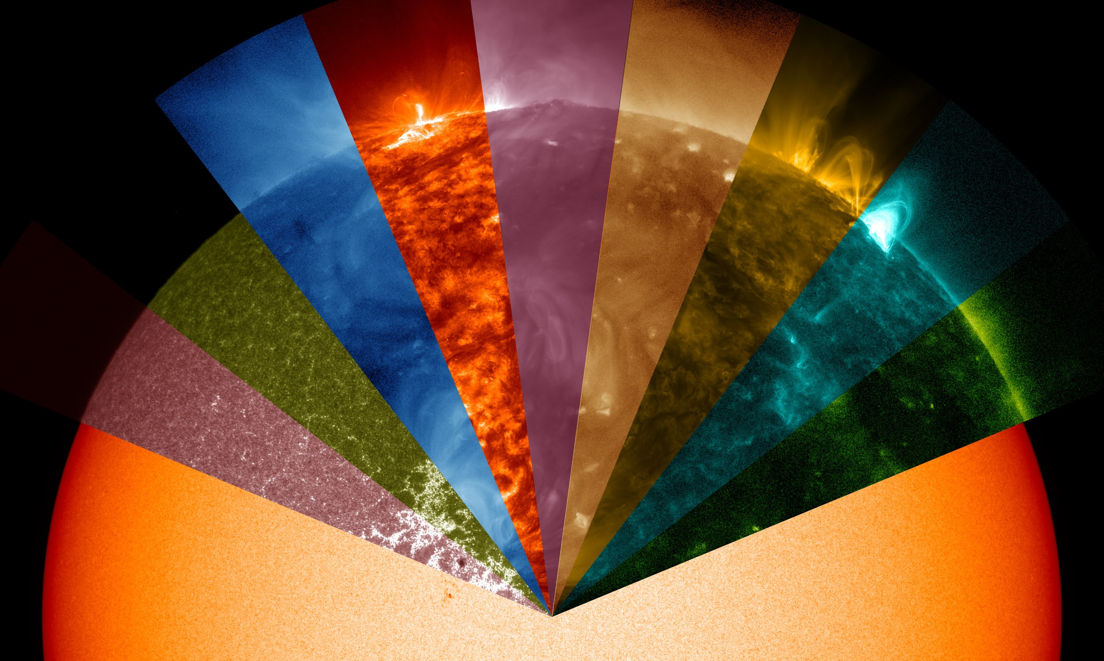
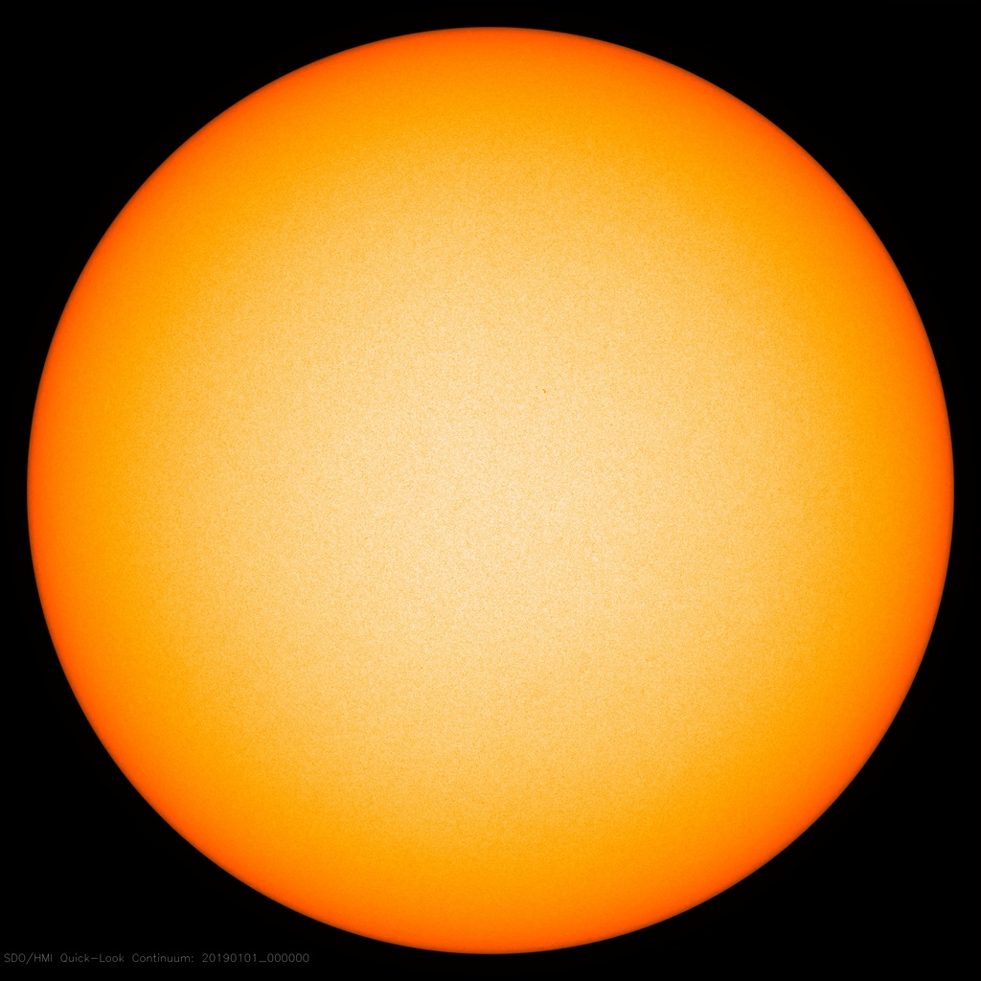
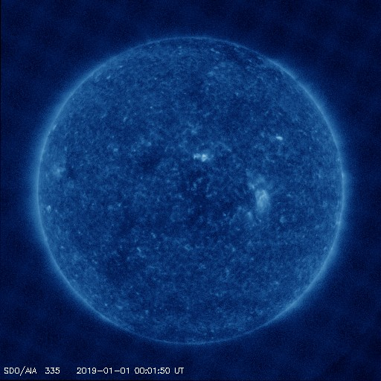
See Our Sun
SolidGoldSol: JP Ventura, Colleen Cleary, Kenny Yu

Slide 2
The Open Space Solar Browser:
What Worked:
Download openspace software to computers.
Openspace 0.12 worked for mac.
What didn’t:
Openspace 0.12 needed additional software to enable the solar browser.
High traffic on WiFi made difficult to download large files.

Slide 3
Helioview & Unirest: Acquiring the data
What worked:
The Unirest request client package downloaded easy.
The documentation pages were easy to read however...
What didn’t:
Written for older python version.
Required other dependencies.

Slide 4
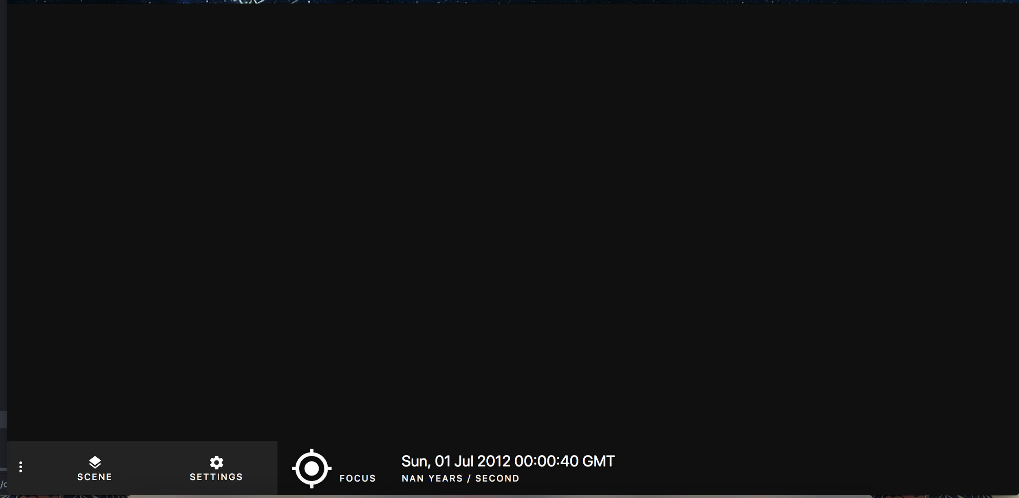
OpenSpace Web GUI Front End!

Slide 5
OpenSpace Web GUI Front End!
It took a long time to get this set up

Slide 6

OpenSpace Web GUI Front End!

Slide 7
How it turned out
Downloading and setting up the Openspace is difficult
A consistent way of installing a working project would be useful (ie Docker)

