Slide 1

CHALLENGE // See Our Sun
#HacktheSolarSystem
@AMNH

Slide 2
OUR CHOSEN // Solution
Solar browsing interface in OpenSpace. Create an Interface to download imagery on demand and feed it into OpenSpace's solar browsing module.

Slide 3
CURRENT TOOL // Helioviewer API
Allows a variety of different data to be collected from the SDO dataset
Both raw images and metadata required for OpenSpace
Easy to pull one image or a movie, not set up for multiple image files

Slide 4
OUR CREATION // Celeste
Interfaces between OpenSpace and Helioviewer
Collects a date range and telescope of choice to pull images from SDO dataset
Provides individual image files and respective metadata in .zip file
Default interval between images - 15 minutes. Can be adjusted

Slide 5
IDEAS FOR // Next Steps
Fully connected frontend and backend
Ability to select other “Space Thangs”
Download-path selector to streamline loading into OpenSpace
Capture download trigger from within OpenSpace
Move away from dependency on Helioviewer API
Greater control over image resolution

Slide 6
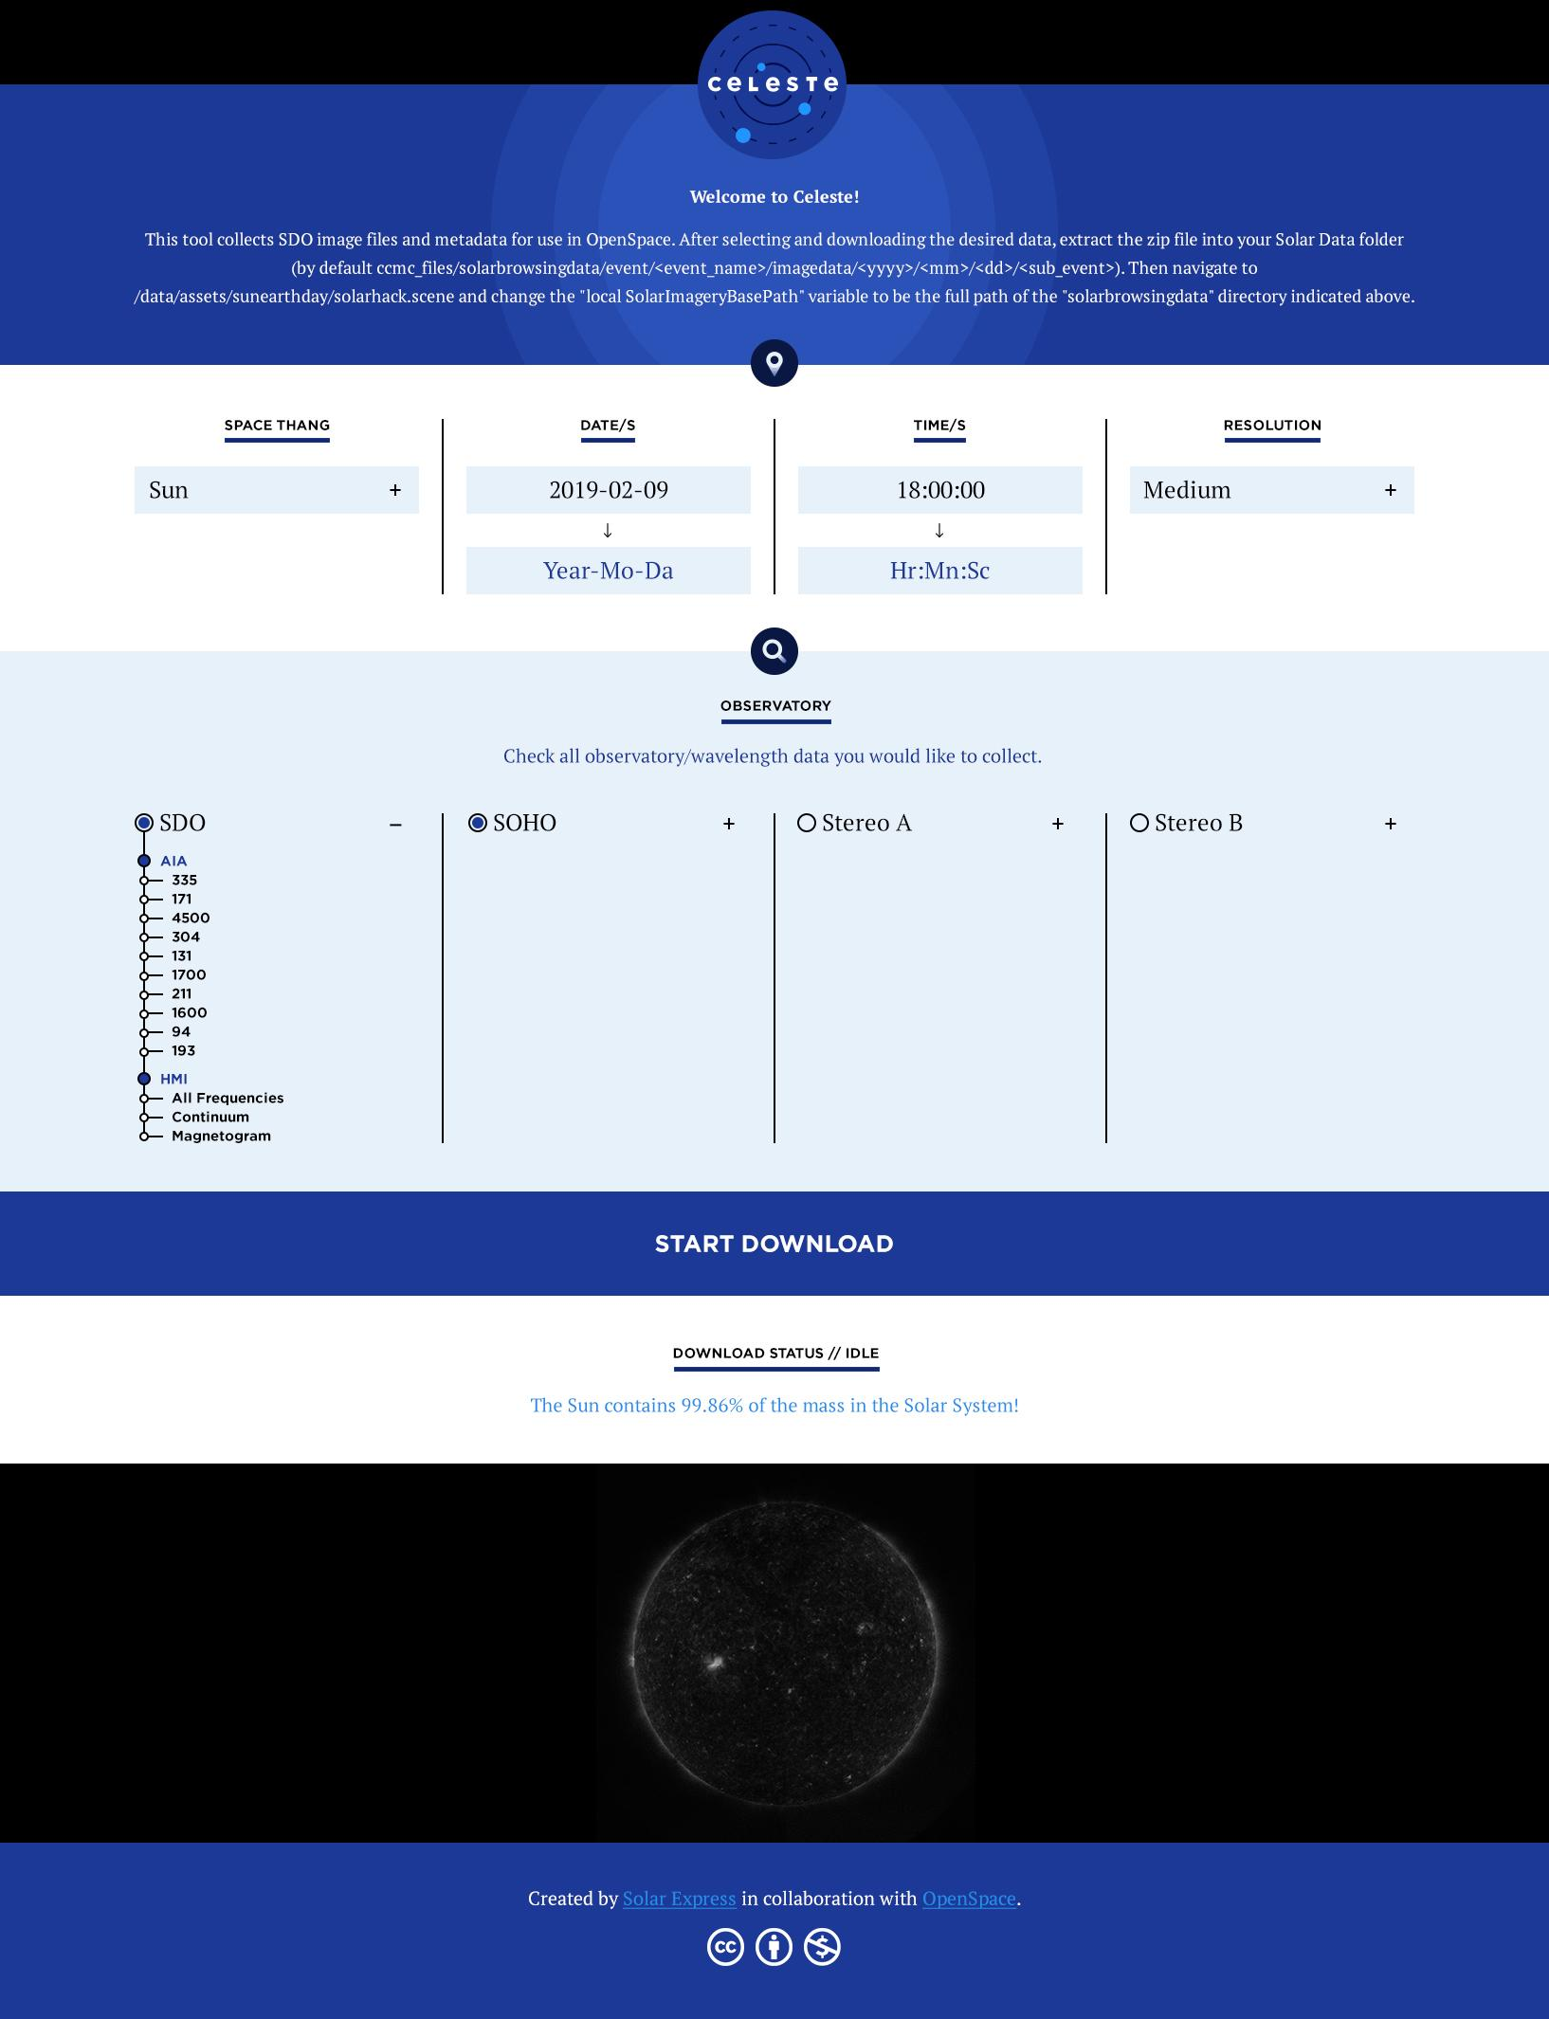

Slide 9
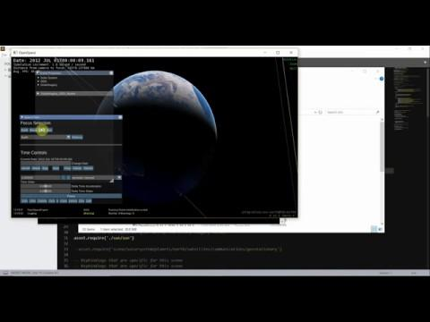

Slide 10
