Slide 1
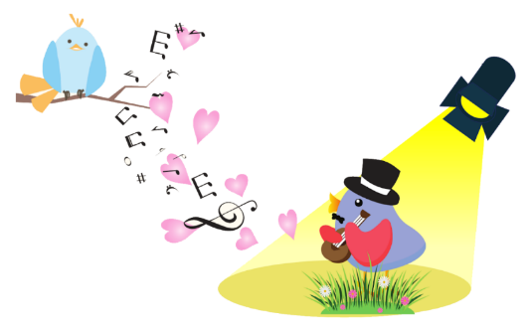
Different brains for different songs
Jacob Edwards
PhD Student
Columbia Psychology Dept.
Woolley Lab

Slide 2


Undergrad major:
Ecology & Evolutionary Biology
Career goal:
Botanist
Spoiler alert:
Didn’t happen

Slide 3
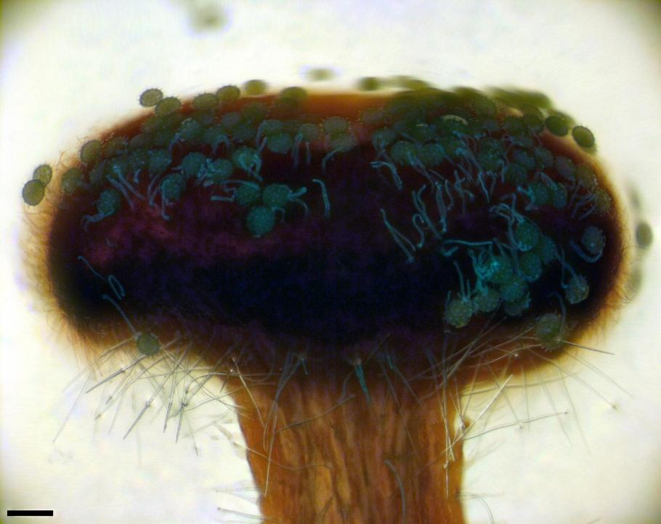
Best skills I learned:
Taking detailed notes
Thinking methodically
Staining tissue/using a microscope

Slide 4
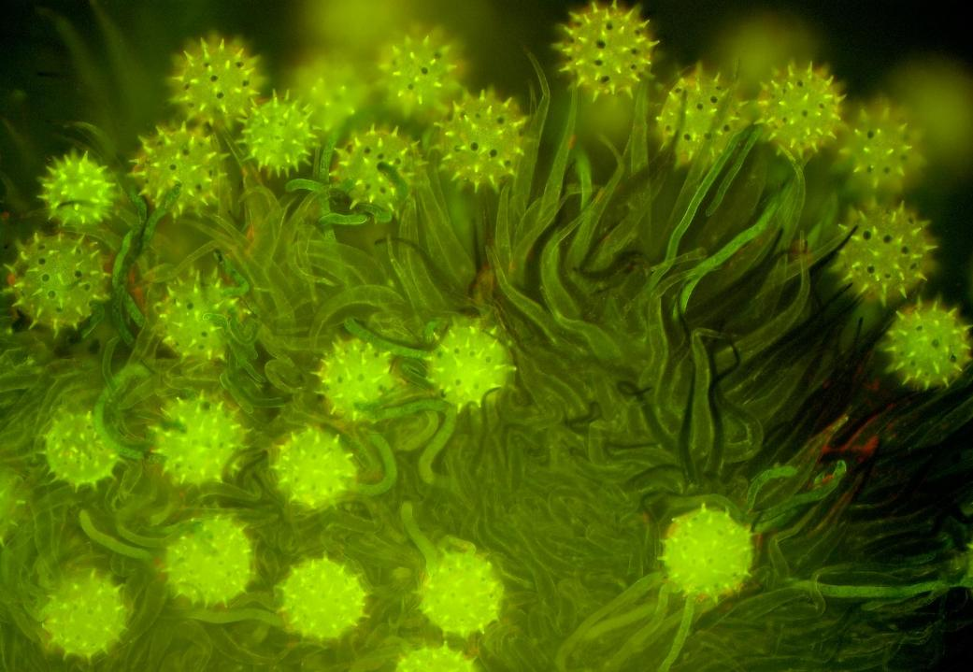
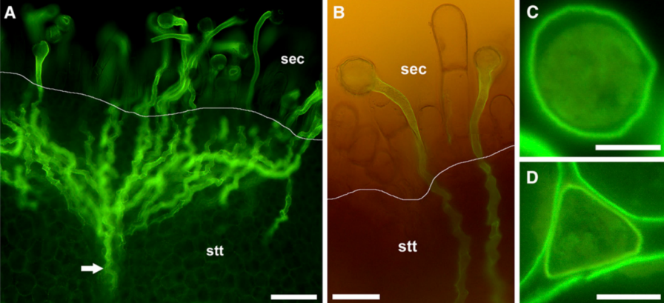

Slide 5


Slide 6
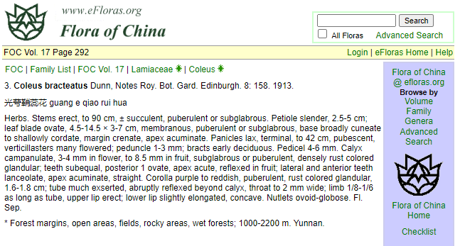
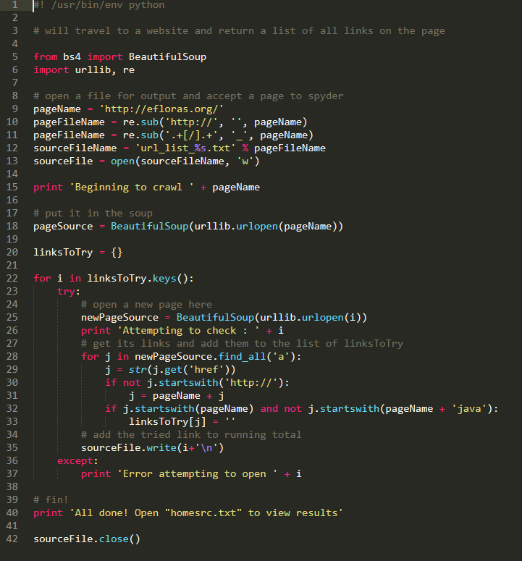
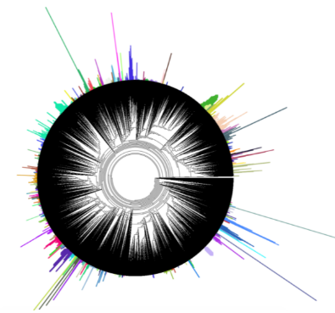
Searched
116,895 species
Flower size across
4,828 species

Slide 7

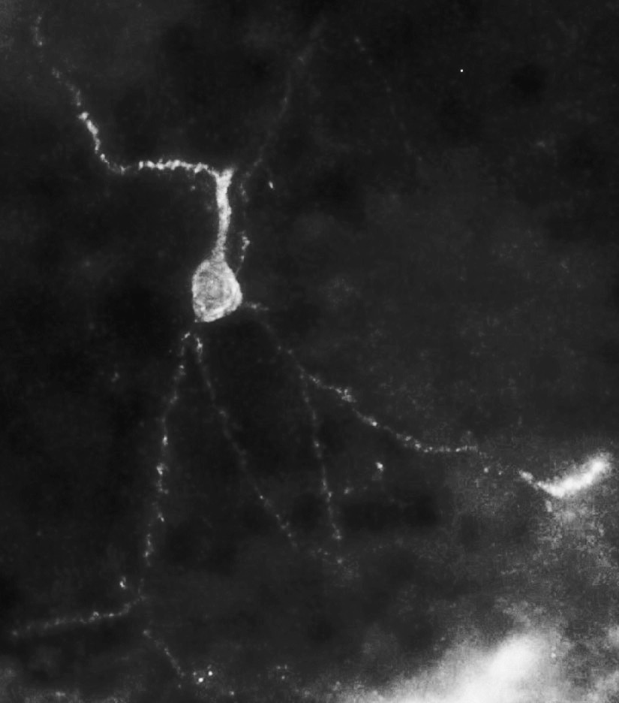
Perineuronal nets
Celio et al. 1994

Slide 8

Learning gets harder as we get older
plasticity
PNNs?
Learning capacity
stability
Age

Slide 9
PNNs develop in the brain from the “bottom up”

Slide 10
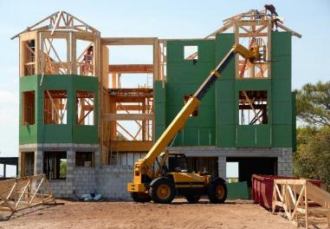
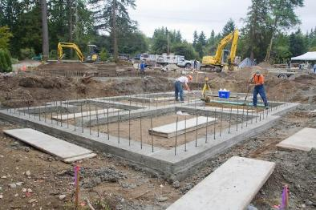

Stability supports plasticity
Takesian & Hensch (2013)

Slide 11
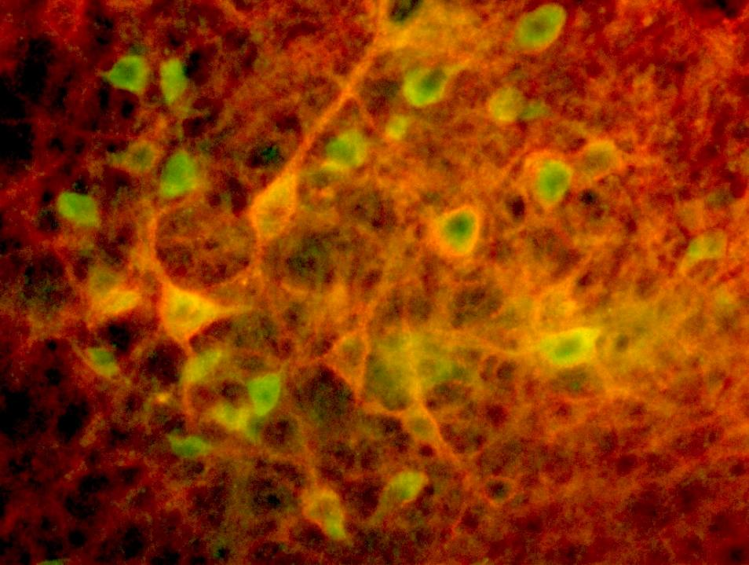
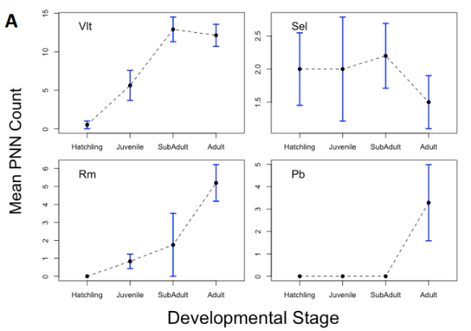
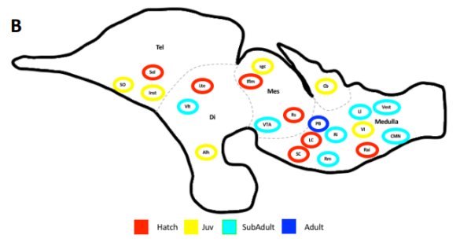

Slide 12
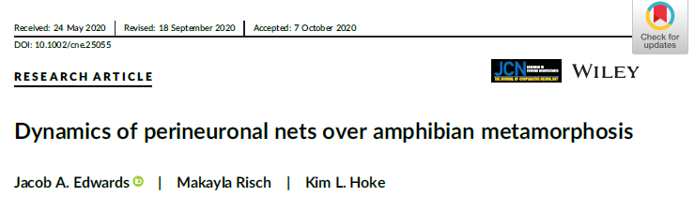
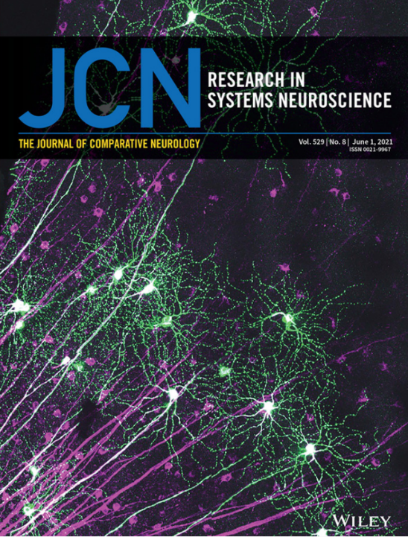
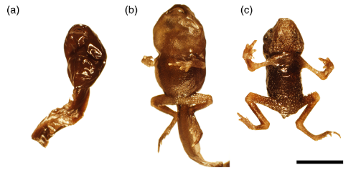
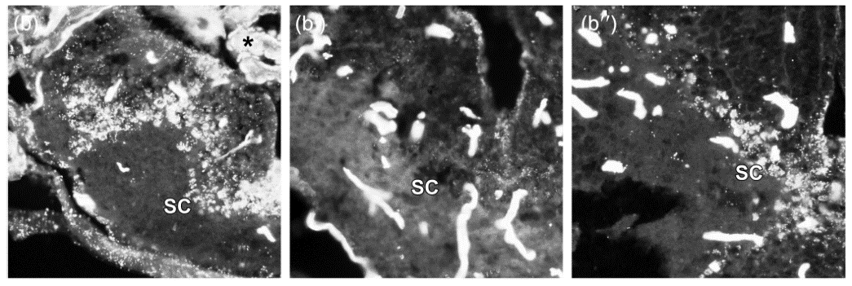

Slide 13
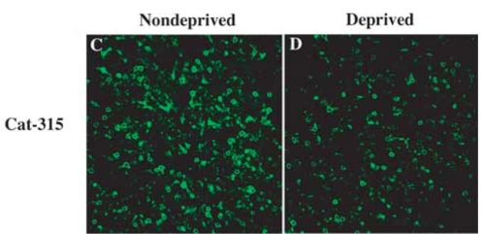
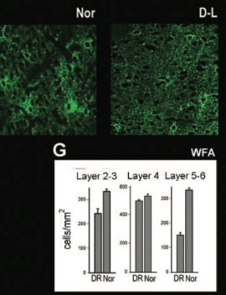
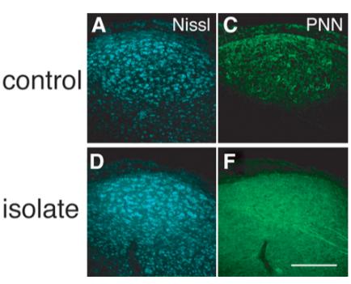
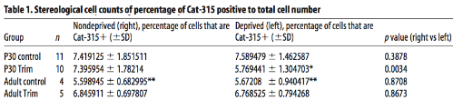
PNNs in the auditory system remained mysterious
Tactile
Visual
Auditory
McRae et al. 2007
Pizzorusso et al. 2002
Balmer et al. 2009

Slide 14









Slide 15
Jacob’s life advice (your mileage may vary):
Talk to people!
Dive deep into your interests; follow your curiosity as your interests evolve
Learn how to write code. Python is a great 1st language (it helps to pick a project that is meaningful to you). Writing code forces you to think methodically

Slide 16
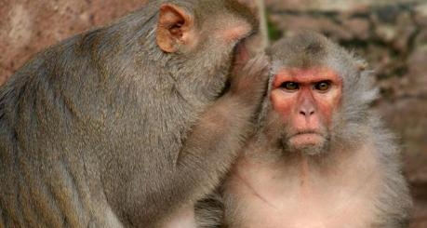

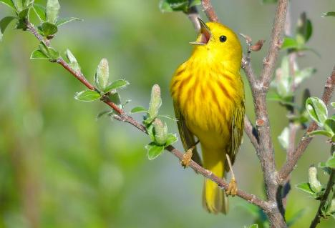
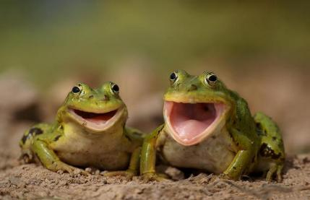
The power of listening
Notes:
We are vocal communicators. We convey social information using voice and our listeners process that information using the sense of hearing. In fact, most animals communicate vocally to some degree. Our lab is interested in the brain mechanisms underlying social communication, and the overarching question in my talk is – how does the brain pick out sounds in the environment that are relevant to YOU? Among all animals that communicate vocally, none resemble the richness and complexity of human communication more than songbirds.

Slide 17
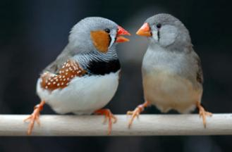
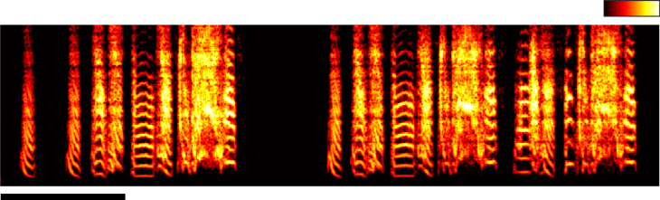
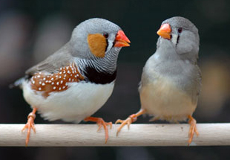
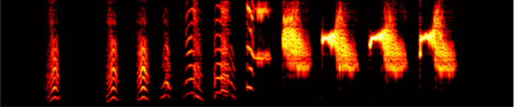
Song is essential for finding a mate
Good (tutored) song
Rel. power
0
1
8
Frequency (kHz)
4
0
0.5 s
Bad (untutored) song

Slide 18
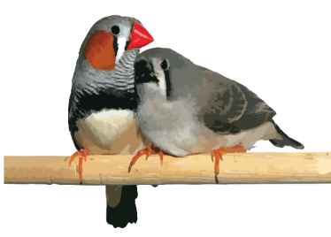
Songbirds are outstanding vocal learners
Practice, practice, practice
Listening, memorizing
Mature
song
hatch
20
40
60
80
100
Days old
Notes:
Just like humans, songbirds are outstanding vocal learners. Point out that humans go through the same phases of vocal learning – sensory, babbling & refinement, and stable mature behavior

Slide 19
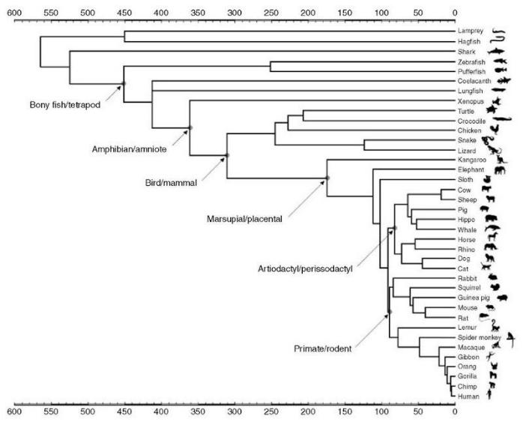
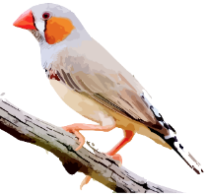
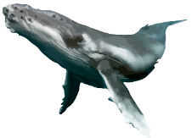

Vocal learning is RARE

Slide 20






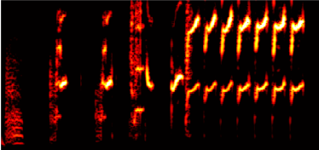
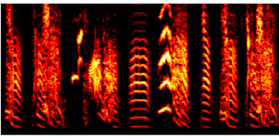
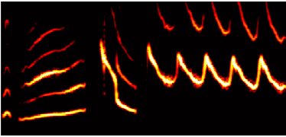
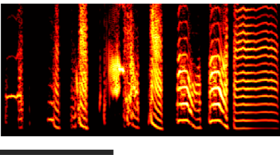
Song is individual-specific and species-specific
8
kHz
4
0
0.5 s
Notes:
What learning means is that each male bird sings a unique song – song is specific to each individual. But, differences in song are not random – all zebra finches sing something with the “essence” of zebra finch song. And that “essence” is also different across species.

Slide 21
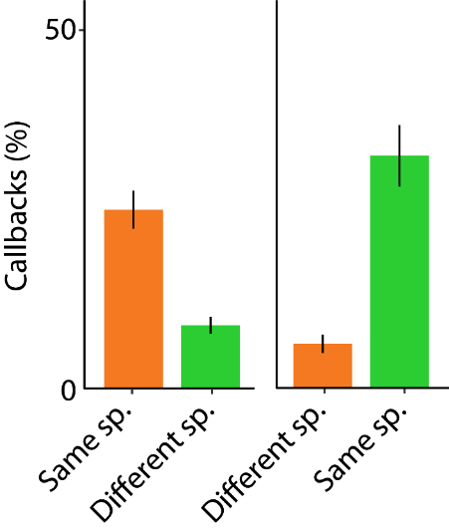

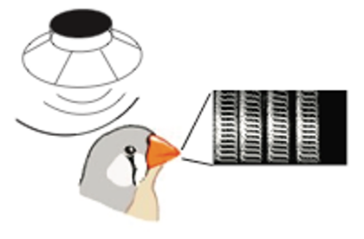
In behavior, songbirds are most interested in their own species (conspecifics)
Data from labmate Moises Rivera

Slide 22
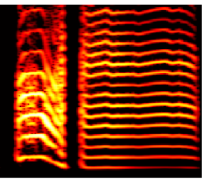
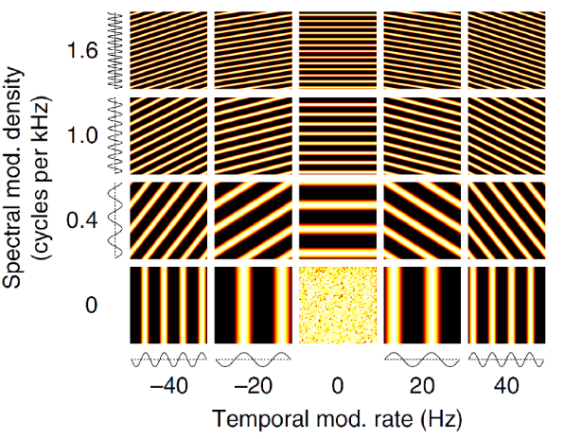



Describing the acoustic structure of song
8
Density of harmonics
Change in freq. over time
4
kHz
0
250 ms
8
+
+
kHz
4
0
Notes:
Let’s describe this sound using some simple building blocks. Ladder analogy. First thing we notice is a ladder at the start of the first note. Then, there’s another ladder, but it’s tilted to the right. Then, the long note is also a ladder, but with more steps than the first one. So we could describe these sounds in terms of: how many steps are on the ladder, and how much does it tilt to the left or right. We call these building blocks “ripples”. We can recreate any complex sound using ripples.

Slide 23

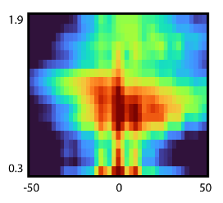

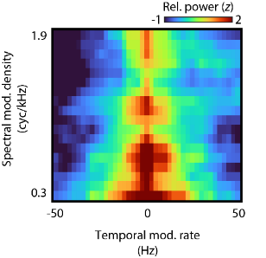
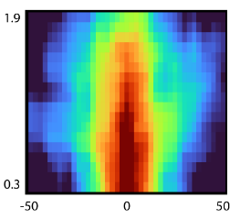

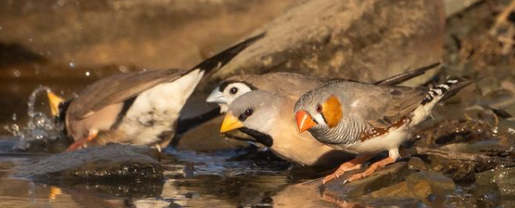
Hypothesis: Birds key in on acoustic structure of conspecifics
Photo credit:
Col Roberts Photography

Slide 24
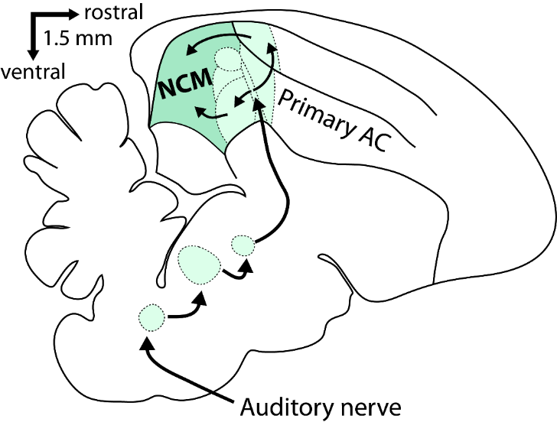
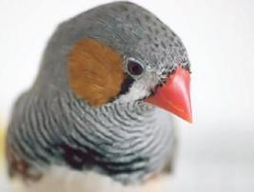
Where are songs encoded for conspecific communication?

Slide 25
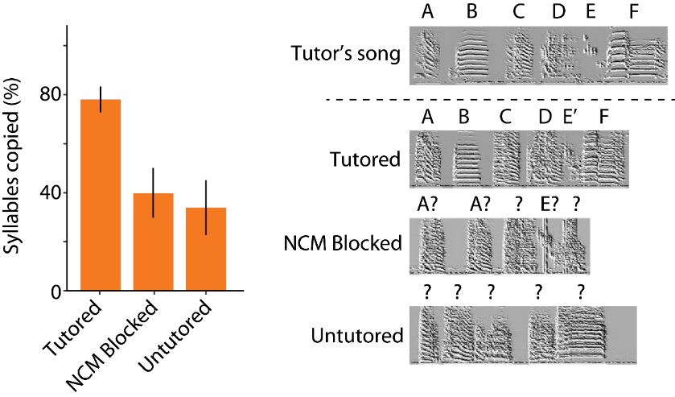
NCM is necessary for perception that supports song learning
London & Clayton 2008 Nat. Neuro.

Slide 26
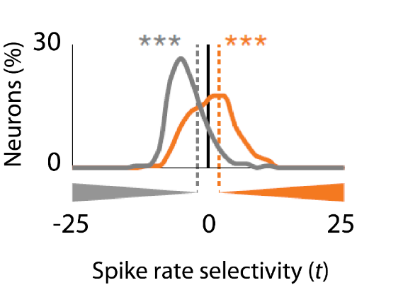
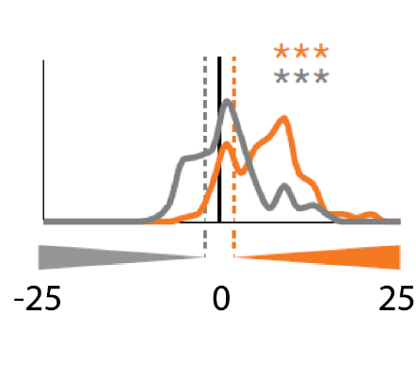



NCM neurons respond selectively to conspecific song
Sec.
(NCM)
Input
Moore & Woolley 2019 Nat. Neuro.
Notes:
These same neurons, that are necessary for song learning, are also respond selectively to conspecific songs. Recent work from our lab showed that

Slide 27
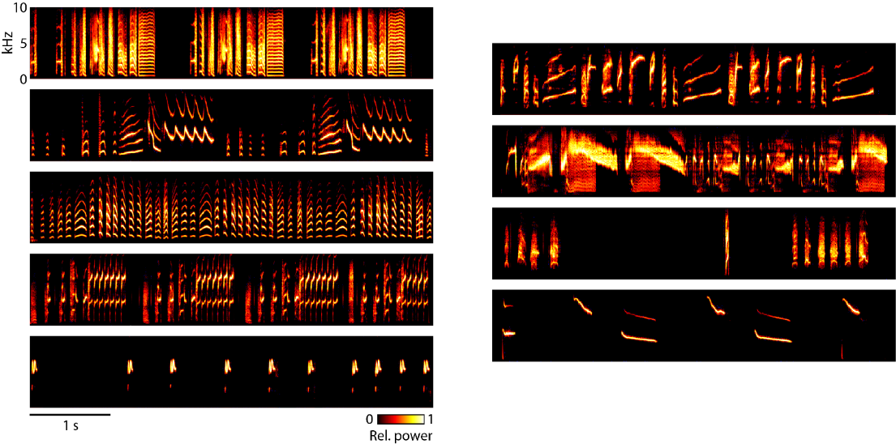



How does acoustic structure in song drive selective coding?
Notes:
So wanted to expand on these findings and present neurons with a diverse but natural stimulus set, containing songs that ranged from acoustically very similar to vastly different

Slide 28





I record activity of single neurons in NCM
Notes:
Top down view of the brain, NCM is the medial-most 0.7mm on either side of midline. I lower an array of electrodes, with 32 conductive sites spread over 4 shanks, into the brain. Before this, I paint the electrode array with a fluorescent dye so I can resolve where the recording locations were in tissue sections. I then stain these sections with Nissl stain, that allows me to mark out the anatomical borders of brain regions. From this I can reconstruct the position of each recording site throughout the brain. At each site, I’m picking up a continuous voltage signal, and I’m looking for these sharp, fast deflections called spikes. When a neuron is driven by a stimulus, the rate at which spikes occur goes up from baseline. This spike rate is the measure of brain activity I’ll refer to throughout my results.

Slide 29




NCM neurons respond best to conspecific song… but also to some different-species songs
Notes:
Height of the bar is spike rate, color is species. Yes, NCM neurons respond best to conspecific song, but also to songs of other species. We wondered if this had anything to do with acoustic structure?

Slide 30




NCM neurons respond best to conspecific song… but also to some different-species songs
Notes:
If we look carefully at the acoustics of these other species, we find that they contain song elements with similar structures, that are all very different from the songs that didn’t drive high responses. So to understand these differences and similarities in responses to songs, I wanted to analyze how neurons respond to differences in acoustic structure

Slide 31






Ripple matrix links song acoustics to neural tuning
Song Acoustics
Neural Tuning
Notes:
Recall the ripple matrix, that allows us to describe song in terms of its density of harmonic frequencies, and the changes in frequency over time.

Slide 32




Ripple responses reveal tuning to acoustic structure
Ripple
Overlap
Neural Tuning
Song Acoustics
r = 0.79
r = 0.18

Slide 33





Tuning to acoustic structure explains song responses… sometimes
p < 0.05
p < 0.05
n.s.
Notes:
Drive the point home that neurons are responding to the fine acoustic structure of song – other species songs might share similar features, and neurons respond to those songs because of this

Slide 34



Tuning to pitch alone explains song responses in the green species
p < 0.05
p < 0.05
p < 0.05

Slide 35




Pitch tuning in the green species is unique to NCM
NCM
Input
NCL
p < 0.05

Slide 36






Conclusions
Secondary auditory cortex neurons are tuned to the hallmark acoustic structure of your own species’ songs, but they are agnostic to species/singer identity
Sensory tuning could align perception and mating decisions to sounds that feature conspecific acoustic structure
Zebra
finch
Double-barred
finch
Gold-breasted
waxbill

Slide 37






Future directions: Where does information from NCM go?
NC
RA
AAV
AIV
Notes:
Zfzf: Tutor Albz209320; Pupil rr3132
Zfbf: Tutor; Pupil
Zflf: Tutor; Pupil

Slide 38





Future directions: Constraints on song learning
Tutor
Pupil
Notes:
Zfzf: Tutor Albz209320; Pupil rr3132
Zfbf: Tutor; Pupil
Zflf: Tutor; Pupil

Slide 39


Future directions: Hybrid birds copy songs very well
Tutor
Pupil
Notes:
Zfzf: Tutor Albz209320; Pupil rr3132
Zfbf: Tutor; Pupil
Zflf: Tutor; Pupil

