Slide 1
Build 3

Slide 2
Architecture Diagram :

Slide 3
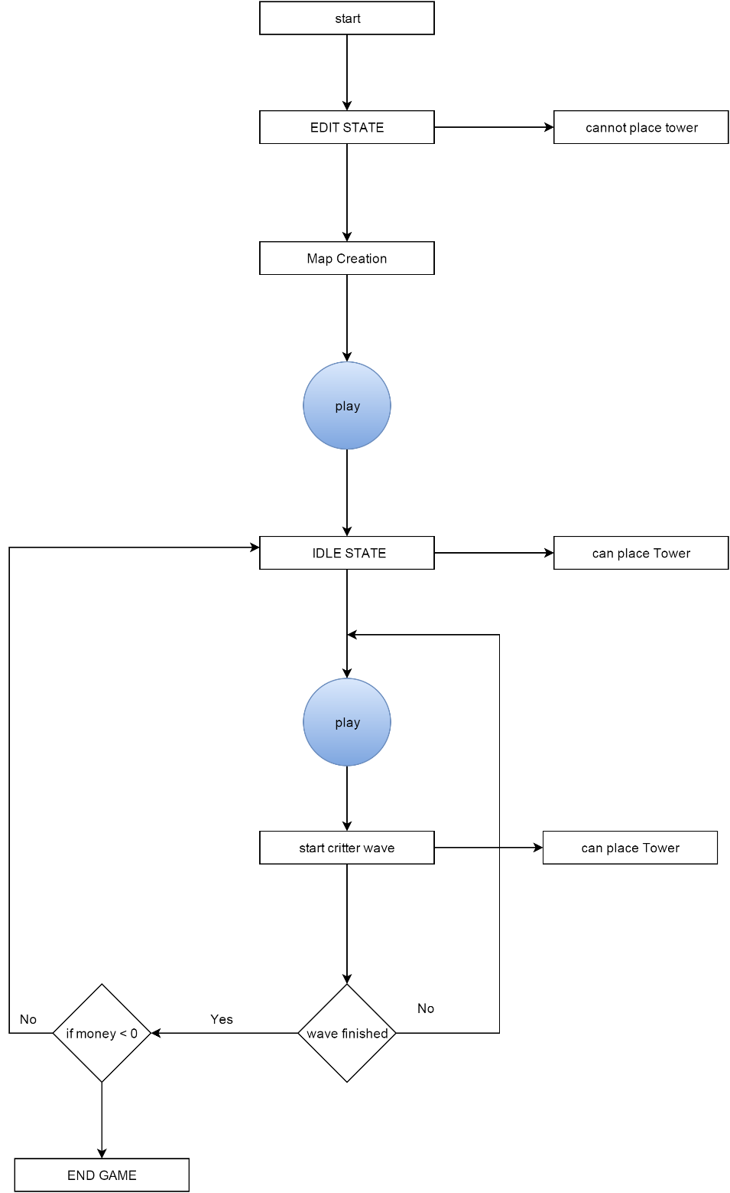
State Diagram :

Slide 4



Tower Description
CANNON TOWER :- This tower will provide BURNING (inflicts damage over time after a critter has been hit) damage effect to critters.
BOMB TOWER :- This tower will provide SPLASH (inflicts damage to critters around the targeted critter) damage effect to critters.
FREEZE TOWER :- This tower will provide FREEZING (slows down the critter for some time) damage effect to critters.

Slide 5
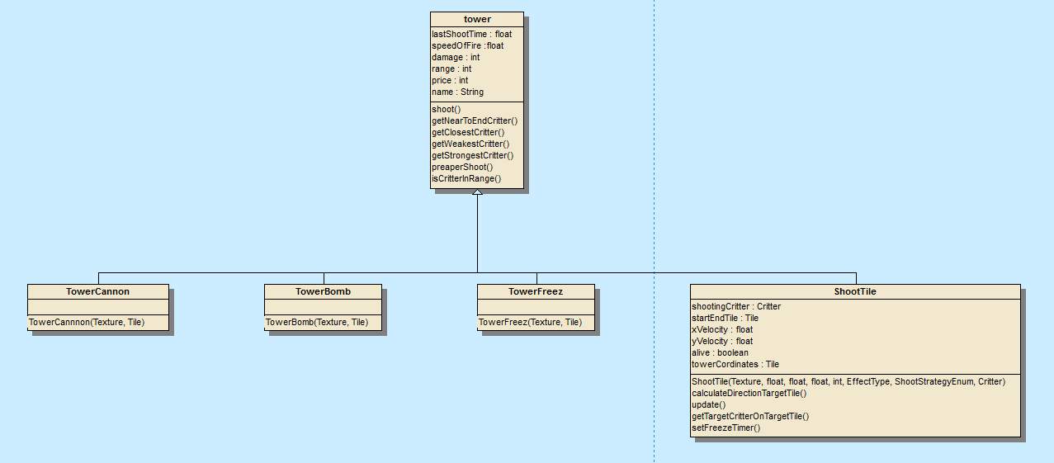
Tower Hierarchy

Slide 6
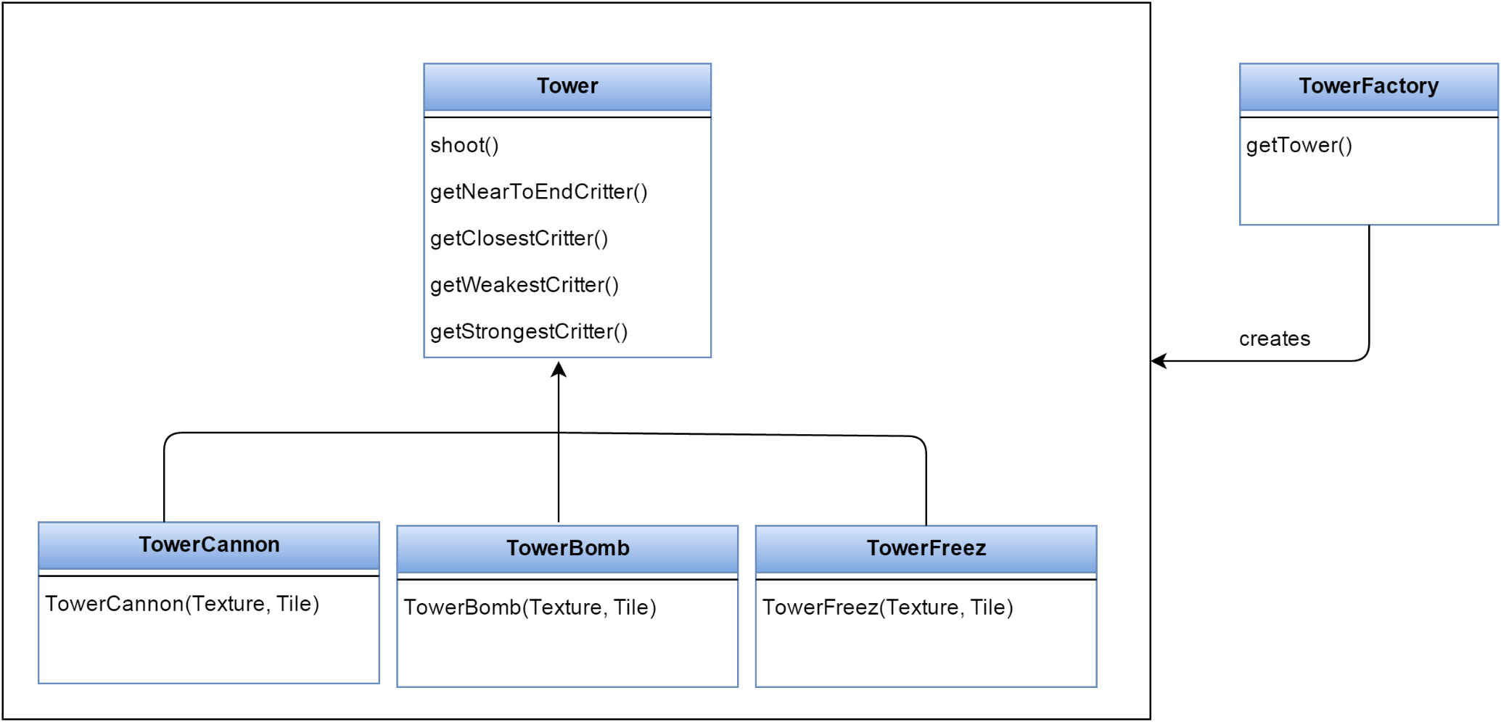
Factory pattern for towers

Slide 7
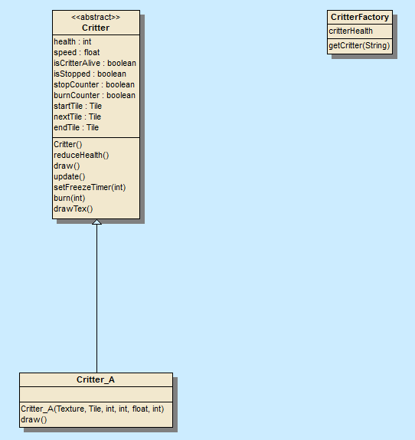
Critter Hierarchy

Slide 8
Factory pattern for critters

Slide 9
Observer Pattern

Slide 10
Singleton Pattern

Slide 11
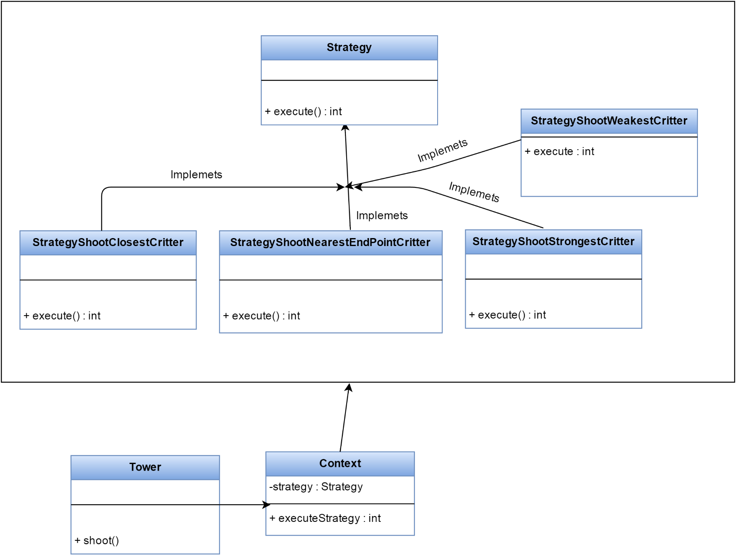
Strategy Pattern

