Slide 1
HiChat! Chat System
By
Amna Muqeem, Immad Amir, Ishmal Tahir,
M. Hannan Faryad and Muzamil Jillani

Slide 2

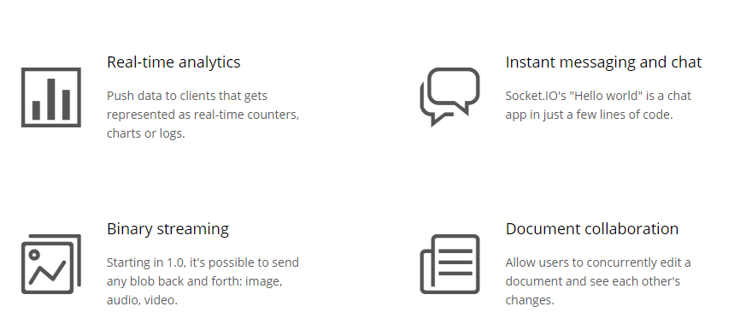
Introduction
Socket.IO is a JavaScript library for real-time web applications.
Socket.IO enables real-time, bidirectional and event-based communication.

Slide 3
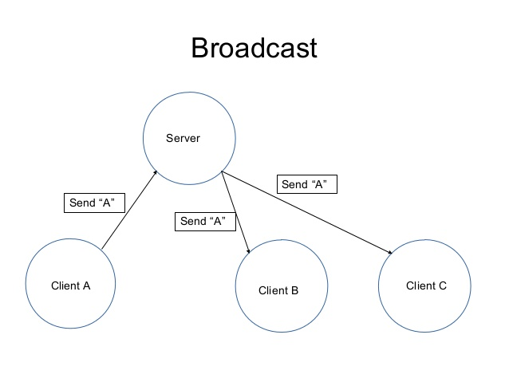
Introduction
Writing a chat application with popular web applications stacks like LAMP (PHP) has traditionally been very hard.
Sockets have traditionally been the solution
Whenever you write a chat message, the idea is that the server will get it and push it to all other connected clients.

Slide 4
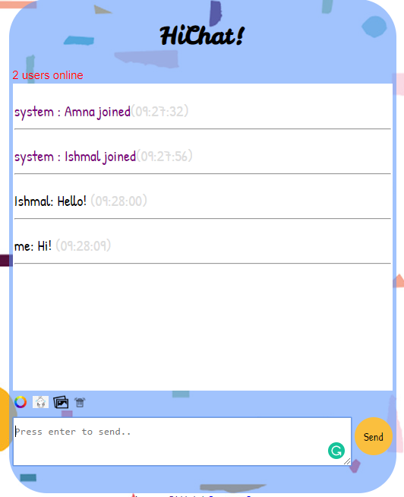
Main Files
Our chat system has four main files:
server.js
hichat.js
index.html
main.css

Slide 5

Functions
Including the usual sending and receving of messages, our chat system handles the following functions:
Emojis
Image upload
Clear chat
Text color

Slide 6
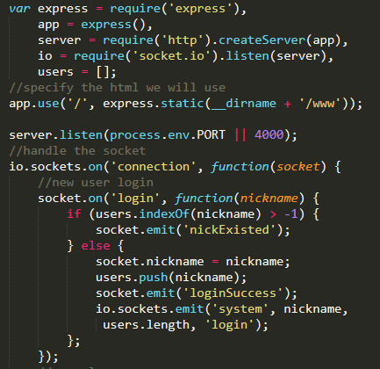
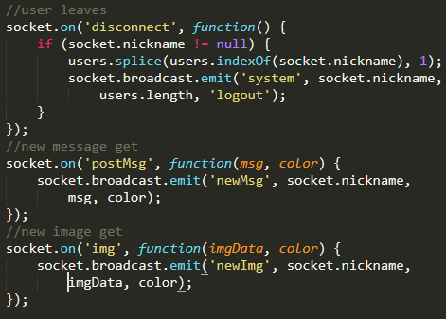
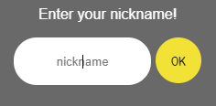
Server.js

Slide 7
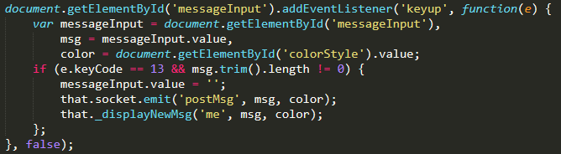


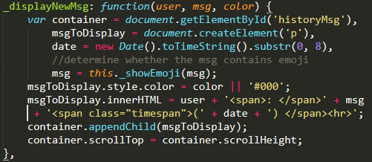

Sending messages & clear

Slide 8
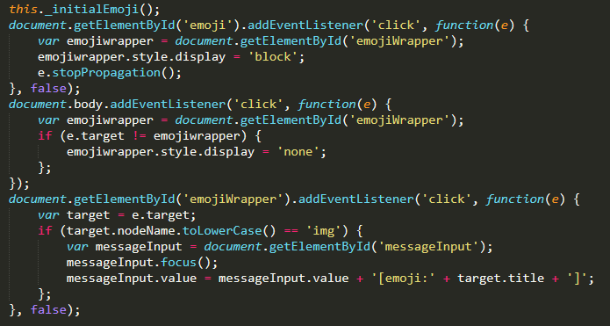
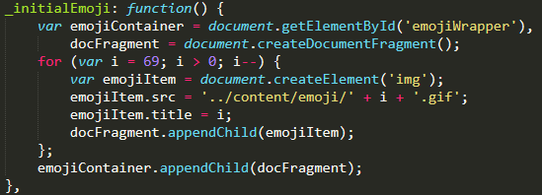
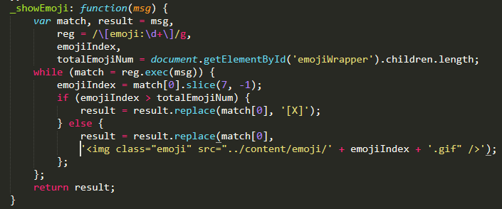
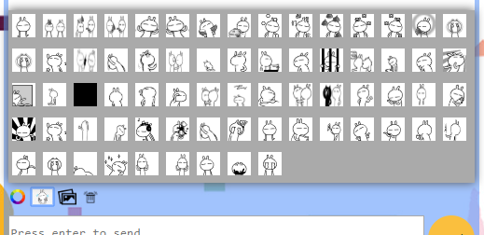
Emojis

Slide 9
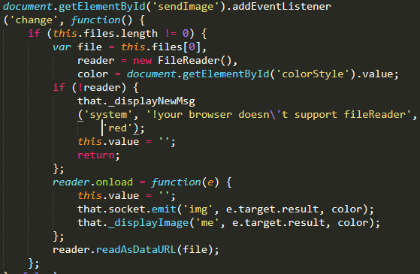
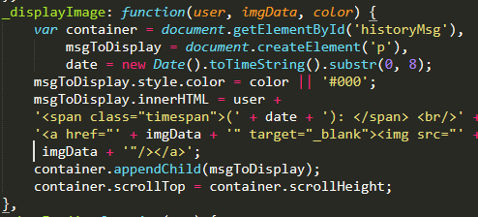

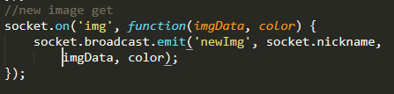
Image Upload

Slide 10
Demo!

