Slide 1
Deblurring
No more OTUs?

Slide 2
Problems with OTUs
De-novo:
Non-consistent
Computation time
Closed reference
Depend on database
In general – limited resolution, also when increasing read length

Slide 3
Why do we need OTUs
Read errors
For 150 bp reads and 0.5% read error we expect only (1-0.005)¹⁵⁰ =~ 0.5 of the reads to be error free.
All errors give different sequences, some with non-negligible frequencies. For example for a sequence with 1000 reads, we will almost certainly get some hamming-1 sequence with at least 10 reads.

Slide 4
Using OTUs to overcome errors
Closed reference OTU assignment
De-novo clustering
True 16S sequences
After Sequencing

Slide 5
Can we do without OTUs?
In an ideal world (no pcr/sequencing errors), ask which bacterial 16S sequences are present in the sample.
(can be seen as 100% OTUs)
There may be a problem with several 16S sequences in same bacteria.
Do we care about such resolution
They don’t all even have names

Slide 6
Deblurring Algorithm Idea
We know more or less how noise behaves.
If we know a true sequence is present, then we can predict more or less how it will leak to neighboring sequences.
The sequences present (before errors) will be a local maximum in number of reads after sequencing if the read is short enough and read error is small (e.g. 1%,100bp).
We can therefore sort according to number of reads, and then for each sequence subtract the predicted read errors from it’s neighbors
It’s ok to over-estimate the noise

Slide 7
Deblurring pipeline
Done for each sample independently
Trim
Dereplicate and sort
Remove singletons
Mutiple sequence alignment
Deblur
Denovo chimera removal
Remove sequencing artifacts (phix, AAAAAA)
Running time for pipeline:
~1 min for sample of ~50k reads, length=150bp
* Run independently on each sample, therefore parallelizable for many samples.

Slide 8
Limitations
Estimating the error profile
Maximal frequency difference for closely related sequences (~10%)
Throwing away singletons
Trimming to constant length

Slide 9
Simulation S6 (human fecal sequences)
OTUs 97% GG13.5:
575 OTUs,
500 non-singleton OTUs

Slide 10
Simulation S6 (human fecal sequences)
Incorrect sequence
Resolution
limit

Slide 11
Simulation S6 (human fecal sequences)

Slide 12
Simulation S4 (Prevotella sequences)

Slide 13
Simulation S4 (Prevotella sequences)
Resolution
limit

Slide 14
Mock Mixture 22

Slide 15
Mock Mixture 22

Slide 16
Mock Mixture 44
OTUs 97% gg13.5:
~700 OTUs
~400 non-singleton OTUs

Slide 17
Mock Mixture 44

Slide 18
Mock Mixture 66
Resolution
limit

Slide 19
Mock Mixture 66

Slide 20
Stability - subsampling

Slide 21
Stability – biological repeats

Slide 22
Moving Pictures
For 1 sample (L2S93.273568):
~53k reads
1k unique non-singleton reads
Closed reference against gg13.5 97%:
880 OTUs
550 non-singleton OTUs
Uclust 97%:
150 OTUs
Deblur:
170 OTUs
For the whole fecal dataset (M3 1 year):
332 samples
Deblur:
1135 Seqs
679 appear in non-negligible way (>10 reads / 10000)
OTUs (97% gg 13.5 – non-trimmed):
3066 OTUs
1508 appear in non-negligible way

Slide 23
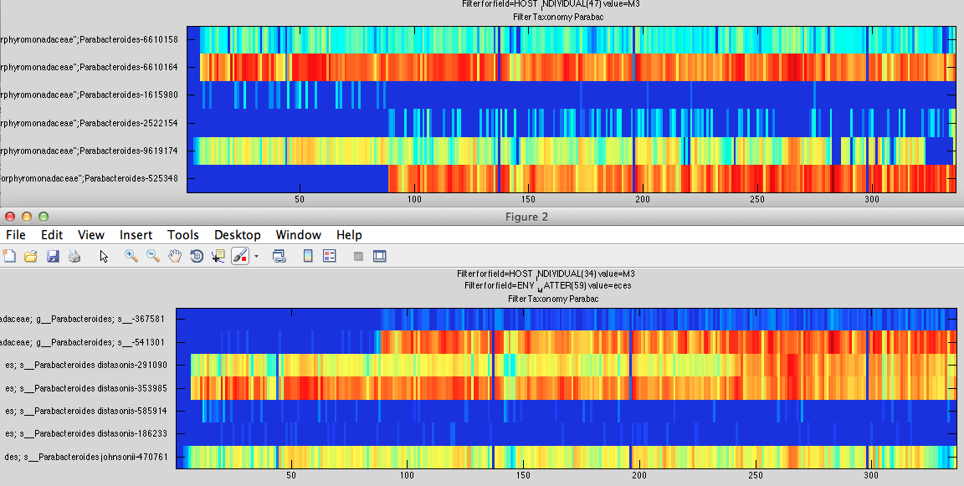
Comparison on Moving Pictures
Deblur
Same OTU
Closed ref. OTUs 97% gg 2011

Slide 24
Improvements
Account for 454 error profile
Handle long reads
Incorporate MiSeq error profiles (use phix data)
Estimate error profile from sample without phix
Use more information from quality data / more stringent quality filtering
Remove chimeras from run rather than samples (can chimeras happen between different barcodes?)

